Slide 1


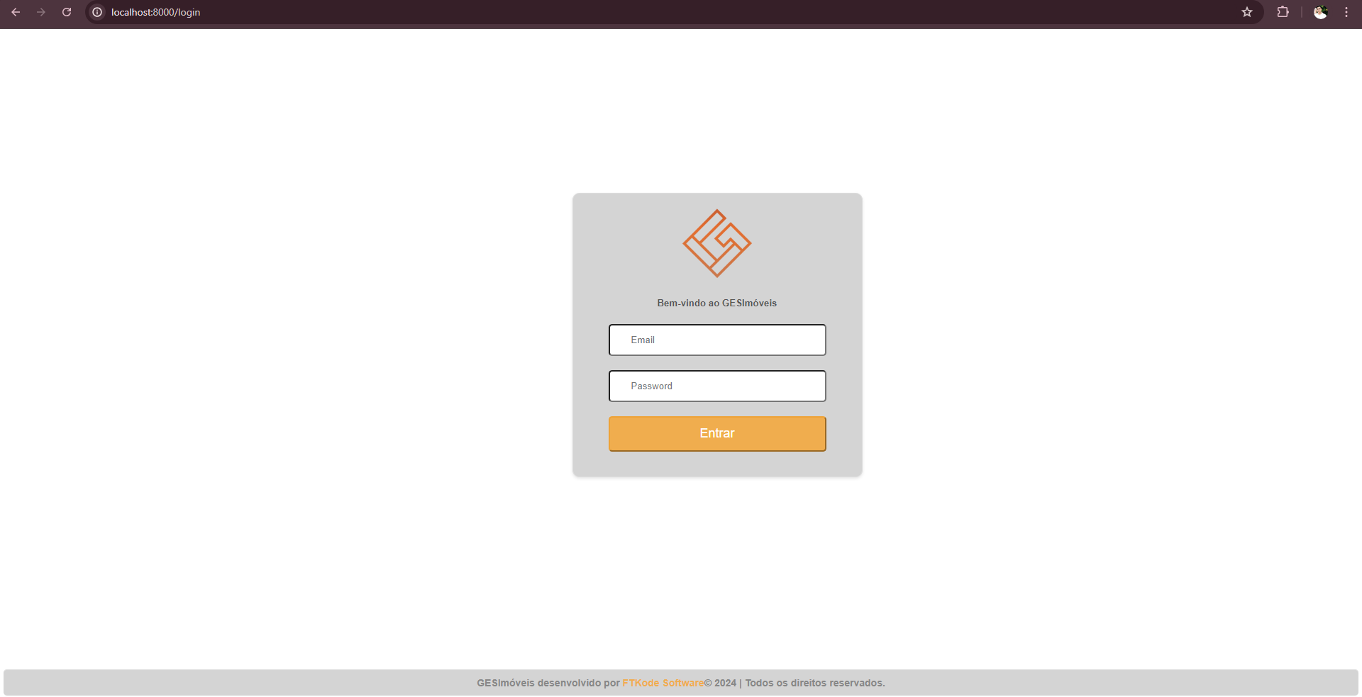
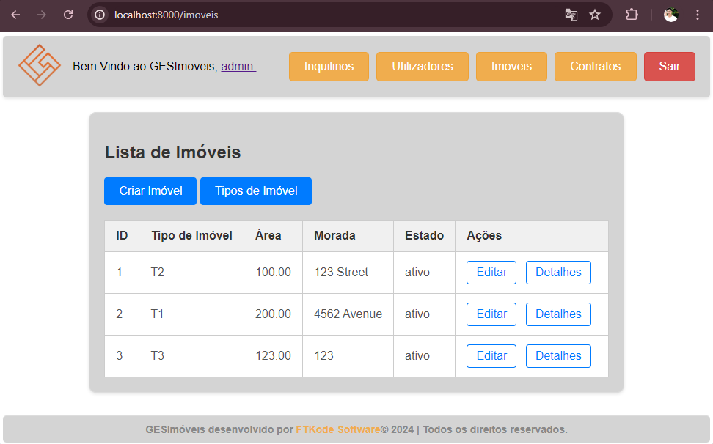
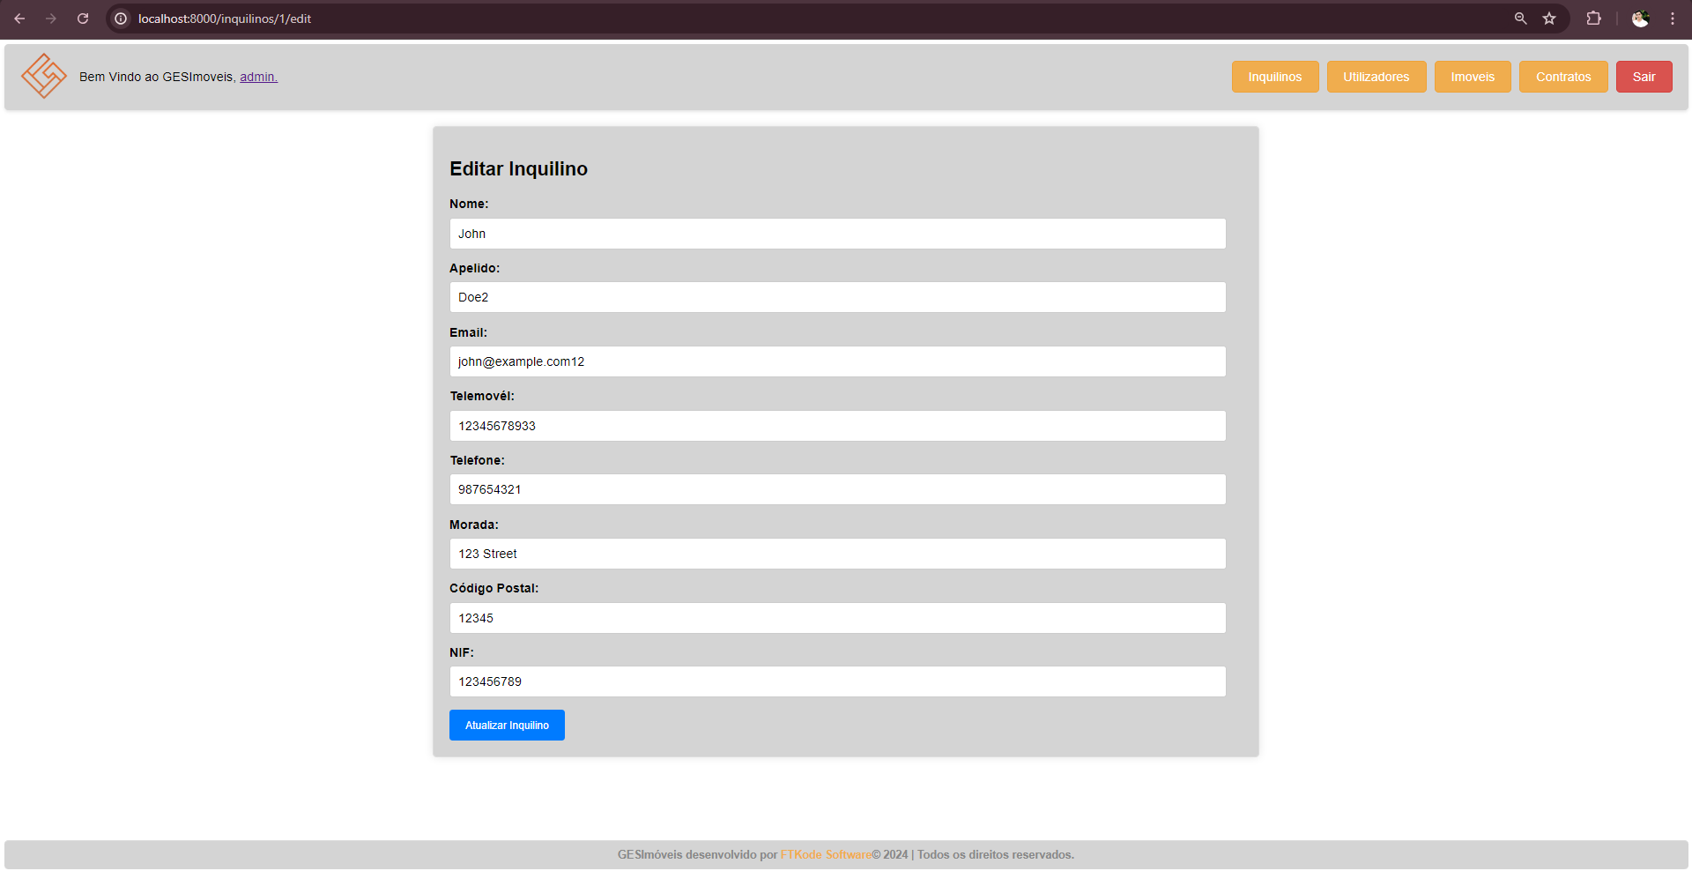
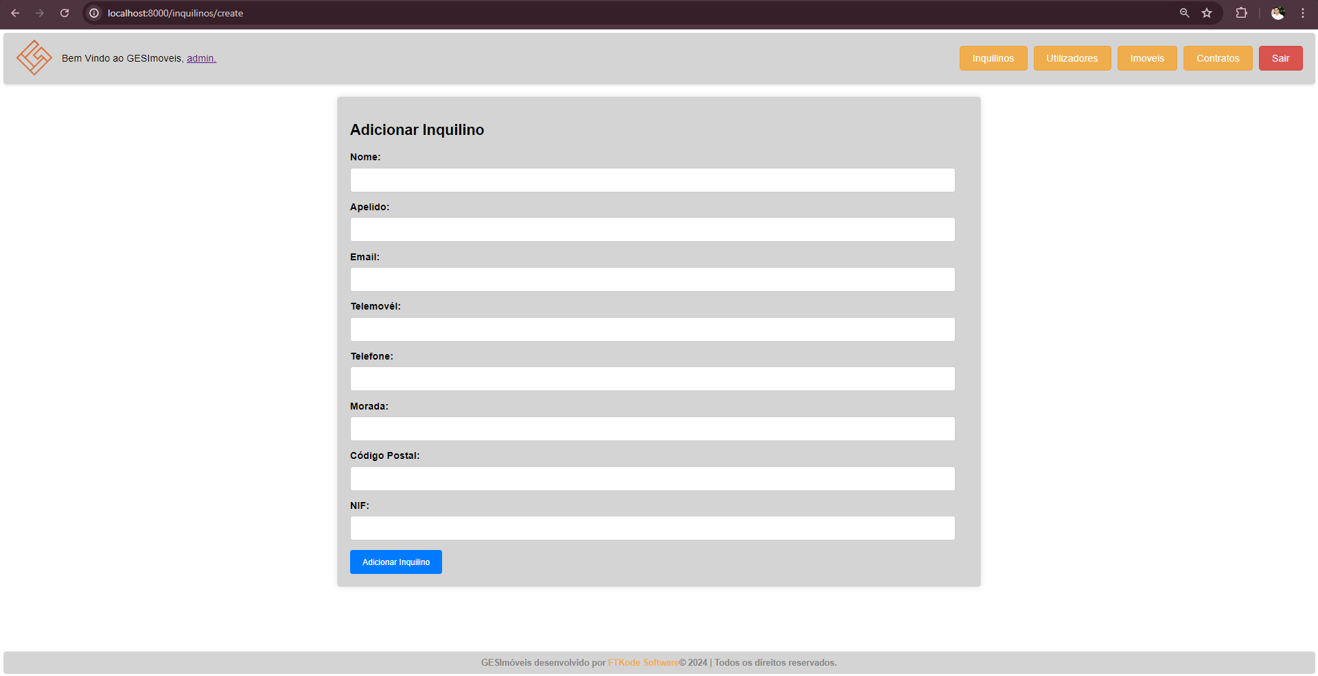












Introduction
GESImoveis
Alexandre Santos, António Gomes;
Graduation in
Informatics Engineering
Polytechnic Institute of Viana do Castelo;
Curricular Unit: Project IV
In the curricular unit of Project IV, our team took on the challenge of developing a web platform called "GESImoveis" using Laravel. This project was initiated in collaboration with FTKode and our academic supervisors. The aim was to create an integrated real estate management system that seamlessly interfaces with GESFaturacao software to enhance property management efficiency.
Objective
The main objective of the GESImoveis project is to develop a comprehensive web platform for real estate management. The system should allow users to manage various types of properties and rental contracts effectively. Key features include:
User management: Register and manage users.
Property management: Handle different types of properties with details like type, area, address, year of construction, and financial information.
Expense Tracking: Record and manage property-related expenses.
Tenant Management: Register and manage tenant information.
Rental Contracts: Manage rental contracts with details such as start and end dates, payment schedules, and contract terms.
Integration with GESFaturacao: Use the API to create invoices for rent payments directly from the platform.
Login Screen
Data listing example
Data editing example
Data creation example
Discussion / Conclusion
Tools and Technologies used
The development of the GESImoveis platform significantly contributed to our understanding and practical application of the Laravel framework. By integrating property management with GESFaturacao, we provided a streamlined solution for property owners and managers. This project not only enhanced our technical skills but also provided valuable experience in developing real-world applications, preparing us for future professional challenges. Moreover, the seamless integration with GESFaturacao showcases the advantages of API usage in enhancing software functionality and user experience.
Professor Doutor Ricardo Freitas;
Engenheiro Miguel Guerra;
ANO LETIVO 2023/2024;
References
Orientation
Laravel Documentation: https://laravel.com/docs/11.x/readme
Rentila Software: https://www.rentila.pt/
Endorsement
FTKode, Lda.

