Slide 1


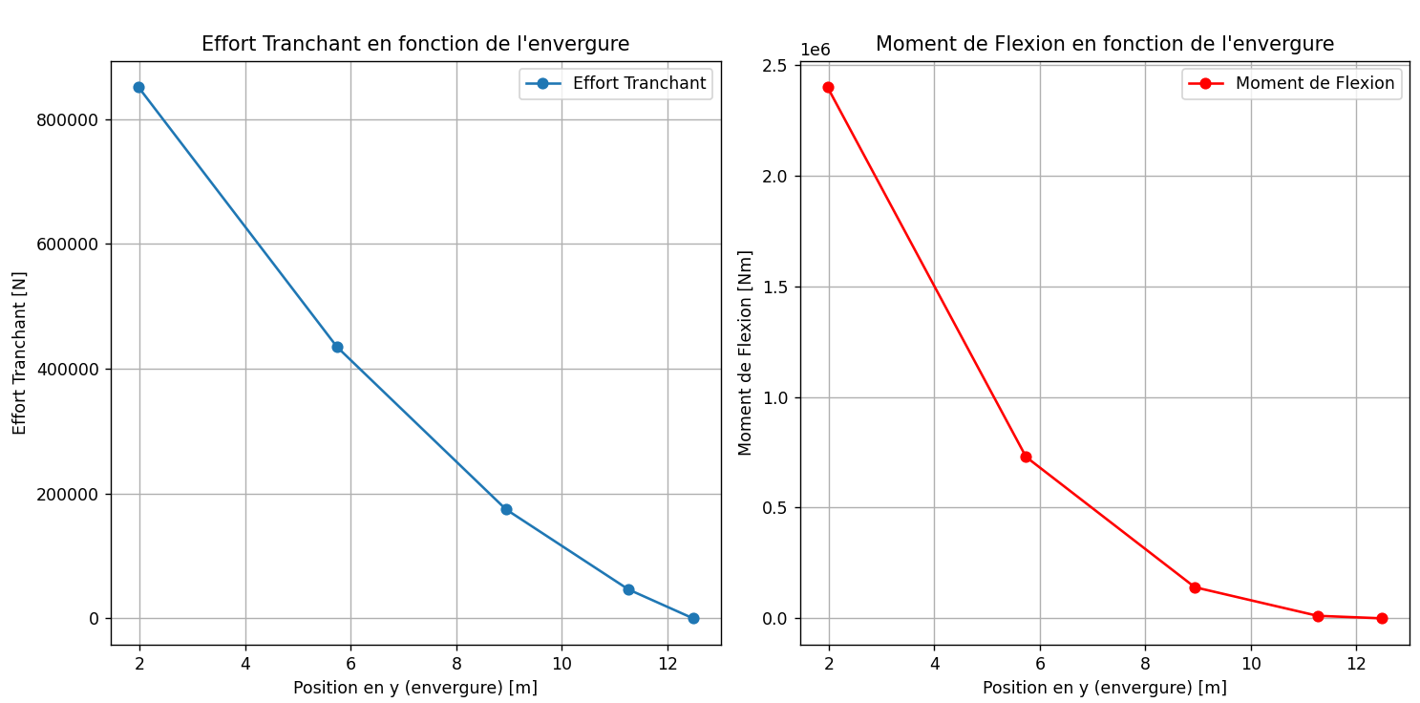
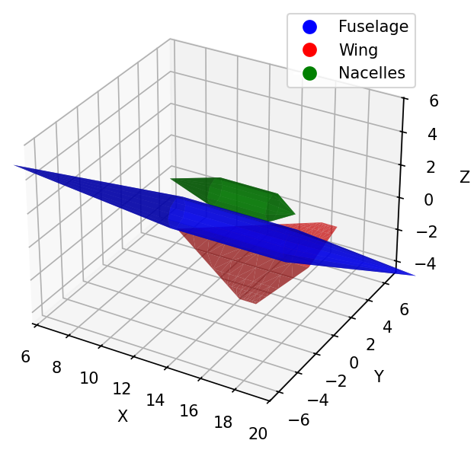
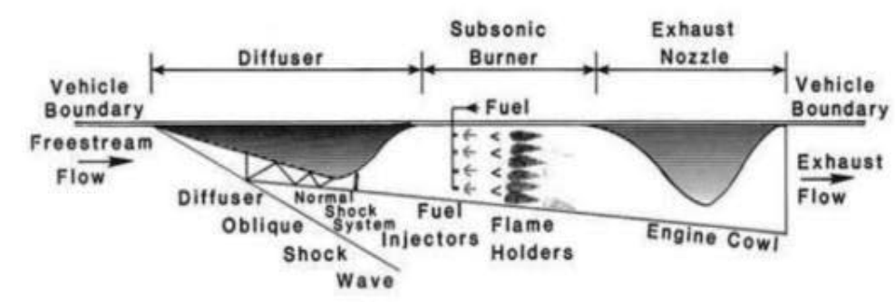
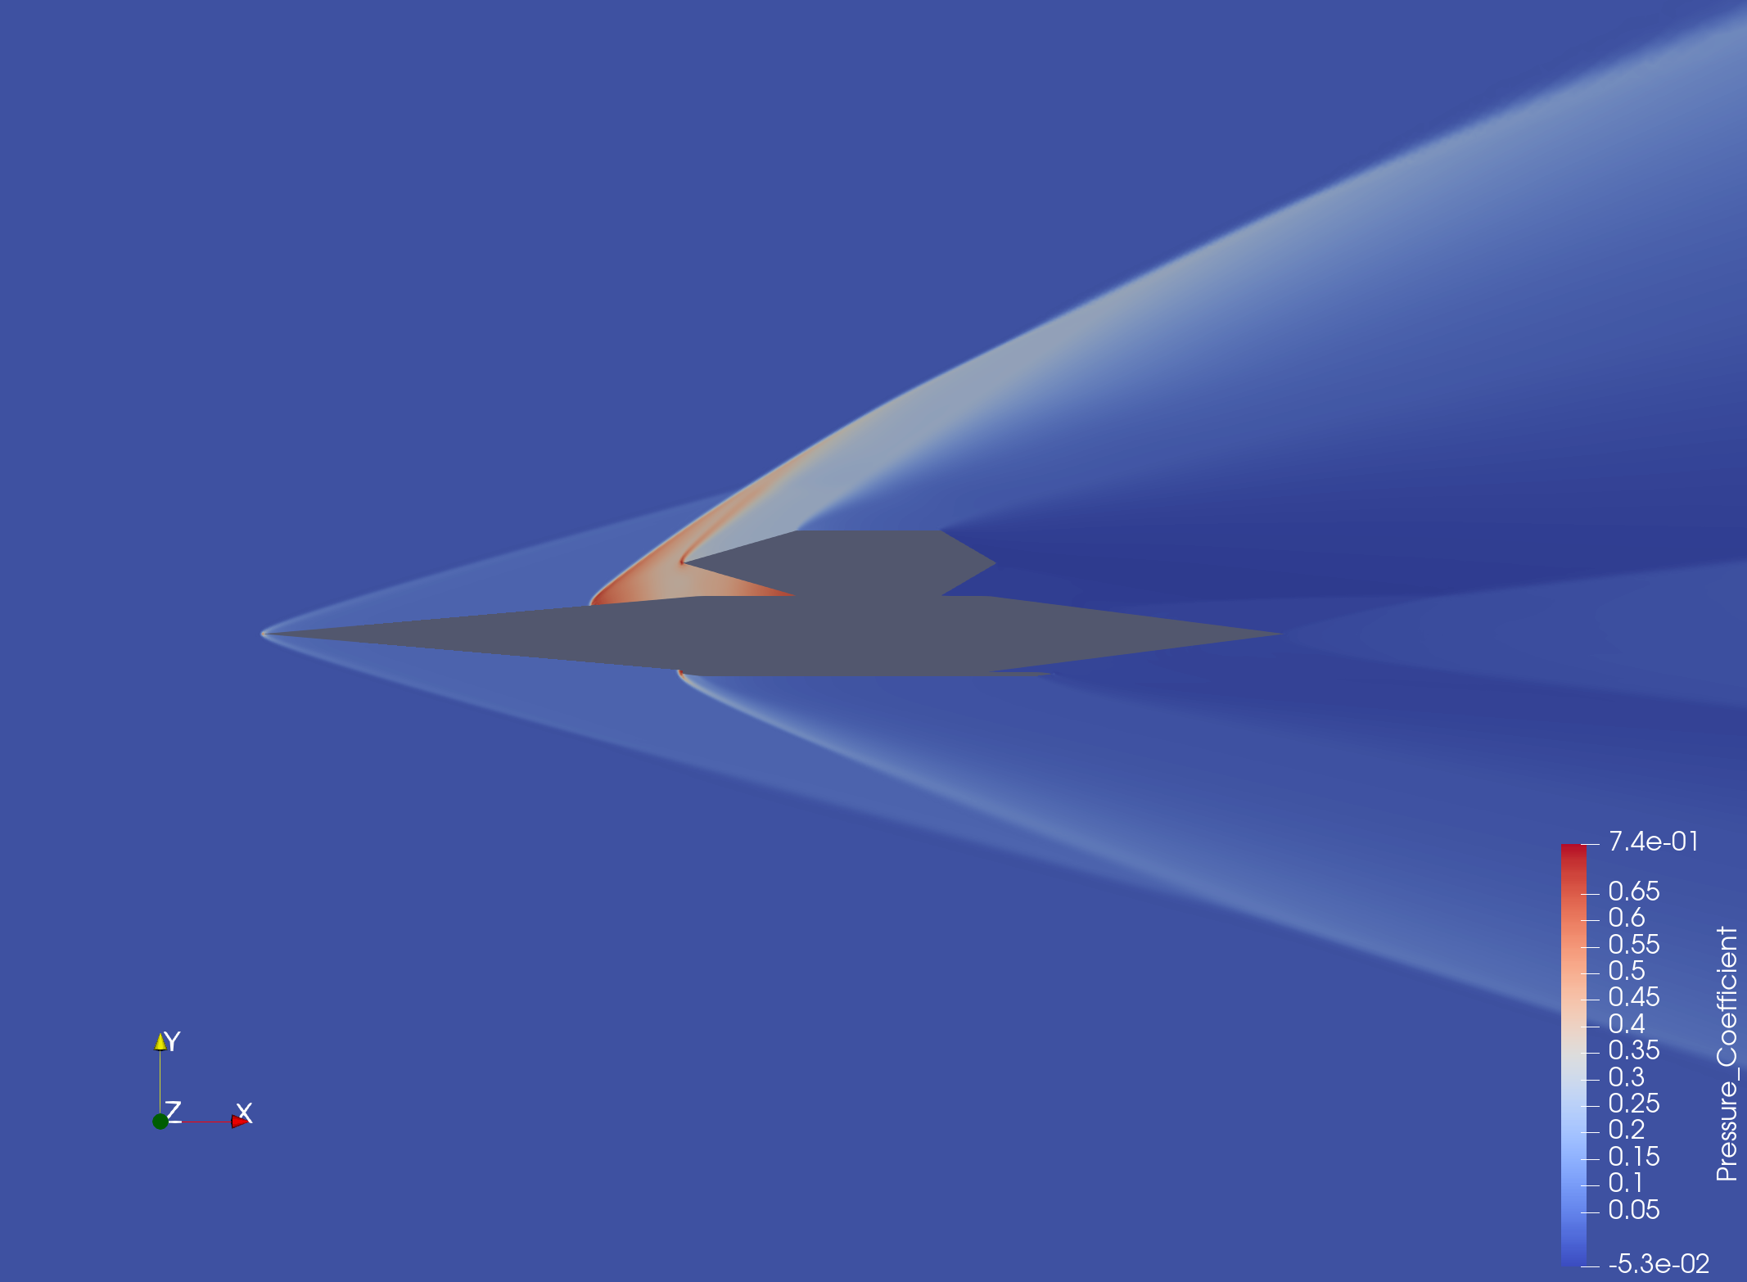
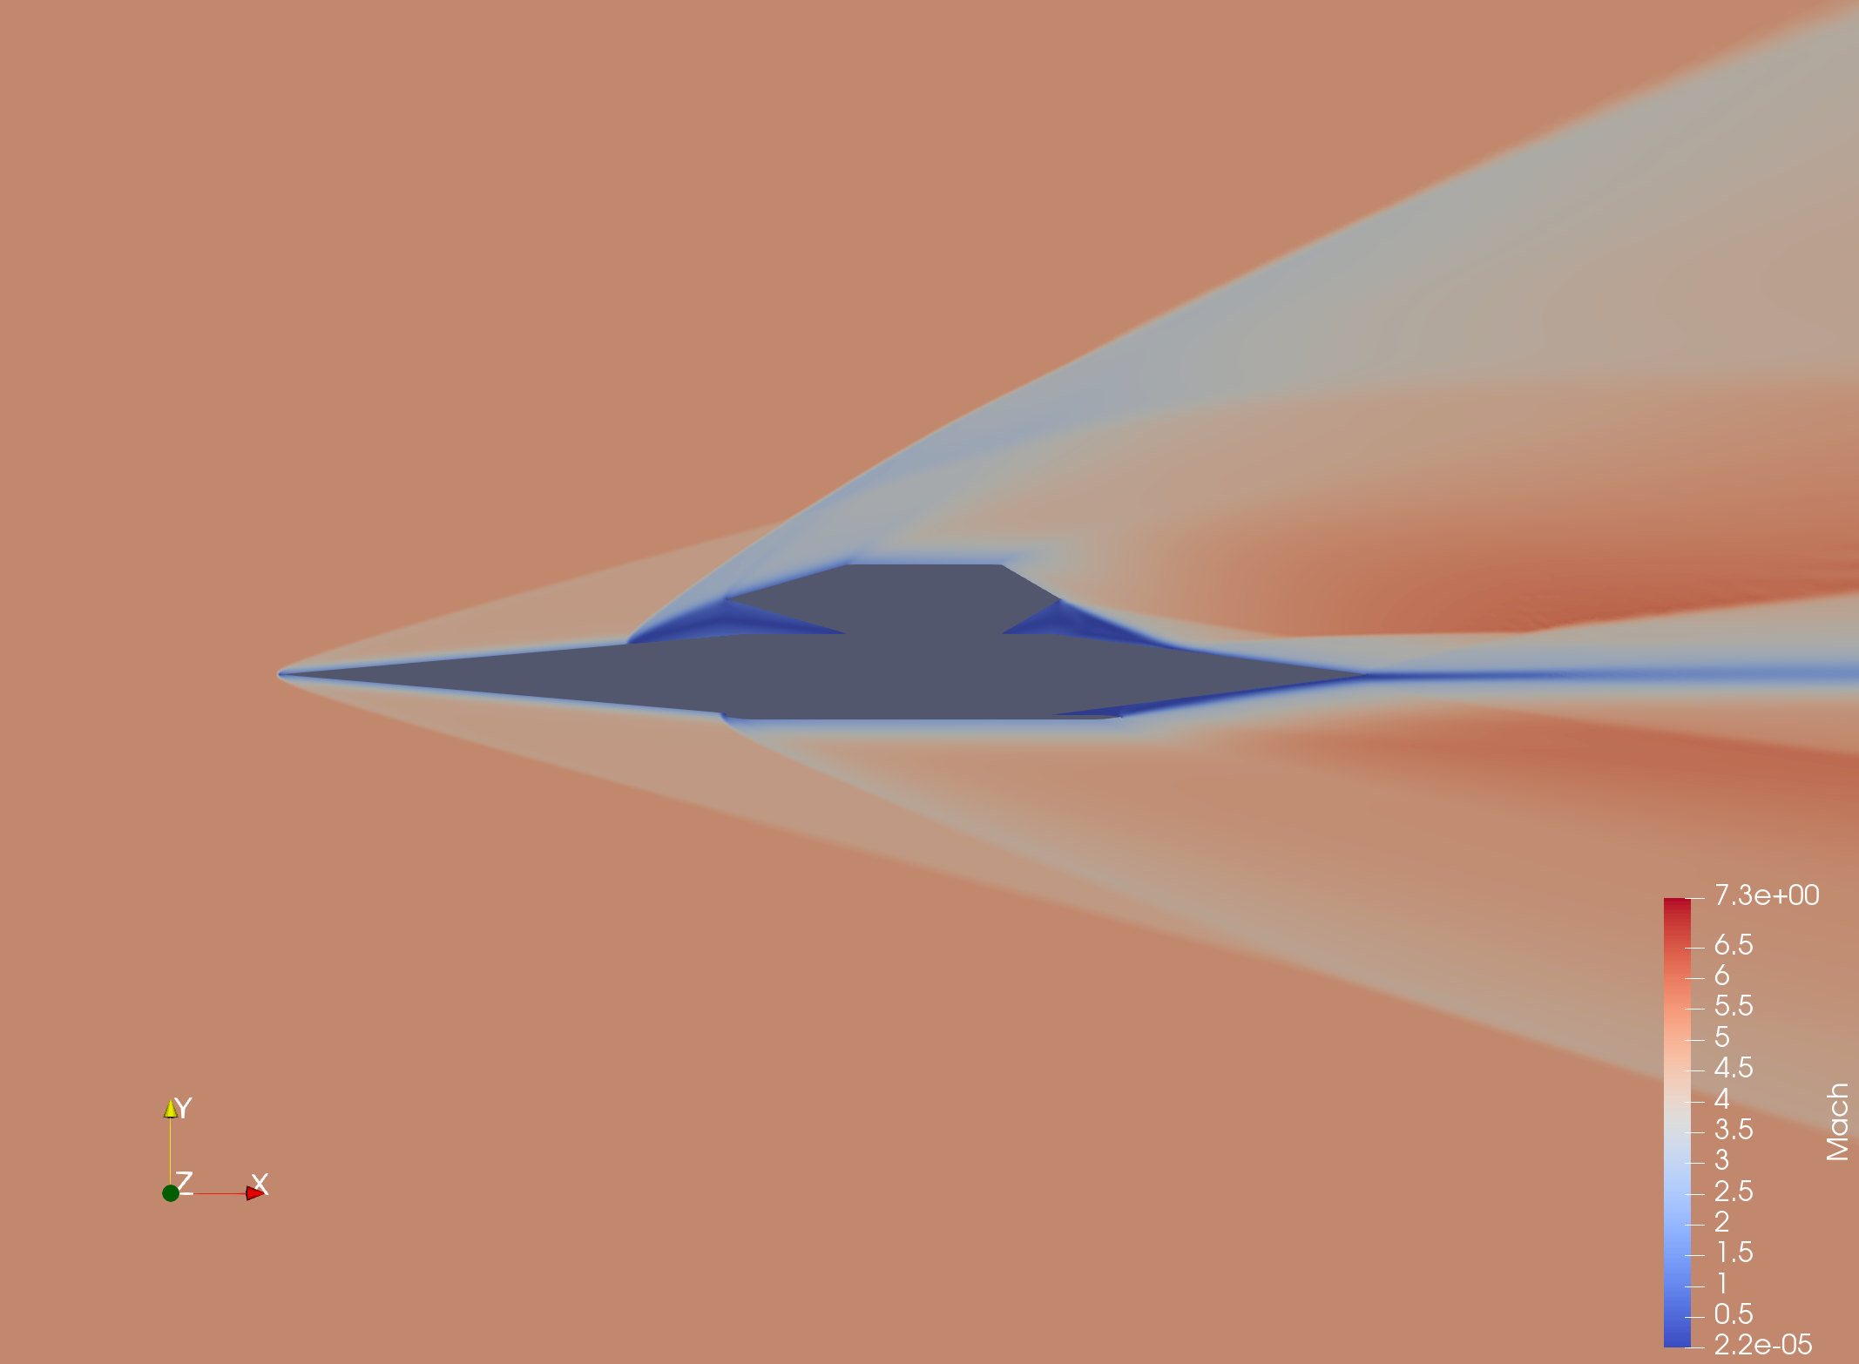
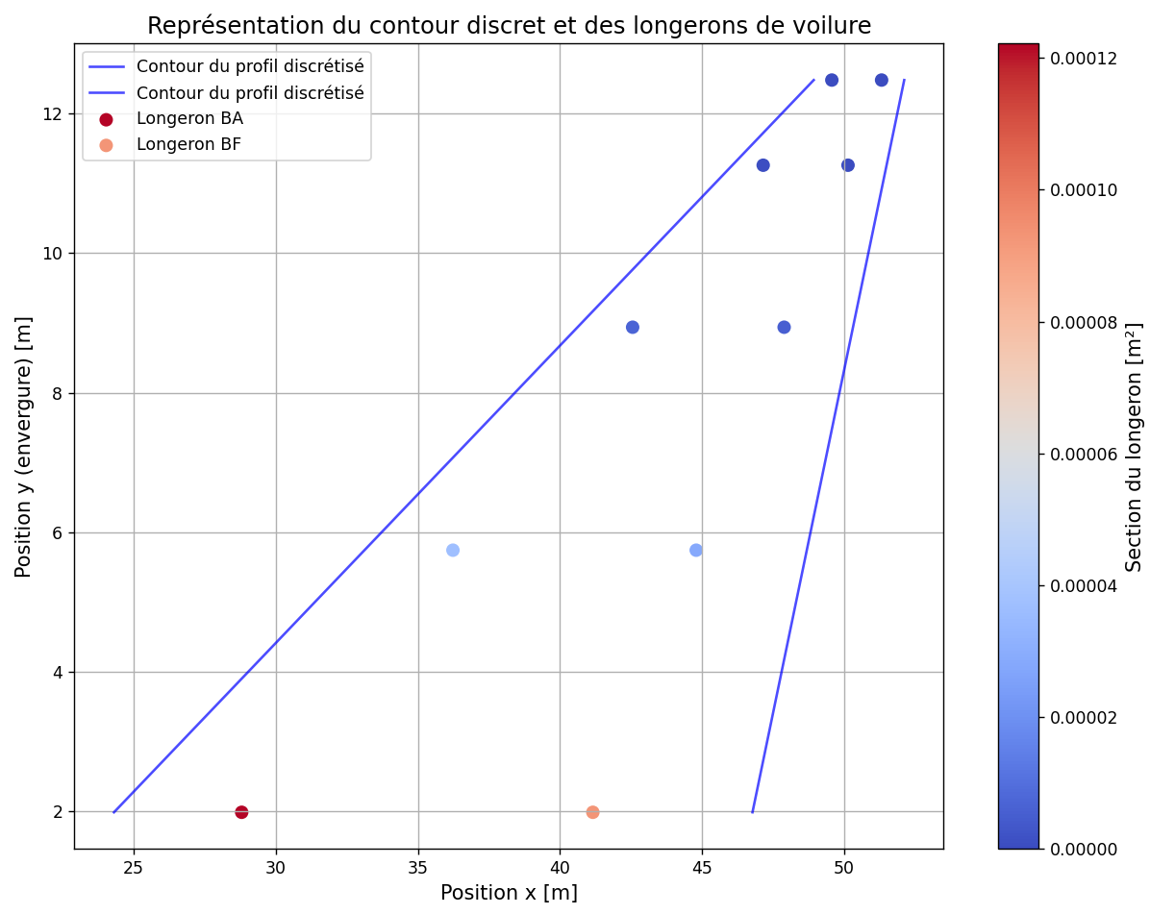
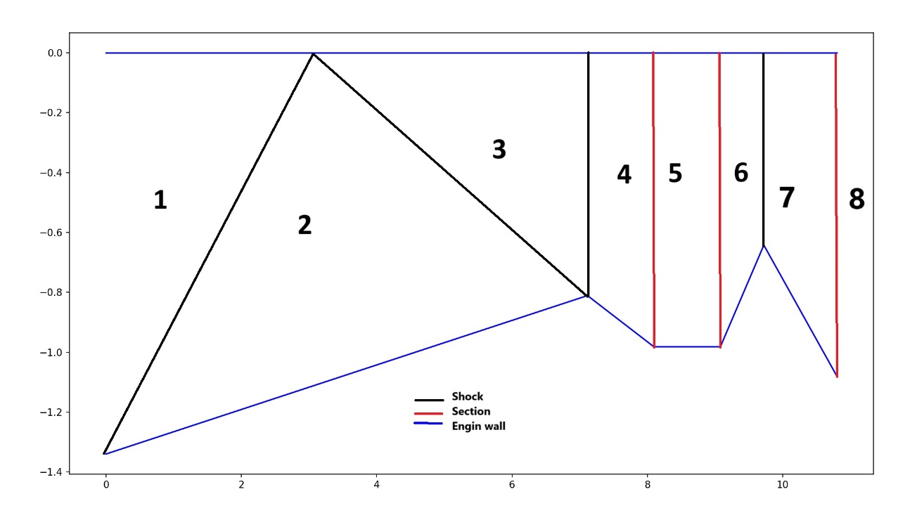



Multi-Disciplinary Optimization (MDO)
Commercial Hypersonic Aircraft
Aerodynamic
Structure
Propulsion
Use of Hyper.exe
Modelling using conceptual design of hypersonic plane
Couple aerodynamic database and CFD results
Shape optimization
Internal stresses characterisation
Localisation and dimensioning of the main wing spars
Simplified RamJet Model
Pressure Coefficient distribution
Mach distribution
Validation:
CFD
Unprecise experimental
Optimisation using CosAPP
Drag reduction
Adapte thrust
Reduce engin size
Add more design constraint to our optimization (Range, PAX…)
Predict and Optimize the behavior of every physic model (CFD & experimental validation)
Exploration of technologies and concepts to evaluate the viability of hypersonic commercial flight

