Slide 1
Big Scale Analytics
Week 4: How to use BigQuery from Google cloud

Slide 2
Create an account on google cloud
Go to https://cloud.google.com/ and create a new account. (you may use your existing Google account)
Choose the free subscription plan
You will get $300 credit for one year
You will be asked to enter your credit card info, but don’t worry! You won’t be charged unless you upgrade to a paid plan.

Slide 3
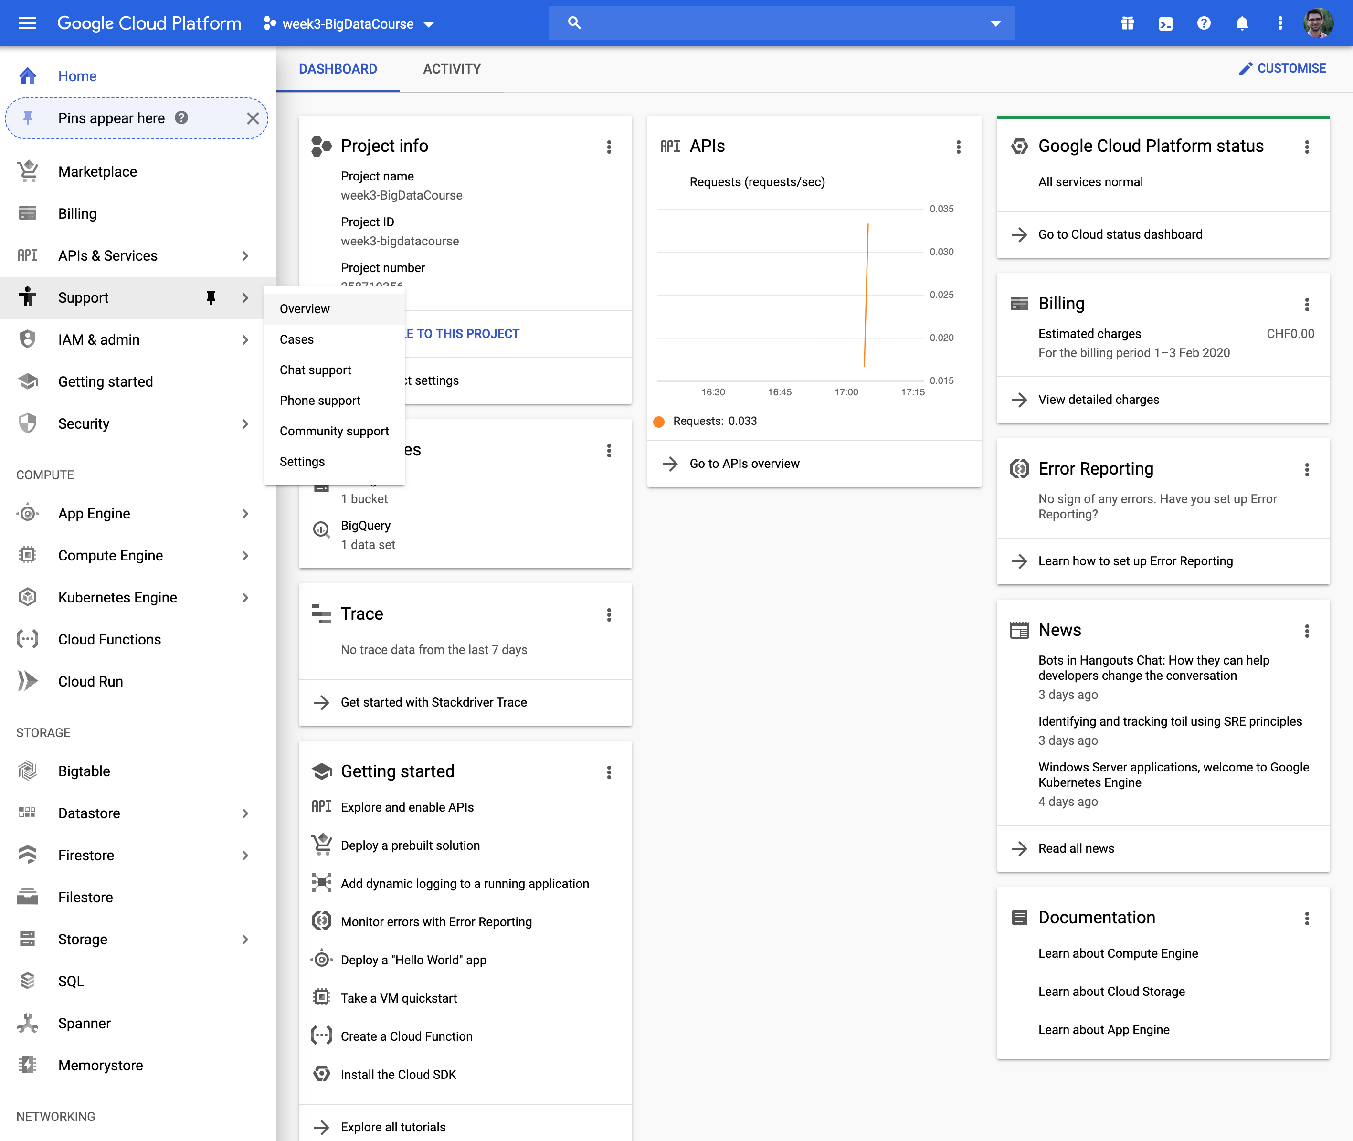
The web UI console
After creating your account , you can see the console
You can access several services from the panel on the left
Try to play with this console a little bit!

Slide 4
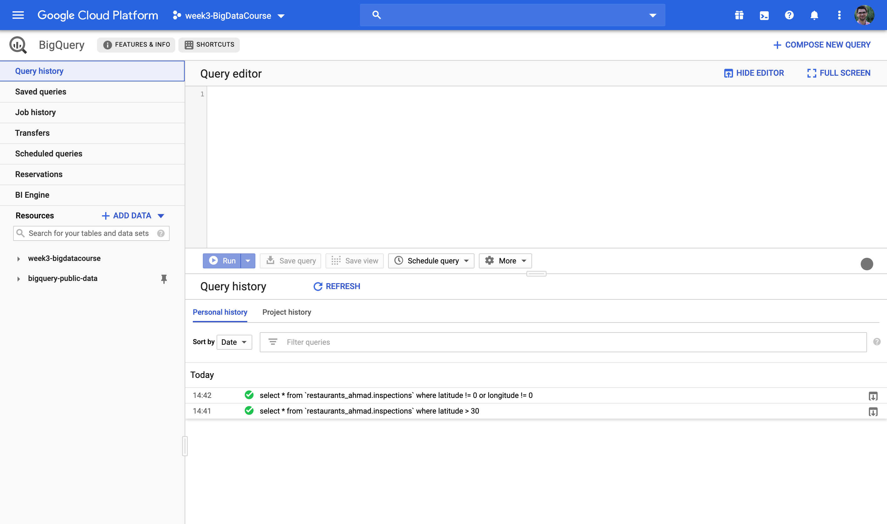
Big Query
From the panel on the left click on BigQuery. You will see a page like this:

Slide 5
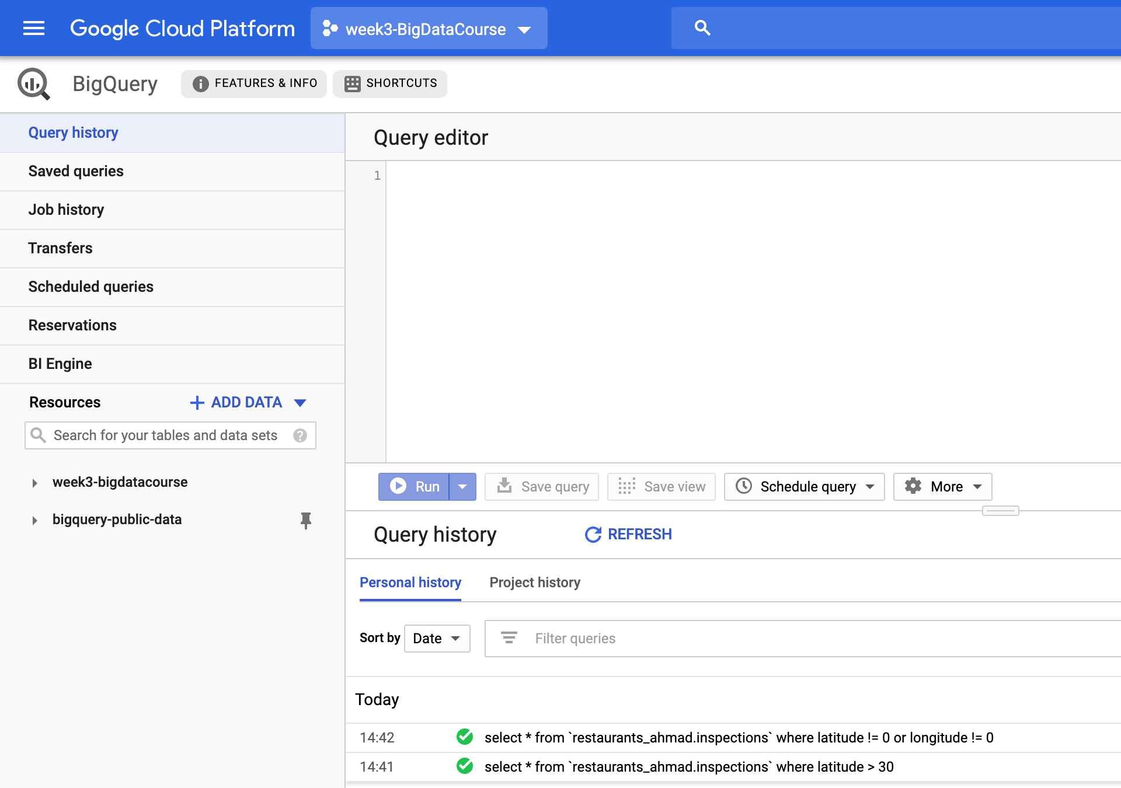
Create you own project in BigQuery
On the top left you can see the project name which is set by default. But you can make your own project. Just click on it and then in the window that pops up select New Project.

Slide 6
Public Datasets in Google cloud
There are several public datasets available within Google cloud which you can use them
To do so, just click on the ADD DATA button in the Resources tab on the left and then explore the datasets available.
For instance you can search for “usa_names” or just “names” and explore the dataset of names selected for newborns in USA in different years

Slide 7
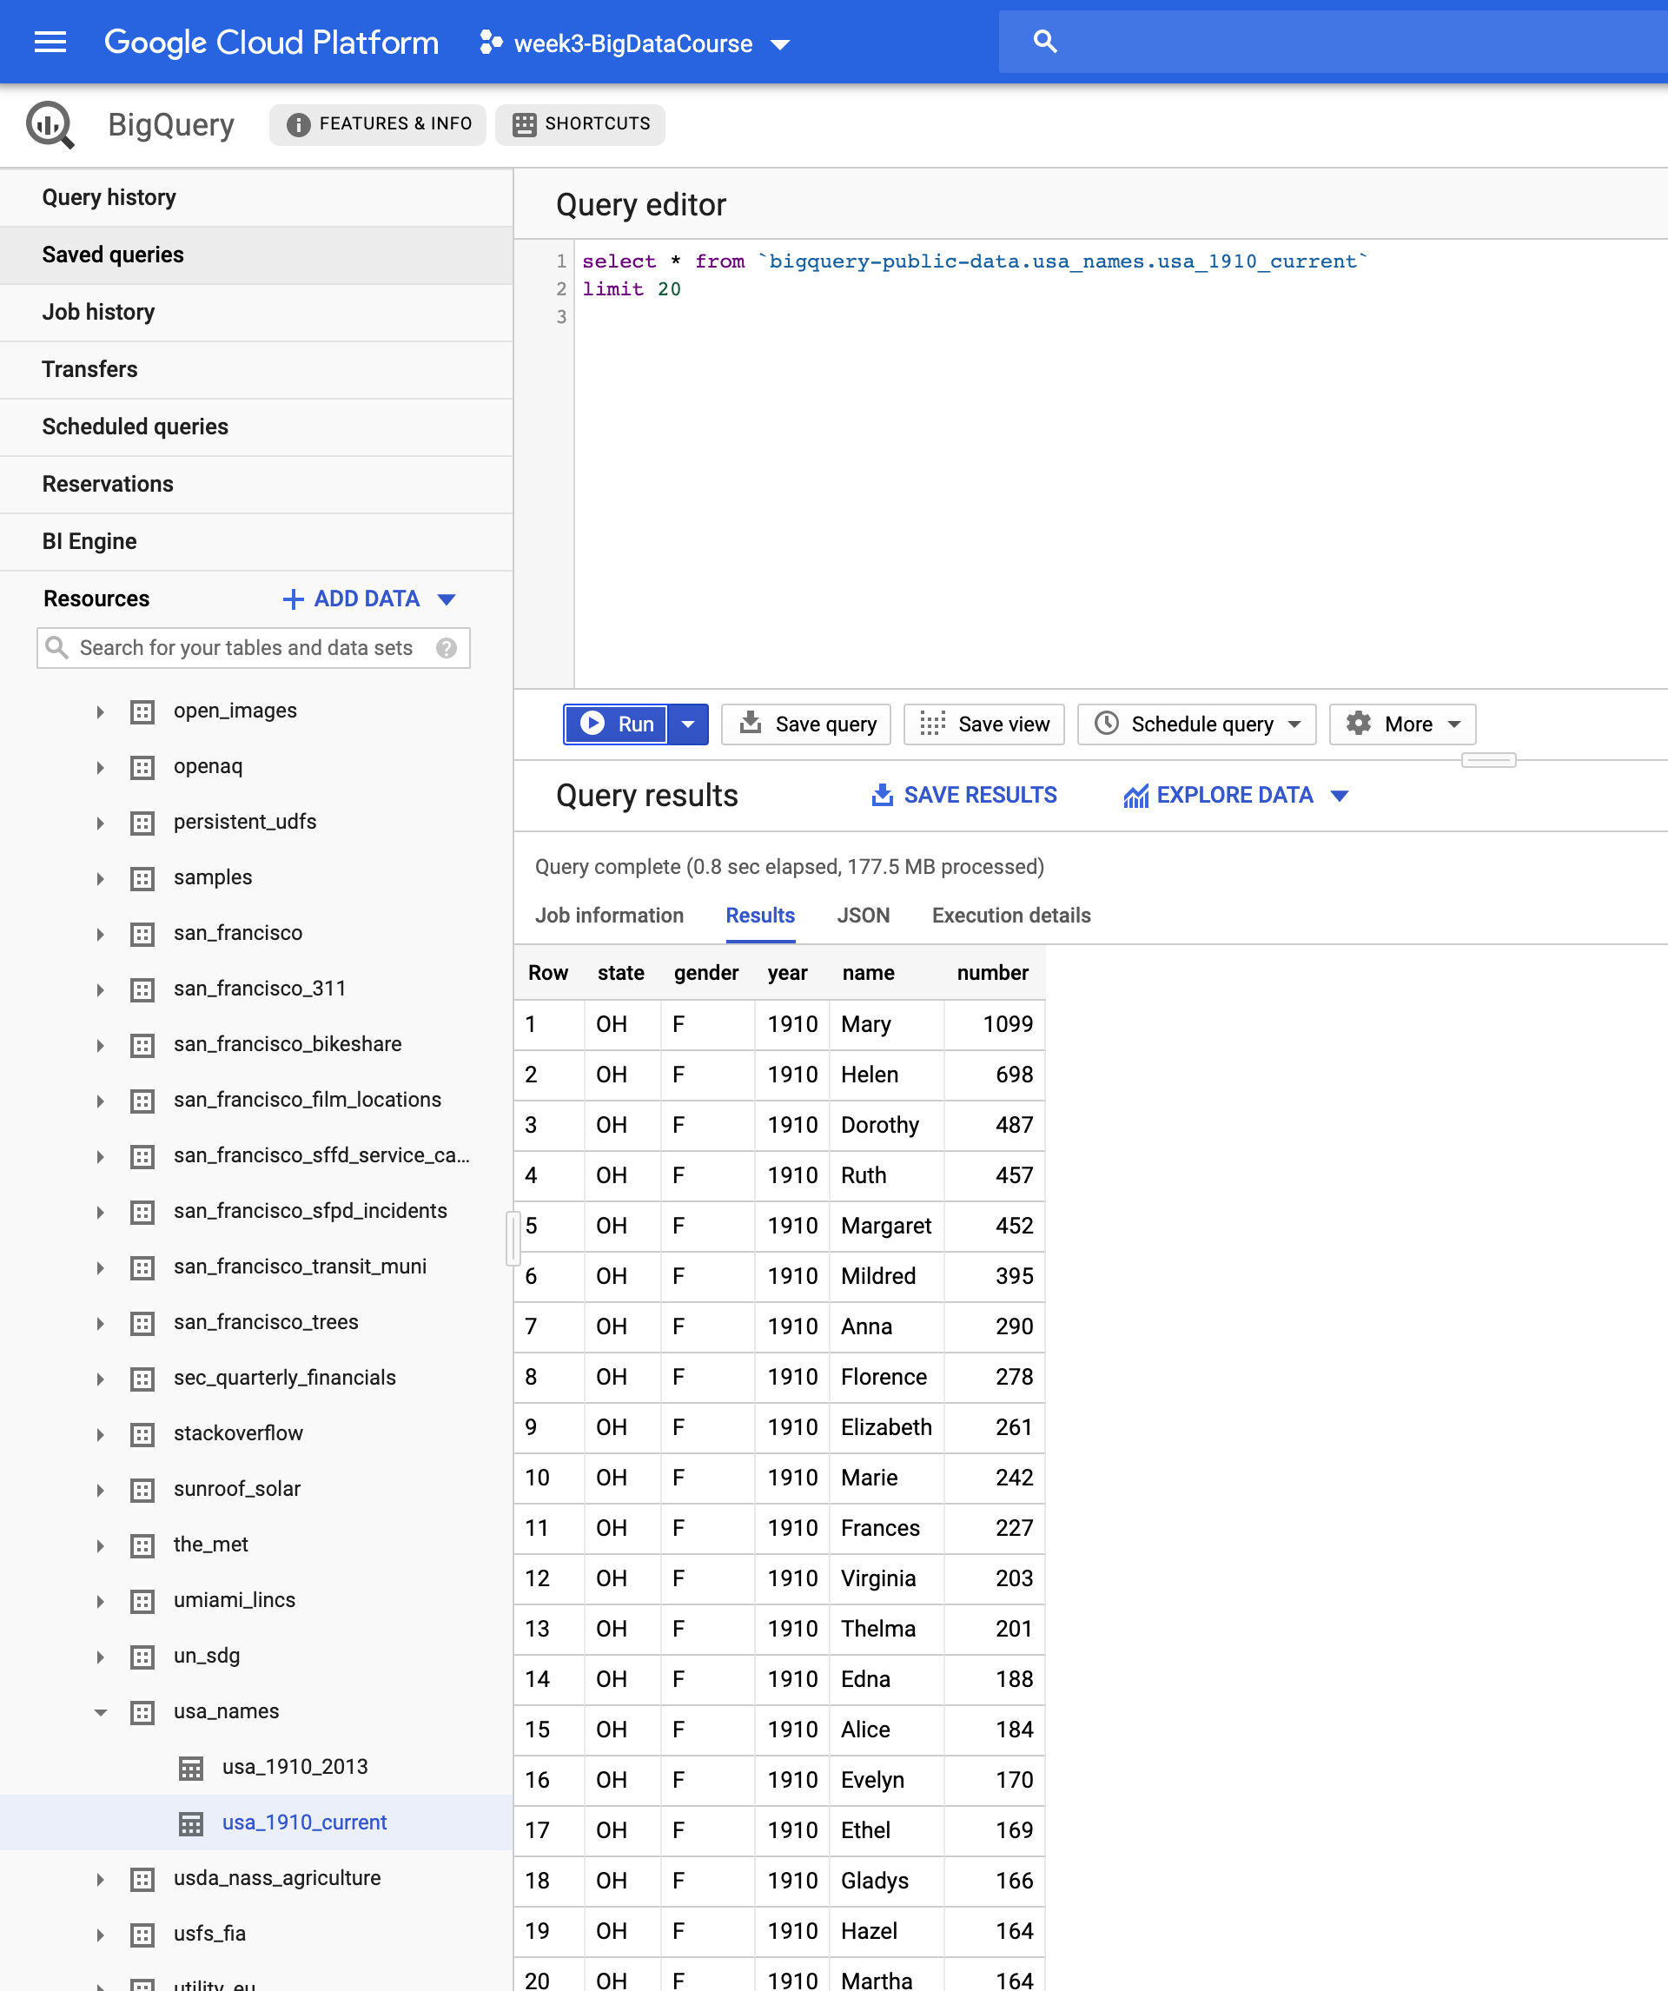
Run sample queries using the query editor
Run some sample queries on the `usa_1910_current` table using the query editor
Pay attention to the way the table name is specified in the example query in the screenshot
Project_name.dataset.table.name

Slide 8
Create your own dataset in BigQuery
It is possible to upload data to google cloud and create your own data-set in BigQuey
For that, first click on your project name on the right panel
Then click in the CREAT DATASET button
In the window that pops up, choose a proper name for your dataset
It is better to choose locations in EU to have less latency when querying your data
Notice that a dataset can contain several tables (eg, csv files that you upload)
Check out the screen shot in the next slide

Slide 9
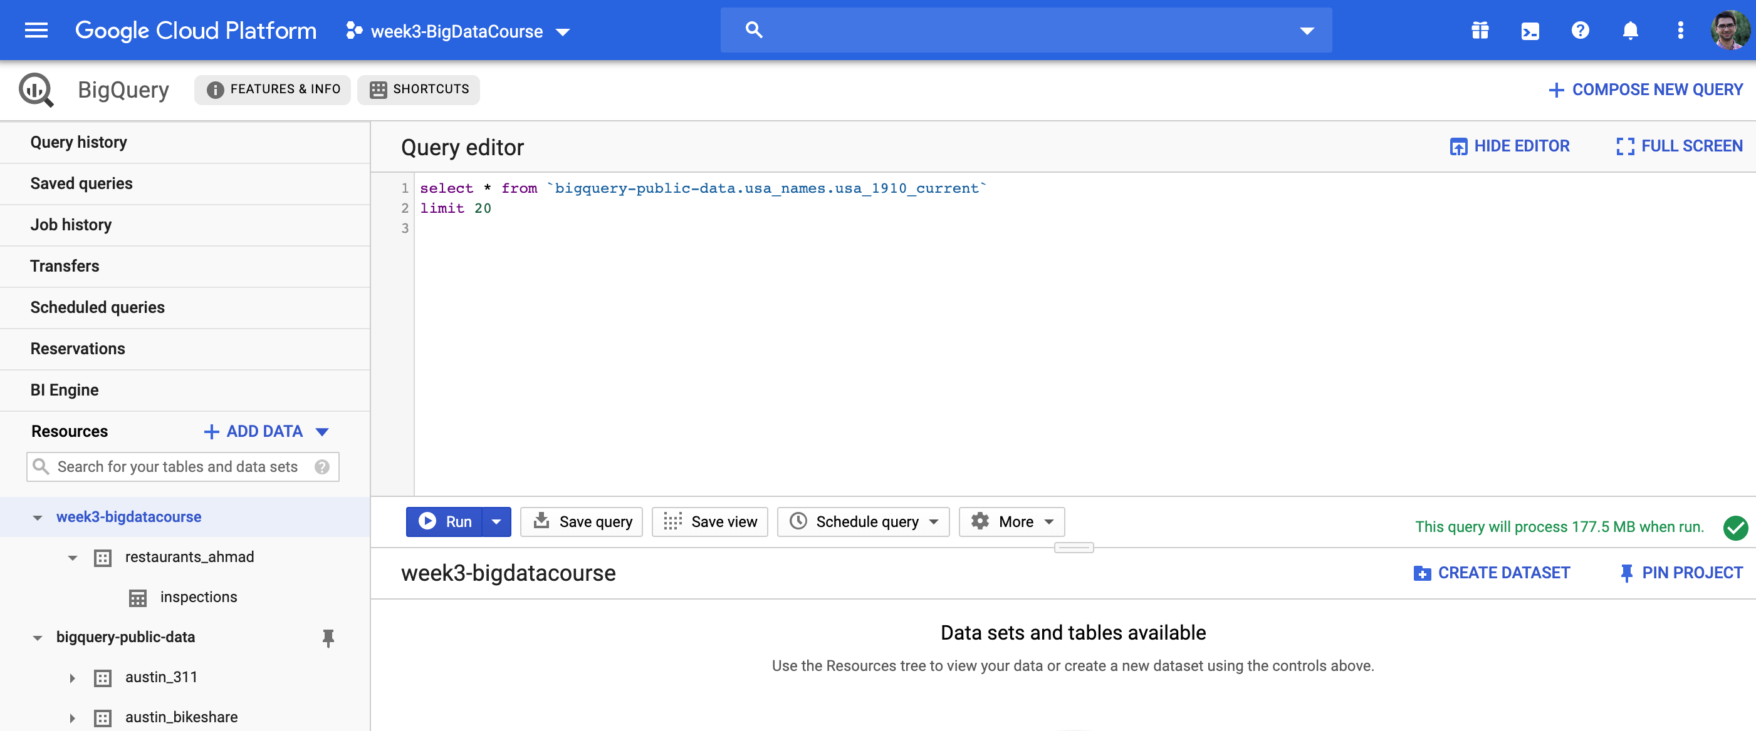
Create Dataset

Slide 10
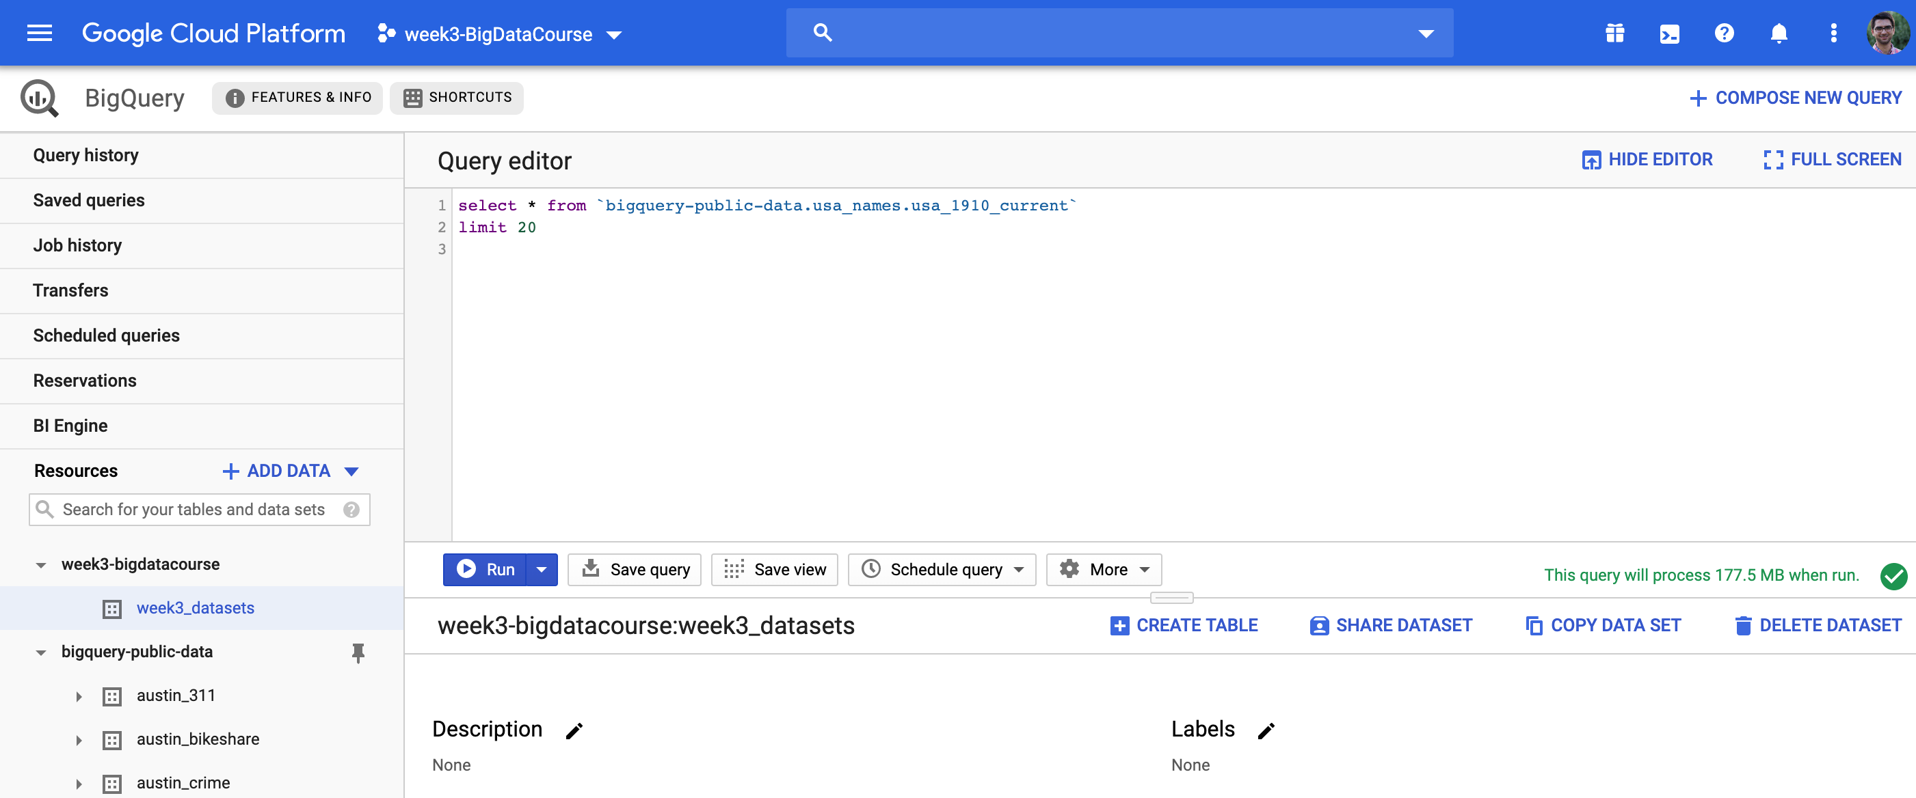
Create table
Click on the dataset you just created. Then click on CREAT TABLE to upload a csv file.

Slide 11
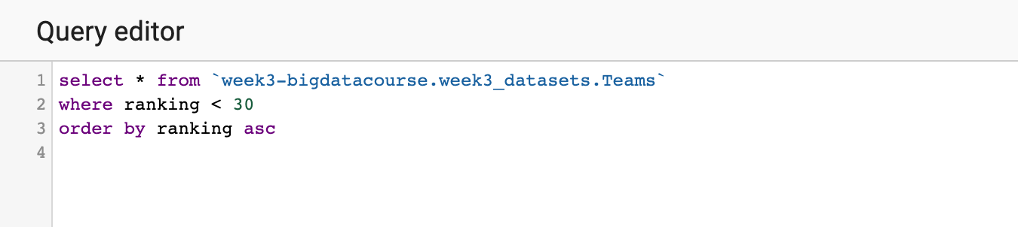
Create table : World cup data
You can upload different formats like csv, json, etc.
The schema could be automatically inferred by BigQuery, however if there are problems then you would probably need to specify the schema
As an example try to upload the Teams.csv and Players.csv from previous week and create two tables under the dataset you made
Try to run some queries on these tables

Slide 12
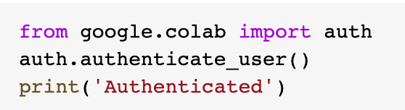
Access BigQuery tables from Python
In Colab:
You need to use the google.cloud package (already available in colab)
You would also need to give your credentials. It is easy to do this in colab. Run the following code:
You will be redirected to a page (and possibly you need to sign in to your google account). There is a key there, just copy it and paste it in colab in the box that appeared by running the above code.
You’re all set to connect to BigQuery client

Slide 13
Access BigQuery tables from Python
In your local machine:
Follow the instruction here to install the client library and setting up the authentication.
Edit the `bash_profile` file in mac (or `.bash_rc` file in linux) and add the line below to it. Instead of ‘[PATH]’, enter the path to the json file you just downloaded (which contain your credentials)
export GOOGLE_APPLICATION_CREDENTIALS="[PATH]"
Save your changes and do `source .bash_profile` to apply the changes.
Make sure to run your python script or jupyter notebook from the same shell that you create the above environment variable

Slide 14
Practice yourself!
Go to the Github page of the course and work on the “BigQuery” notebook under the week 4 folder.

