Slide 1
CST336 Challenge activity
NOTE: For Attendance, you must submit the
Google Form by the end of the session
Databases/ Javascript/php

Slide 2
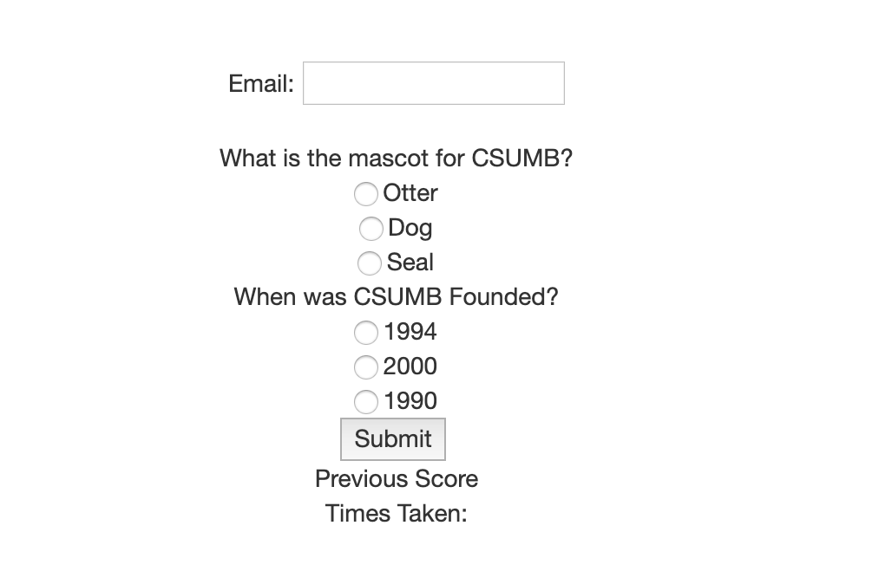
Task: Quiz

Slide 3
Directions:
You’ll start working INDIVIDUALLY for 10 minutes.
Individually, do the following:
1) Within the “practice” folder, create a new folder for this lab
2) Upload the initial files
3) Upload the SQL to myphpadmin
4) Start working on it. Do as much as you can!

Slide 4
Directions:
Work in pairs for 50 minutes.
In pairs, do the following:
You MUST use ONLY ONE computer
The teammate to the right must start coding for 7 minutes. The other teammate must observe and help.
After every 7 minutes, you MUST switch (the coder becomes the observer and the other way around)
BOTH of you must be engaged in the activity
Those who complete the activity in 50 minutes will get three extra points in a homework assignment.
A few completers will be selected to show your work

Slide 5
Rubric:
You MUST use ONLY ONE computer and SWITCH typing every 7 min. Three Points:
Insert the users email into the database (if it doesn’t exist)
Update the amount of times taken for each email in the database
Display the amount of times taken using an AJAX call
Two Bonus Points!
Update the score in the database (based off the latest quiz score).
Display the PREVIOUS score using an AJAX call (when submitting the quiz)
Example: If john@csumb.edu submits quiz for the FIRST time with a score of 5:
1) A new record is inserted in the database (john@csumb, 5, 1) 2) Data displayed: Previous Score: None, Attempts: 1 For the SECOND time, if the score is 10. 1) The existing record is updated: (john@csumb, 10, 2) 2) Data displayed: Previous Score: 5, Attempts: 2

