Slide 1
DVN · AT3 · THE DETECTIVE BRIEF
01 / 11
AUSTRALIA · AGED CARE · 2025
Australia's
Aged Care Gap
A nation-scale lens on quality, supply and the regions in crisis.
REGIONS
SPAN
DATASETS
LENS
UTS · MDSI · Autumn 2026
323 SA3
12 quarters
7 sources
NFP CEO
DVN AT3
01 / 11

Slide 2
FRAME · THE HAT WE'RE WEARING
02 / 11
§ STAKEHOLDER
One lens. Three audiences.
We pitch as CEO of a Not-For-Profit aged-care provider — asking where to expand.
THE HAT
AUDIENCE 01
"Is care near my parents any good?"
Families
Not-For-Profit
Aged-Care
Provider
AUDIENCE 02
"Where am I genuinely needed?"
Workers
AUDIENCE 03
"Where is undersupply structural, not cyclical?"
Where do we expand?
Investors
SAME DECISION · THREE ANSWERS
02 / 11

Slide 3
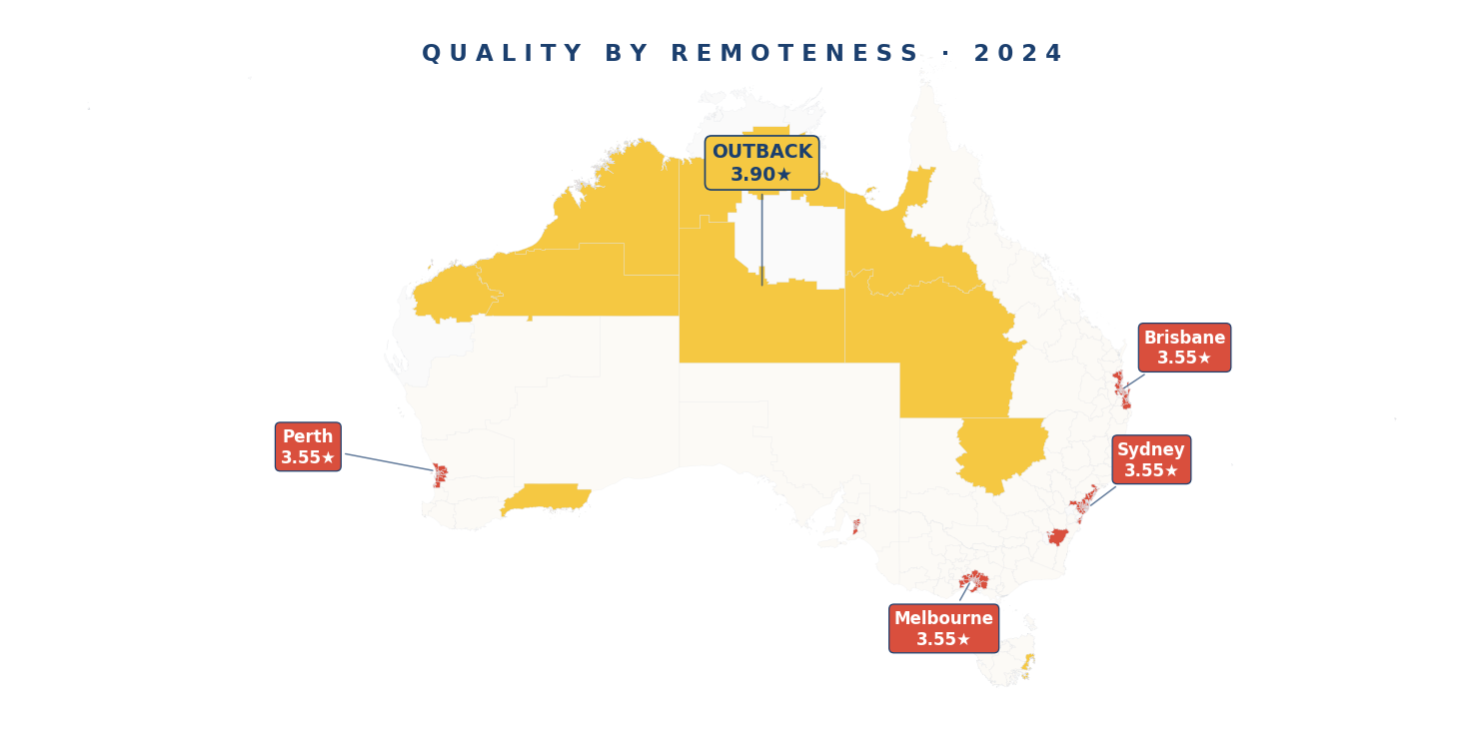
CHAPTER 1 — THE HOOK
03 / 11
§ GUT CHECK
Where is Australia's aged-care crisis worst?
Most people guess remote. The data laughs.
MM7 VERY REMOTE
MM1 MAJOR CITY
3.90★
3.55★
The crisis lives in our four biggest cities.
highest in the country
lowest in the country
REMOTENESS FLIPS THE MAP
03 / 11

Slide 4
CHAPTER 1 — PAYOFF · THE GEOGRAPHY
04 / 11
§ TOP-10 WORST REGIONS
Every top-10 worst region is a major city.
Unley, SA: Care Gap Index 2.78 — 2.46× the national average of 1.13.
ⓘ Care Gap Index = demand pressure ÷ care quality. Higher = bigger crisis.
CARE GAP BY STATE · 2024
STATE | CARE GAP | RESIDENTIAL ACCESS
ACT | 1.37 | 5.01% (highest)
SA | 1.23 | 4.32%
VIC | 1.21 | 4.34%
NSW | 1.13 | 4.03%
WA | 0.99 | 3.47%
NT | 0.84 | 3.00%
TAS | 0.81 | 2.92%
ACT leads despite high quality — it's the highest-demand state, not the lowest-quality. Same pattern as the named SA3s: urban demand, not rural neglect.
FIG. 4 · CARE GAP — REGION + STATE VIEW · 2024
The crisis is geographic — concentrated in cities, not the outback.
N = 323 SA3 REGIONS · 2024
04 / 11

Slide 5
CHAPTER 2 · PART 1 — THE CAUSE
05 / 11
§ OWNERSHIP TREND · 12 QUARTERS
The 0.57-star gap
that hasn't moved in 12 quarters.
4.07★
3.61★
3.50★
GOVERNMENT
NOT-FOR-PROFIT
FOR-PROFIT
Government 4.07★ · Not-for-profit 3.61★ · For-profit 3.50★ — stable across every state and remoteness band.
SOURCE — ACQSC STAR RATINGS · 2023-Q2 → 2026-Q1
05 / 11

Slide 6
CHAPTER 2 · PART 2 — THE PARADOX
06 / 11
§ FUNDING VS QUALITY
2.7× more money.
Lower quality. Identical outcomes.
For-profit: $8.97M public funding per facility · Government: $3.27M (2025).
STAFFING — INPUT GAP
PUBLIC FUNDING vs QUALITY
Govt 4.39 vs For-profit 2.61 — a 1.78-pt input gap.
OWNERSHIP
FUNDING / FAC.
QUALITY (★)
QUALITY MEASURES — OUTCOMES
Government
$2.85M
4.07★
Resident health outcomes: 3.52 vs 3.51 — virtually identical.
Not-for-profit
$5.54M
3.61★
EXTERNAL CORROBORATION
For-profit
$7.46M
3.50★
Chu et al. JAMDA 2024 (n = 2,476) — for-profit 8× less likely to reach 4–5★ than government.
+2.7× FUNDING — LOWEST QUALITY.
N = 2,476 FACILITIES · ACQSC + DoHAC
06 / 11

Slide 7
CHAPTER 3 · PART 1 — HEART-STRING
07 / 11
§ THE WORST RATIO IN THE COUNTRY
3.1 high-needs people. 1 bed.
Central Highlands, Tasmania — 56 people · 18 beds. Australia's worst supply-demand ratio.
CRISIS THRESHOLD = 1.0 (every bar above this is a structural-deficit SA3)
82
SA3 regions in structural deficit — 1 in 6 (2025)
+24
net new crisis zones (2024→2025)
59.1%
of 2025 home-care approvals are L3-L4 (172,285 high-needs)
12/20
worst-pressure regions are MM1 major cities
HIGH-NEEDS HCP L3-L4 ÷ RESIDENTIAL BEDS
07 / 11

Slide 8
CHAPTER 3 · PART 2 — THE MARKET FAILURE
08 / 11
§ SUPPLY DIVERGENCE · 2019 — 2025
We are building 12,000 beds in the wrong places.
Crisis zones lost 323 places while the rest of Australia added 12,593.
82 CRISIS ZONES
REST OF AUSTRALIA
Where the need is
Where the beds went
−323
+12,593
net beds, 2019 → 2025 · +24 net new zones in 2025
net beds flowing to already-served areas
F I G . 8 · R E S I D E N T I A L S U P P L Y · 2 0 1 9 – 2 0 2 5
108
+12,593 beds · rest of Australia
104
−323 beds · 82 crisis zones
100
96
2019
2020
2021
2022
2023
2025
Indexed to 2019. 82 crisis SA3s collectively lost 323 places; the rest of Australia added 12,593 over the same period.
INDEXED 2019 = 100 · RESIDENTIAL PLACES
08 / 11

Slide 9

CHAPTER 4 — THE TOOL
09 / 11
§ LIVE DEMO
Not a report. A live decision system.
A Home page (Ch0) — interactive map with 3 projection scenarios, 8 city markers, and Find My Area SA3 search — opens into four advanced capabilities. Built for any user wearing any hat.
01
Context-Aware Filtering
02
Visual Tooltips & Modals
Sidebar rewrites every chart and callout across
Click any SA3 — drill into pressure, demand, ownership, demographics.
SCAN · LIVE STREAMLIT
03
Narrative Scrollytelling
04
What-If Parameterisation
A 5-chapter detective arc — each section unfolds as the analyst's reveal.
Ch4 RN-minutes slider · Ch5 population scenario radio · live recompute.
DASHBOARD · INTERACTIVE · FILTERABLE
09 / 11

Slide 10
CHAPTER 5 — THE FORECAST
10 / 11
§ FORWARD PROJECTION · POPULATION-ONLY FORECAST
If the trend holds, where does 2025 land?
Three population scenarios · supply held at real 2025 · the gap widens.
2024
2025
ACTUAL · OBSERVED
PROJECTED · BASELINE
58 crisis-zone SA3s
▶
>58 crisis-zone SA3s
Care Gap > national average; supply-demand ratio > 1.0.
More SA3s worsen than improve under the baseline trend.
BASELINE
AGGRESSIVE +4%/Y
TRANSPARENCY
More SA3s worsen than improve on Care Gap Index.
Crisis-zone count expands beyond the 58 we see today.
Only pop_65_plus is projected — quality, supply, home-care all use real data.
SA3s IMPROVED
SA3s WORSENED
NET CHANGE
fewer
more
↓
TOP-10 MOVERS — THE BUILD LIST
10 / 11

Slide 11
CLOSING · THE MANDATE EFFECT & THE MOVE
11 / 11
§ CHAPTER 4 — VERDICT
Better on paper.
Not yet in lives.
The Mandate Effect — October 2023.
+
Quality +0.25★ nationally (3.40 → 3.65). Staffing +0.51★. Compliance 26.1% → 65.2%.
~
Quality Measures (resident health): −0.015★ — input fixed, outcomes flat.
−
For-profit compliance 50% vs Government 89% — a 39-point gap the mandate hasn't closed.
▲
NT rose from rank 4 → rank 1 (+0.35★) — largest state-level improvement post-mandate.
Build NFP capacity in the 82 crisis zones.
Start with the top-10 movers.
▸ THANK YOU
+0.25★ POST-MANDATE · 3.40 → 3.65
DVN AT3 · UTS MDSI · AUTUMN 2026
11 / 11

Slide 12
CLOSING · THANK YOU
12 / 12
§ END OF DECK
Thank you.
Happy to take your questions.
DVN AT3 · UTS MDSI · AUTUMN 2026
end

