Slide 1
DATAPIE
A python framework for creating a real time processing data cluster consisted of distributed nodes

Slide 2


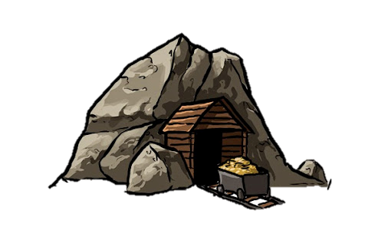
Basic concepts
Miners subscribe to mines
Mines forward data to miners
Miners can receive data from other miners as well
Miner
Miner
Miner
Mine

Slide 3

Basic concepts MINE
Is the primary source of information
The place where miners can subscribe to
Receives incoming stream of unending raw data
Raw data are transferred through the mine to all subscribers (one element at a time)

Slide 4



Basic concepts MINER
Subscribes to one or more Mines
Can also subscribe to other Miners (forming a mining chain)
Receives one element as input
“Mines” the input (performs a function or process)
Forward the “mined” input to other subscribed Miners (if any)

Slide 5

BASIC CONCEPTS COMMUNICATION MODEL
Each node is a standalone “server”
Listens to subscribe events and appends to its Subscribers List
The output is emitted to the Subscribers List
On connection error the subscriber is removed from the List
Communication is done through TCP sockets
To ensure reliability a proper Message Queue must be implemented

Slide 6
Topology
A cluster is formed as a directed graph of nodes (a.k.a. topology)
Each node has an input and an output

Slide 7

BASIC API BASE Server
Add to listeners()
Adds a subscriber to the list
Remove from listeners()
Remove a subscriber from the list
Set data()
Adds data to a listeners queue

Slide 8
Framework API mine
Get data()
Gets raw data from a source
Can be overridden by the miner
Start storing()
Continuous storing raw data to the miners queues

Slide 9
Framework API miner
Connect and start receiving()
Connect to a mine
Call Start receiving()
Start receiving()
Receive from mine
Call the Process()
Storing the processed data to listeners queues
Process()
Process the data that receives
Must be implement by the miner

Slide 10
example
What we have
One mine
Two miners
Connection sequence
Miner2 connects to Miner1
Miner1 connects to Mine
What we have to know
Miner1 has to know the IP address and port of Miner
Miner2 has to know the IP address and port of Miner1

Slide 11
example
What we process
Mine sends a string of random letters (lower and upper)
Miner1 gives a string of upper letters
Miner2 takes the upper and gives a string of lower letters

