Slide 1
Performance investigation of various microservice architectures
Alexandros Kyriakakis
supervised by Vassilios Vescoukis

Slide 2
Introduction
Main discussion points:
01
02
03
04
Software Architecture
Microservices
Case Study
Benchmarking & Results

Slide 3

Software Architecture
The software architecture of a computing system is the set of structures needed to reason about the system, which comprise software elements, relations among them and properties of both.
Software Architecture:
The blueprint of the system.
It describes its high-level structure.
Making the right architectural choices is fundamental to the success of a software project.
Performance
Cost
Documenting the architecture is as important as crafting it.
That’s why we used UML diagrams!

Slide 4
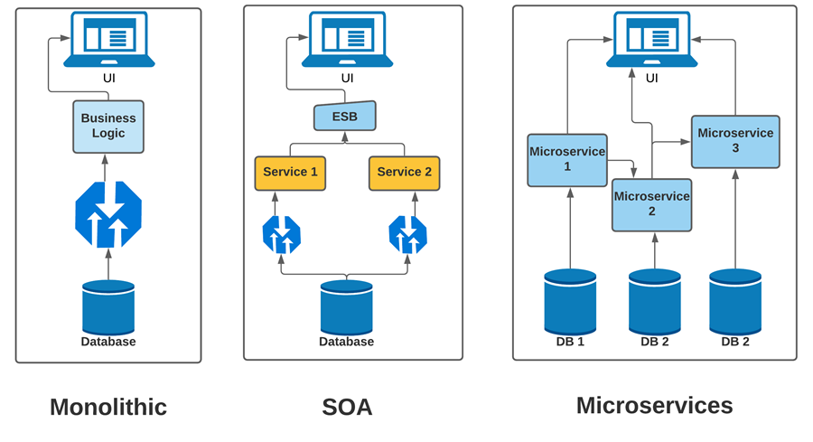
Architectural patterns
Monolithic
All functionality into one single application. Modules share the resources of the same machine.
Service-Oriented
Services that communicate through an enterprise service bus and share the same database.
Microservices
Set of loosely-coupled, independent, small services that communicate with lightweight mechanisms.

Slide 5
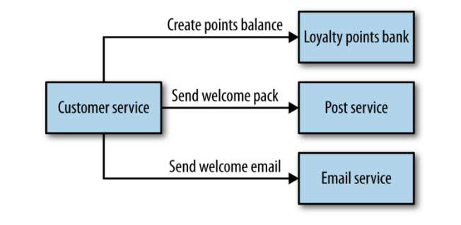
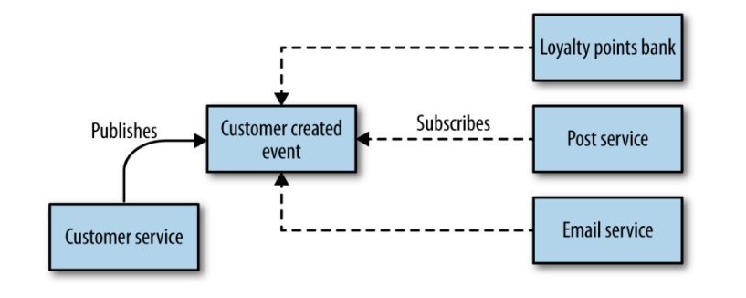
Microservices Communication
Orchestration
Synchronous request/response communication
A central coordinator listens to all the events emitted by any of the microservices. Based on the incoming event, it triggers another microservice.
Choreography
Event-based asynchronous communication
When a microservice executes a process, it publishes an event which can be subscribed by one or more other microservices to trigger their processes.

Slide 6



Message Brokers
An application that acts as an intermediary or a middleware for communication between various applications
RabbitMQ | Redpanda
push-based | pull-based
many-to-one (not fanout) | many-to-many
stores in queue | stores in disk partition
deletes messages after consumption | stores messages for later use

Slide 7







Tools

Slide 8
Case Study
Alternative Microservice Implementations of a Data Warehouse Engine
Concept
Metrics
Select sum(load) group by day
Select sum(load) group by week
Select sum(load) group by month
Requirements
Aggregation of the data on a daily weekly and monthly basis for each country
Focus on performance
Parse, analyze and store energy consumption data from the ENTsoe V3 API, for a number of countries.
Latency, throughput, capacity, availability, scalability

Slide 9
What architecture is the fastest?
Async Orchestrator
Serialised Orchestrator
Serialised RabbitMQ
SOA Redpanda
Orchestrator
1
2
3
4
5
Let’s find out!

Slide 10
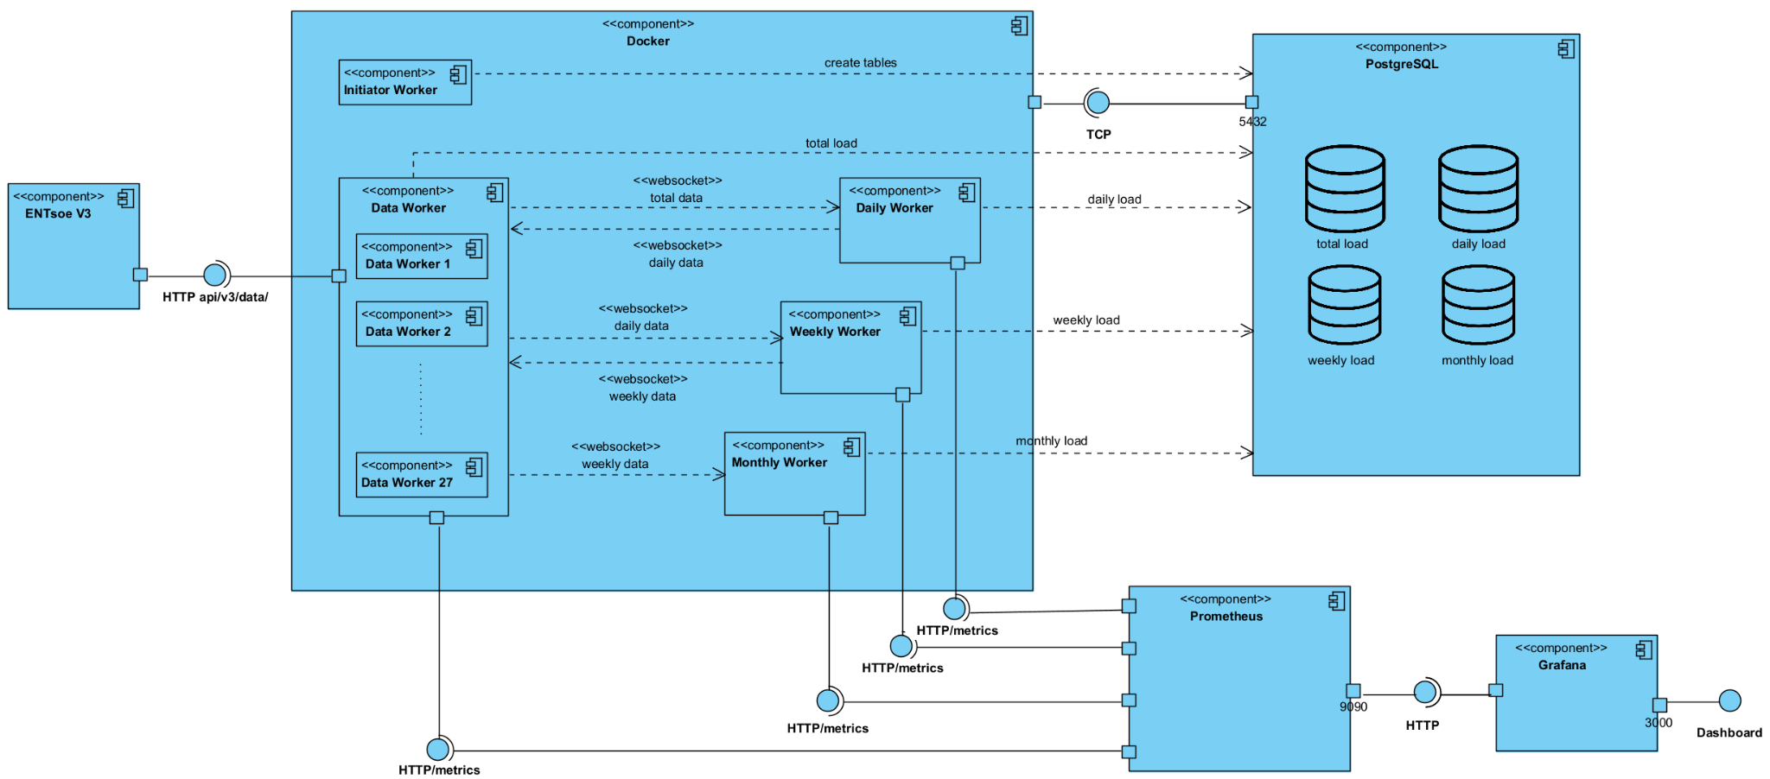
Orchestrator

Slide 11
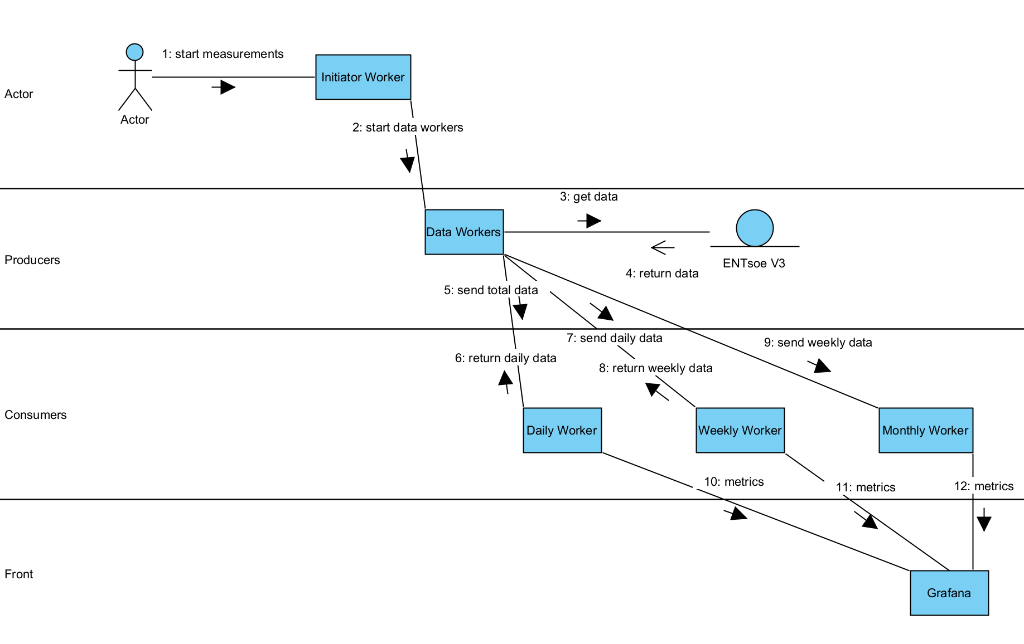
Orchestrator

Slide 12
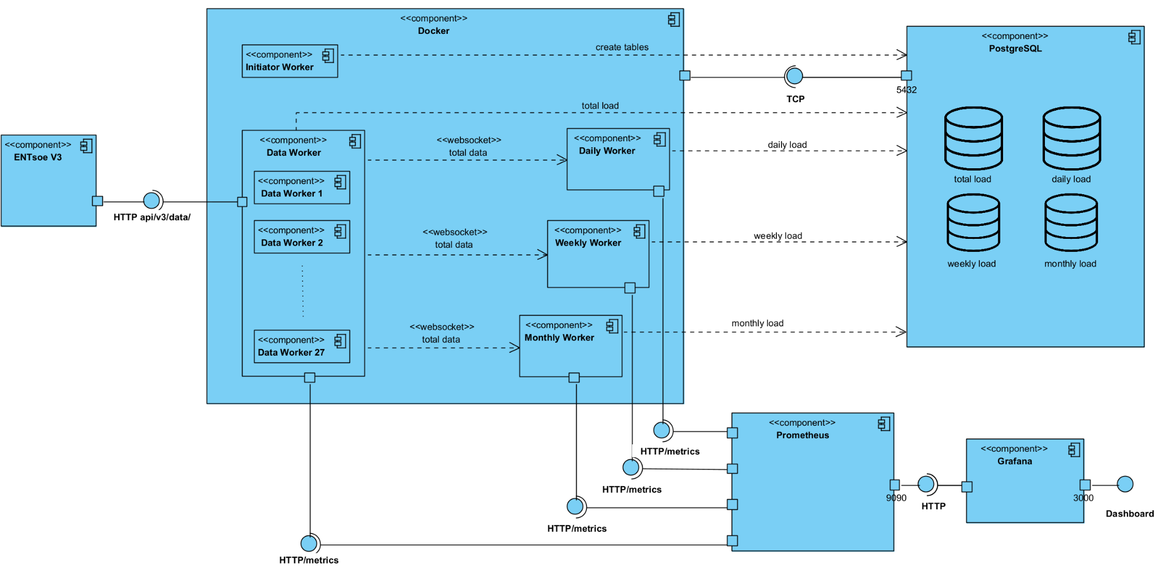
Async Orchestrator

Slide 13
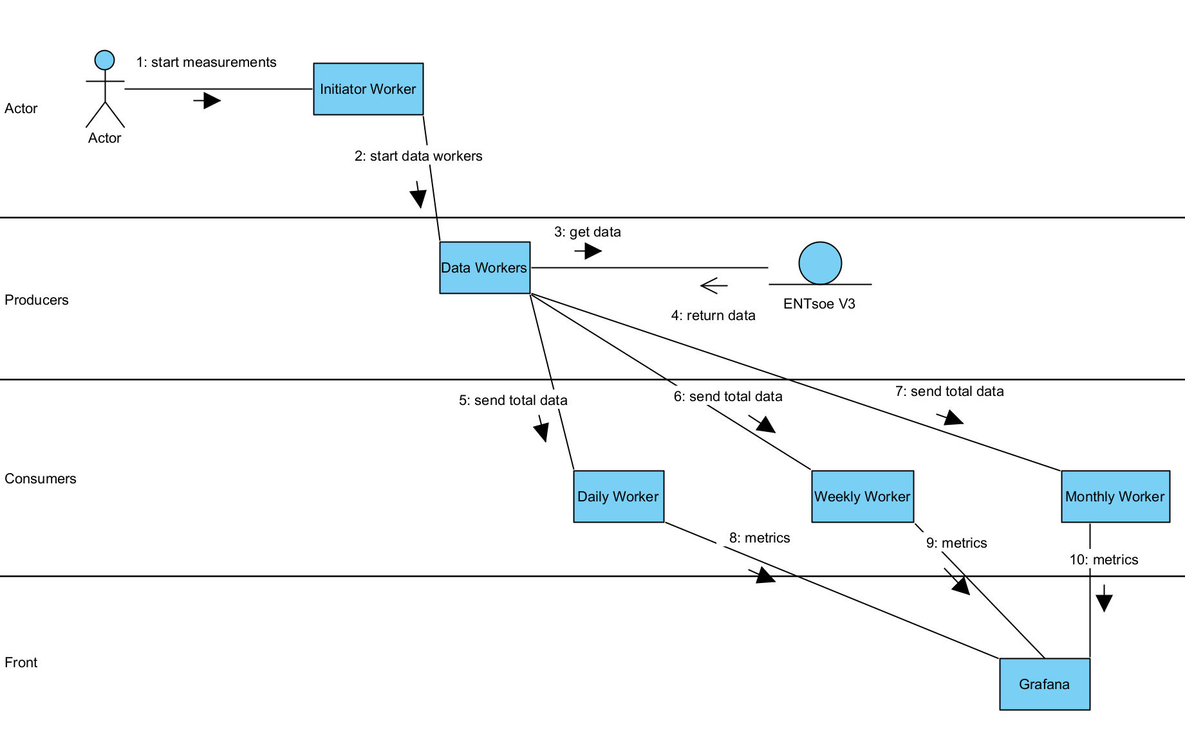
Async Orchestrator

Slide 14
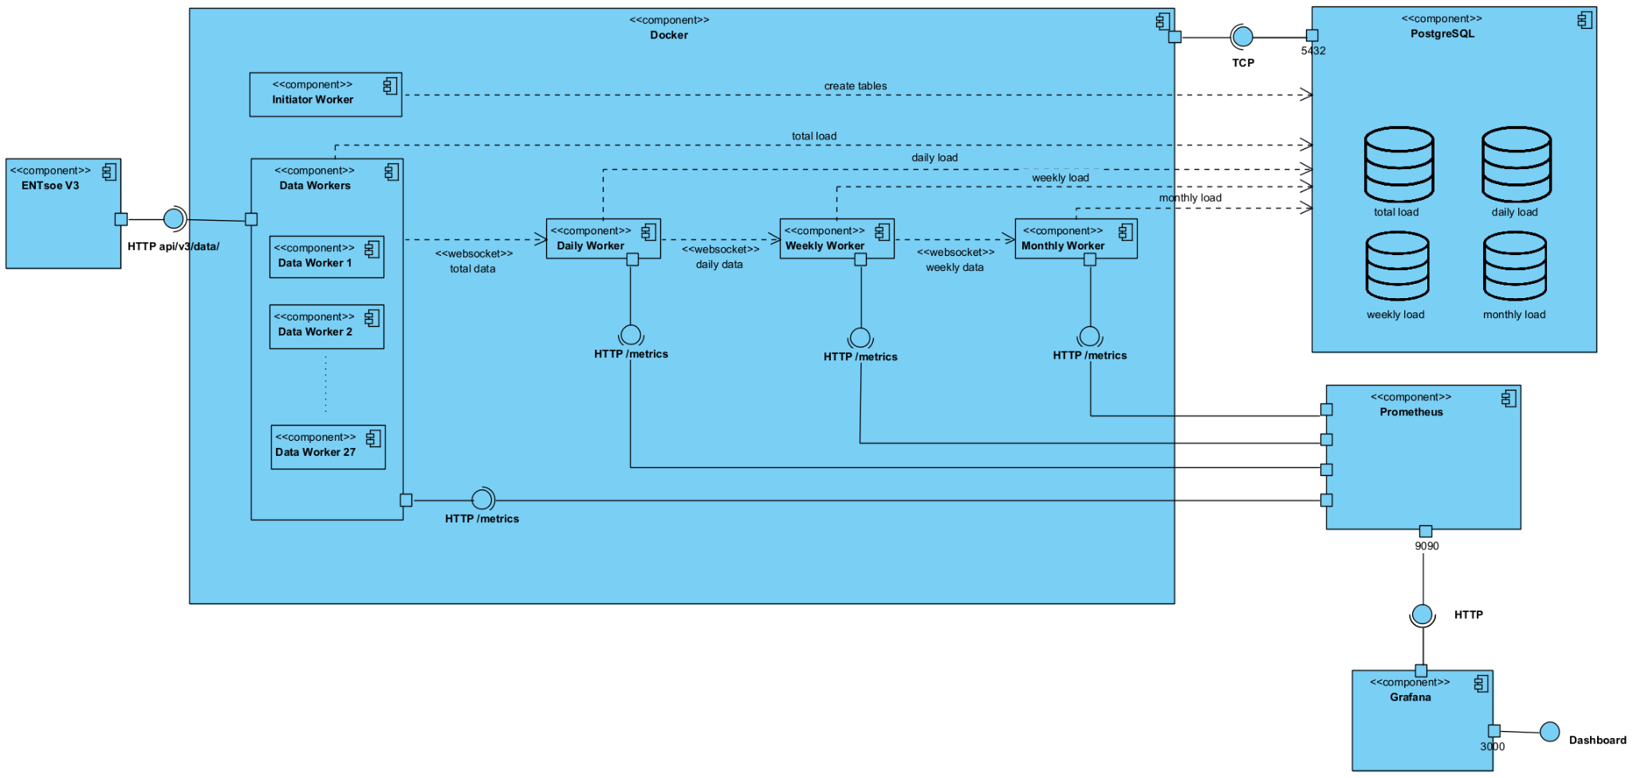
Serialised Orchestrator

Slide 15
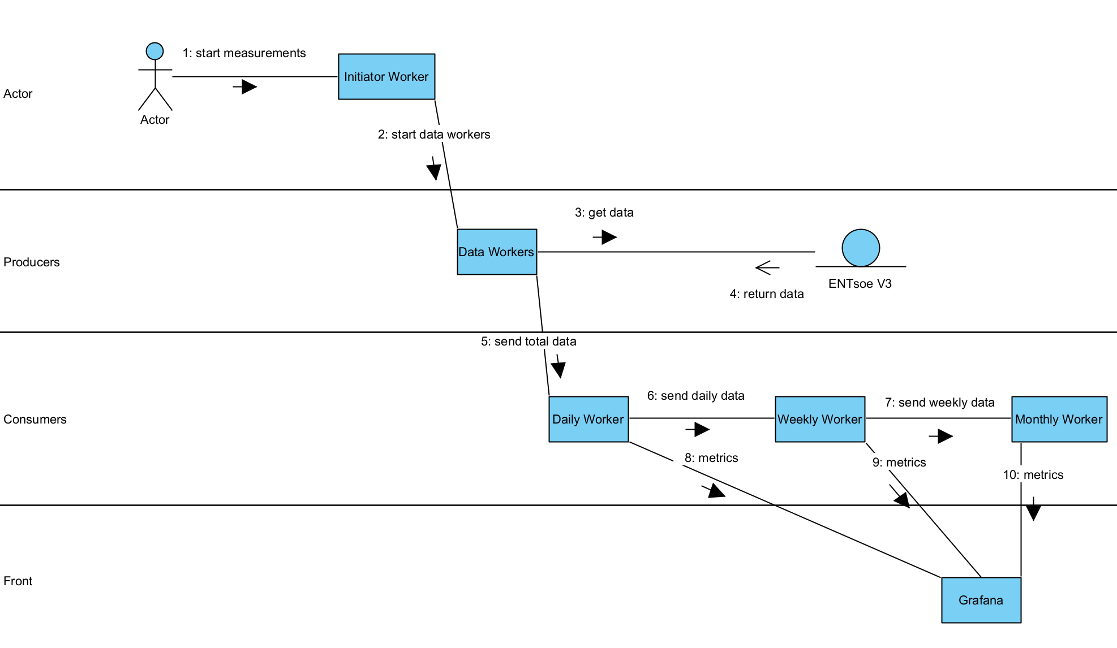
Serialised Orchestrator

Slide 16
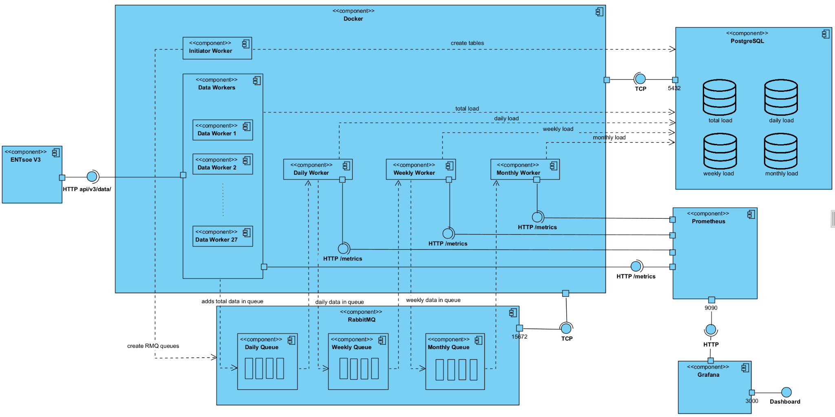
Serialised RabbitMQ

Slide 17
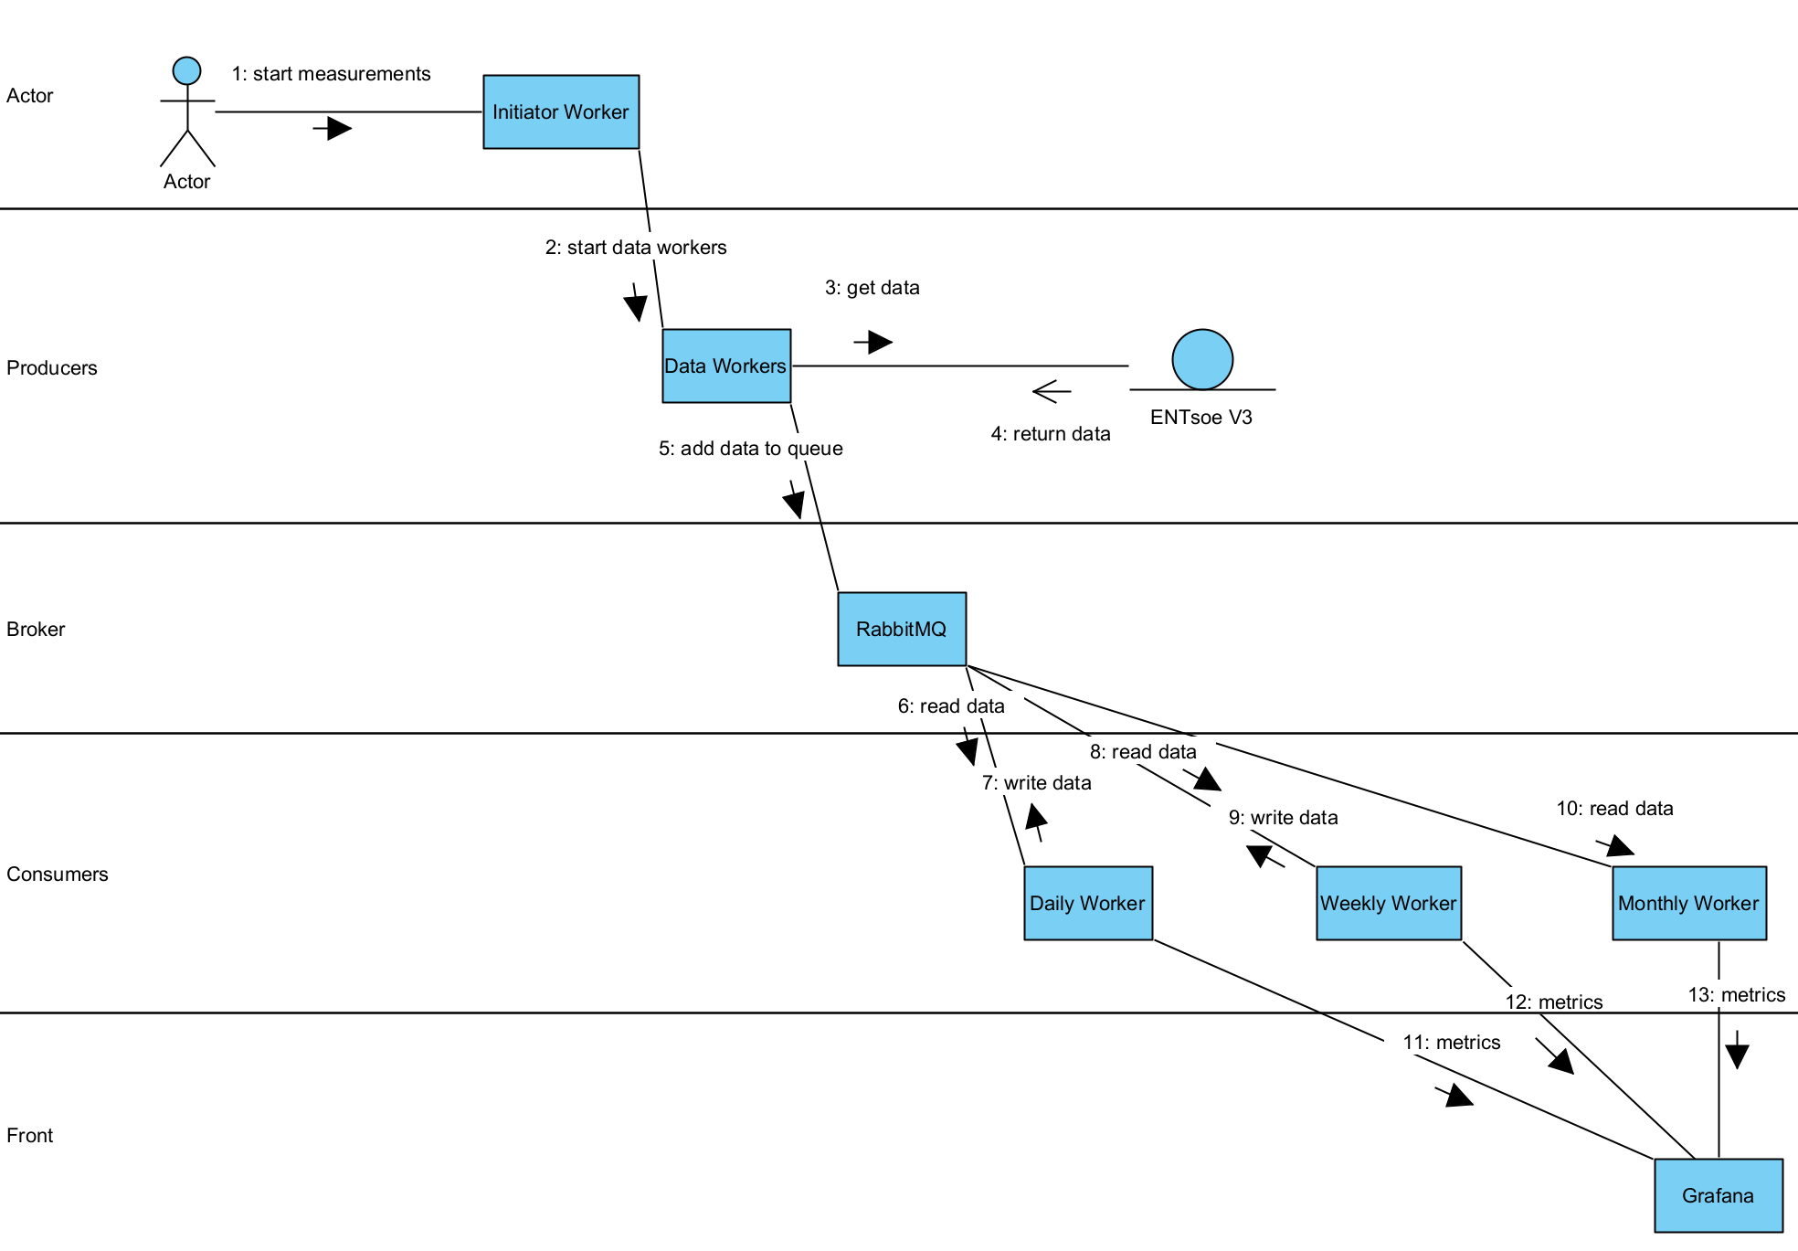
Serialised RabbitMQ

Slide 18
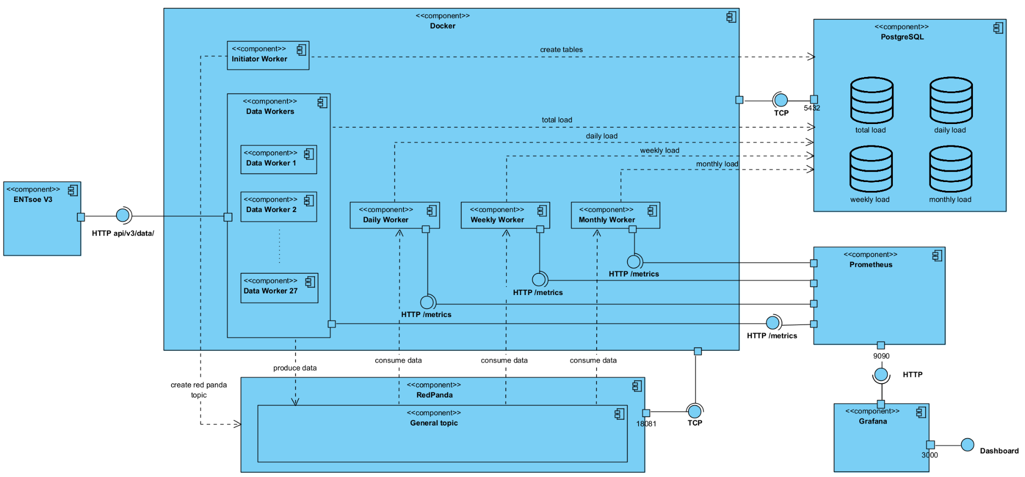
SOA Redpanda

Slide 19
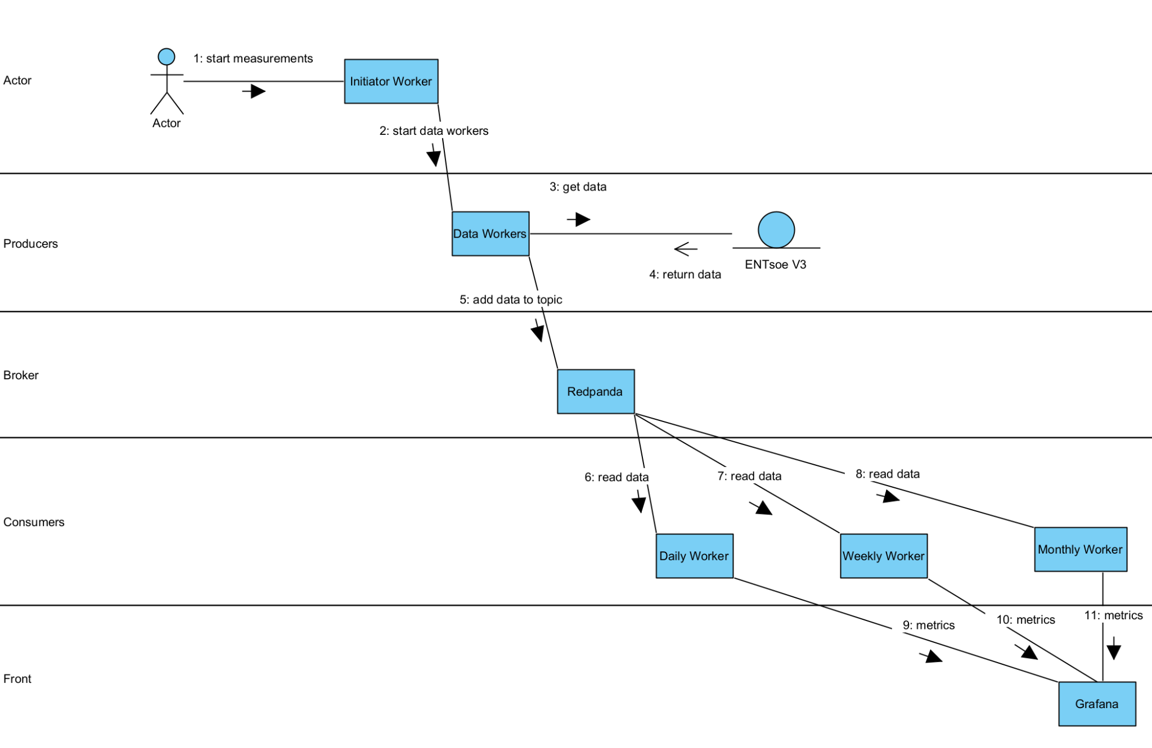
SOA Redpanda

Slide 20
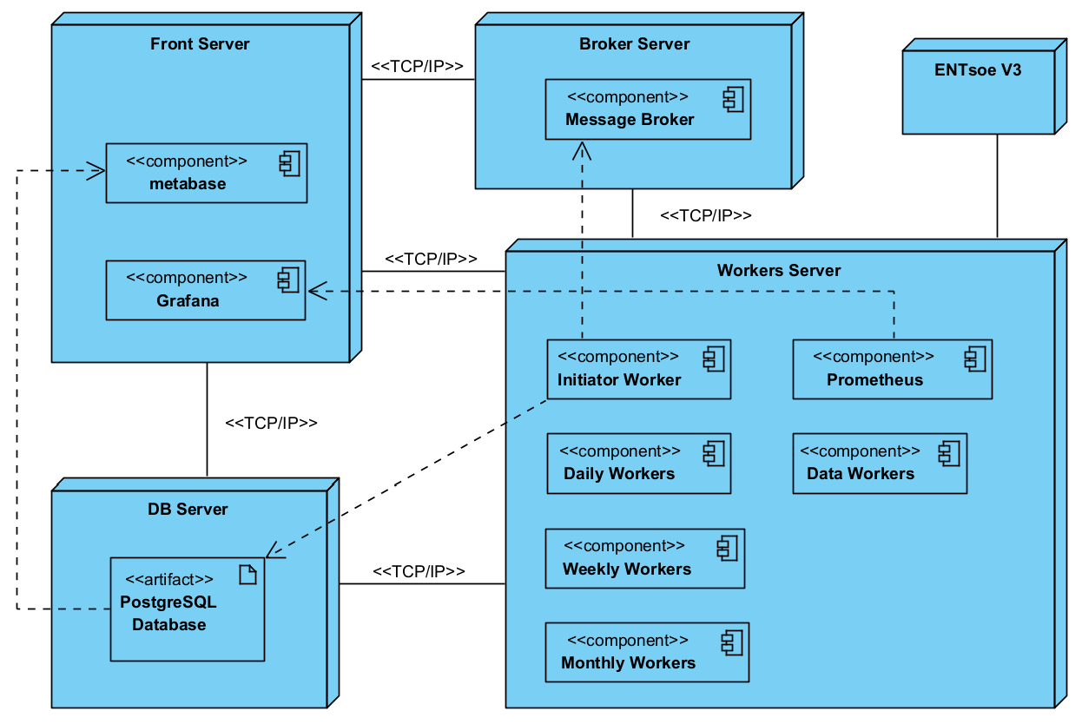
Deployment
RabbitMQ
Redpanda
Redpanda Console
4 CPU cores
16GB RAM
40GB disk space
2 CPU cores
4GB RAM
40GB disk space
2 CPU cores
8GB RAM
40GB disk space
4 CPU cores
16 GB RAM
40GB disk space

Slide 21


Testing
x 27
Data
Alternating the number of shards in Daily, Weekly and Monthly workers
Daily
Weekly
Monthly
Alternating the data load
since
6 tests for each architecture
2022
2020
2017
2022
2020
2017
=

Slide 22
Load Dispatching
How are the various shards of workers coordinated?
RMQ / Redpanda
Orchestrator architectures
The broker is responsible for distributing messages across multiple consumers.
RMQ broker uses round-robin algorithm.
Redpanda (kafka) broker uses consumer groups.
Each data worker is assigned to a consumer based on the modulo of data worker index to the number of parallel workers.
This results in a one-to-one connection between data workers and consumers.

Slide 23
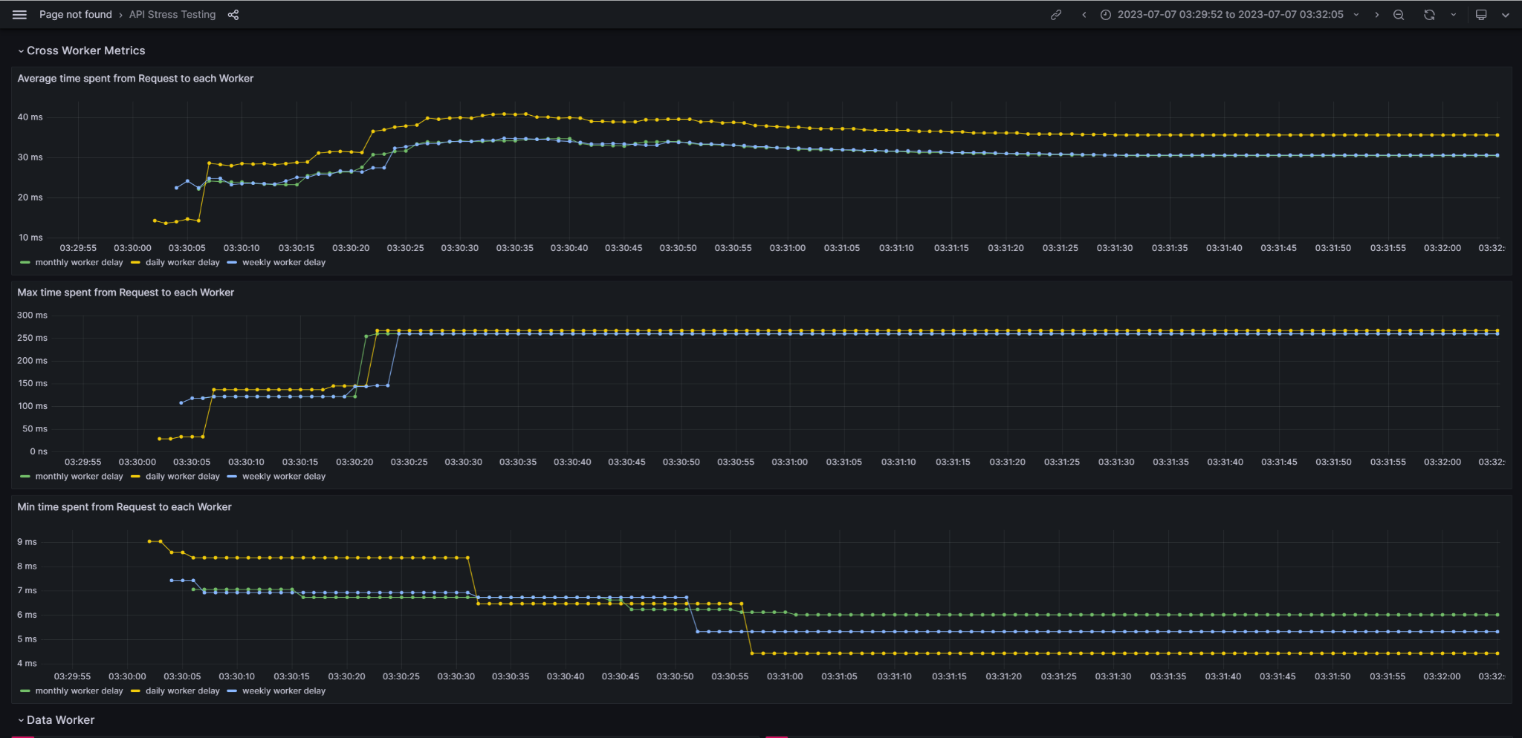
Prometheus and Grafana
So how did we get the metrics? We used monitoring and visualisation tools!
Our Grafana dashboard
Prometheus scraps metrics from the workers.
Grafana connects to Prometheus and uses it as a data source. It takes the metrics and makes beautiful visualisations.

Slide 24
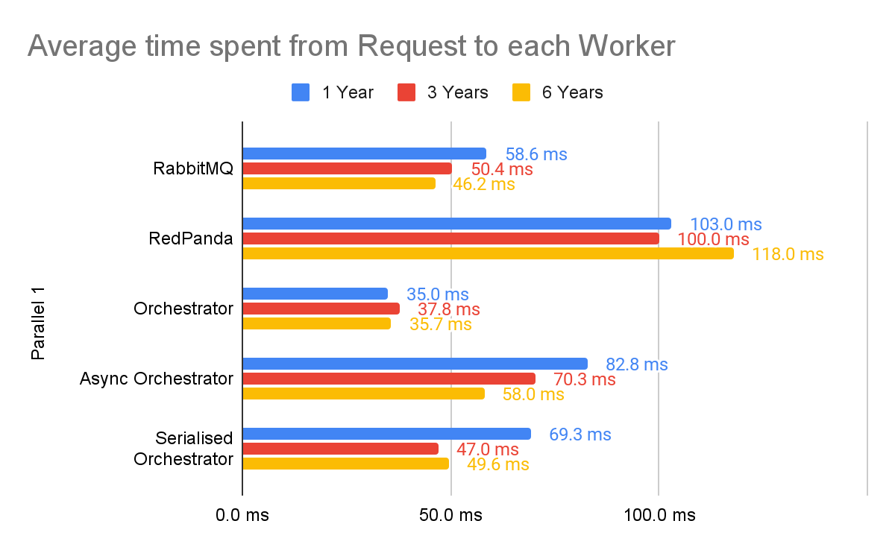
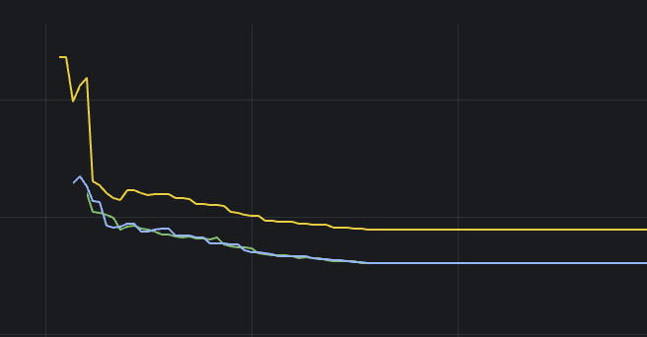
Results: Comparing architectures - 1 worker
Why does the time reduce while the load increases?
Why Redpanda is that slow?!
Why Async Orchestrator is slower than the others?
 | 1 Year | 3 Years | 6 Years
Total Bytes | 44MB | 118MB | 224MB
x 2.6
x 1.9
Why Orchestrator is the fastest?

Slide 25
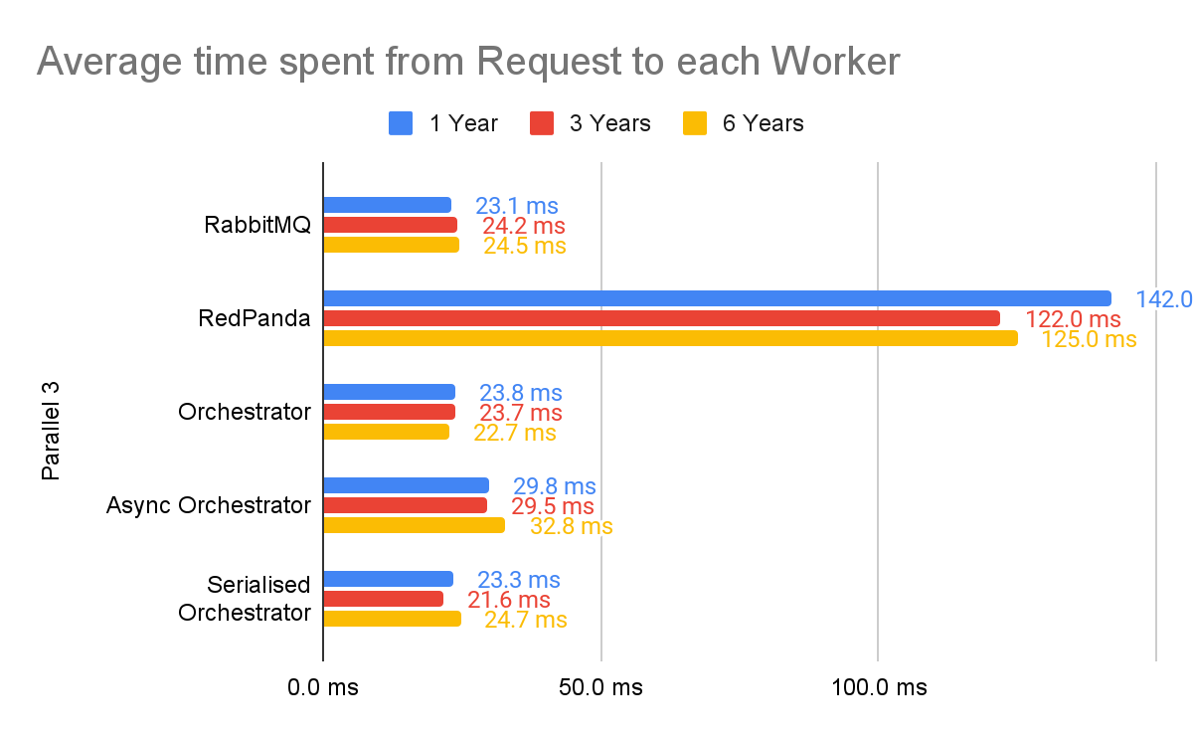
Results: Comparing architectures - 3 workers
Did the parallelism enhance performance?
Why all the metrics are similar ?
Why does RMQ have similar performance to the orchestrators?

Slide 26
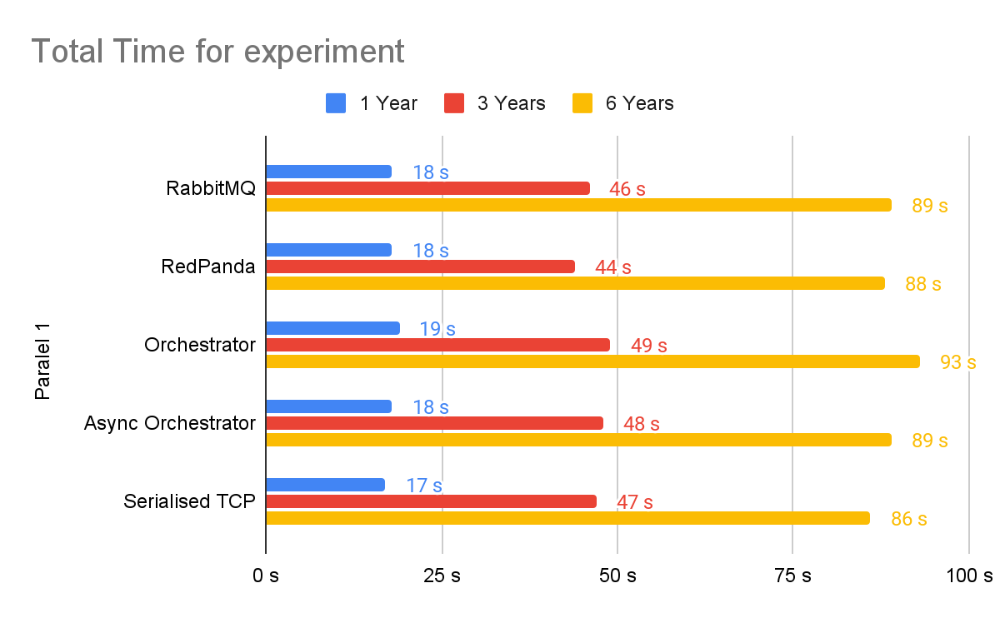
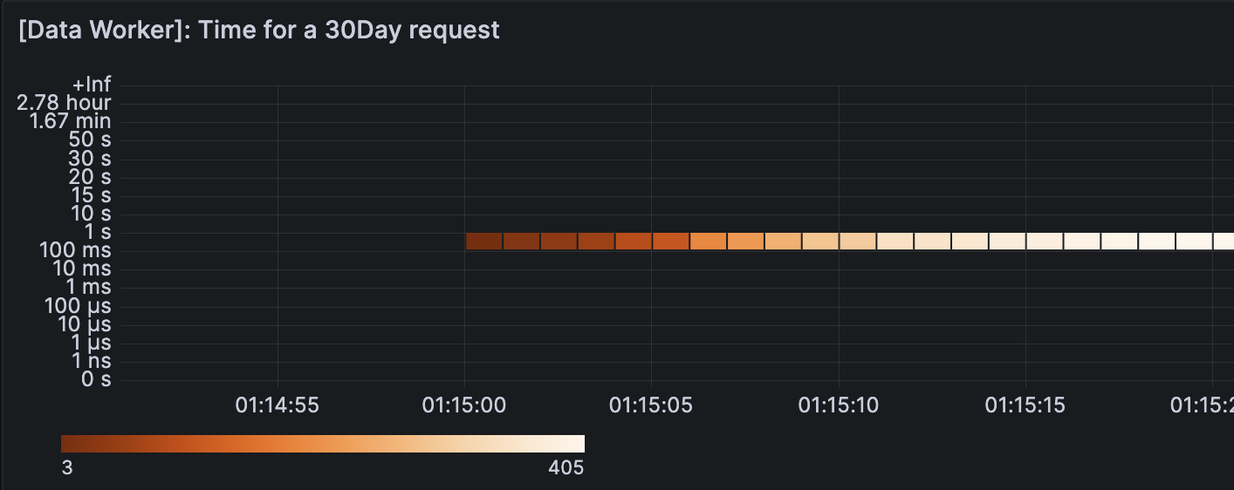
Results: Comparing total execution time
Why do all metrics look the same?
So why build these architectures?
What does this mean for us?

Slide 27
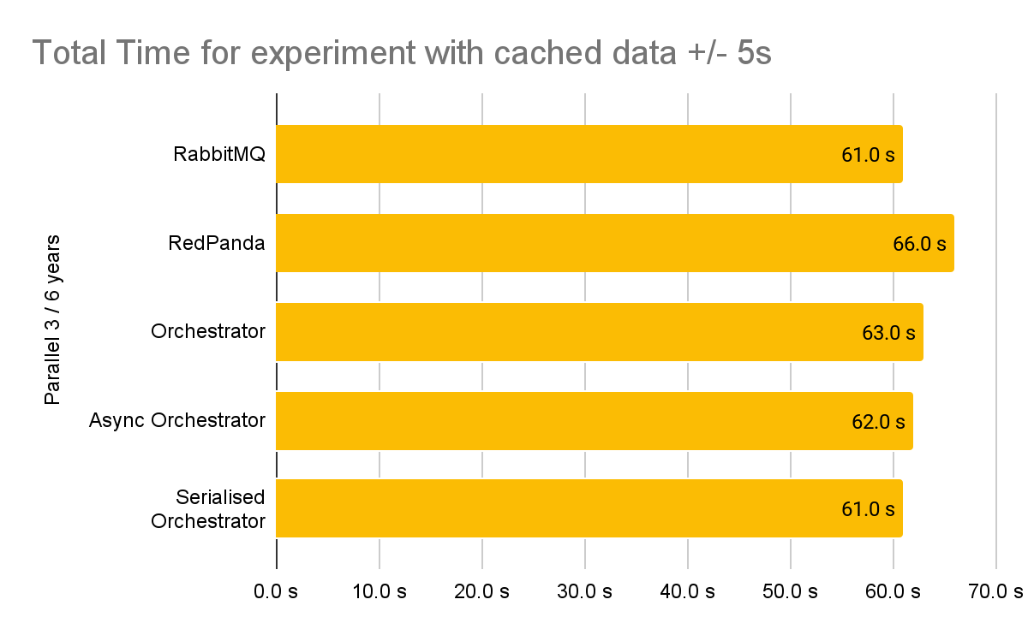
Results: Total execution time under heavy load
Why do all metrics look the same?
What does this mean for us?

Slide 28
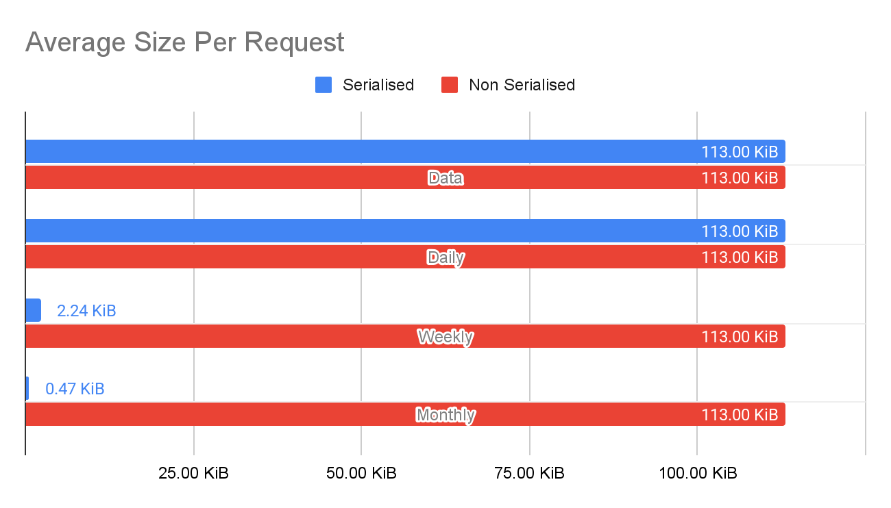
Results: Comparing size of request per worker
Serialised:
Orchestrator +
Serial. Orchestrator + RabbitMQ
Non Serialised: Async Orchestrator + Redpanda
Just a few Bytes!

Slide 29
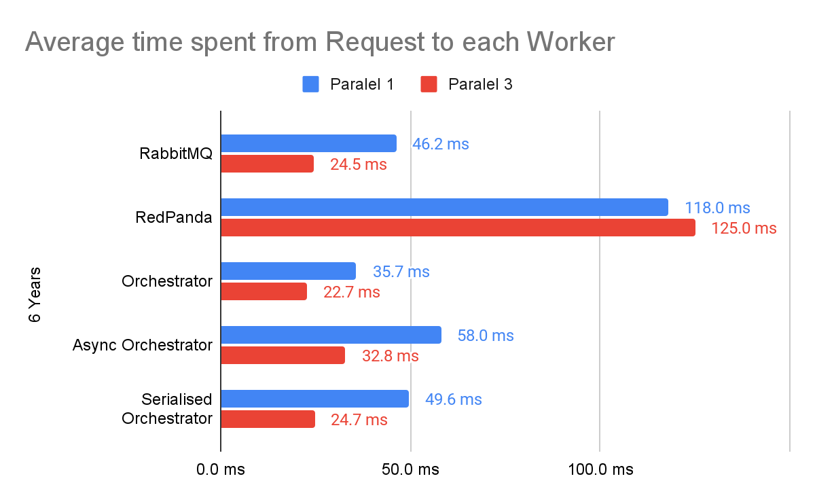
Results: Comparing 1 to 3 workers - 6 years
Almost all architectures’ time dropped due to parallelism.
Redpanda seems to be too heavy a tool to improve its performance

Slide 30
Conclusions
When to use
When not to use
On a heavy system with too many producers/consumers that need to be truly stateless
Each consumer can be at any offset we want to be (so we could replay the whole load)
Instant scalability (we can add as many workers as needed)
Heavy infrastructure - When per request delay is the most important.
Redpanda
When we exclusively need prioritised consumption of data its a FIFO queue
When we need a performant message broker
Instant scalability (we can add as many workers as needed)
When we don’t care about consumption prioritisation
RabbitMQ
In case we need to orchestrate the whole system through a single point eg filtering all data through a pipe
We care about Performance of the system a lot
When we need to be stateless
Orchestrator
Async Orchestrator
When we have excess CPU and number of communications does cost a lot
When we have not excess CPU
Serialised Orchestrator
When meta-data processing adds a lot value to the performance

Slide 31
Thank you for your attention!

