Slide 1

ACME Insurances
Intelligent Policy Assistant
An AI-powered assistant for branch operations
ACME Insurances | Intelligent Policy Assistant | 1 / 17

Slide 2
Value Proposition
1.
Answers policy and KPI questions in seconds
2.
Provides source citations for every answer
3.
Full audit trail for regulatory compliance
4.
Runs 100% on the workstation — nothing leaves the building
ACME Insurances | Intelligent Policy Assistant | 2 / 17

Slide 3
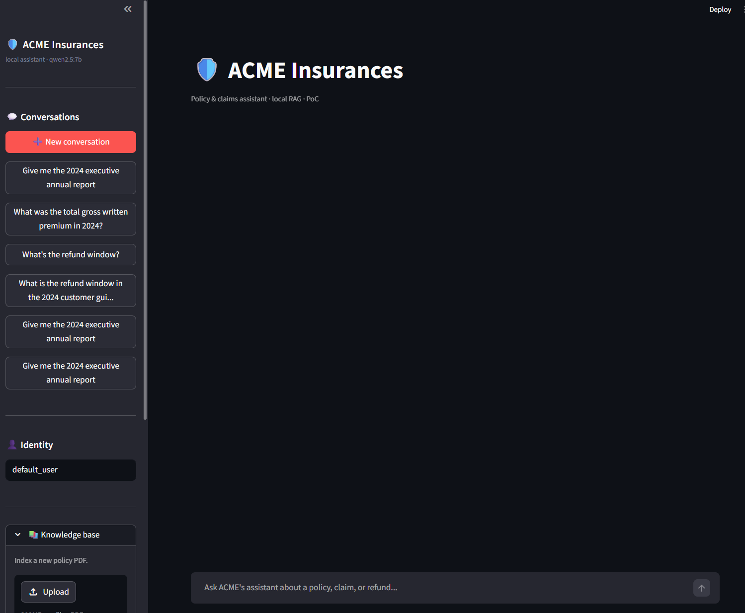
The Business Challenge
Branch employees spend hours every day looking up policy clauses
Lookups are slow, inconsistent, and impossible to audit after the fact
The assistant answers in seconds with source citations and a full audit trail
Fully local deployment — no sensitive data ever leaves the workstation
ACME Insurances | Intelligent Policy Assistant | 3 / 17

Slide 4
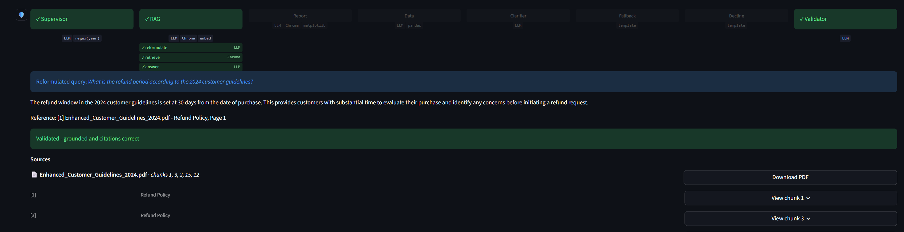
Intelligent Request Routing
Every question is automatically classified and routed to the right handler
RAG — policy questions with year-specific retrieval and built-in validation
Report — single-policy summary OR executive annual report
Data — quantitative answers across 14 key performance indicators
Clarifier — asks a clarifying question when the year is ambiguous
Out-of-year — graceful handling when data is unavailable
Decline — out-of-scope requests handled politely
ACME Insurances | Intelligent Policy Assistant | 4 / 17

Slide 5
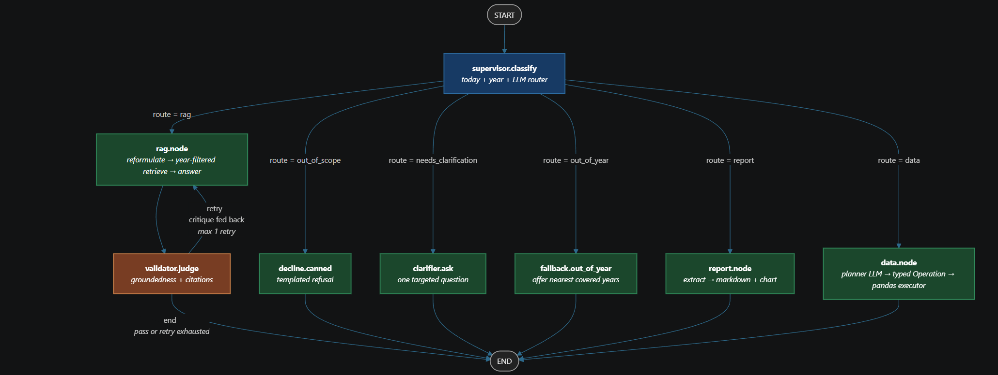
Decision Graph Architecture
The routing topology visualized as a compiled decision graph
Topology defined in a single source-of-truth configuration
Each node enforces strict behavioral contracts (permitted and prohibited actions)
Every decision point is traceable and fully auditable
ACME Insurances | Intelligent Policy Assistant | 5 / 17

Slide 6
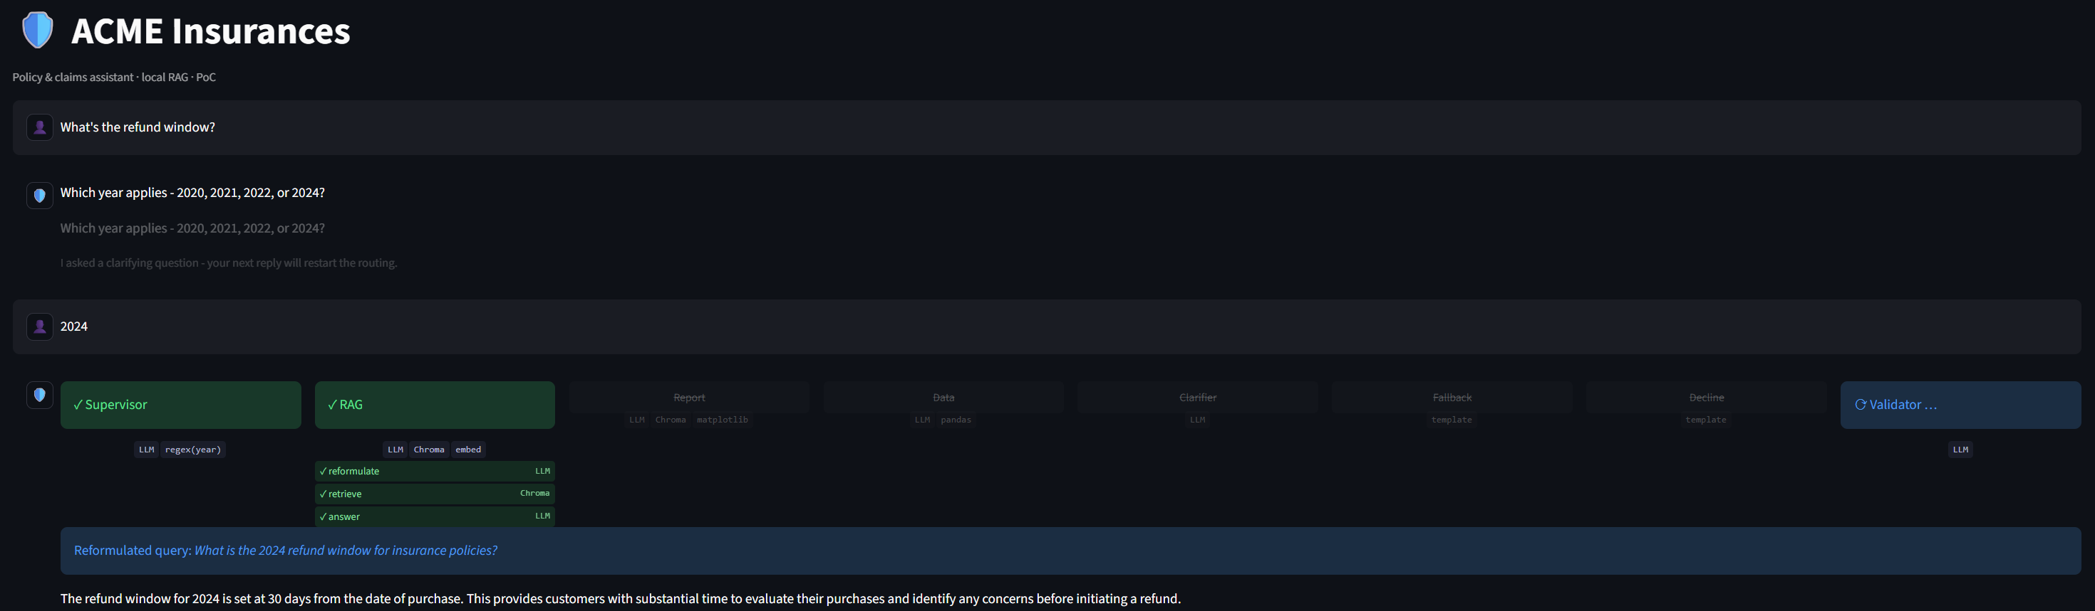
Year-Aware Retrieval & Clarifier
Knowledge base spans 2020–2024 — the 2023 gap tests handling of missing data
“What’s the refund window?” — the assistant asks which year (never guesses silently)
User replies “2024” — answer is retrieved from the correct policy document
“What does the 2023 policy say?” — request declined before any processing begins
ACME Insurances | Intelligent Policy Assistant | 6 / 17

Slide 7
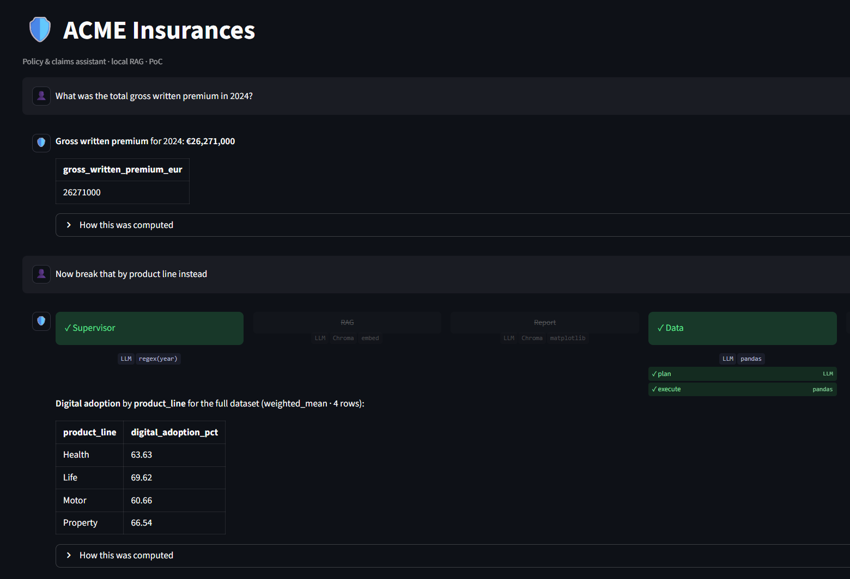
Natural Language KPI Queries
Quantitative answers across 14 KPIs — with deterministic data processing
AI plans the query, then a rules-based engine executes it
No AI involvement in actual data calculations
Five built-in validation rules prevent invalid calculations
Conversational drill-down (e.g. “now break down by product”)
ACME Insurances | Intelligent Policy Assistant | 7 / 17

Slide 8
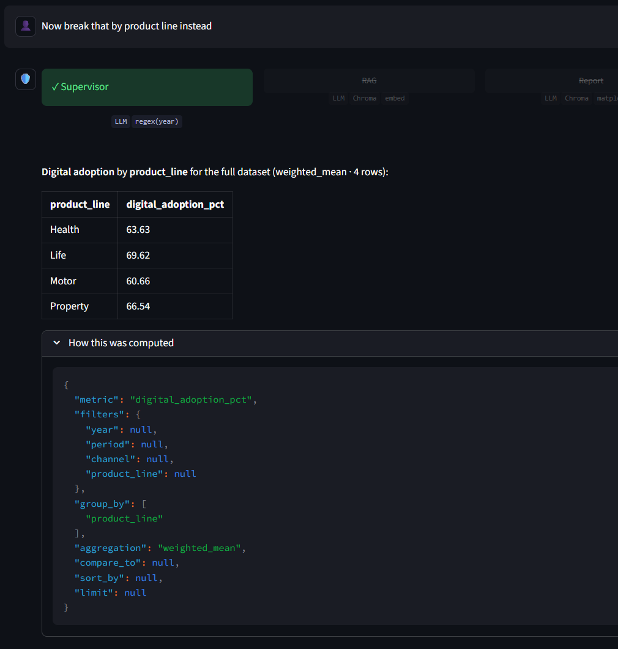
Conversational Drill-Down
Every follow-up shows what carried over and what changed
Inherited: metric, filters, and aggregation
Changed: grouping dimension
Compliance reviewers can replay any answer using the unique reproducibility hash attached to each dataset
ACME Insurances | Intelligent Policy Assistant | 8 / 17

Slide 9
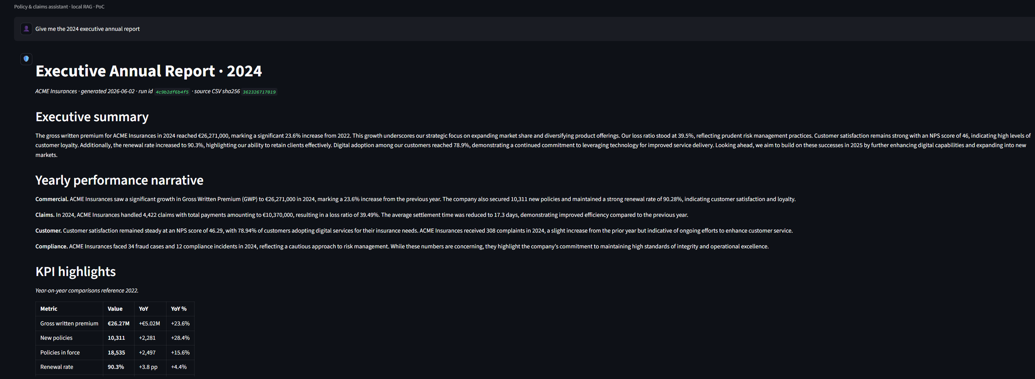
Executive Annual Report
Structured report generation in three delivery formats
Data collection, narrative generation, assembly, and formatting
Each section is grounded independently — the model processes one section at a time, ensuring accuracy
Three output formats from one source: Markdown, DOCX, and PDF
A unique run ID in the footer guarantees full reproducibility
ACME Insurances | Intelligent Policy Assistant | 9 / 17

Slide 10
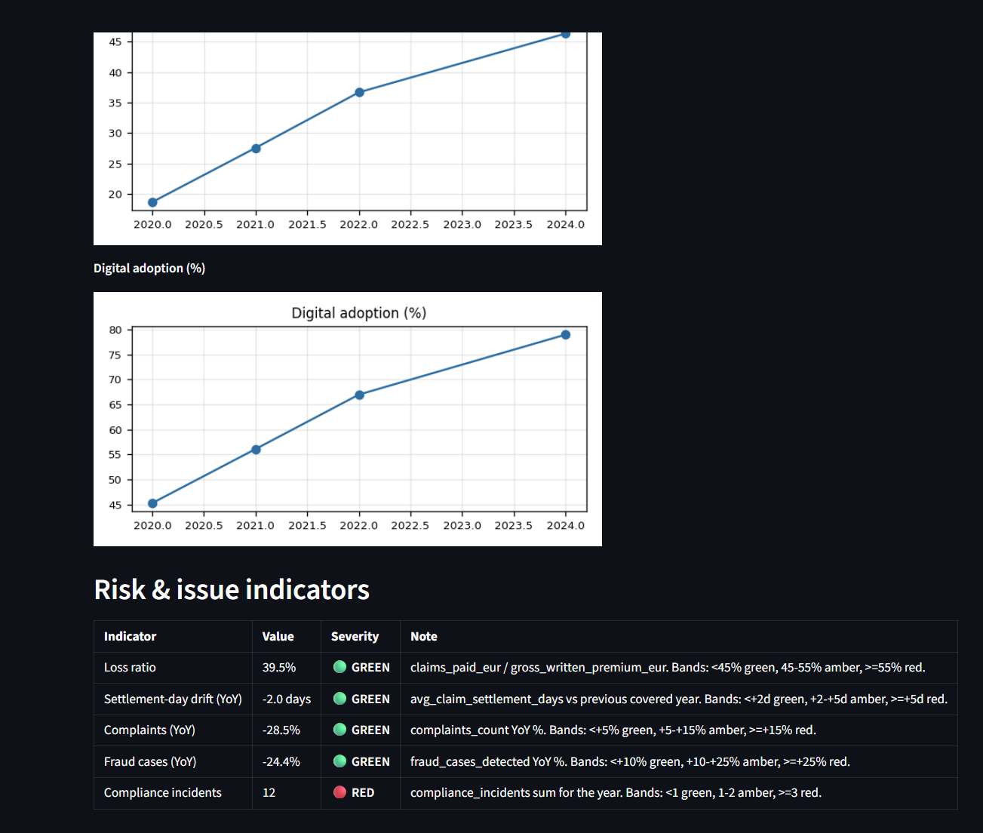
Risk Indicators
Risk severity is determined by fixed thresholds, not AI
Loss ratio · Settlement drift · Compliance incidents
All five thresholds are predefined and auditable
A deterministic, trustworthy foundation for risk assessment
ACME Insurances | Intelligent Policy Assistant | 10 / 17

Slide 11

Multi-Format Report Downloads
Three buttons under every executive report
One report source rendered consistently to all three formats
Direct download endpoint for any supported format and year
Run ID guarantees number consistency across all formats
ACME Insurances | Intelligent Policy Assistant | 11 / 17

Slide 12
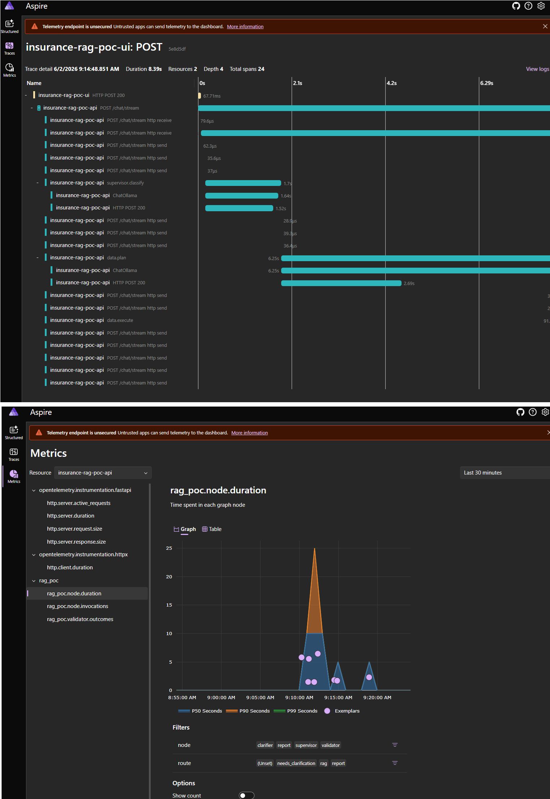
Full Observability
End-to-end traces, logs, and metrics built in from day one
Every interaction traced from request through processing to validation
All AI model calls automatically captured and instrumented
Granular visibility into each processing step and sub-step
ACME Insurances | Intelligent Policy Assistant | 12 / 17

Slide 13
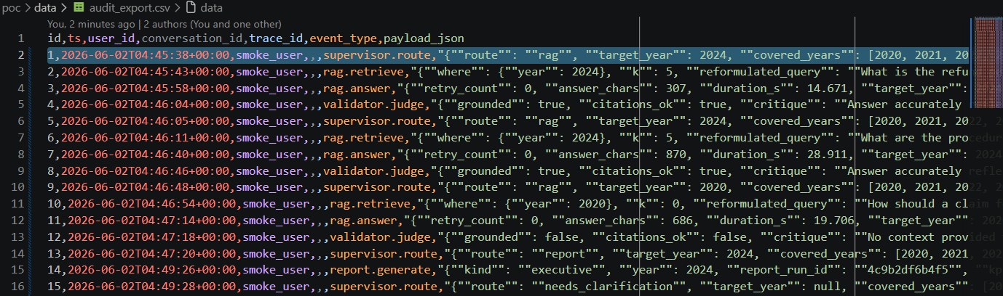
Audit Trail — Compliance Export
Every routing, retrieval, validation, data, and report decision recorded
Dedicated audit database — separate from conversation memory
Each record is cross-referenced with the full observability trace
One-click export to CSV for BI and SIEM tools
“Why did the model reason this way?” — answerable weeks later
ACME Insurances | Intelligent Policy Assistant | 13 / 17

Slide 14
What I Enjoyed Building
Full open-source constraint. Zero paid LLM APIs. Every design ran through the “does this still work on a local 7B model?” filter.
Diagram-first design. Drawing the state machine before the code shaped what got built.
“View chunk” + Download PDF. Compliance plumbing disguised as UX.
Chunker telemetry in Aspire. Sections, chunks kept vs skipped, embedding spans — all visible without a separate dashboard.
A real BO-grade report from a 7B model. Markdown + chart + Operation expander — a deliberate squeeze of a small local model into a serious deliverable shape.
Three-format executive report from one source. Same typed ReportDocument → Markdown / DOCX / PDF. Per-section LLM grounding + deterministic risk bands + reproducibility hash.
ACME Insurances | Intelligent Policy Assistant | 14 / 17

Slide 15
What I Would Do Differently
Prioritise Talk-to-Data earlier — but guard it with UI affordances. Quantitative answers are the highest-value thing the assistant can do, and the easiest to get wrong. Surface rows + Operation alongside every numeric answer; add quick-pick dimension chips + a metric glossary.
Use AG-UI as the front-end protocol. Streamlit was the right call for a PoC; AG-UI brings streaming tool calls, native human-in-the-loop, and a real component model.
Azurize the model layer for production. GPT-5.1 for RAG, mini/nano for query reformulation, GPT-5.4 / reasoning-medium for the executive report.
One-shot executive report as a side-by-side experiment against the per-section pipeline. The challenge is structural stability; the prize is dramatically lower latency and cost.
ACME Insurances | Intelligent Policy Assistant | 15 / 17

Slide 16
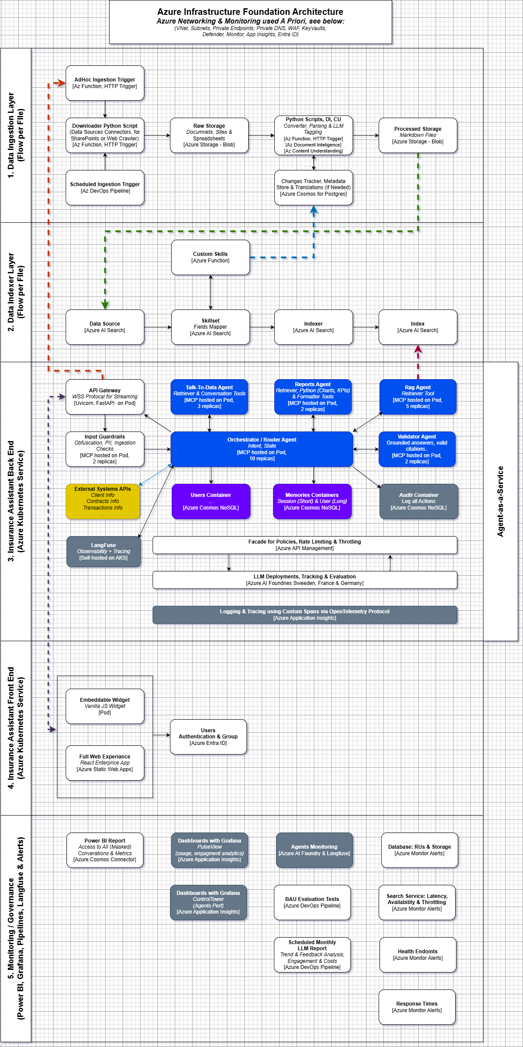
Production Architecture on Azure
Production-ready deployment with enterprise Azure cloud services
RAG generator — GPT-5.1 for grounded answers
Query reformulator — mini / nano model for sub-second latency
Executive report narrator — GPT-5.4 / reasoning-medium for multi-section pipelines
Vector store — Azure AI Search with hybrid retrieval
Telemetry — Azure Monitor + Langfuse for AI-specific monitoring
Compliance — EU AI Act record-keeping via immutable Blob Storage
ACME Insurances | Intelligent Policy Assistant | 16 / 17

Slide 17
Thank You
Questions, demo requests, or deep dives — happy to discuss.
ACME Insurances | Intelligent Policy Assistant

