Slide 1
ACME Insurances · Local RAG PoC
A locally-running agentic assistant for branch operators
Answers policy & KPI questions in seconds
Cites the exact paragraph it used
Logs every decision for compliance review
Runs 100% on the workstation — nothing leaves the building
ACME Insurances · Local RAG PoC · slide 1/16
Notes:
Cover slide. Speaker introduces themselves and the demo.

Slide 2
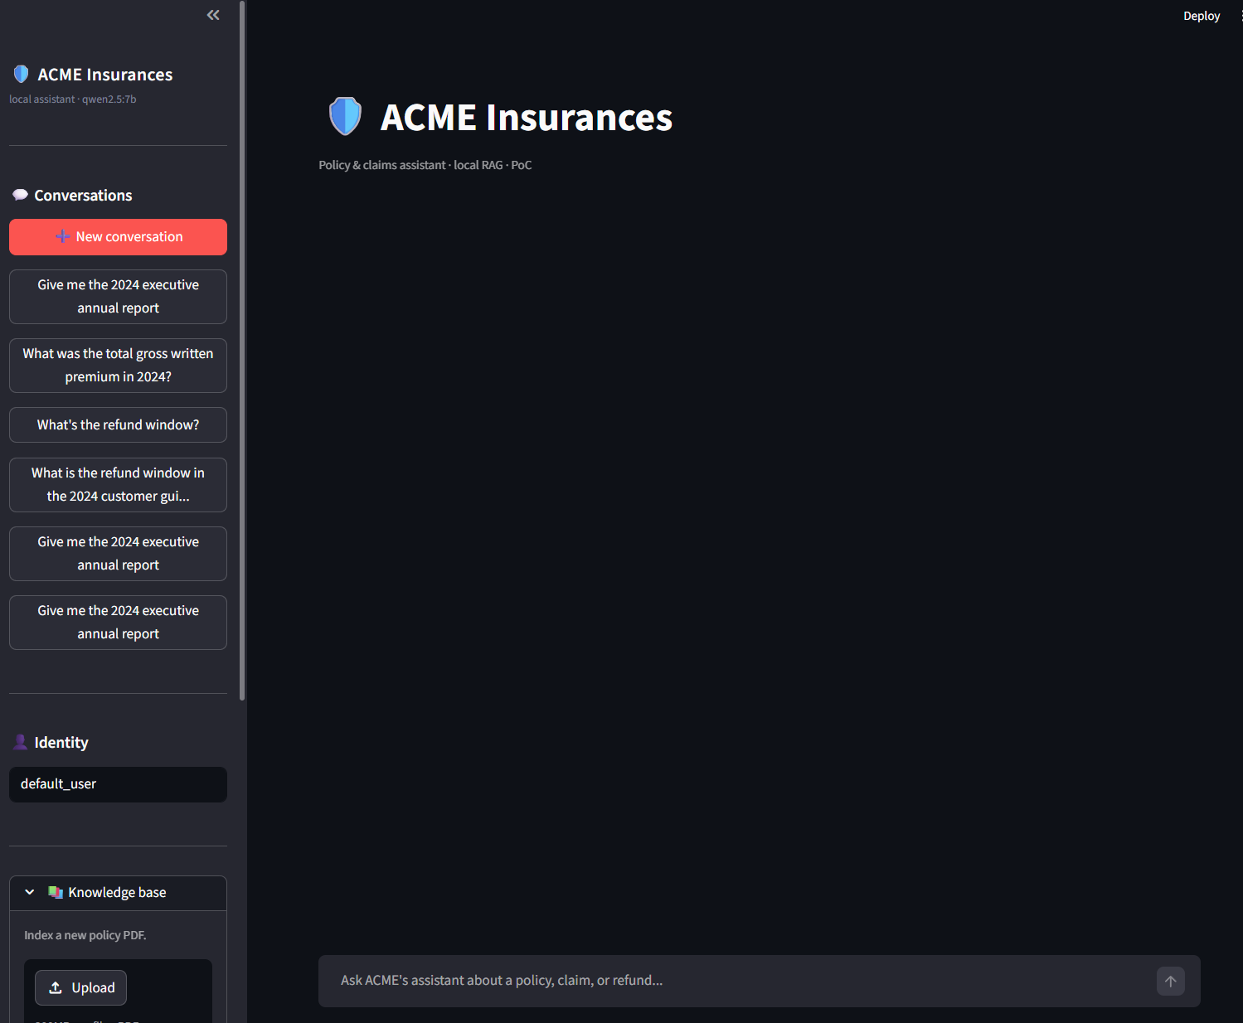
What this PoC solves
Branch employees spend hours every day looking up policy clauses
Lookups are slow, inconsistent, and impossible to audit after the fact
This assistant answers in seconds with citations + audit trail
Local-only — no PII or document content ever leaves the workstation
ACME Insurances · Local RAG PoC · slide 2/16

Slide 3
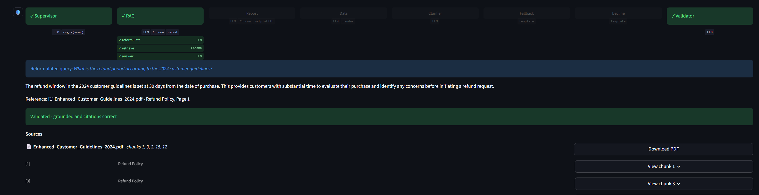
Seven-route state machine
Every question routes to exactly one of seven branches
RAG — policy questions, year-scoped retrieval, validator + 1 retry
Report — single-policy summary OR executive annual report
Data — quantitative questions over the KPI dataset
Clarifier — one targeted question when the year is missing
Out-of-year fallback — graceful refusal for the 2023 gap
Decline — out-of-scope handled politely
ACME Insurances · Local RAG PoC · slide 3/16

Slide 4
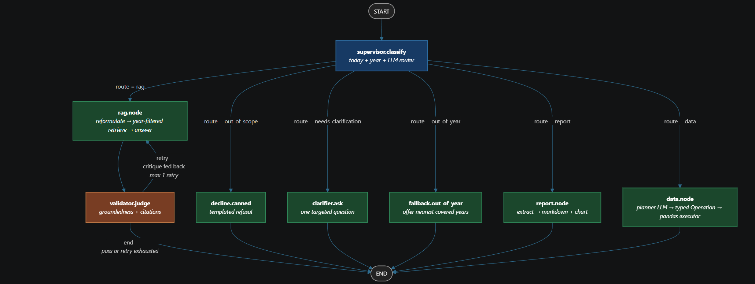
LangGraph — compiled state machine
The seven-route topology as the actual compiled graph
Source of truth: [`poc/app/graph/builder.py`](../../poc/app/graph/builder.py)
Per-node contracts (MUST / MUST-NOT): [`docs/agent_topology.md`](../agent_topology.md)
Colour code: 🟦 router · 🟩 worker · 🟧 guard · ⬛ terminal
Every node carries an OTel span; every edge is auditable
ACME Insurances · Local RAG PoC · slide 4/16

Slide 5
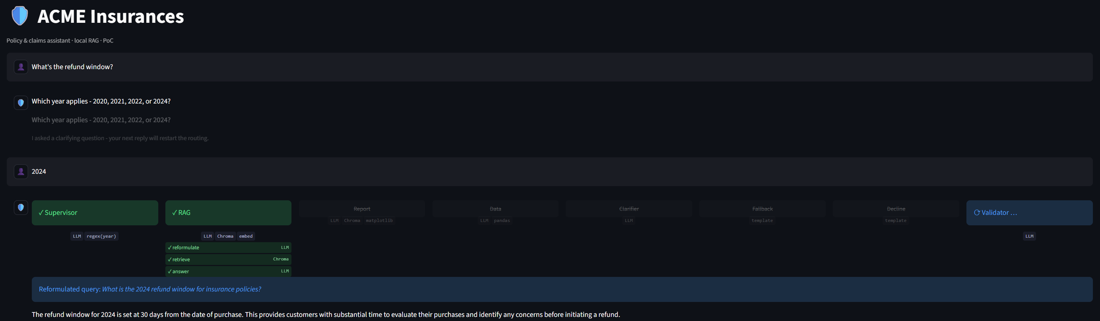
Year-aware retrieval & clarifier
Knowledge base covers 2020 · 2021 · 2022 · 2024 — the 2023 gap is intentional
*"What's the refund window?"* → clarifier asks the year (no silent guess)
*"2024"* reply → stitched onto the original question, routed to RAG
*"What does the 2023 policy say?"* → refused **before any LLM call**
ACME Insurances · Local RAG PoC · slide 5/16

Slide 6
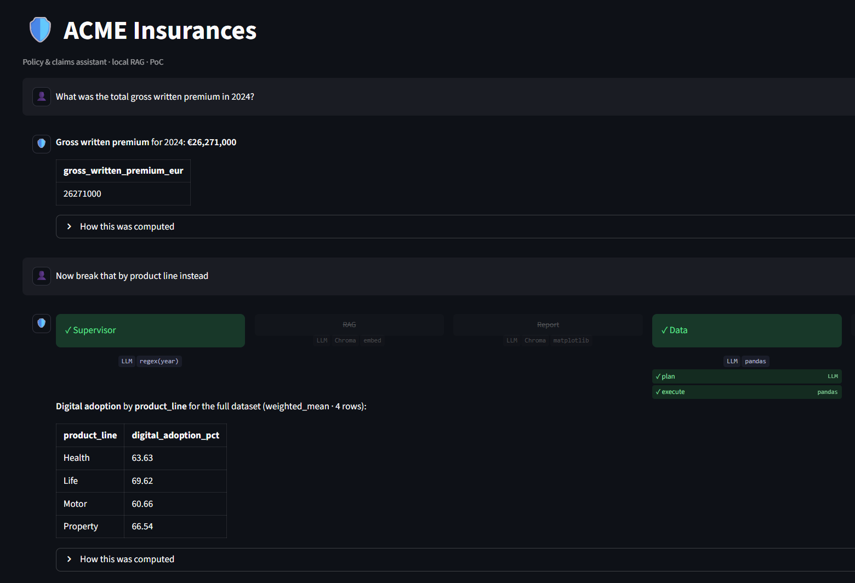
Talk-to-Data agent
Quantitative answers over 14 KPIs — without letting the LLM touch pandas
Planner LLM emits a **typed Operation JSON**
A hand-written pandas executor consumes it
Five schema-aware guards (no `sum` on rates, no 2023, …)
Drill-down via prompt patch-mode (*"now break by product"*)
ACME Insurances · Local RAG PoC · slide 6/16

Slide 7
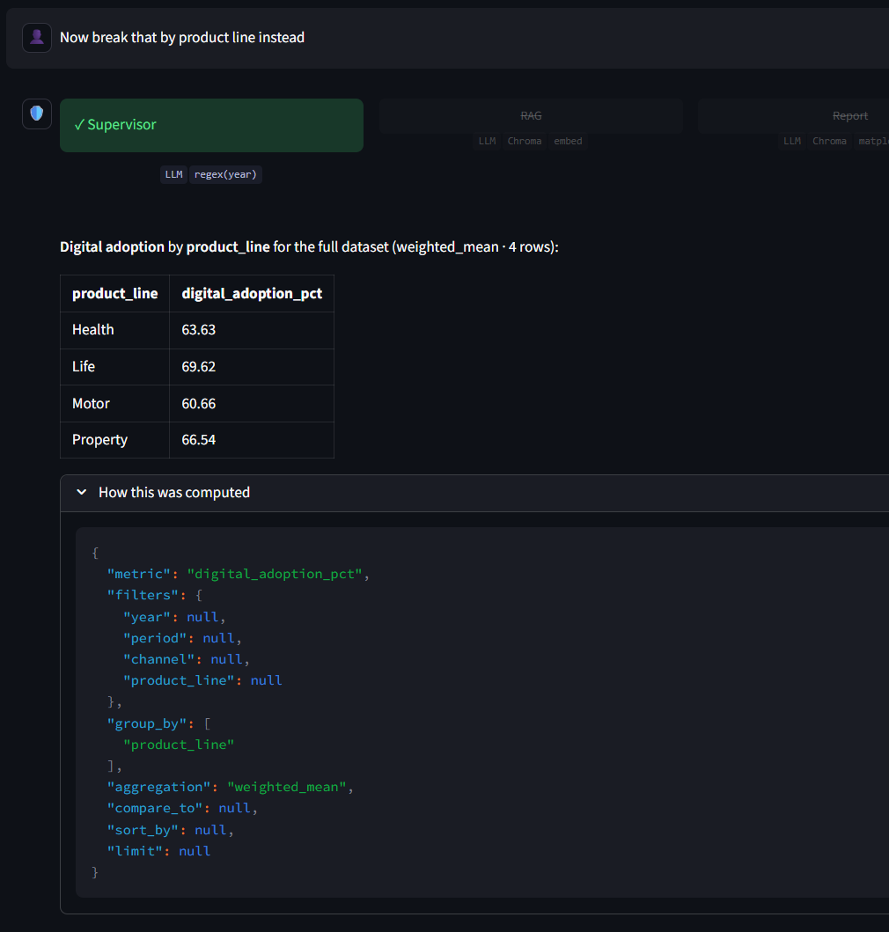
Drill-down — inherited / changed
Every follow-up shows what carried over and what changed
Inherited: metric · filters · aggregation
Changed: group_by
Compliance reviewers can replay any answer by re-running the
Operation against the same `csv_sha256`
ACME Insurances · Local RAG PoC · slide 7/16

Slide 8
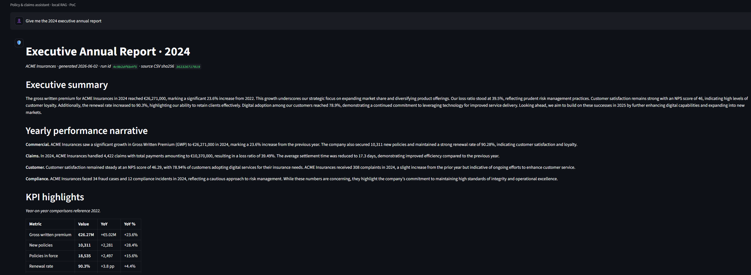
Executive annual report
Section-by-section pipeline · three delivery formats
Collector → Narrator → Assemble → Writers
Per-section LLM grounding — the model is bounded to ONE section
at a time and only sees that section's structured inputs
Three writers from one source: Markdown · DOCX · PDF
`report_run_id = sha256(year + csv_sha + git_sha)[:12]` in the footer
ACME Insurances · Local RAG PoC · slide 8/16

Slide 9
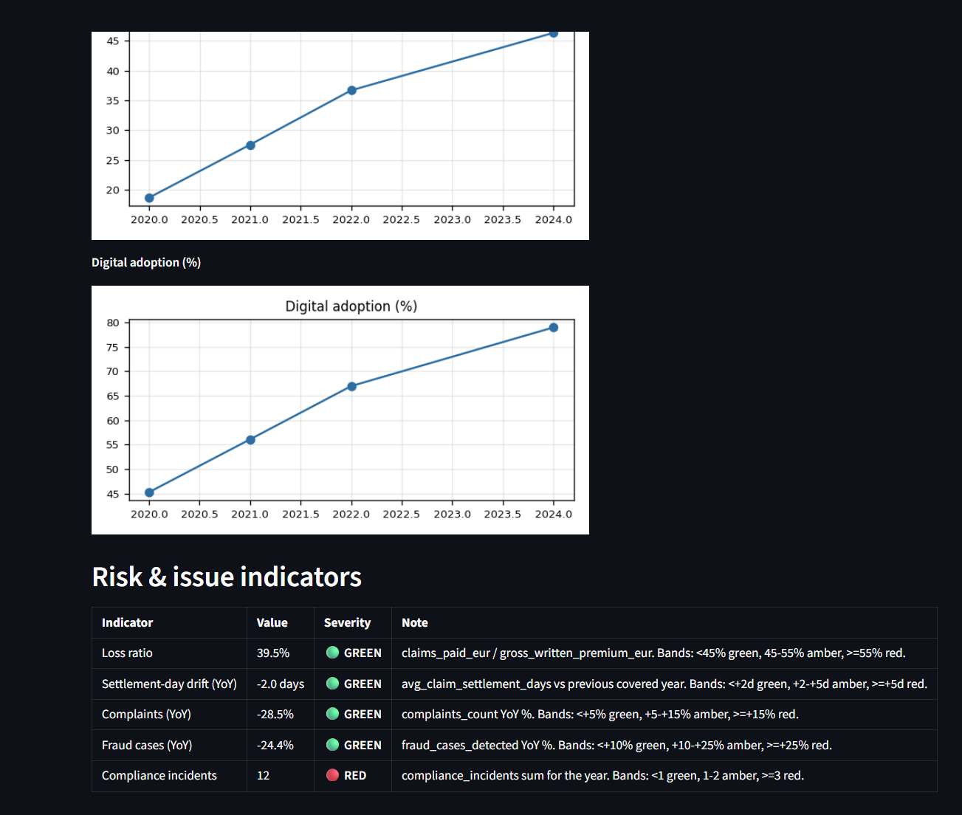
Risk indicators — deterministic bands
Severity is band lookup, never LLM-decided
🟢 Loss ratio · 🟡 Settlement drift · 🔴 Compliance incidents
All five thresholds hand-coded in `thresholds.py`
Single point of LLM-free trust in the whole report
ACME Insurances · Local RAG PoC · slide 9/16

Slide 10
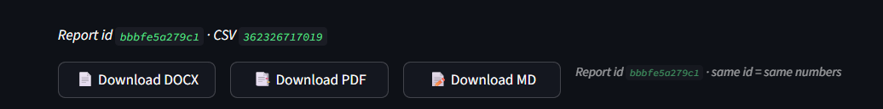
DOCX · PDF · MD downloads
Three buttons under every executive report
Same `ReportDocument` rendered to all three formats
API endpoint `GET /reports/{year}.{md|docx|pdf}` for direct downloads
Run-id caption: *"same id = same numbers"*
ACME Insurances · Local RAG PoC · slide 10/16

Slide 11
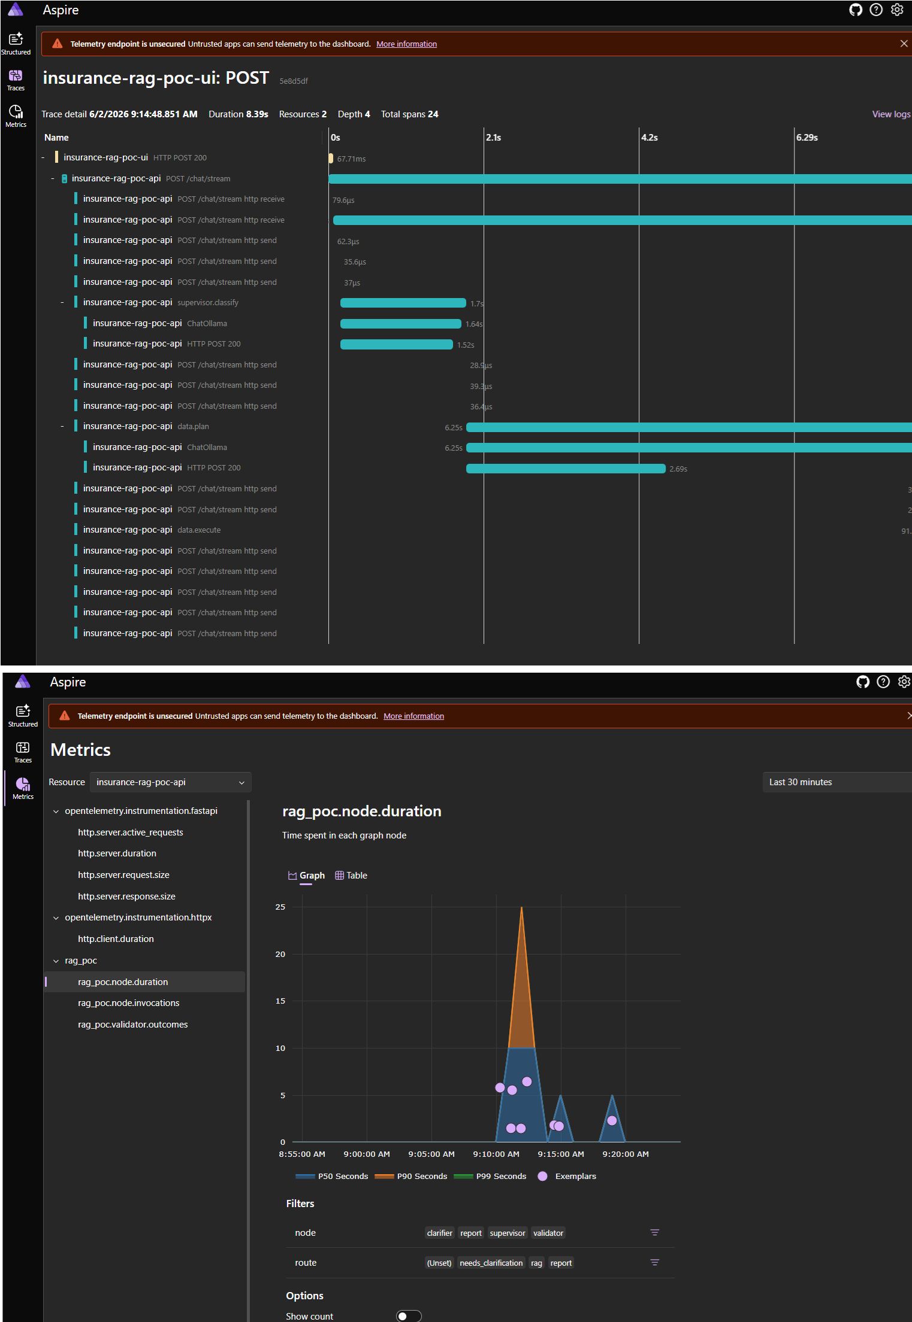
Observability — every decision in Aspire
OpenTelemetry traces, logs, and metrics out of the box
One trace per chat turn — supervisor → worker → validator
LangChain calls auto-instrumented (prompts, completions, tokens)
Custom spans per node + per sub-step (reformulate / retrieve / answer)
ACME Insurances · Local RAG PoC · slide 11/16

Slide 12
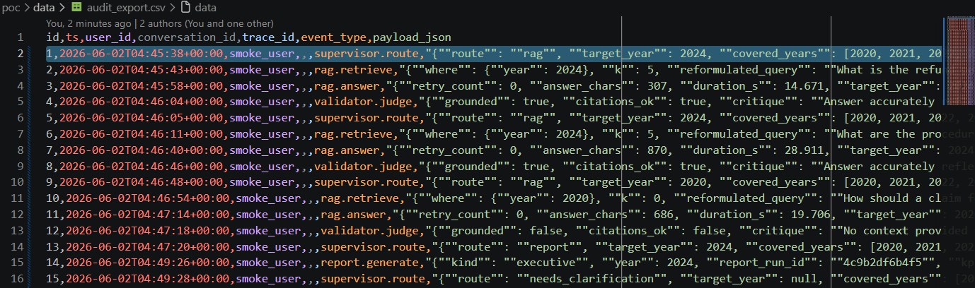
Audit trail — compliance export
Every routing / retrieval / validation / data / report decision recorded
`data/audit.sqlite` — separate from conversation memory
Each row carries the OTel `trace_id` for cross-reference
`python scripts/audit_export.py` → CSV ready for PowerBI / Splunk
*"Why did the model reason this way?"* — answerable weeks later
ACME Insurances · Local RAG PoC · slide 12/16

Slide 13
What I enjoyed building
Full open-source constraint. Zero paid LLM APIs. Every design
ran through the "does this still work on a local 7B model?" filter
Diagram-first design. Drawing the state machine before the code
shaped what got built
"View chunk" + Download PDF. Compliance plumbing disguised as UX
Chunker telemetry in Aspire. Sections, chunks kept vs skipped,
embedding spans — all visible without a separate dashboard
A real BO-grade report from a 7B model. Markdown + chart +
Operation expander — a deliberate squeeze of a small local model
into a serious deliverable shape
Three-format executive report from one source. Same typed
`ReportDocument` → Markdown / DOCX / PDF. Per-section LLM
grounding + deterministic risk bands + reproducibility hash
ACME Insurances · Local RAG PoC · slide 13/16

Slide 14
What I would do differently
Prioritise Talk-to-Data earlier — but guard it with UI affordances.
Quantitative answers are the highest-value thing the assistant can
do, and the easiest to get wrong. Surface rows + Operation alongside
every numeric answer; add quick-pick dimension chips + a metric
glossary so users are steered into well-formed questions
Use AG-UI as the front-end protocol. Streamlit was the right call
for a PoC; AG-UI brings streaming tool calls, native human-in-the-loop,
and a real component model
Azurize the model layer for production. GPT-5.1 for RAG · mini/nano
for query reformulation · GPT-5.4 / reasoning-medium for the executive
report (multi-section pipelines benefit disproportionately from a
reasoning model)
One-shot executive report as a side-by-side experiment against
the per-section pipeline. The challenge is structural stability; the
prize is dramatically lower latency and cost
ACME Insurances · Local RAG PoC · slide 14/16

Slide 15
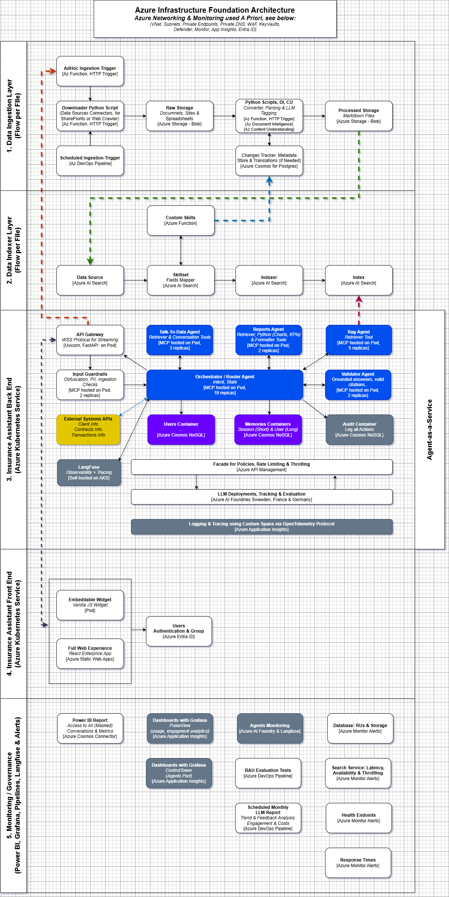
Northstar — production architecture on Azure
Where this PoC graduates to with Azurized models + cloud infra
RAG generator — GPT-5.1 for grounded answers
Query reformulator — mini / nano model for sub-second latency
Executive report narrator — GPT-5.4 / reasoning-medium (multi-section
pipelines benefit disproportionately from a reasoning model)
Vector store — Azure AI Search with hybrid retrieval
Telemetry — Azure Monitor + **Langfuse** for LLM-specific signals
Compliance — EU AI Act record-keeping via immutable Blob Storage
ACME Insurances · Local RAG PoC · slide 15/16

Slide 16
Thank you
Questions, demo requests, code review — happy to dive in.
ACME Insurances · Local RAG PoC · slide 16/16
Notes:
Closing slide. Speaker invites questions.

