Slide 1
CA Brightside Workshop
Automate Mainframe Apps with Jenkins

Slide 2
Add Table of Contents

Slide 3
Workshop Outline

Slide 4
Goals
Write automation scripts for mainframe app to build and deploy
Write automated tests for mainframe apps using open testing frameworks
Build a Jenkins CI/CD pipeline for mainframe app

Slide 5
Technical Skills
Ideal background:
Familiarity with IDEs
Familiarity with scripting
Familiarity with DevOps concepts
What skills will you gain in this workshop?
JavaScript
Jenkins config and pipelining
CLI based scripting
Db2

Slide 6
Day 1 Agenda
Accessing the workshop environment
Eclipse CHE
Jenkins
Introduction to a traditional mainframe Db2 application called “Marbles”
Learn about a simple Jenkins pipeline
Use Brightside’s CLI to implement handling of a ”Cost” column in Marbles
Create a Gulp task to perform a code build on the Mainframe
Implement a “Build” stage in Jenkins
Implement a “Deploy” stage in Jenkins
Summary of Day 1
Q&A

Slide 7
Day 2 Agenda
Review Day 1
Execute the Jenkins pipeline
Learn about automated testing concepts
Build a Jest automated test to verify a Db2 transaction
Implement “Test” stage in Jenkins
Summary of Day 2
Q&A

Slide 8
Accessing your Workshop Environment

Slide 9




Workshop Environment
Remote Desktop
Web Browser
Hosted Desktop Environment
Hosted Jenkins Instance
GitHub.com
Jenkinsfile
Build Scripts
Automated Tests
z/OS LPAR z/OSMF | Db2 Mainframe (COBOL)
File Master

Slide 10
Attendee ID
You will be assigned a two-digit attendee ID.
Write down this ID as you will need to access the proper environment in the following cases:
Eclipse CHE Workspace Name
Jenkins
GitHub repository
Cobol Source
Db2 Stored Procedure
JCL

Slide 11
Developer Environment
Open your remote desktop application
Login using URL and credentials (Note: Refer to your cheatsheet for URL and your assigned credentials)
Open command prompt
Issue “bright --h”
Issue “bright plugins list”
Issue “npm -h”
Issue “git help”
Open Visual Studio Code
Go to embedded terminal
Issue “bright --h”

Slide 12
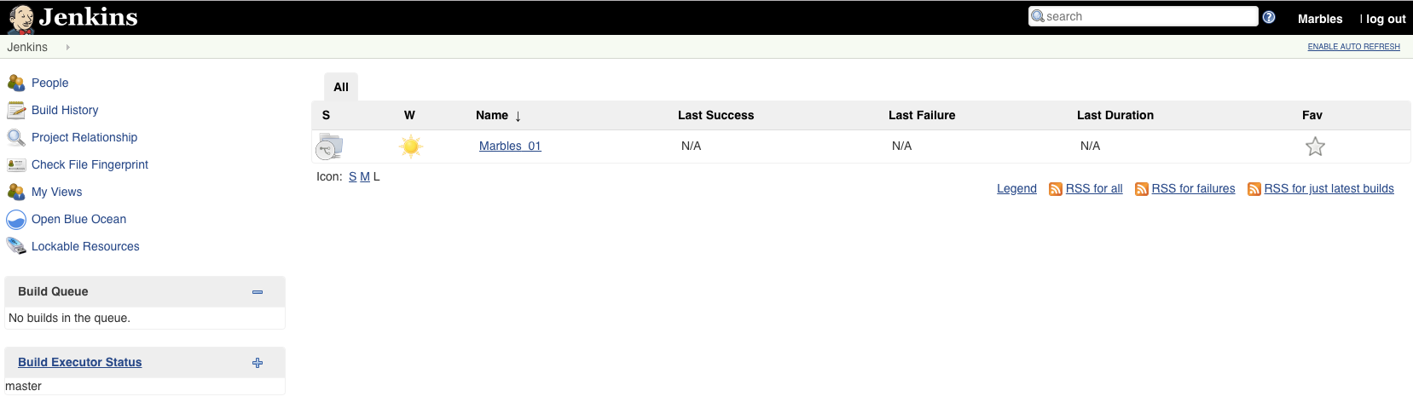
CI/CD Orchestrator - Jenkins
Open your web browser
Go to Jenkins URL provided in your cheatsheet
Login using credentials from your cheatsheet

Slide 13
z/OS Services
You have been assigned a single set of login credentials for accessing all of the Mainframe resources on a remote z/OS LPAR which is hosted by Broadcom, including TSO, z/OSMF, Db2, and CA File Master Plus.
Your userid is CUSTxxx where xxx is a 3-digit number from 001 through 030. (Example: CUST015) Each user is assigned a unique number.
Your password is the same as your userid.
z/OSMF Host:Port – 35.192.238.214:443
Db2 Host:Port - 35.192.238.214:6017
CA File Master Plus Host:Port - 35.192.238.214:6001

Slide 14
Marbles
Familiarize yourself with the Marbles application.
Go to your web browser
Access the Marbles Web GUI using this URL
Create your assigned marble color
Try adding marbles
Try changing the quantity of a marble
Try changing the cost of a marble
URL will be provided at a later time
Web GUI will not be available for this workshop
Note: At this point, attempts to change the cost of a marble should fail. This is because, the Db2 transaction being called by the web GUI does not have the ability to make changes to the cost column.

Slide 15

Marbles

Slide 16
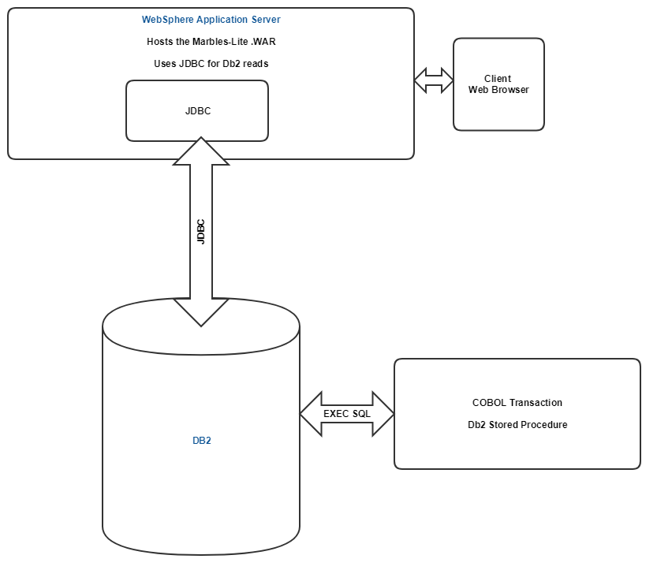
Marbles App
Notes:
Source: https://cawiki.ca.com/display/MWS/Marbles+for+Workshop

Slide 17
Demo
Notes:
Show GUI
Show Transaction invocation
Show Database state

Slide 18
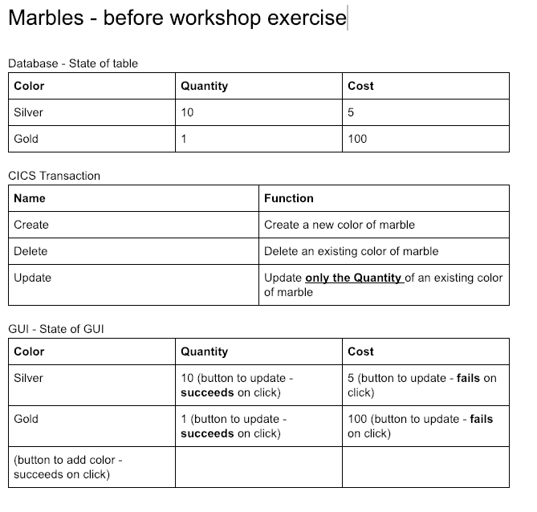
State of Marbles App – Before Workshop
Notes:
Source: https://drive.google.com/open?id=1tlSRzOTvLiS27vgZyUCSLOxyKCw0x_DxTreqNWU7k84

Slide 19
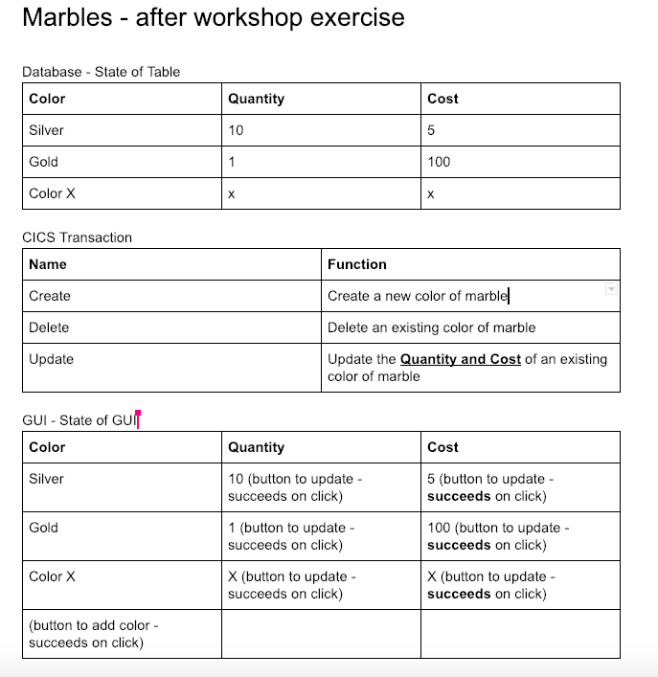
Desired State of Marbles App – After Workshop
Notes:
Source: https://drive.google.com/open?id=1tlSRzOTvLiS27vgZyUCSLOxyKCw0x_DxTreqNWU7k84

Slide 20
Current behavior of Marbles – Before Workshop
Validate the existing stored procedure and calling program
Stored Procedure
zowe db2 call sp “BRIGHT.MARBLES.DEMOA.MBBLSPXX(‘<COLOR>',?)" --parameters 0
Validate that the correct inventory count is returned for your color.
Calling Program – compiles and builds the cobol program
zowe zos-jobs submit data-set "BRIGHT.MARBLES.DEMOA.JCL(MBBLMNXX)"
OR zowe zos-jobs submit local-file "jcl/mbblmnxx.jcl"
Validate that the table is returned with the correct color, and the associated inventory count
Substitute your assigned number for “xx”.
Notes:
Source: https://drive.google.com/open?id=1tlSRzOTvLiS27vgZyUCSLOxyKCw0x_DxTreqNWU7k84

Slide 21
Desired Build and Test Process of Marbles – After Workshop
Build
Abstract Cobol COMPILE in modern task runner
Implement a ”Build” stage in Jenkins
Deploy and Activate
Abstract deployment and activation of Db2 Stored Procedure in modern task runner
Implement a “Deploy” stage in Jenkins
Test
Build an automated test to validate the Db2 Stored Procedure functions
Implement a “Test” stage in Jenkins
Notes:
Source: https://drive.google.com/open?id=1tlSRzOTvLiS27vgZyUCSLOxyKCw0x_DxTreqNWU7k84

Slide 22
Sample CI Pipeline

Slide 23
Simple Pipeline Demo
CI/CD orchestrator
Process automation scripts to perform mainframe actions
Scripts call Brightside CLI commands

Slide 24
Section I:
Enhance Marbles with the ability to display cost

Slide 25
Steps for Section I
Currently the Db2 stored procedure is able to display the quantity of a marble. We want to enhance this stored procedure to be able to display the cost of a marble in addition to its existing functionality.
Steps:
Test application
Download the COBOL source to your remote desktop from the Mainframe
Edit the code in Eclipse CHE
Upload the code to the Mainframe
Compile the code using the provided JCL
Note: all the following steps should be performed from your assigned Eclipse CHE workspace.

Slide 26
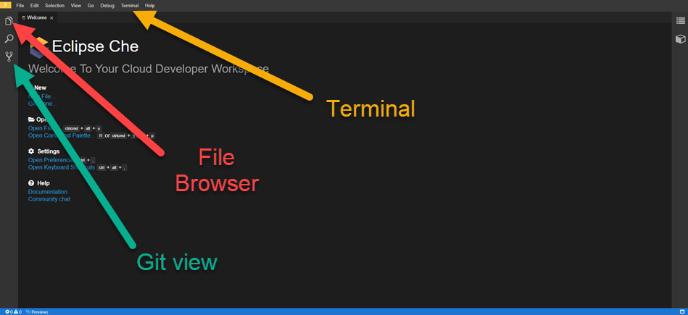
Accessing Che Environment

Slide 27
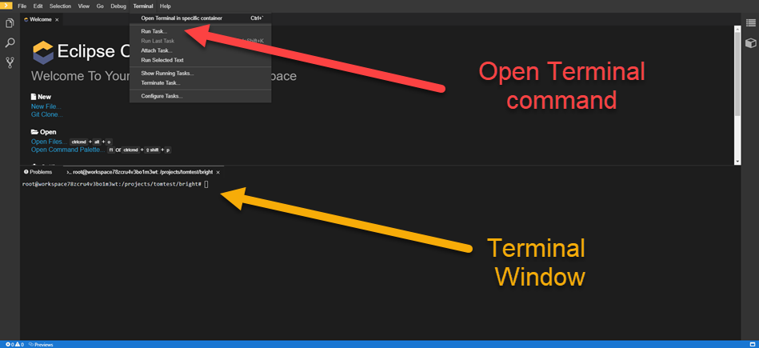
Accessing Che Environment

Slide 28
Create zOSMF profile and Db2 profile - Step 1
We will be using the zOSMF to download the source code from the mainframe. Since we’ll be issuing multiple zOSMF commands from the CLI, it’ll be handy to create a profile for zOSMF. This is not a required step as you can issue commands without profiles, but it makes life easy for us.
Create your zOSMF profile:
bright profiles create zosmf custxxx --host 35.192.238.214 --port 443 --user custxxx --password custxxx --ru false --protocol http
Create your Db2 profile:
bright profiles create db2 custxxx --host 35.192.238.214 --port 6017 –database D10CPTIB --user custxxx --password custxxx

Slide 29
List Elements available- Step 2
Before we can download the code element, we need to look at the list of elements to identify the one want to modify for to implement the cost enhancement.
Issue the List data set command: zowe zos-files list ds CUSTXXX.BRIGHT.MARBLES.*
You can also list only datasets you are interested in (XX is your assigned ID): zowe zos-files list am CUSTXXX.BRIGHT.MARBLES.COBOL
zowe zos-files list am CUSTXXX.BRIGHT.MARBLES.PARMLIB
zowe zos-files list am CUSTXXX.BRIGHT.MARBLES.JCL
Note: This command used the profile from Step 1 to communicate with the mainframe.

Slide 30
Validate current execution - Step 2
Let’s test the application to ensure it works properly.
Call a DB2 stored procedure to ensure it executes: zowe db2 call sp "EVENT.MBSTOR01('WHITE',?)" --parameters 0
Call a COBOL program to ensure it works: zowe zos-jobs submit data-set "CUSTXXX.BRIGHT.MARBLES.JCL(MBBLMNXX)"
zowe zos-jobs view jsbj JOB00XXX
zowe zos-jobs list sfbj JOB00XXX
zowe zos-jobs view sfbi JOB00XXX 118
This version will show all the output after completing:
zowe zos-jobs submit data-set "CUSTXXX.BRIGHT.MARBLES.JCL(MBBLMNXX)" --vasc

Slide 31
Download the stored prodecure from the mainframe - Step 3
Now that we’ve identified the elements we know we need to change, let’s download to our remote desktop using another command.
Note: The command below uses options provided in the command which take precedence over your default profile from Step 1. This makes the command long, but gives you the option to override your default profile.
Position your terminal to the folder where you want the file downloaded to.
Download element:
zowe files download am CUSTXXX.BRIGHT.MARBLES.PARMLIB

Slide 32
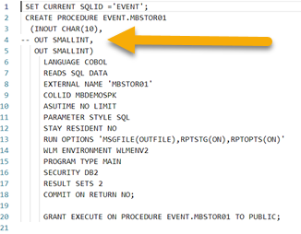
Edit the Cobol Stored Procedure in Eclipse CHE- Step 3 continued
We are now ready to make the code updates to implement the ability to change the cost of a marble using a Db2 Stored Procedure.
Open your source code using the editor
Go to line 4 and remove the two dashes:
Save the changes locally.
Push the file back to the mainframe:
zowe files upload dtp cust001\bright\marbles\parmlib cust001.bright.marbles.parmlib

Slide 33
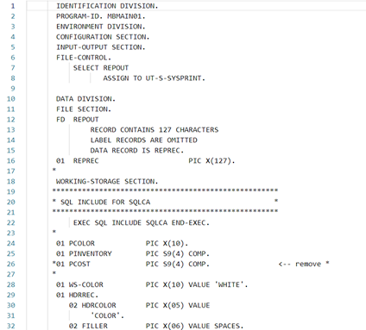
Edit the Cobol Main Program in Eclipse CHE- Step 4
Now modify the COBOL programs.
Download the elements from the PDS
zowe files … ?
Open MBMAINXX.TXT, remove all the comments and save.
Save the changes locally.

Slide 34
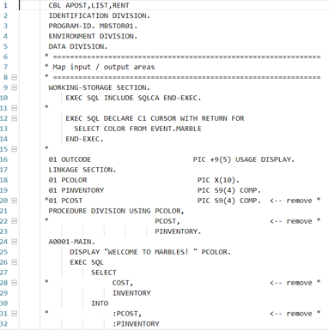
Edit the Cobol Stored Procedure in Eclipse CHE- Step 4 continued
Now modify the COBOL programs.
Open MBSTORX.txt, remove all the comments and save.
Save the changes locally.

Slide 35
Upload the elements to the mainframe - Step 5
After making the code changes locally, we need to upload the element to the mainframe in order to perform a build.
There are multiple ways to push the files back to the mainframe:
zowe files upload --help
Upload multiple elements:
zowe files upload dtp ...
Or single:
zowe files upload ftds ...

Slide 36
Compile the source element - Step 6
Now that our code changes have been uploaded to the mainframe, we can compile it using the provided JCL to see if there are any errors.
Use JCL to compile the elements. The JCL is located in the CUSTXXX.BRIGHT.MARBLES.JCL dataset.
zowe zosmf submit –h
zowe zos-jobs submit data-set "CUSTXXX.BRIGHT.MARBLES.JCL(MBBLSPXX)" --vasc
Ensure that the compile action is successful.

Slide 37
Section II:
Automate the Code Build

Slide 38
Prerequisites
In this section, you will need access to a GitHub repository, please share your workshop ID and public GitHub ID with the workshop administrator so they may add you as a collaborator to the project. If you do not have a public GitHub ID, please go to github.com and create one.

Slide 39
Automate the Code Build - Introduction
Now that you’ve used the CLI to successfully make code changes and perform compiles and bind processes, it’s time to automate these steps.
CLI commands can be embedded in scripts that you can run repeatedly from your local machine.
These same scripts can also be called from CI/CD tools like Jenkins
Task Runners are a way to organize and interact with your automation scripts more easily.
We will be using a javascript based Task Runner called Gulp for this section. Task Runners can also be called from CI/CD tools like Jenkins
Note: Task Runners are an abstraction layer over scripts. They are helpful but are not a necessity.

Slide 40
Steps for Section II
Now that you’ve used the CLI to successfully make code changes and perform generates on Endevor, it’s time to automate these steps.
Clone the git project which provides a framework for this workshop
Initialize the project
Create a build task in gulp
Review gulpfile and gulp verify-dataset task
Create build-jcl,
Create gulp build task that combines the verify-dataset-exists and build-jcl tasks
Commit and push changes to GitHub
Share results with Facilitator
Note: Gulp is a JavaScript based task runner. Other task runners like Gradle use other scripting languages like Groovy.

Slide 41
Clone the git project – Step 1
Gulp tasks are generally stored as part of a git project. You can clone a git project that already has the boilerplate code for creating gulp tasks.
Ensure you can access your provided GitHub repository at https://github.com/chipset/Zowe-Batch-Workshop-XX
From your terminal, enter the directory where you would like to clone the project.
Replace XXX with your assigned number and run git clone https://github.com/chipset/Zowe-Batch-Workshop-XX.git

Slide 42
Initialize your project – Step 2
Gulp is a NodeJS package. NPM is a package manager for NodeJS. Before you begin creating your gulp tasks, you need to initialize the gulp project locally.
Open your project folder in Visual Studio Code
Install the Gulp CLI globally: npm install gulp-cli –g
Install npm dependencies locally: npm install (Hint: The npm install command needs to be run from your project’s directory where package.json resides) The previous command installs all dependencies specified in your projects package.json
IMPORTANT NOTE: Do not perform the upgrade if recommended during the running of these commands. The security warnings are noted. If you do upgrade, it will break gulp and a downgrade will be required.

Slide 43
Create a Build task in Gulp – Step 3
Compiling the source element and the LNK element on the mainframe are steps that you’ll need to perform every time after making code changes to create the load module. It’s a great task to automate, so that you don’t have to keep doing it manually. Let’s start by reviewing our gulpfile and existing gulp verify-dataset exists task. Then you will create a task in Gulp called build-jcl.
Review gulpfile: A gulpfile is a file in your project directory titled gulpfile.js that automatically loads when you run the gulp command.
At the top of the gulpfile, take note of three packages that we are using:
gulp-help: Adds a default help task to gulp and provides the ability to add custom help messages for gulp tasks. Try issuing gulp help in the terminal at your projects directory.
gulp-sequence: Allows a series of gulp tasks to be run in order
node-cmd: Simple terminal interface that allows cli commands to be run. These commands are run asynchronously.

Slide 44
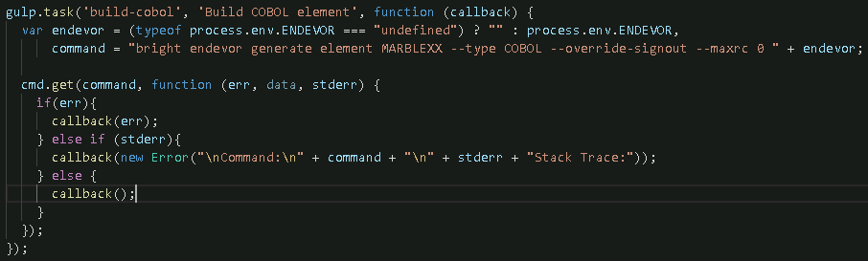
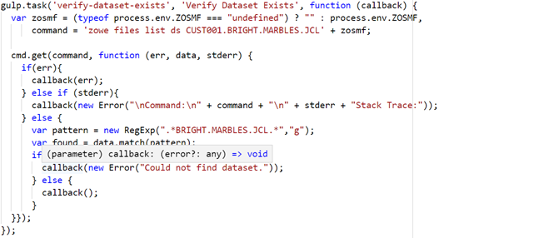
Create a Build task in Gulp – Step 3
Review verify-jcl task
Name of task: verify-dataset-exists
Description of task: Verify Dataset Exists
function (callback): function that this gulp task runs. Because node-cmd runs terminal commands asynchronously, we supply a callback which is called upon task completion.
var zosmf = … : if an environment variable named ENDEVOR is defined then assign it to zosmf; otherwise assign it an empty string. This scheme will allow for our Jenkins pipeline to run gulp tasks without requiring a profile.
command = … : command to run with zosmf variable appended.
cmd.get(command, function (err, data, stderr) {}); : runs command asynchronously; when the command is complete, all of the stdout will be passed into the supplied callback.
Finally, standard error checking is done. If successful, no error is included in the callback.

Slide 45
Create a Build task in Gulp – Step 3
Run gulp verify-dataset-exists and verify it completes successfully.
Create a build-jcl gulp task using the verify-dataset-exists gulp task as a reference.
Ensure the build-jcl task and description appear when you issue gulp help
Ensure the build-jcl task completes without error when you issue gulp build-jcl

Slide 46
Combine build tasks into single task – Step 4
Let’s take the gulp build-cobol and gulp build-lnk tasks and combine them into a single gulp task. The gulp-sequence package can help us achieve this.
Add the following gulp task to your gulpfile to combine the existing build tasks into a single gulp build task. gulp.task('build', 'Verify and Build', gulpSequence('verify-dataset-exists', 'build-jcl'));
If we wanted to run tasks in parallel we could group them inside square brackets. For example, gulp.task(‘ex', ‘example', gulpSequence([‘a',’b’],’c’,[’d’,’e’])); would run tasks a & b in parallel, then task c, then tasks d & e in parallel.
Ensure the build task and description appear when you issue gulp help
Ensure the build task runs both the verify-dataset-exists and build-jcl tasks without error when you issue gulp build

Slide 47
Commit and push changes to GitHub – Step 5
Review the files you have changed before committing: git status
There may endevor reports you wish to delete, commit or only keep locally. If you wish to only keep them locally, add endevor-report*.txt to your .gitignore file in your project’s root directory. You can run git status again to verify you no longer see the endevor-report files.
Follow the instructions git presents, if any. For example, you may need to run:
git config --global user.email “you@example.com”
git config –-global user.name “Your Name”
Commit your changes when satisfied: git commit -a –m “Add gulp build tasks”
Push your changes to GitHub: git push

Slide 48
Share the build task output with the Facilitator
Now that you’ve created and run the build task in Gulp, it’s time to share this with the facilitator.
Take a screenshot or copy the results from running your Gulp build task.
Paste it into the Slack channel for your workshop to share your results.

Slide 49
Section III:
Add Code Build to Continuous Integration

Slide 50
Continuous Integration - Introduction
Task runners help individual developers run their automation scripts easily and avoid wasting time doing mundane tasks. We can take this one step further and allow many of these tasks to be performed by CI orchestrators when code changes occur in a shared team repository.
Identify tasks that need to be performed after code changes are made at a shared level.
Create stages in CI orchestrators for these tasks
Call automated scripts from these stages
Note: In addition to automating these steps from CI, you will likely want to automate the trigger of the CI process from the shared code repository when code changes occur.

Slide 51
Steps for Section III
In our case, the build step is a common one that could be performed from CI once a code change is made in Endevor. Let’s add it to a Jenkins pipeline.
Log in to Jenkins, view MARBLES_XXX project, and verify pipeline runs.
Review Jenkinsfile
Enhance Jenkinsfile to build project
Enhance build stage in Jenkinsfile to run gulp build
Add Environment variables to supply connection and project details.
Add Credentials to Jenkins project
Manually kick off the pipeline to test
Proceed to the next page for details on Step 1

Slide 52

Log in to Jenkins – Step 1
Jenkins is a hosted application running on a web server. You can access it from most web browsers.
Log in to Jenkins: http://jenkins-104.198.149.87.nip.io Username: marbles_XXX Password: XXX_marbles (Hint: XXX is your assigned workshop number)
Verify that the environment is in the right starting state
Click on the name of your project (Marbles_XXX)
Select the master branch
Click in the left side menu and verify the project builds successfully.

Slide 53
Review Jenkinsfile – Step 2
Review and understand Jenkinsfile
A Jenkinsfile is a text file that contains the definition of a Jenkins Pipeline and is checked into source control. Using a Jenkinsfile, which is checked into source control, enables
Code review/iteration on the pipeline
Audit trail for the pipeline
Single source of truth for the pipeline
More detailed information is available at https://jenkins.io/doc/book/pipeline/jenkinsfile/

Slide 54
Review Jenkinsfile – Step 2
Reviewing the Jenkinsfile in our project’s root directory, the agent directive instructs Jenkins to allocate an executor and workspace for the pipeline. In our workshop, we use the label ca-brightside-ce-agent to instruct Jenkins to execute the tasks in a docker container that contains CA Brightside Enterprise Edition and is being pulled from Docker Hub.
Environment variables can be declared within an environment directive or with an Env step.
An environment directive in the top-level pipeline block applies to all steps within the pipeline
An environment directive within a stage will only apply those variables to that stage.
The stages directive contains various pipeline stages and the steps directive provides the tasks for each stage.

Slide 55
Enhance Jenkinsfile to build project – Step 3
Implement the Build stage by calling the Build gulp task.
Locate the build stage in your Jenkinsfile
Remove the following line of code which called a shell script which simply echoed out a statement: sh "chmod +x $BUILD && $BUILD"
Uncomment the ensuing withCredentials code block. Inside this block, we will have access to eosCreds we will define in Jenkins. We define the user environment variable to be ZOWE_OPT_USER and the password to be ZOWE_OPT_PASSWORD because CA Brightside can be influenced by environment variables. Let’s take a moment to discuss command line precedence.

Slide 56
CA Brightside Command Line Precedence
You can specify any option on any command through the use of environment variables using the prefix ZOWE_OPT_.
For example, you can specify the option --host by setting an environment variable named ZOWE_OPT_HOST to the desired value.
For more information on defining environment variables, please reference: https://docops.ca.com/ca-brightside-community-edition/1-0/en/using/define-connection-settings/define-environment-variables
When a Brightside command is run, the order of precedence for determining the option values to use is:
Command line arguments
Environment variables
Profile settings
Default values

Slide 57
Enhance Jenkinsfile to build project – Step 3
Add the following command inside the withCredentials block to instruct Jenkins to run the gulp build task you created as part of build stage: sh 'gulp build'
Recall the ZOSMF environment variable that we referenced in our gulp verify-dataset-exists and gulp build-jcl tasks to accommodate running them in profile-less environments. We want to have Jenkins manage all of our credentials and not duplicate that by storing them in a Brightside profile. Locate the environment directive towards the top of the Jenkinsfile. Remove the line that creates the BUILD environment variable and add the following code to create an ZOSMF environment variable that contains the non-sensitive connection and location information we previously used in our Brightside profiles. Please change JENKXXX to JENK and your assigned ID:
// ZOSMF Details
ZOSMF_CONNECTION="--port 443 --protocol http --reject-unauthorized false"
ZOSMF="$ZOSMF_CONNECTION $ZOSMF_LOCATION"

Slide 58



Enhance Jenkinsfile to build project – Step 3
Besides username and password, we will also be treating the hostname as sensitive. Please add the following environment variable which retrieves an eosHost credential that we will define to Jenkins: ZOWE_OPT_HOST=credentials('eosHost');
Commit your changes: git commit -a –m “Added build to Jenkinsfile”
Push your changes: git push
Now we need to add our credential in Jenkins that we referenced in our Jenkinsfile. Navigate to your project in Jenkins (not your branch, URL: http://jenkins-104.198.149.87.nip.io/job/Marbles_XXX/). Click on in the left side navigation. Now click on the Marbles_XX (e.g. ) under the “Stores scoped to Marbles_XXX” section. Now click on . Finally, click on in the left side navigation to add credentials.

Slide 59
Enhance Jenkinsfile to build project – Step 3
Add Username with password credential
Username: custxxx
Password: custxxx
ID: eosCreds
Description: Credentials to access workshop system
Add Secret text credential
Secret: 35.192.238.214
ID: eosHost
Description: Hostname for workshop system

Slide 60

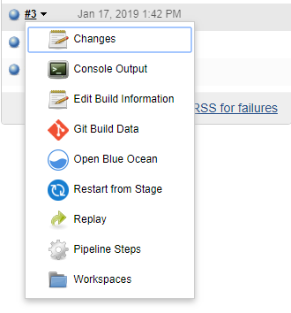

Run the pipeline – Step 3
Now that we have the build stage implemented, let’s run it again to see if it’s successful.
Return to your Jenkins project master branch
Click
Debug any issues that may arise. Reach out to facilitator for guidance if needed.
The Jenkins Blue Ocean plugin has been installed on this Jenkins machine. You can click in the left side navigation to view the pipeline in a popular UI. You can also view the console log in the build history 🡪

Slide 61
Share the build stage output with the Facilitator
Now that you’ve created and run the Build stage in Jenkins, it’s time to share this with the facilitator.
Find the URL of your successful Build stage run.
Share the URL on the Slack channel for your workshop

Slide 62
Section IV:
Add Execution/Deployment to Continuous Integration

Slide 63
Deployment - Introduction
Deployment is another step that is commonly automated. Once you’ve built your code and binary artifacts like load modules are ready, you may want to copy these artifacts to a system where you can run the program.
Identify deployment steps
Identify requirements for parametrization in deployment
Do the build artifacts come from a different location depending on whether it’s a dev build or a team build?
Does the deployment system vary depending on the stage?
Automate the deployment
Note: Deployment scripts should be written in a parameterized fashion so that the same script can be used to deploy for devtest, QA, system-test or even production.

Slide 64
Steps for Section III
Deployment for marbles requires us to copy the load modules, and activate the changes in the target CICS environment.
Deploy manually using CLI commands
Create and implement a Deploy gulp task
Create and implement a Deploy Jenkins stage

Slide 65
Manual– Step 1
When we compiled the LNK element on the mainframe in previous sections, creating load modules. We can deploy these load modules to the proper dataset location that Db2 is using.
Confirm that the load modules exists in the dataset
To do this we will make use of some core Brightside commands. Core Brightside makes interacts with the mainframe via z/OSMF. Therefore we will need to create the following z/OSMF profile to get started.
zowe profiles create zosmf pe02brs --host 35.192.238.214 --port 443 --user custXXX --pass custXXX --reject-unauthorized false
Verify the connection details you entered are correct and you can contact z/OSMF by issuing: zowe zosmf check status
We can now execute commands to ensure it works. bright files list ds “CUSTXXX.BRIGHT.*” bright files list am “CUSTXXX.BRIGHT.MARBLES.JCL”
Pro tip: These commands can be combined with standard command-line utilities which is effective for seeking specific output. For example, grep is a command-line utility used to search input for lines that match a regular expression. Try opening Git Bash (you can simply search Windows for Git Bash) and running the following command which will only return lines that match MARBLEXX. This will easily confirm that your MARBLE entry is present: bright files list am “CUSTXXX.BRIGHT.MARBLES.JCL” | grep MBBLSP

Slide 66
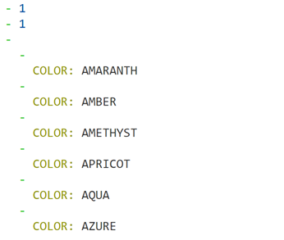
Manual – Step 1
Verify the db2 command works as expected
Zowe db2 call sp “EVENT.MBSTOR01(‘WHITE’,?,?)” --parameters 0 0
Output should look similar to:

Slide 67

Manual – Step 1
Verify cobol commands run as expected
zowe jobs submit data-set “CUSTXXX.BRIGHT.MARBLES.JCL(MBBLMNXX)” --view-all-spool-content
Alternative approach
zowe jobs submit data-set “CUSTXXX.BRIGHT.MARBLES.JCL(MBBLMNXX)”
Example returned jobid: JOBXXXXX
zowe jobs view job-status-by-jobid JOBXXXXX
Zowe jobs view sfbi JOBXXXX 118

Slide 68
Create and implement a Deploy gulp task – Step 2
Similar to creating the gulp build tasks, we will now create gulp tasks to deploy our changes.
Create verify-cobol task to verify the cobol code executes
Create verify-jcl task to verify the JCL code executes
Combine individual deploy tasks into one verify task.
Commit and push code to GitHub.

Slide 69
Create and implement a Deploy gulp task – Step 2
Create verify-jcl task to copy the verify the JCL works.
Using the gulp build tasks as a reference, try constructing a gulp task called verify-jcl
Be sure to account for the implementation of the DB2 ENV var. Jenkins will make use of this feature so a profile will not need to be created.
Ensure your task appears when issuing gulp help
Ensure your task completes without error
Create verify-cobol task to verify the COBOL works.
Be sure account for the implementation of some ZOSMF ENV var. Jenkins will make use of this feature so a profile will not need to be created.
Ensure your task appears when issuing gulp help
Ensure your task completes without error

Slide 70
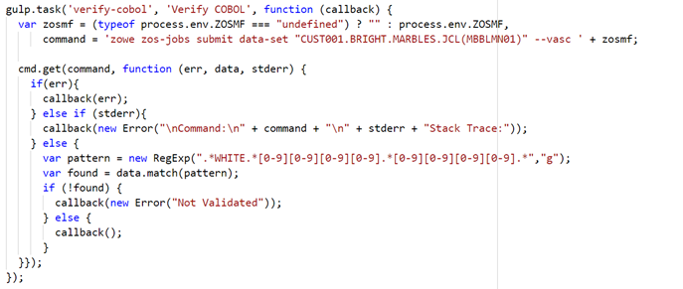
Create and implement a Deploy gulp task – Step 2
Sample verify-cobol task to submit job

Slide 71
Create and implement a Deploy gulp task – Step 2
Combine the tasks into a single verify task using gulpSequence.
Using the task you created to combine the verify-dataset-exists and build-jcl tasks into a single build task as a reference, combine the following tasks into a single verify task that will deploy the program:
verify-cobol
verify-jcl
Ensure your task appears when issuing gulp help
Ensure your task completes without error
Commit and push code to GitHub

Slide 72
Create and implement a Deploy Jenkins stage – Step 3
Similar to implementing the Build stage, we will now implement the Deploy stage in Jenkins.
Implement Deploy stage
Commit and Push Code to GitHub
Log in to Jenkins and build your project

Slide 73
Create and implement a Deploy Jenkins stage – Step 3
Implement Deploy stage
Remove the call to the Deploy script and the DEPLOY ENV var under the environment directive.
Uncomment withCredentials block
Call the gulp verify task that you created. This will need placed inside the inner withCredentials block. The FMP plugin currently uses --pass instead of --password, which requires us to use multiple variables.
Add the z/OSMF Connection Details using the appropriately named (ZOWE_OPT_) ENV vars:
// z/OSMF Connection Details
ZOWE_OPT_PORT="443"
ZOWE_OPT_REJECT_UNAUTHORIZED=false
Note: Plugins also inherit the ZOWE_OPT_ vars, but can be overridden on the command line.

Slide 74
Create and implement a Deploy Jenkins stage – Step 3
Commit and Push Code to GitHub
Log in to Jenkins and build your project
Debug any issues that may arise. Reach out to facilitator for guidance if needed.

Slide 75
Share the Deploy stage output with the Facilitator
Now that you’ve created and run the pipeline in Jenkins with the Deploy stage, it’s time to share this with the facilitator.
Find the URL of your successful run with the Deploy stage.
Share the URL on the Slack channel for your workshop

Slide 76
Day 1 Summary

Slide 77
Day 1 Summary
Congratulations on completing Day 1 of the CA Brightside workshop. You learned about the following topics today:
Using CLI to interact with services on the mainframe
Building Gulp scripts to automate common mainframe actions for the individual developer
Building Jenkins stages to automate common mainframe actions for a team of developers.
Build and Deployment are common actions that are automated in CI/CD

Slide 78
Day 1 Review

Slide 79
Day 1 Review
Congratulations on completing Day 1 of the CA Brightside workshop. You learned about the following topics today:
Using CLI to interact with services on the mainframe
Building Gulp scripts to automate common mainframe actions for the individual developer
Building Jenkins stages to automate common mainframe actions for a team of developers.
Build and Deployment are common actions that are automated in CI/CD

Slide 80
Day 2 Agenda

Slide 81
Day 2 Agenda
Execute the Jenkins pipeline
Learn about automated testing concepts
Build a Mocha automated test to verify a CICS transaction
Implement “Test” stage in Jenkins
Test Marbles GUI with new enhancement
Summary of Day 2
Q&A

Slide 82
Section V:
Run the Continuous Integration Pipeline

Slide 83
Run the pipeline – Step 1
We’ve now implemented two stages in Jenkins – Build and Deploy. As a checkpoint, let’s manually run the pipeline and verify that it still runs successfully.
Log in to Jenkins and build your project
Debug any issues that may arise. Reach out to facilitator for guidance if needed.

Slide 84
Share the Deploy stage output with the Facilitator
Now that you’ve created and run the pipeline in Jenkins with the Deploy stage, it’s time to share this with the facilitator.
Find the URL of your successful run with the Deploy stage.
Share the URL on the Slack channel for your workshop

Slide 85
Section VI:
Automated Testing

Slide 86
What is automated testing?
Applications behave in an expected manner. When making code changes, it’s common for developers to test the expected behavior many times. This can be time consuming and boring. Developers started to write scripts that automate these repetitive tests so that they can stay focused on writing more code.
Different types of automated testing
Unit Tests
Integration Tests
System Tests
Performance Tests

Slide 87
Types of Automated Tests
Unit Tests
Front-end code (JavaScript)
Web code (Java)
Back-end code (COBOL / CICS)
Integration Tests
UI
Web Server
Db2
System Tests
Performance Tests

Slide 88
Automating Tests
Automating tests comes down to two choices:
Write scripts in your language of choice and manage them manually.
Choose a scripting framework that suits your needs and skills.
Popular testing frameworks:
Mocha
Robot
Jest
Jasmine
JMeter

Slide 89
Section VII:
Automate Testing of a Db2 Stored Procedure

Slide 90
Db2 Manual Test
Manually test your deployed program to ensure the MABRLE was successfully created.
Recall that you previously issued the following command to ensure your program was successfully updated and deployed: zowe db2 call sp “CUSTXXX.BRIGHT.MARBLES.MBBLSPXX(‘<COLOR>',?, ?)" --parameters 0 0
Validate that the correct inventory count is returned for your color.
Calling Program – compiles and builds the cobol program
zowe zos-jobs submit data-set "CUSTXXX.BRIGHT.MARBLES.JCL(MBBLMNXX)"
Validate that the table is returned with the correct color, and the associated inventory count
Substitute your assigned number for “xx”.
Now we will run a batch job that submits sql to gather the contents of the table of Marbles so that we can verify our marble was successfully created with the appropriate quantity and cost.
Use Brightside to submit “CUSTXXX.BRIGHT.MARBLES.JCL(MBBLSPXX)” and get the jobID
Use Brightside to view the status of the job to ensure that it has completed
Use Brightside to list the spool files of the job
Use Brightside to view the spool file that contains the table of Marbles
Ensure that your Marble is in the table with the expected quantity and cost.

Slide 91
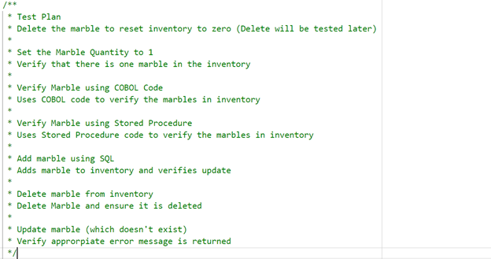
Db2 Test Scenario
A framework has been provided that tests that the quantity of marbles in inventory is manipulated appropriately. We will be updating the test plan to account for the cost being updated appropriately as well. The current test plan is as follows:

Slide 92
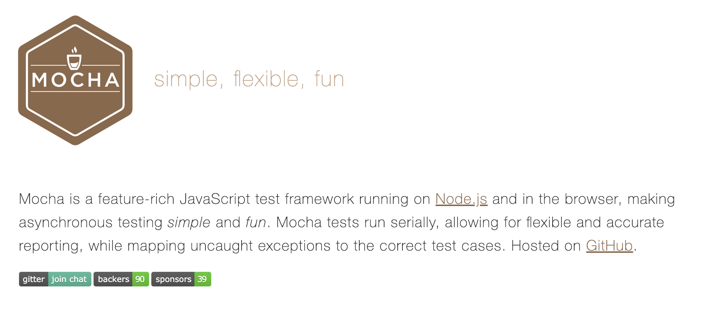
MochaJS

Slide 93
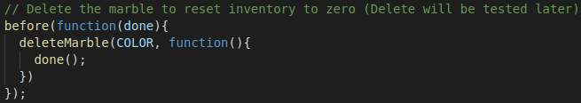
Initialize and Review Project – Step 1
The project was initialized when you ran the npm install command to initialize gulp earlier in the workshop.
All tests for this workshop are located in test/test.js.
In test.js find . This is our initial suite of inventory manipulation tests.
The following snippet simply ensures the marble inventory for our color is reset to zero before we begin testing.

Slide 94
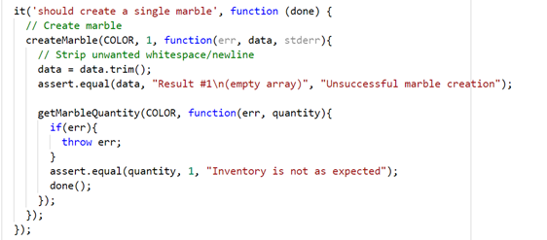
Initialize and Review Project – Step 1
The following snippet shows the first test. Within the test, a marble is created and the contents of the database are verified, and the tests asserts that 1 marble of the specified color is in the inventory.

Slide 95
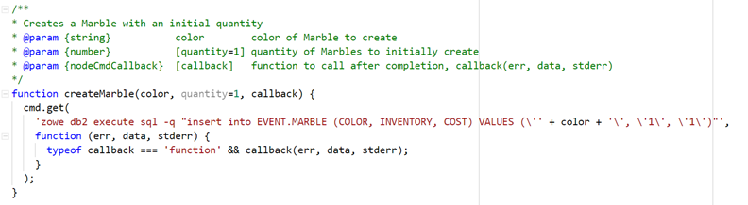
Initialize and Review Project – Step 1
The createMarble function issues a bright db2 execute sql command to execute a sql statement to create a marble of a specified color with an initial specified inventory. If the initial inventory is not specified, the function defaults it to 1. Once the command completes, it will call an optional callback.

Slide 96
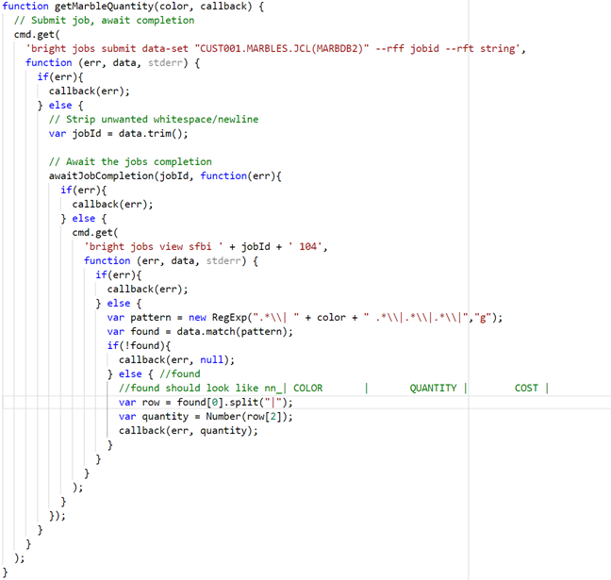
Initialize and Review Project – Step 1
The getMarbleQuantity function submits a job the runs SQL to retrieve the contents of the Marbles table. It waits for the job to complete and then retrieves the spool file of interest (which has an id of 104). It then parses the spool file for a regular expression that represents the row of output in the Marbles table that contains the designated color. Rows have a specific structure where columns are separated by “|”. Finally, a callback is made upon completion and the quantity is returned as a parameter.

Slide 97

Initialize and Review Project – Step 1
You could run the existing mocha tests and produce a report by issuing mocha --reporter mochawesome. However, if you look in your package.json at your project’s root, you will see: This demonstrates how to set up a test script. This test script can then be run with the npm test from your terminal at your project’s root.
Run the tests and verify they all pass. Work with the facilitator should any issues arise.

Slide 98
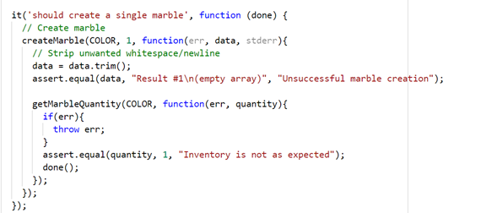
Implement Test – Step 2
Now that we have ensured all the existing tests for marble inventory manipulation pass, let’s adjust the test case for creating a single marble so that it creates a single marble with a cost of 1.
First, locate the following test and update the title from ‘should create a single marble’ to ‘should create a single marble with a cost of 1’
Change the createMarble function call to createMarble(COLOR, 1, 1, … Also, adjust the createMarble function call in the test case titled: should not create a marble of a color that already exists Next, we will update the createMarble function to accept a cost parameter.

Slide 99
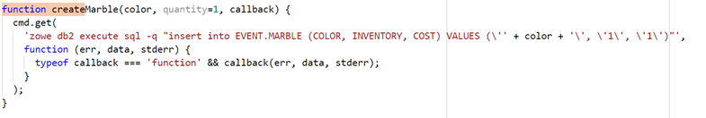
Implement Test – Step 2
Locate the following function:
Add another number parameter after quantity called cost with a default value of 1. (Use the quantity parameter as a reference).
Adjust the zoew command being issued to include another space and the cost. Next, we will update our function that retrieves the quantity of marbles of a specific color to also retrieve the cost.

Slide 100
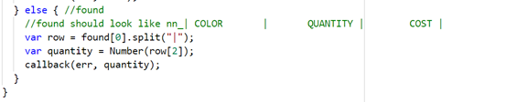

Implement Test – Step 2
Locate the getMarbleQuantity function. We are most interested in the following snippet:
row is an array of column values where column 0 is some numeric value follows by an underscore, column 1 is the color, column 3 is the quantity and column 2 is the cost. Please add another line under var quantity… to retrieve the cost and pass it back as a third argument in the callback. You should create something like:

Slide 101

Implement Test – Step 2
To keep are callback documentation up to date, locate the following:
Update the documentation with a param of type number named cost. Use the quantity param as a reference.

Slide 102
Implement Test – Step 2
Relocate the test we are updating. Finally, add the cost parameter to your getMarbleQuantity callback function and assert that cost is equal to 1. A finished updated test is shown on the next slide.

Slide 103
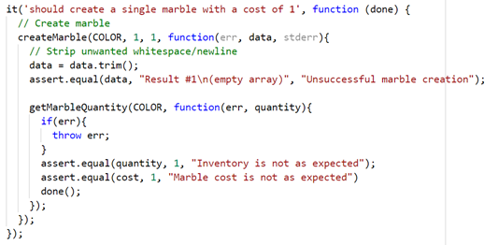
Implement Test – Step 2

Slide 104
Run Test – Step 3
Run npm test verify the tests all pass. Work with the facilitator should any issues arise.
A report of your test has been generated. Open the following file from your project’s root to view: mochawesome-report/mochawesome.html

Slide 105
Share the Automated Test run with the Facilitator
Now that you’ve created and run your Db2 Stored Procedure automated test, it’s time to share this with the facilitator.
Take a screenshot or copy the results from the result of your test run.
Paste it into the Slack channel for your workshop to share your results.

Slide 106
Section IX:
Add Automated Testing to Continuous Integration

Slide 107
Testing Step in CI - Introduction
Testing is another step that is commonly automated. Once you’ve built up a suite of automated tests, you may want to integrate them into your CI process. Running these tests on every CI run is crucial as passing tests increase your confidence in the code changes and the automation.
Identify set of tests that are worth running in every CI run. You may want to avoid time-consuming performance tests for a stage further down the pipeline such as before deploying to production. All of the tests invoked by npm test are system tests that we want to include.
Create a stage in Jenkins to invoke these tests after code is checked in, built and deployed.
Note: Consider exploring code coverage tools to obtain metrics of code that is tested by your automated tests.

Slide 108
Create Test stage – Step 1
We’ve already built an automated test using Mocha. Let’s implement a test stage in Jenkins to call it.
Remove the call to the Test script and the TEST ENV var under the environment directive.
Uncomment withCredentials block in the ‘test’ stage
Call the npm test command that runs your test suite.

Slide 109
Run pipeline – Step 3
After adding the Test stage, test out the pipeline by pushing your changes and running it manually.
Commit and Push Code to GitHub
Log in to Jenkins and build your project
Debug any issues that may arise. Reach out to facilitator for guidance if needed.

Slide 110
Share the Test stage output with the Facilitator
Now that you’ve created and run the pipeline in Jenkins with the Test stage, it’s time to share this with the facilitator.
Find the URL of your successful run with the Test stage.
Share the URL on the Slack channel for your workshop

Slide 111
Section X (optional):
Archive Artifacts in Jenkins

Slide 112
Archive Artifacts
For audit purposes, you may want to archive build/test results for each pipeline run.
Uncomment the post section of the Jenkinsfile
Commit and Push Code to GitHub
Log in to Jenkins and build your project
Debug any issues that may arise. Reach out to facilitator for guidance if needed.
In the Blue Ocean view, click the Artifacts tab in the upper right to view the archived artifacts for a specific run

Slide 113
Section XI:
Marbles End-to-End Test

Slide 114
Test Drive Marbles
We’ve successfully enhanced the Db@ Stored Procedure to handle requests to update the cost column. Let’s test it out from the Web GUI.
From a browser, access the marbles web GUI.
Try updating the cost of your assigned marble.
Verify that it succeeds.

Slide 115
Test Drive the automation
Marbles is working now with cost! However, the marbles sales team has decided that the change is no longer needed as cost of marbles are being standardized regardless of color.
Re-download your assigned transaction code from Endevor.
Comment out the line that enabled handling of cost.
Upload the element to Endevor.
Run your Jenkins pipeline.

Slide 116
Day 2 Summary

Slide 117
Day 2 Summary
Congratulations on completing Day 2 of the CA Brightside workshop. You learned about the following topics today:
Automating testing concepts.
Using Mocha to built an integration test for a Db2 Stored Procedure.
Implementing a Test stage in Jenkins to call automated tests
Making code changes and enjoying your automated build, deploy and test process.

Slide 118
Thank You

