Slide 1
8-bit Arithmetic Logic Unit
Proiect — Calculatoare Numerice
Ștefănescu Alexandru Ștefan | Varga Andreea Florina
Trifuț Alexandra Rebecca | Șulan Stanko

Slide 2
1. Project Overview and Objectives
Proiectarea si implementarea unui ALU pe 8 biti capabil sa execute adunare, scadere, inmultire (Booth Radix-2) si impartire (Restoring Division), coordonat de o unitate de control FSM implementata structural in Verilog.
F
S
V
P
Functionalitate
Structura
Validare
Performanta
Implementarea corecta a operatiilor aritmetice cu circuite logice eficiente
Ierarhie clara — module separate pentru fiecare operatie si modul de control
Testbench complet pentru verificarea rezultatelor si generare waveforms
Timp de propagare minim si utilizare eficienta a resurselor hardware

Slide 3
2. Architecture — Module Principale
Datapath — Stocare si Deplasare
Blocuri Aritmetice si Control
Reg A — Accumulator 8-bit
Full Adder 1-bit (structural)
Reg B — Operand B 8-bit
Adder/Subtractor 8b — 8x FA + XOR
Reg M — Multiplicand/Divisor
MUX 2:1 x 8bit — ASU.A si Mux B
Reg Q — Multiplier/Dividend
ASU Mux — selectie ADD/SUB
Q-1 FF — 1-bit flip-flop
Booth Mult — Booth Radix-2
DSR Shift Logic — Arith. Shift Right
Restoring Div — Restoring Division
Counter 3-bit — 8 iteratii
Control Unit — FSM 6 stari

Slide 4
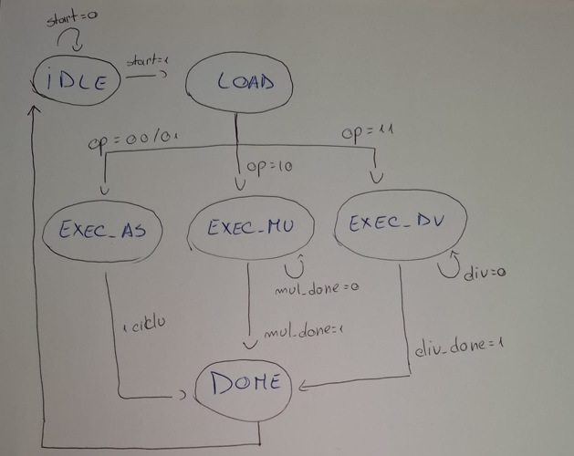
2.3 FSM — Control Unit

Slide 5
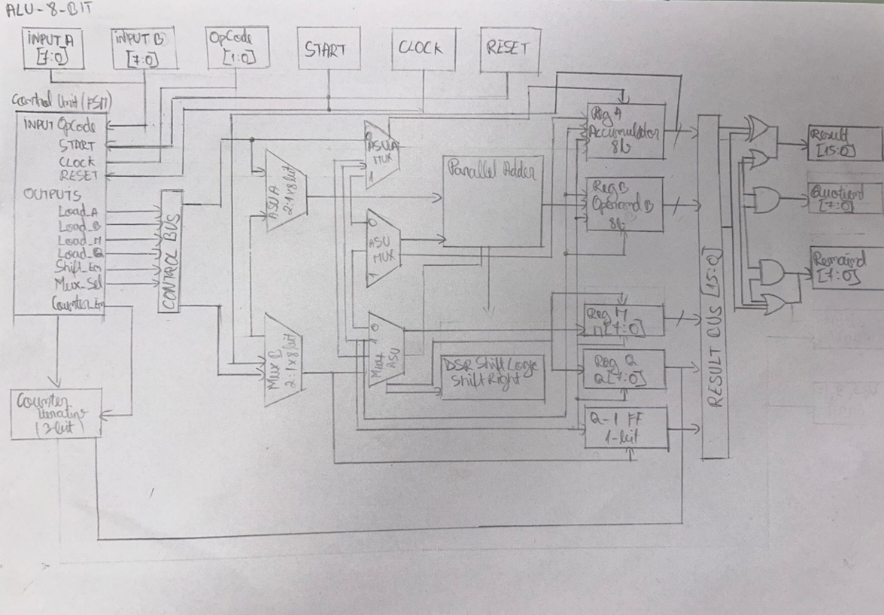
2.4 Diagrama Hardware

Slide 6
3. Algorithm Functionalities
Booth Radix-2 — Inmultire
Restoring Division — Impartire
1. Initializare: A=0, M=multiplicand, Q=multiplier, Q[-1]=0
1. Initializare: A=0, Q=dividend, M=divisor
2. Evalueaza {Q[0], Q[-1]}:
2. Shift stanga {A, Q} cu 1 bit
01 → A = A + M
3. A_new = A - M
10 → A = A - M
4. Daca A_new >= 0: A=A_new, Q[0]=1
00/11 → nicio operatie
5. Daca A_new < 0: restore A, Q[0]=0
3. Arithmetic Shift Right {A, Q, Q[-1]}
6. Repeta 8 iteratii
4. Repeta 8 iteratii
7. Q = Cat, A = Rest
5. Rezultat 16-bit = {A[7:0], Q[7:0]}
8. div_by_zero daca M=0

Slide 7
4. HDL Implementation — Module Verilog
Fisier
Descriere
full_adder.v
Full Adder 1-bit (XOR, AND, OR)
adder_subtractor_8b.v
8x FA + XOR pentru SUB
mux_2to1_8b.v
Multiplexor 2:1 pe 8 biti
asu_mux.v
Selectie ADD/SUB (ASU Mux)
reg_8b.v / reg_1b.v
Registre 8-bit si 1-bit
dsr_shift.v
Arithmetic Shift Right A:Q
counter_3b.v
Counter 3-bit (8 iteratii)
booth_mult.v
Inmultire Booth Radix-2
restoring_div.v
Impartire Restoring Division
control_unit.v
FSM Control Unit — 6 stari
alu_8bit.v
Top-Level — integreaza totul
tb_alu_8bit.v
Testbench — 14 teste

Slide 8
4.2 OpCodes & Ierarhia Modulelor
OpCodes
Ierarhia Modulelor
00
Adunare (ADD)
alu_8bit (Top-Level)
01
Scadere (SUB)
control_unit — FSM 6 stari
10
Inmultire — Booth Radix-2
mux_2to1_8b (x2) — ASU.A Mux, Mux B
11
Impartire — Restoring Division
asu_mux — selectie ADD/SUB
adder_subtractor_8b — 8x full_adder
reg_8b (x2) — Reg A, Reg B
booth_mult — Booth Radix-2
restoring_div — Restoring Division

Slide 9
5. Testing and Simulation Results
14 PASS / 0 FAIL
Op
Test
Rezultat (hex)
Status
Waveforms vizualizate in GTKWave — fisier tb_alu_8bit.vcd
ADD
15+27=42
002A
PASS
ADD
0+0=0
0000
PASS
ADD
100+55=155
009B
PASS
SUB
50-20=30
001E
PASS
SUB
10-10=0
0000
PASS
SUB
10-30=-20
FFE6
PASS
MUL
6x7=42
002A
PASS
MUL
0x255=0
0000
PASS
MUL
-4x3=-12
FFF4
PASS
MUL
15x15=225
00E1
PASS
DIV
42/6=7 r0
Q=07
PASS
DIV
17/5=3 r2
Q=03
PASS
DIV
100/10=10
Q=0A
PASS
DIV
10/0
div_by_zero=1
PASS

Slide 10
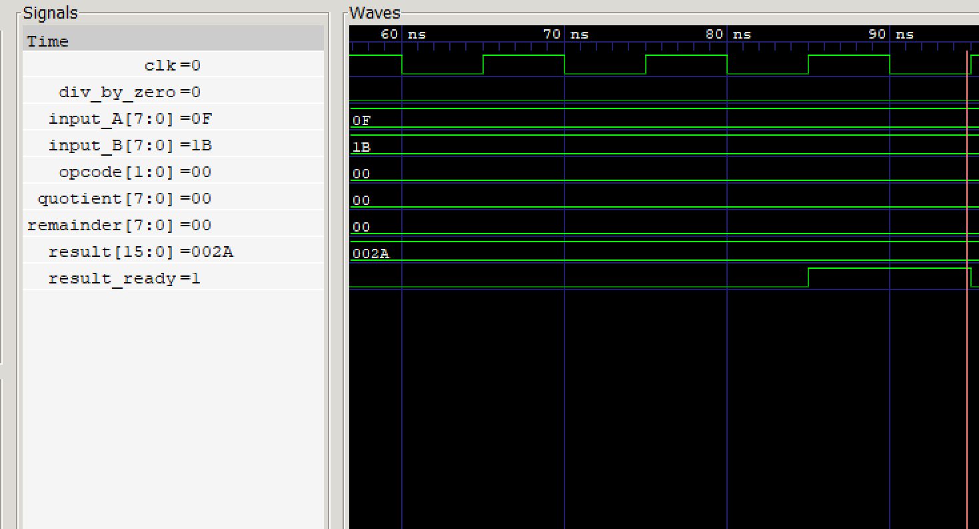
5. Testing and Simulation Results
ADUNARE

Slide 11
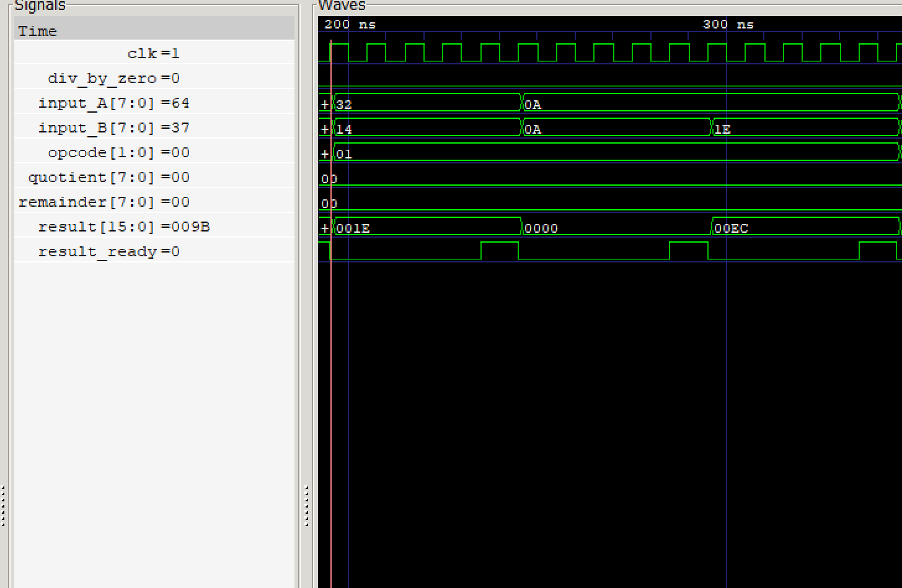
5. Testing and Simulation Results
SCADERE

Slide 12
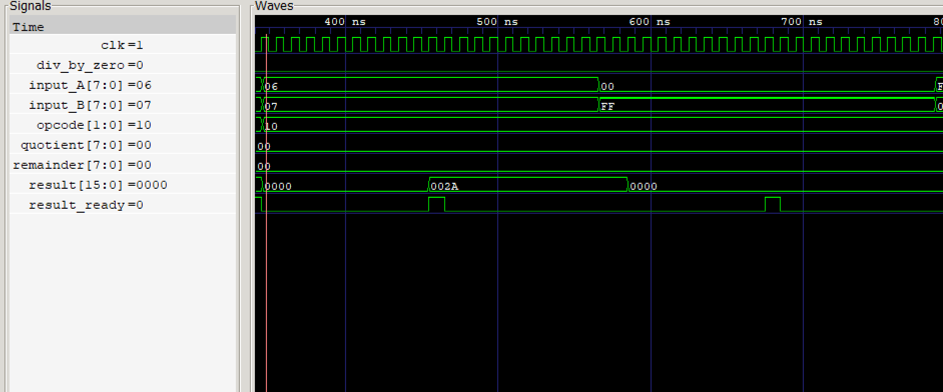
5. Testing and Simulation Results
INMULTIRE

Slide 13
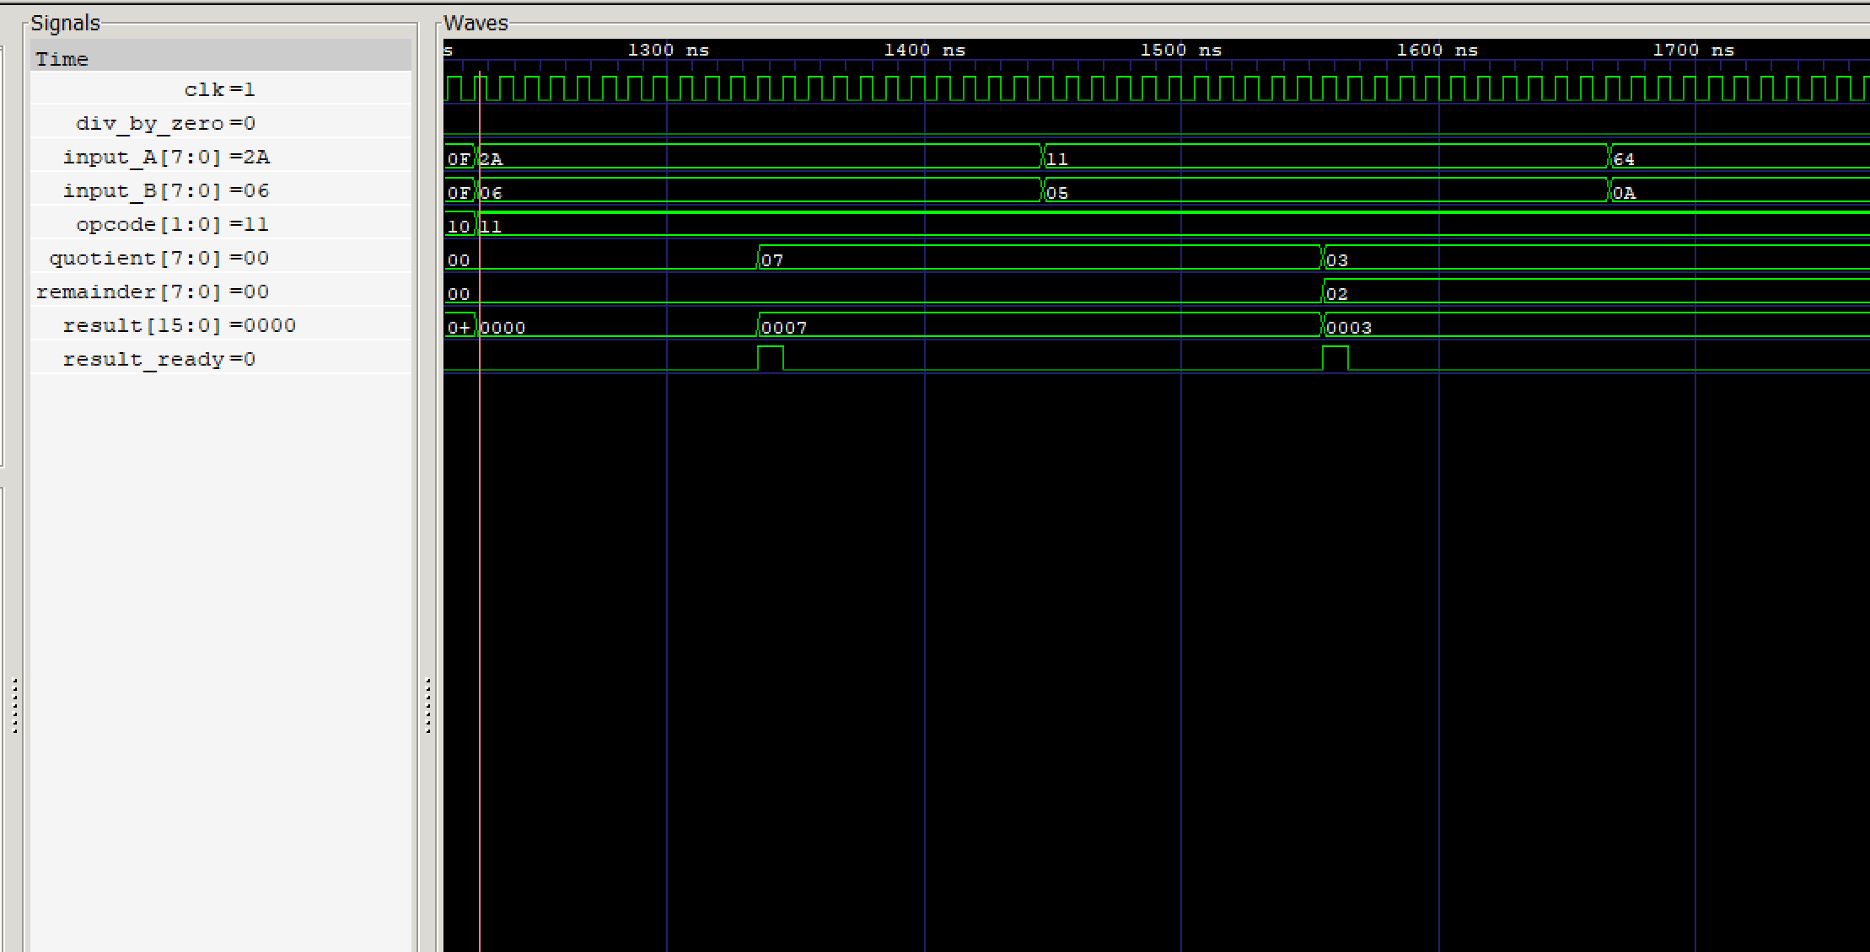
5. Testing and Simulation Results
IMPARTIRE

Slide 14
6. Bibliografie si Tool-uri
Bibliografie
Tool-uri folosite
Oprițoiu Flavius (2026) — Arhitectura Calculatoarelor, Universitatea Politehnica
Icarus Verilog (iverilog) — compilare si simulare cod Verilog
Patterson, D., Hennessy, J. — Computer Organization and Design
GTKWave — vizualizare waveforms (.vcd)
Weste, N., Harris, D. — CMOS VLSI Design
Visual Studio Code — editare cod HDL
ALU 8-bit • Arhitectura Calculatoarelor • 2025-2026

