Slide 1


Slide 2
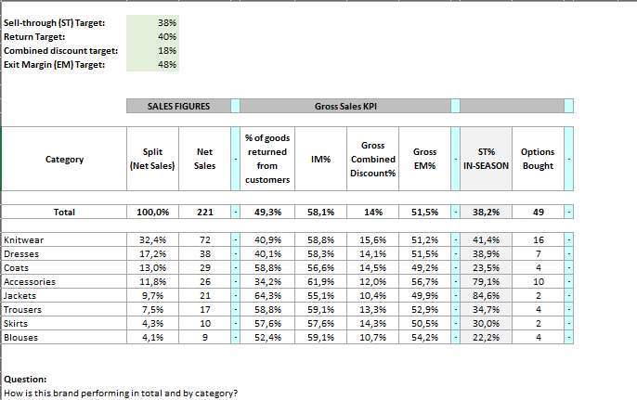
Provided dataset

Slide 3
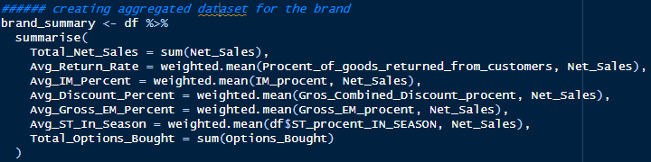
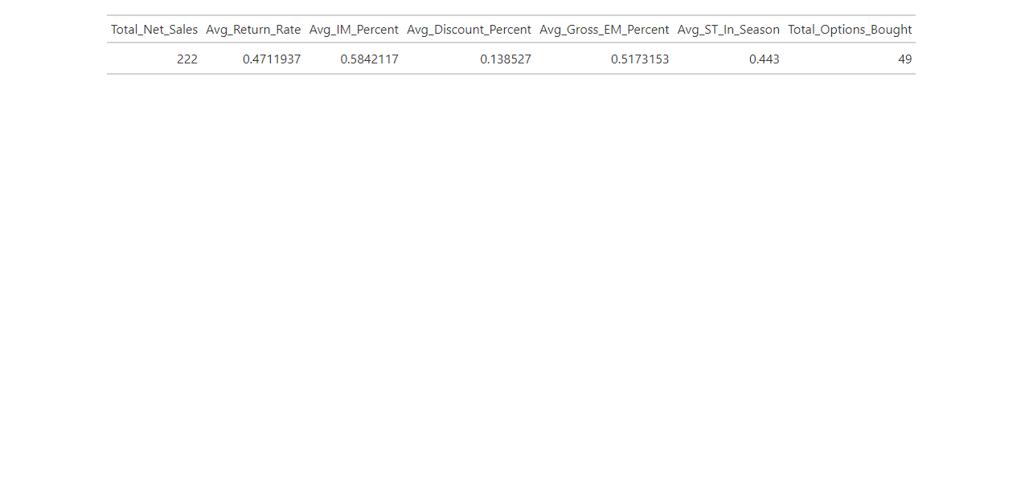
How is this brand performing in total?
Discrepancies were displayed in net sale orignaly (n=221). After controlling this output total net sales accounted for (n=222) items. ST_in_seasone also displayed an inaccurate number. This discrepancy necessitated a recalibration of all previously provided metrics to ensure accuracy.
To account for the observed imbalance in the dataset, I employed a weighted mean for the calculations. This approach allows a more accurate representation of the impact of each data point. The final table displays the adjusted values for the brand’s overall performance.
Key metrics for the brand.
Total Units Sold: The brand has recorded sales of 222 units. This figure represents the gross sales prior to adjustments for any returns or discounts.
Return Rate: Approximately 47% of sold products are returned by customers. The high return rate may be attributed to factors such as product fit, quality, or unmet customer expectations. We recommend conducting an in-depth analysis to identify the primary causes and mitigate their impact on profitability.
Discounting Strategy: The average discount offered by the brand stands at 13.8%. Should revenue performance be below expectations, it is advisable to evaluate the discount strategy and consider introducing alternative discount ranges.
Gross Margin: The brand maintains a robust gross margin of 51.7%.
In-Season Sales Rate: 44.3% of items are sold within their respective seasons, which is designated as 'ST_in_Season'. Given this metric, it may be prudent to reevaluate the production volume. Reducing the amount of product manufactured is advisable unless other metrics indicate a different strategy would be more beneficial."
 | SALES FIGURES |  |  | Gross Sales KPI
Category | Split (Net Sales) | Net Sales | - | % of goods returned from customers | IM% | Gross Combined Discount% | Gross EM% | - | ST% IN-SEASON | Options Bought
Total | 100,0% | 221 | - | 49,3% | 58,1% | 14% | 51,5% | - | 38,2% | 49

Slide 4
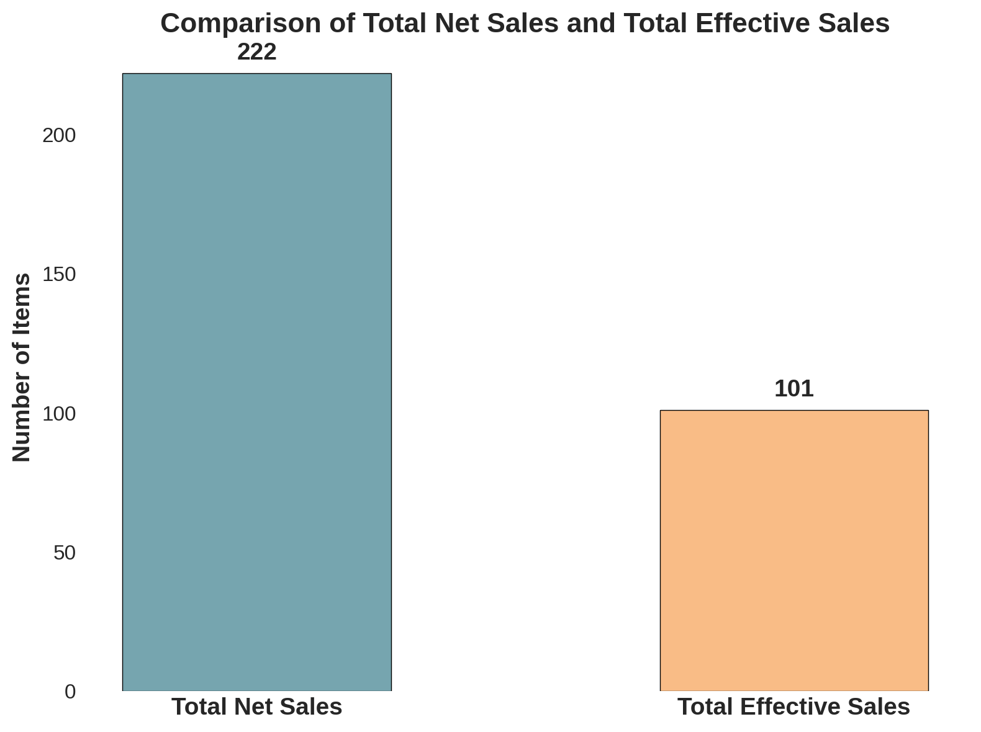
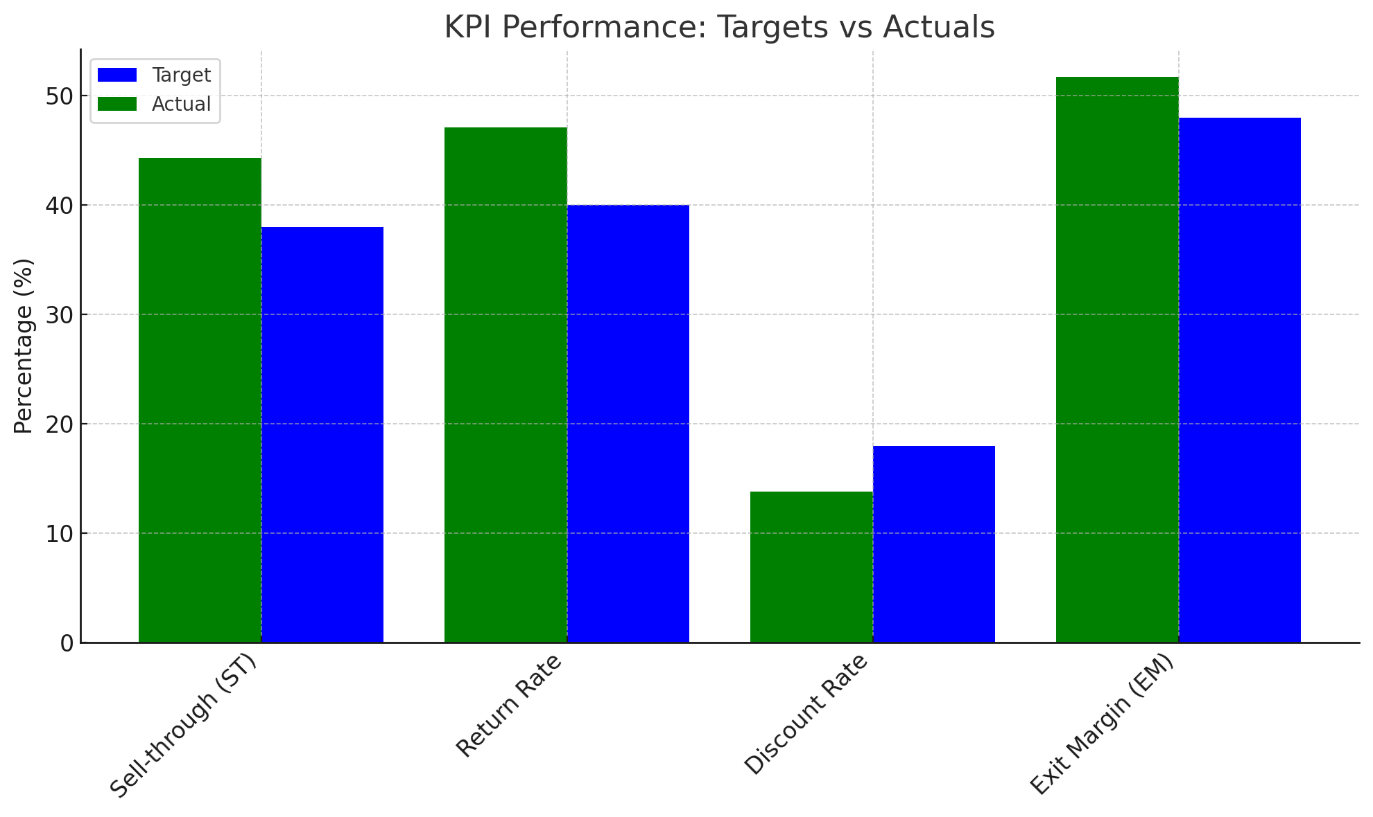
Brand Performance Assessment: Achievement of Stated Targets?
Total Effective Sales = Net Sales×(1−Return Rate)×(1−Discount Rate)
45.5% Total Effective Sales
How much did the brand sell? Graph 1 presents a visual comparison between the brand's Total Net Sales and Total Effective Sales. The Total Net Sales are marked at 222 units. The Total Effective Sales, which are the actual sales realized after accounting for returns & discounts, is 101 units. This equates to 45.5% of the Total Net Sales. In order to better understand if this is profitable for the business more parameters need to be accounted for such as Cost to produce product (COGS), Funds spent on marketing/ADS and/or ability to sell the remaining products.
Sell-through (ST) Target: The taget was set to 38% and the buissnes achived a higher sell though, 44.3%. Target outpreformed. Return Rate Target: The taget was set to 38% and the buissnes achived a higher sell though, 44.3%. Taget underpreformed. Concider evaluating parameters that affect return rates in future analysis.
Combined discount Targe: The taget was set to 18% and the buissnes achived a lower rate, 13.8%. Ambivalent parameter. The target was outprefromed, however, Higher disconts may affect other parameters such as Sell-though and/or return rates. Thus If the brand had higher discounts this affect returnrates and/or increase Sell-through (ST). It is therefore missleading to evaluate the direction of the effect souly based on this KPI.
Exit margin (EM):
The taget was set to 48% and the buissnes achived a higher sell though, 51.7%. Target outpreformed.

Slide 5
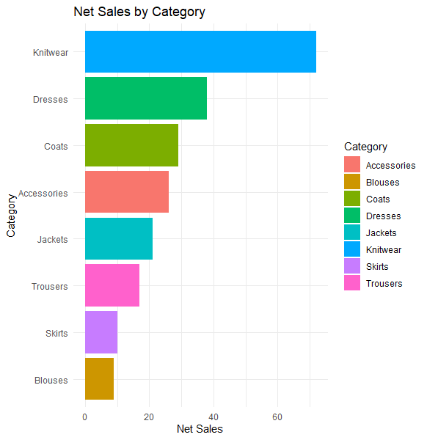
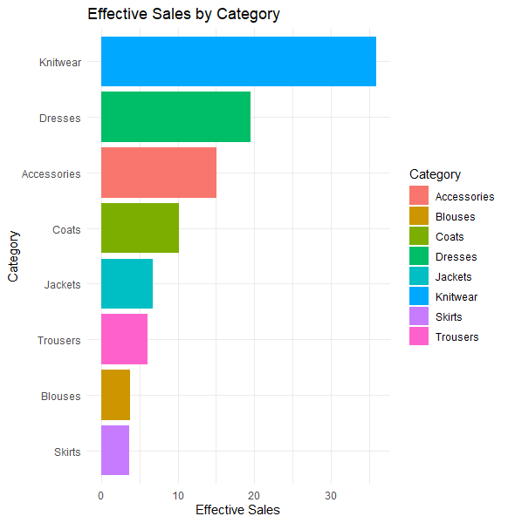
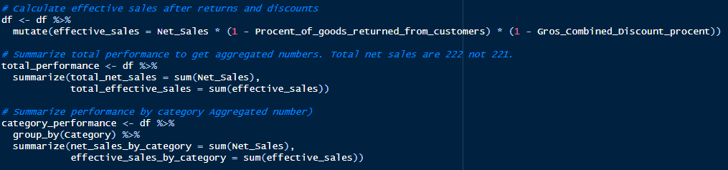
How is this brand performing by category?
Grapsh below display net sales by category and effective sales by category
How are the product Preforming?
The two main diffrances illsutrated by the graphs are
Acessories are preforming to a greater extent than coats after accounting for returns and disconts.
Blouses ourprefrom skirts (small diffrance)

Slide 6
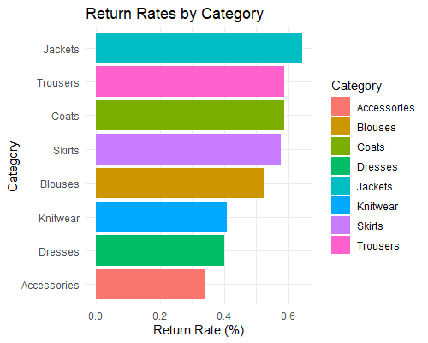
Is there a diffrance in retrun rates?
Some items do display higher retrun rates.
Accessories, dresses and Knitwear account for the lowest amounts of return rates.
Jackets, Trousers and Coats account for the highest return rate.
Further parameters are needed to better understand what is driving these product differences such as price, size and/or colour.
Example 1 : Higher priced items such as jackets, trousers and coats may increase the incentive to return an item compared to cheaper items such as Accessories.
Example 2: Customers tend to re-purchase Coats in a different size. Could any adjustments be made to help potential buyers find the right size?

Slide 7
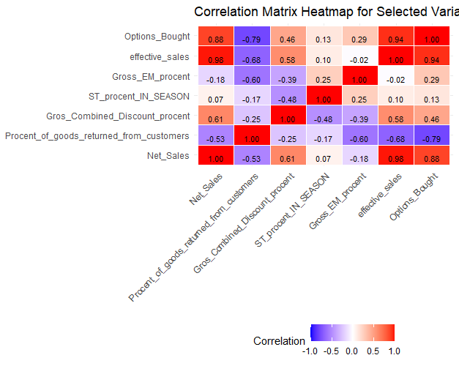
Does any relationship exist between parameters?
The correlation matrix below is used to better understand relationships and directions betwen parameters.
Options bought is displaying a strong relationship (r=.88) with net sales indicating that as the options increase so do net sales implying that item categories offering more options tend to sell to a higher degree.
Options bought display a strong negative relationship (r=-.79)with Procent of goods returned implying that item categories that have more options tend to be returned to a lesser extent.
Gross_EM has a positive association (r=.29) with options bought suggesting that item categories with more options may outpreform items with fewer options.
ST_IN_Season displays a negative relationship (r-.48) with Combined discount. This suggest that seasone items a less likely to be discounted.

Slide 8
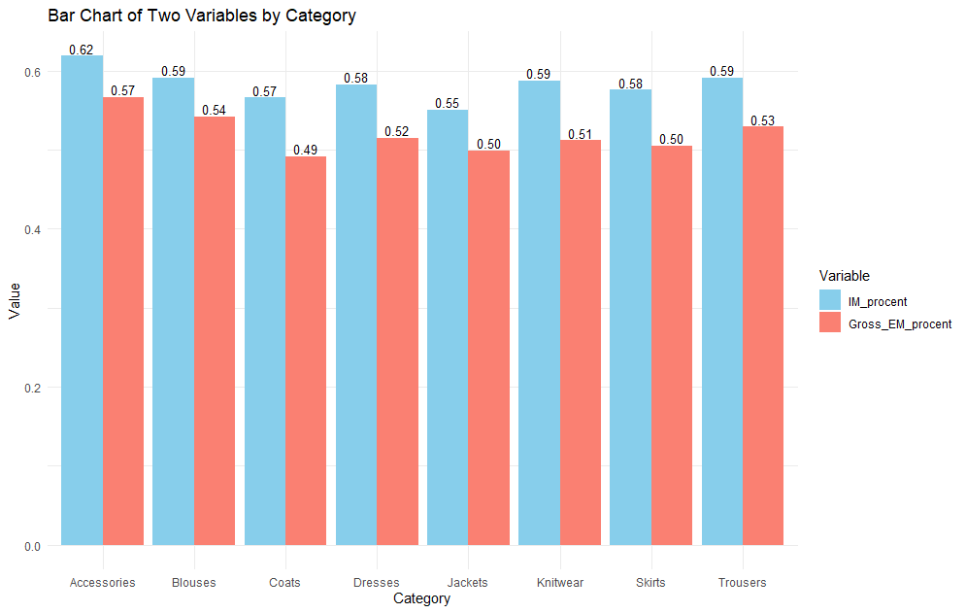
Initial profitability (IM) & Realized profits (EM)
To review the overall proformance between and within categoires a comparison is displayed below showcasing diffrances in (IM) and (EM).
Does any significant diffrances exist?
Over all no significant differences exist between categories. Implying that in general the brand is realizing profits to a similar degree.
However, some minor differences exist within categories ranges (IM-EM). For instance Coats display a larger difference between IM and EM (.08) compared to the mean 0.05. Future analysis ought to review the Coats category to better understand what is influencing this discrepancy.

Slide 9
Final Thoughs
Brand Overview The brand has demonstrated a strong presence in the market with a total gross of 222 units sold. However, the actual sales performance paints a more nuanced picture. Only 101 of these units, equating to 45.5% of the gross sales, after factoring in returns and discounts.
The brand has a significant return rate of 47%, indicating potential issues with product fit, quality, or customer expectations. The average discount rate applied is 13.8%, which is below the industry target, possibly affecting the return and sell-through rates.
The gross margin stands healthy at 51.7%, suggesting that the brand is managing its cost of goods sold effectively. The in-season sales rate is above the target at 44.3%, showcasing a solid performance in moving inventory within the season.
What is next? Deep Dive into Returns: An in-depth analysis to understand the root causes of the high return rate. Addressing these reasons will likely enhance customer satisfaction and retention.
Revise Discounting Strategy: Revisiting the discounting approach may balance out the lower discount rate's potential impact on the sell-through and return rates.
Optimize Product Manufacturing: Assessing the current in-season sales success suggests a potential revision of production volumes to avoid excess stock that may not sell.
Expand Metrics Analysis: Additional parameters such as cost of goods sold (COGS), marketing investments, and strategies for selling off-season products need consideration to better understand the brand’s profitability and market positioning.

