Slide 1
Review of “RALBA: A Computation-aware Load Balancing Scheduler for Cloud Computing”
JUSTINIAN Petcu, Grupa 407

Slide 2
Introduction
Cloud computing
Very known business paradigm
Guaranteed on-demand availability of computing power
Used for solving high-performance computing problems
Distributing work over a set of virtual machines
Poor resource utilization has serious repercussions on the environment and also affects costs overall.
1.6 million tons of additional CO2 emissions are released only from idle computing resources in data centers
19 billion dollars are lost in terms of resources and energy consumption because of load imbalance.

Slide 3
Common scheduling techniques, positives and negatives
Random selection (RS)
Allocating jobs randomly to VMs
Simple implementation, low overhead
Low resource utilization and load imbalance
Round-Robin (RR)
Allocating jobs in sequential order
Simple implementation, low overhead
May cause load imbalance
Minimum completion time (MCT)
Scans every VM for each task to determine the most suitable machine to complete the task
Better makespan than RS and RR
Faster resources will be overloaded – load imbalance
Min-Min and Max-Min
Based on MCT but also taking into account the minimum earliest finish time.
Reduced makespan for smaller jobs (min-min), reduced makespan for bigger jobs(max-max).
Load imbalance – min-min overloads faster machines with smaller jobs, max-min overloads faster machines with larger jobs

Slide 4
RALBA – Resource-Aware Load Balancing algorithm
RALBA ensures a balanced distribution of workload based on computation capabilities of VMs.
Primary objectives:
Maximize resource utilization
Minimize execution time
Maximize throughput.

Slide 5
RALBA algorithm and complexity
RALBA is comprised out of two sub-schedulers
Fill sub-scheduler
Fill selects the VM-j with the largest computing share of all the VMs available, determines the largest task from the remaining possible tasks and assigns it to VM-j. The computing share of VM-j is modified after the allocation.
Fill repeats this process until
There is no VM that can take any more tasks or
The set of jobs to be scheduled becomes empty.
Spill sub-scheduler
After Fill termination, Spill selects the most demanding job and matches it to the VM that produces the earliest finish for that job and the expected completion time of the VM is updated.
The spill process is repeated until there are no more tasks to be assigned.
The complexity of RALBA is O(M^2 x N + M x n) where M is the number of VMs, N is the total number of jobs to be scheduled and n is (N – jobs assigned in fill scheduler).
*A Cloud Resource Manager that can track the status of all the VMs in the virtual layer is needed. The CRM should also be able to create and terminate VMs when needed.

Slide 6
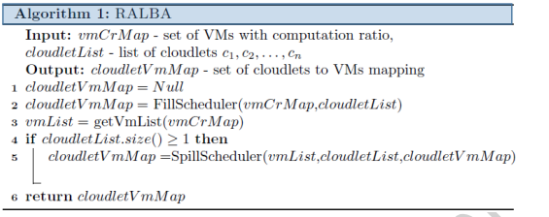
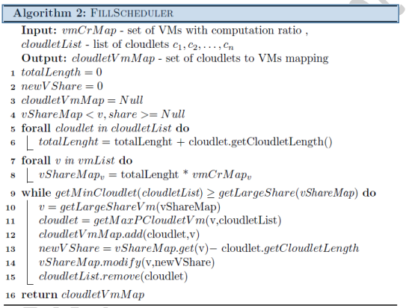
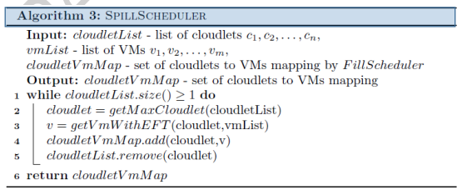
RALBA algorithm

Slide 7
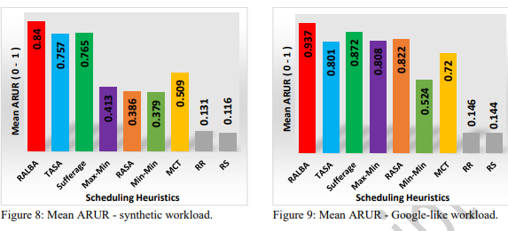
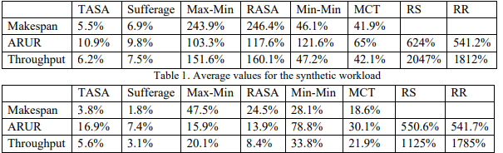
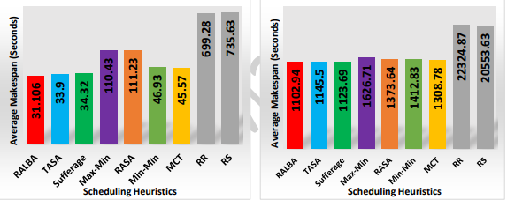
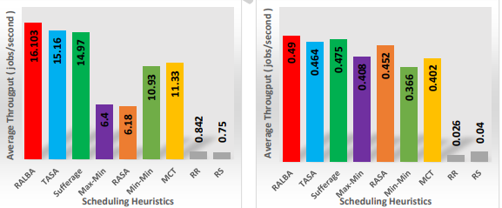
Results
RALBA was tested against other state of the art algorithms on two sets of workloads: a synthetic workload and a Google-like realistic workload. Results are analyzed based on average execution time, average resource utilization ratio and average throughput.

Slide 8
Conclusion
The paper has shown that inefficient resource utilization can cause reduced makespan and low throughput and offered a solution that was compared to the current state-of-the-art scheduling heuristics. The results have shown that RALBA has attained better execution time and throughput.

