Slide 1
Review of ”Secure and Sustainable Load Balancing of Edge Datacentres in Fog Computing - Deepak Puthal, Mohammad S. Obaidat, Priyadarsi Nanda, Mukesh Prasad, Saraju P. Mohanty, and Albert Y. Zomaya”
By Teodor Mircea Piron
406 IS

Slide 2
Introduction
Fog computing is a recent research trend to bring cloud computing services to network edges.
Edge datacenters (EDCs) are deployed to decrease the latency and networks congestion by processing data streams and user requests in near real-time
In such scenarios, load balancing between the EDCs plays a vital role for user response and real-time event detection.

Slide 3
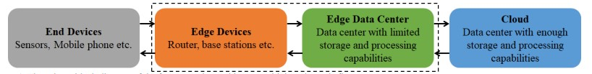
Introduction
Fog computing has overlapping features of cloud with additional attributes such as location awareness and edge datacentre deployment.
Large geographically distributed EDCs offer mobile, low latency data transparency over real-time request and response.
There are three layers of architecture in Fog computing architecture(bottom layer of device layer, middle or Edge layer, and the top or Cloud layer)

Slide 4
Why do we need Load Balancing in Fog Computing
IoT smart sensing devices from the mobile users, that have a random path, and this leads to offloading tasks in the local EDCs.
EDCs may be in idle state while others could be overloaded. Hence, the load states of EDCs in various locations differ greatly.
Load balancing is used for redistributing the workload among EDCSs to improve resource utilization and job response time.
Load balancing also avoids a situation where some EDCs are heavily loaded while others in idle state or doing small data processing

Slide 5
Proposed method for Load Balancing
In the paper a dynamic load balancing technique was used to design the proposed solution
Based on the current literature survey, there is no such architecture to authenticate the edge datacenter before allocating tasks.
The paper proposes a novel architecture to not only authenticate, but also get the load information of the EDCs before sharing the tasks.

Slide 6
Proposed method for Load Balancing : Secure Authentication
In Fog computing architecture all data is stored and processed at the cloud, and EDCs work as the intermediate datacenters to reduce the latency of the user requests.
Because Cloud is always deployed in a secured environment, we will start the authentication process here.
Cloud initiates the authentication by assigning an initial ID(Ei) associated with the key(Ki) and a shared key (Kc) for individual EDCs in the EDC deployment phase.

Slide 7
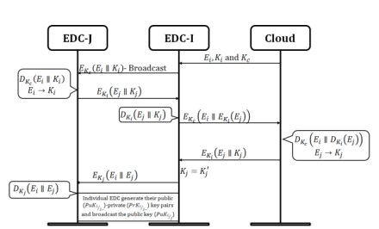
Proposed method for Load Balancing : Secure Authentication
EDCs use trusted modules (such as Trusted Platform Module (TPM)) to store the secret information from the cloud and the rekeying process.
After initialization of the EDCs, each individual EDC starts to authenticate the EDCs in the region.
This in future makes identifying malicious EDS easier.
Stepwise information and credential flow for the secure authentication of EDCs

Slide 8
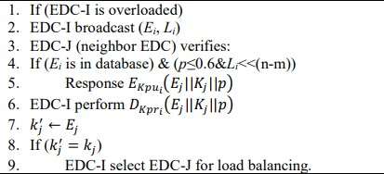

Proposed method for Load Balancing : Secure Authentication
This paper follows BFS (Breadth First Search) method to design the proposed load balancing technique.
Two parameters have been used, m and n to maintain the load of all EDS.
m is the current load and n is the maximum capacity of loaded tasks.
In order to compute the current load statues, we use a parameter p, where $p = m⁄n$.

Slide 9
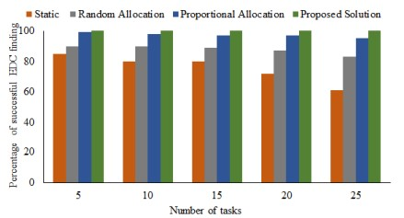
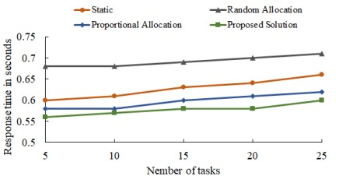
Proposed method for Load Balancing : Secure Authentication
Percentage of successfully selecting the destination ECS for load
balancing.
Response time of destination EDC for load balancing.

Slide 10
Security Evaluation
During the authentication process, individual EDCs use their secure module to perform the encryption or decryption or to save their keys.
Hence, it is nearly impossible to get either process or keys from secure module, from TPM properties.

Slide 11
Experiments and Results
The performance of the proposed Load Balancing solution was evaluated using Matlab simulation enviorment.
The machine on which the program was run, was a Dell computer with a i7 processor and 8 GB of RAM.
All simulations were executed 10 times each and average values from the execution were considered to validate the scheme.
It was assumed that EDC-I is already overloaded and hence, required to perform load balancing after getting any extra tasks.

Slide 12
Conclusions
Bringing Cloud technology to the edge of the network, that is Fog computing, via the EDCs, is a great improvement to the standard cloud architecture, but as we have seen in the paper this can have ups and downs and using a Load Balancing algorithm for this type of network yields great results.
The proposed solution also includes a robust authentication security architecture, that is hard to break by an attack, although the number of steps required to authenticate is relatively high.
In my opinion further development steps for this type of network could be the introduction of a lightweight security authentication process and improving Load Balancing in a Fog Computing environment.

