Slide 1
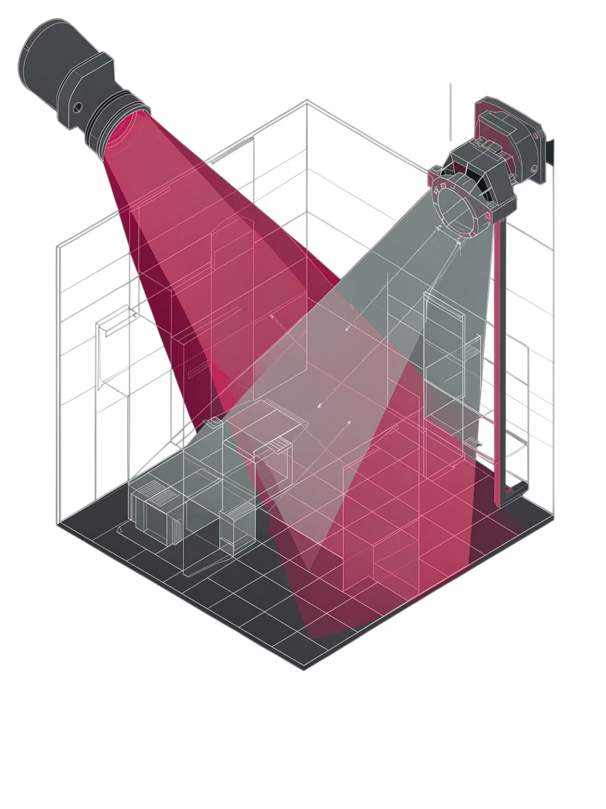
PIR Motion Sensor
How Passive Infrared Technology Powers Smart Devices
Cristea Laur-Alexandru, Boros Fabian

Slide 2


Working Principles
PIR sensors are passive — they detect infrared radiation emitted by warm bodies, not emit it themselves.
Dual Pyroelectric Elements
Two side-by-side sensors detect IR difference as motion crosses the field of view.
Fresnel Lens
Focuses and segments the IR field into detection zones, extending effective range.
IR Emission
Fresnel Lens
Dual Pyroelectric
Digital Output
Digital Output
HIGH when motion detected, LOW when idle — simple, reliable, ready for any MCU.

Slide 3
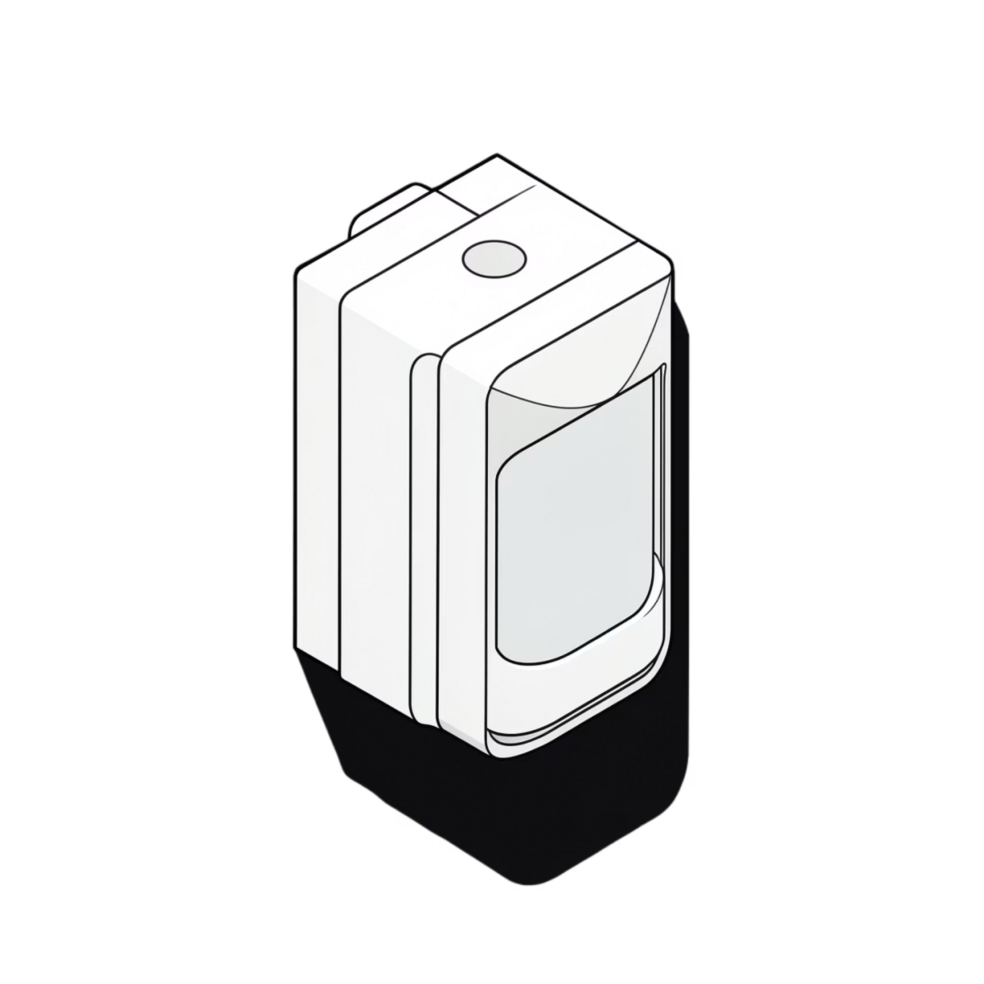
Applications
Low power, low cost, no image processing needed — PIR sensors answer one question: "Is someone here?"
Automatic Lighting
Hallways, bathrooms, and stairwells — lights on only when occupied.
Security & Alarms
Triggers burglar alarms and security cameras on intrusion detection.
Energy Management
Shuts off HVAC and appliances in vacant rooms automatically.
People Counters & Wildlife Cams
Retail foot-traffic analytics and remote wildlife monitoring.

Slide 4
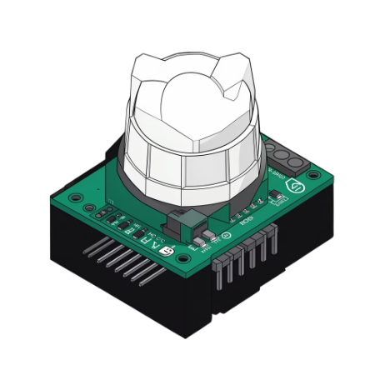
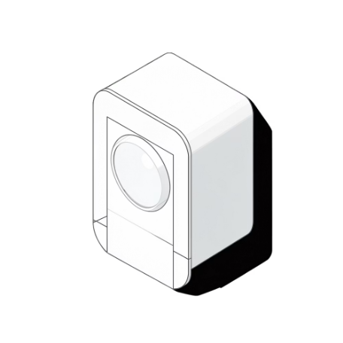
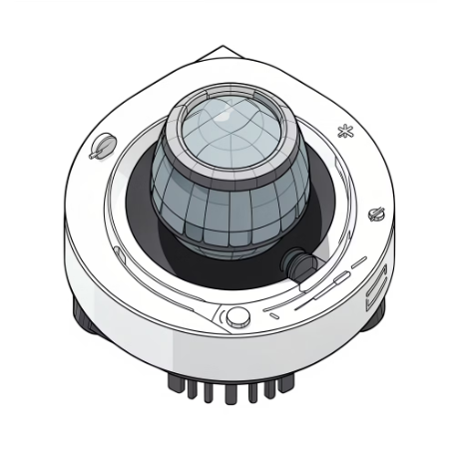

Commercial Products
The same core PIR technology scales from a €0.80 hobbyist module to an enterprise-grade security detector.
HC-SR501
Philips Hue Motion Sensor
Ring Motion Detector
Bosch DS151i
Classic hobbyist module. Adjustable sensitivity & delay. Works directly with Arduino & Raspberry Pi. <€1
Industry-standard detector. Tamper protection, up to 15 m range. Enterprise security deployments.
Consumer smart home. PIR core with Zigbee connectivity. Triggers scenes and lighting automations.
Security-focused PIR sensor. Integrates with Ring ecosystem, push alerts, and Alexa.

Slide 5

Code + Wiring
Three wires. One digitalRead(). That's all it takes to get motion detection running on Arduino.
Arduino Sketch
Wiring
PIR VCC → Arduino 5V
const int pirPin = 2; // PIR OUT → D2
const int ledPin = 13; // Onboard LED
void setup() {
pinMode(pirPin, INPUT);
pinMode(ledPin, OUTPUT);
Serial.begin(9600);
}
void loop() {
int state = digitalRead(pirPin);
if (state == HIGH) {
digitalWrite(ledPin, HIGH); // Motion!
Serial.println("Motion detected");
} else {
digitalWrite(ledPin, LOW); // Clear
}
delay(100);
}
PIR GND → Arduino GND
PIR OUT → Arduino D2
Tune onboard potentiometers to adjust sensitivity and output hold time without changing any code.

Slide 6
References
Sources used throughout this presentation — all publicly accessible.
01
02
03
Wikipedia — Passive Infrared Sensor
Arduino Documentation — PIR Sensor Tutorial
HC-SR501 Datasheet
Datasheet covering sensitivity range, timing, and electrical specs for the HC-SR501 module.
en.wikipedia.org/wiki/Passive_infrared_sensor
docs.arduino.cc/built-in-examples/digital/PIR
04
05
Philips Hue Motion Sensor — Product Page
Bosch DS151i — Technical Data Sheet
meethue.com — specifications and Zigbee integration details.
boschsecurity.com — professional PIR detector specifications and installation guide.

