Slide 1

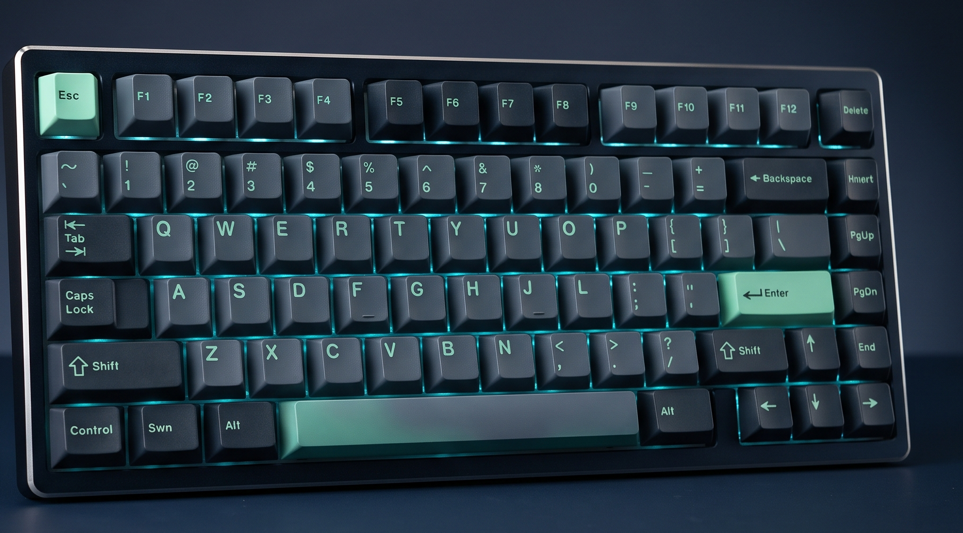



NEXUSGEAR
THE PROTOTYPE
PRESENTATION 02
From product discovery
to a tested specification.
Specification
& Prototype
KB
KEYBOARDS
M
GAMING MICE
E-Commerce Project
8 PRODUCTS
8 PRODUCTS
A curated home for high-performance gaming peripherals and ergonomic desk setups.
PAD
DESKMATS
ERG
ERGONOMIC GAMING CHAIRS
8 PRODUCTS
6 PRODUCTS
Popa-Ion Andrei
Șerban Alexandru-Cristian-George
Frontend Lead & Customer Experience
Backend Lead & System Integrations
UI/UX • client flows • AJAX • responsive design
Layered .NET 10 • 3NF data • Stripe • tests
30 deterministic products • 4 categories
53 passing xUnit tests • 4 bonus features implemented
ACADEMIC YEAR 2026–2027 • P2 / WEEK 7

Slide 2
NEXUSGEAR
01 / CONTEXT & PROGRESS
Context, store niche & progress since P1
A specialist buying journey for enthusiast peripherals and ergonomic desk setups.
THE NICHE
P1 → P2 | WHAT CHANGED
One focused store.
Four connected categories.
01
EXECUTABLE .NET 10 MONOLITH
NexusGear + NexusGear.Tests • Repository Wrapper • Unit of Work • Service Layer
TARGET CUSTOMERS
Gamers
Precision & performance
02
EXPANDED 3NF DATA MODEL
11 relational tables • 14 foreign keys • M:N HAS_ADDRESS
Programmers
Comfort for long sessions
Remote workers
Healthier desk setups
03
AHEAD-OF-SCHEDULE PROTOTYPE
A1, A2, A3, A4, A11, A12 plus B1, B2, B3, B7
CATALOG • DETERMINISTIC DBSEEDER
30 products / 4 categories
8 keyboards • 8 mice • 8 desk mats • 6 chairs
53 / 53 TESTS PASS
Automated xUnit suite • single dotnet test command
E-COMMERCE PROJECT • ACADEMIC YEAR 2026–2027
02

Slide 3
NEXUSGEAR
02 / MANDATORY SPECIFICATION • A1–A6
Frozen specification — mandatory requirements A1–A6
P2 status is distinguished from the requirements scheduled for P3.
A1
PRODUCT CATALOG
A2
BASIC SEARCH
IMPLEMENTED
IMPLEMENTED
Paginated listing (6 or 12/page; always ≤24), category views by unique Slug, product details with live stock/specs and deterministic SQLite seed data.
Case-insensitive title + keyword search via EF Core LINQ; empty-state view includes one-click filter reset.
A3
SHOPPING CART
A4
USER ACCOUNTS
IMPLEMENTED
IMPLEMENTED
CartService uses HTTP Session for guests and IN_CART for users; merges on login; server computes subtotals and enforces stock limits.
Cookie authentication with BCrypt.Net-Next; customer profile supports multiple saved addresses through M:N HAS_ADDRESS.
A5
CHECKOUT FLOW
A6
SANDBOX PAYMENT
SPECIFIED • P3 / WEEK 8
SPECIFIED • P3 / WEEK 9
Four steps: address, Standard Courier $15 / Express Next-Day $35, discount, review and NXG-2026-XXXX confirmation.
Order starts Unpaid; only a cryptographically verified checkout.session.completed webhook at /api/webhook/stripe changes it to Paid.
E-COMMERCE PROJECT • ACADEMIC YEAR 2026–2027
03

Slide 4
NEXUSGEAR
03 / MANDATORY SPECIFICATION • A7–A12
Frozen specification — mandatory requirements A7–A12
Six further acceptance areas; implemented items are shown separately from P3 scope.
A7
STOCK MANAGEMENT
A8
ORDER HISTORY
SPECIFIED • P3 / WEEK 9
SPECIFIED • P3 / WEEK 10
Atomic SQLite transaction on verified payment; EF Core RowVersion concurrency prevents negative stock; cancellation restores inventory.
Authenticated OrdersController dashboard with chronology, status, shipping details and historical CONTAINS UnitPrice snapshots.
A9
ADMINISTRATION PANEL
A10
BASIC SECURITY
SPECIFIED • P3 / WEEK 10
IMPLEMENTED & ENFORCED
Custom AdminController, Admin role, product/category CRUD, local image upload and controlled order transitions.
ModelState validation, antiforgery on state-changing POSTs, parameterized EF queries and server-side Admin role guards (403).
A11
RESPONSIVE DESIGN
A12
AUTOMATED TESTS
IMPLEMENTED
IMPLEMENTED • 53 TESTS
Mobile-first Bootstrap 5.3; customer-facing pages remain usable without horizontal overflow at 360 px.
NexusGear.Tests runs on isolated In-Memory SQLite; catalog, cart, auth, wishlist, reviews, preview/error coverage.
E-COMMERCE PROJECT • ACADEMIC YEAR 2026–2027
04

Slide 5
NEXUSGEAR
04 / BONUS SPECIFICATION
Frozen specification — bonus features B1–B7
Seven optional features extend the frozen specification alongside mandatory requirements A1–A12.
FILTERED SEARCH
IMPLEMENTED
RECOMMENDATIONS
IMPLEMENTED
B1
B2
Category + price + stock filters, price/date sorting; state preserved in URL.
Frequently Bought Together from CONTAINS co-occurrence; Similar Products by category and price tier.
REVIEWS & RATINGS
IMPLEMENTED
SALES DASHBOARD
PLANNED P3
B3
B4
Verified-buyer gate; average rating on cards; Admin IsHidden moderation.
Date range, Chart.js daily revenue, Top 5 products and AOV.
DISCOUNT CODES
SEEDED / P3
TRANSACTIONAL EMAIL
PLANNED P3
B5
B6
NEXUS10 and SETUP50; expiry, max uses and server-side validation.
Mailtrap SMTP HTML receipt after verified Stripe webhook.
WISHLIST
IMPLEMENTED
B7
IN_WISHLIST persistence, navbar count and Move to Cart.
E-COMMERCE PROJECT • ACADEMIC YEAR 2026–2027
05

Slide 6
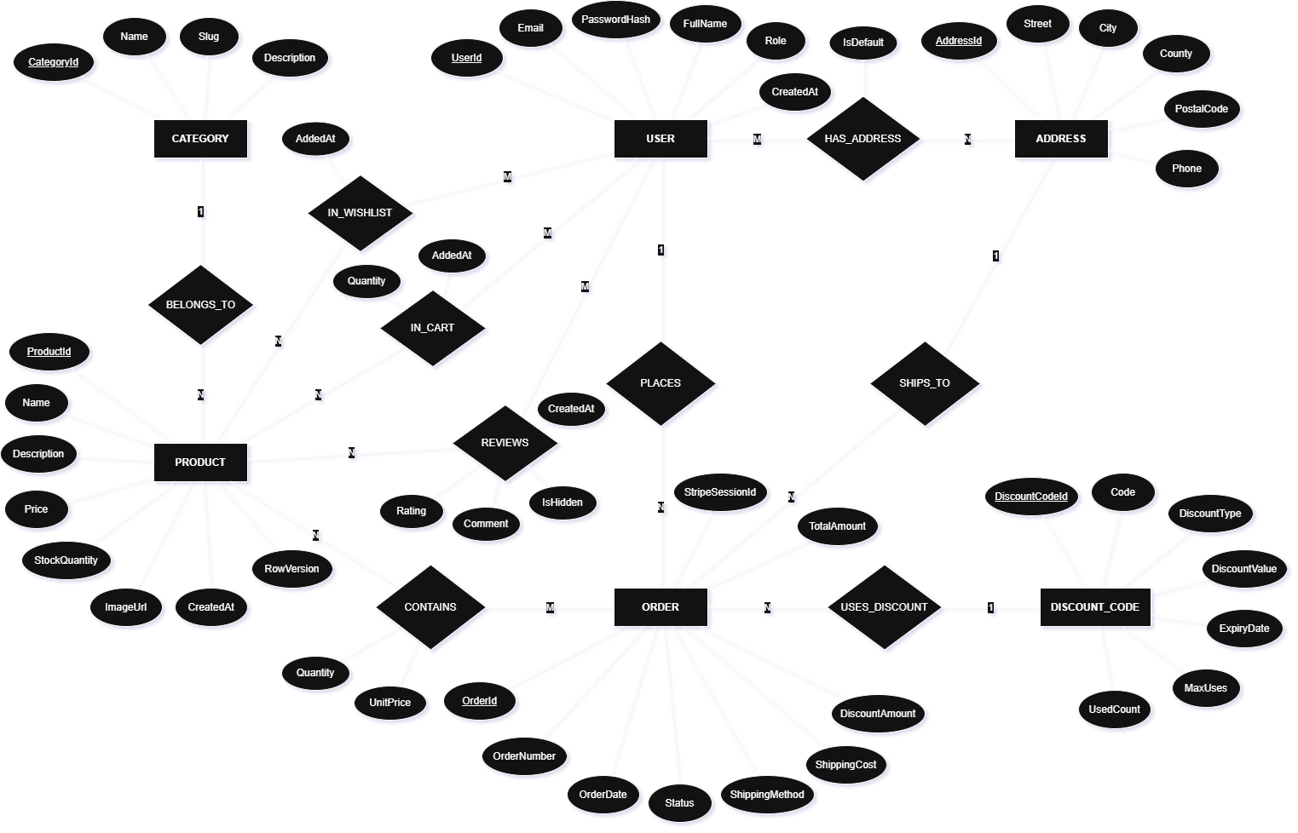
NEXUSGEAR
05 / CONCEPTUAL DATA MODEL
Conceptual data model — Chen ERD
Six core entities • four 1:N relationships • five associative M:N relationships.
E-COMMERCE PROJECT • ACADEMIC YEAR 2026–2027
06

Slide 7
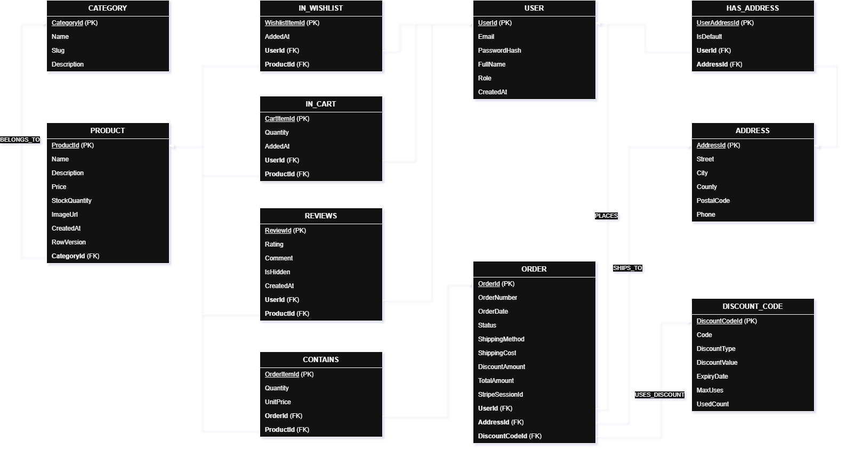
NEXUSGEAR
06 / RELATIONAL SCHEMA
Physical relational model — 11 tables in 3NF
Junction tables keep the same names as the five M:N diamonds in the ERD.
E-COMMERCE PROJECT • ACADEMIC YEAR 2026–2027
07

Slide 8
NEXUSGEAR
07 / SYSTEM ARCHITECTURE
High-level system architecture & design patterns
Layered monolith • dependency injection • Repository • Unit of Work • Service Layer.
PRESENTATION
CONTROLLERS
SERVICES
DATA ACCESS
PERSISTENCE
Views / wwwroot
9 MVC controllers
CartService / WishlistService
Repository + Unit of Work
EF Core 10 + SQLite
Razor • Bootstrap • AJAX
Routing • validation • roles
Business rules • cart merge
RepositoryWrapper
AppDbContext • 11 tables
STRIPE TEST
Checkout session + signed webhook
MAILTRAP SMTP
HTML order confirmation after commit
9 CONTROLLERS
Catalog • Cart • Wishlist • Account • Reviews
Checkout • Orders • Admin • Home
DESIGN PATTERNS
Generic Repository • Unit of Work
Service Layer • Dependency Injection
E-COMMERCE PROJECT • ACADEMIC YEAR 2026–2027
08

Slide 9
NEXUSGEAR
08 / API ROUTES & SECURITY
API endpoints & access control
Complete route catalogue • access is enforced server-side, not only by the UI.
METHOD
ROUTE
ACCESS / PURPOSE
METHOD
ROUTE
ACCESS / PURPOSE
GET
/
Public
Home / storefront
POST
/Account/Logout
Customer / Admin
Cookie logout + CSRF • A4/A10
GET
/Catalog
Public
Catalog + URL filters • A1/A2/B1
GET
/Account/Profile
Customer
HAS_ADDRESS • A4
GET
/Catalog/Details/{id}
Public
Details + B2/B3
POST
/Account/AddAddress
Customer
Create/link ADDRESS • A4
GET
/Cart
Public / Customer
Session or IN_CART • A3
POST
/Account/SetDefaultAddress
Customer
Set IsDefault • A4
POST
/Cart/Add
Public / Customer
Stock validation; AJAX/POST • A3
POST
/Account/DeleteAddress
Customer
Unlink HAS_ADDRESS • A4
POST
/Reviews/Create
Verified buyer
Paid/Delivered check • B3
POST
/Cart/UpdateQuantity
Public / Customer
Quantity cap / remove • A3
POST
/Reviews/ToggleVisibility
Admin
Review moderation • A9/B3
POST
/Cart/Remove
Public / Customer
Recalculate totals • A3
GET / POST
/Checkout / PlaceOrder
Customer
4-step flow + discounts • A5/B5
GET / POST
/Wishlist / Toggle
Customer
Wishlist via AJAX • B7
Stripe signature
Verify + stock + Paid • A6/A7/B6
POST
/api/webhook/stripe
POST
/Wishlist/MoveToCart
Customer
Move saved item to cart • B7
GET / POST
/Orders / Details/{id}
Customer
Own order history • A8
GET / POST
/Account/Register / Login
Public
BCrypt + cookie auth • A4
GET / POST
/Admin / Products/* / Orders/*
Admin role
CRUD, image upload, dashboard • A9/A10/B4/B5
E-COMMERCE PROJECT • ACADEMIC YEAR 2026–2027
09

Slide 10
NEXUSGEAR
09 / CRITICAL FLOW SEQUENCE
Critical flow — payment confirmation & stock concurrency
The browser redirect never marks an order Paid; only a verified server-to-server webhook does.
CUSTOMER
BROWSER
CHECKOUT
CONTROLLER
STRIPE
SANDBOX
WEBHOOK
CONTROLLER
SQLITE DB
TRANSACTION
MAILTRAP
SMTP
1 POST /Checkout/PlaceOrder • create Unpaid order
2 Create Stripe Checkout Session • save StripeSessionId
3 Browser redirect • status remains Unpaid
4 checkout.session.completed + Stripe-Signature
5 Verify signature • idempotency • begin transaction
6 Deduct stock + RowVersion • set Paid • clear cart
7 After commit: send HTML receipt
RACE CONDITION: RowVersion / stock conflict → rollback + cancel second order • Admin cancellation of Paid order → restore stock.
E-COMMERCE PROJECT • ACADEMIC YEAR 2026–2027
10

Slide 11
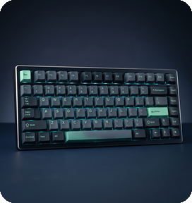



NEXUSGEAR
10 / UI WIREFRAMES • SCREENS 1–2
UI wireframes — catalog & product detail
Conceptual wireframes based on the specified live prototype screens.
nexusgear.ro / Catalog
nexusgear.ro / Catalog / Details / 1
NEXUSGEAR
Search gear… Categories Wishlist Cart
PRODUCT DETAIL
FILTERS B1
MECHANICAL KEYBOARDS • 30 PRODUCTS
NexusForge K-75
Search title
★★★★★ 4.8 rating
$129.00
Category
IN STOCK
Min / Max price
ADD TO CART
NexusForge K-75
NexusTitan K-75
NexusCore TKL
In stock only
TECH SPECS & DESCRIPTION
$129
$149
$99
Frequently Bought Together • B2
Sort by price/date
ADD TO CART
ADD TO CART
ADD TO CART
Verified Customer Reviews • B3
APPLY
Admin moderation: IsHidden toggle
AJAX Add to Cart • stock badges • rating summary • URL pagination
E-COMMERCE PROJECT • ACADEMIC YEAR 2026–2027
11

Slide 12


NEXUSGEAR
11 / UI WIREFRAMES • SCREENS 3–4
UI wireframes — cart & checkout wizard
Cart interactions are specified as AJAX or standard POST; checkout is a P3 build milestone.
nexusgear.ro / Cart
nexusgear.ro / Checkout
YOUR CART • FREE SHIPPING PROGRESS
CHECKOUT 1 ADDRESS → 2 DELIVERY → 3 DISCOUNT → 4 REVIEW
Spend $292 more to unlock free shipping
STEP 1 • DELIVERY ADDRESS
ORDER REVIEW
Default address • IsDefault = true
Subtotal
Shipping
Discount
Final total
NexusForge K-75
− 1 +
ORDER SUMMARY
$129
Subtotal
$208
STEP 2 • SHIPPING METHOD
Shipping
$15
NexusPulse M-40
Discount
-$10
Standard
$15.00
Express
$35.00
− 1 +
Total
$213
$79
CHECKOUT
STEP 3 • PROMO CODE
PAY WITH STRIPE
NEXUS10 / SETUP50
CartService • server totals • stock-limit enforcement • guest-to-user merge
E-COMMERCE PROJECT • ACADEMIC YEAR 2026–2027
12

Slide 13
NEXUSGEAR
12 / UI WIREFRAMES • SCREEN 5
UI wireframe — admin panel & sales dashboard
Custom back-office • catalog management • order fulfillment • analytics and discounts.
nexusgear.ro / Admin
NEXUSGEAR ADMIN
Dashboard
Products
Categories
Orders
Discount Codes
TOTAL REVENUE
PAID ORDERS
AVERAGE ORDER VALUE
TOP 5 BEST-SELLING PRODUCTS
$12,480
84
$148.57
K-75 Pro
DAILY REVENUE • CHART.JS
M-40 Ultralight
Surface-90
ErgoAir
TKL Core
Date range filter • Product/category CRUD • Image upload • Status-filtered order list • Discount code management
E-COMMERCE PROJECT • ACADEMIC YEAR 2026–2027
13

Slide 14
NEXUSGEAR
13 / PROTOTYPE DEMO & TESTING
Functional prototype demo & 53 passing xUnit tests
P2 prototype starts locally, seeds deterministic data and demonstrates the implemented customer journey.
LIVE DEMO FLOW
NEXUSGEAR.TESTS • 53 / 53 PASSED
01
START
dotnet run --project NexusGear
CatalogTests.cs
14
Pagination • search • B1 • B2
02
BROWSE
Catalog • categories • filters • recommendations
CartTests.cs
13
Totals • stock • guest merge
AccountAndReviewTests.cs
12
BCrypt • addresses • B3 moderation
03
CART
Guest add-to-cart • server totals • stock cap
WishlistTests.cs
8
IN_WISHLIST • Move to Cart
04
SIGN IN
customer@nexusgear.ro • merge session cart
PreviewAndErrorTests.cs
6
Admin role • preview routes • errors
05
PROFILE
Saved address book • wishlist • verified review
dotnet test
Isolated In-Memory SQLite • 5 suites
Local seeded customer: customer@nexusgear.ro
Local seeded admin: admin@nexusgear.ro
Demo accounts are seeded for local testing only.
E-COMMERCE PROJECT • ACADEMIC YEAR 2026–2027
14

Slide 15
NEXUSGEAR
14 / ROADMAP TO P3 & CLOSE
Specification freeze & Stage 3 roadmap
P2 freezes the approved scope; implementation and live validation continue in Weeks 8–12.
P2 READINESS
STAGE 3 • WEEKS 8–12
6 / 12
mandatory requirements complete
W8
A5 • Checkout wizard + B5 discount application
Assigned: Popa-Ion Andrei
A1 A2 A3 A4 A11 A12
Implemented and tested at P2
W9
A6 • Stripe webhook + A7 inventory concurrency + B6 Mailtrap
B1 B2 B3 B7
Four bonus features implemented
Assigned: Șerban Alexandru-Cristian-George
W10
A9 • Admin CRUD + B4 dashboard + A8 order history
B4 B5 B6
Planned / seeded for P3
Assigned: Both team members
W11–12
A12 webhook/concurrency tests • A10/A11 audit • backup demo ≤5 min • P3 tag
RoadmapPreview routes keep Stage 3 entry points reachable without HTTP 404 errors.
Assigned: Both team members
LIVE DEMO
NEXUSGEAR • P2 / SPECIFICATION FROZEN
E-COMMERCE PROJECT • ACADEMIC YEAR 2026–2027
15

