Slide 1
TaskFlow Project Overview
Șerban Alexandru-Cristian-George

Slide 2
Technologies & Methods
Java Swing
Model–View–Controller pattern with Action classes
XML Persistence: DOM & SAX handlers
Custom TreeModel & TableModel to separate data from presentation
Custom TreeCellRenderer for colors & icons
JColorChooser integrated directly into dialogs for picking hex colors
Drag & Drop of roots, categories, tasks via a TransferHandler
In-memory service with DefaultTaskService
PDF export using iText 7 + Unicode font
Configuration via properties, built with Maven with UTF-8 encoding

Slide 3
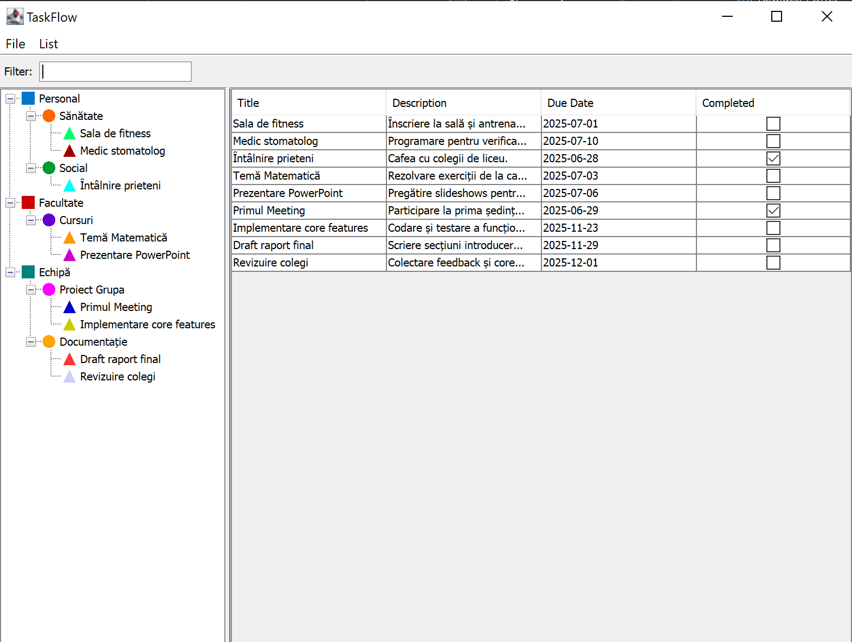
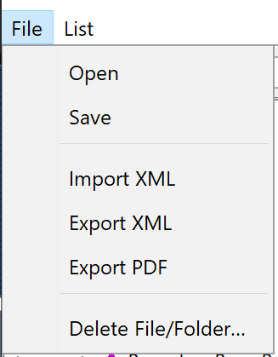
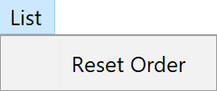

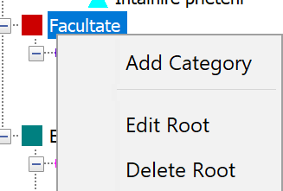
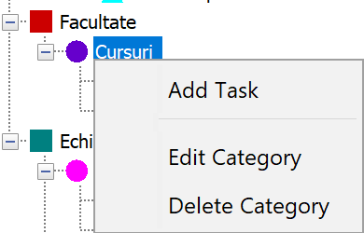
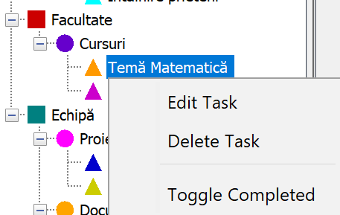
UI Screenshots

