Slide 1
ASP.NET Core, PEEk into the future
By Expert Network
@FII Practic

Slide 2
Who are we
Developers (fancy way of saying I google code online fast)

Slide 3
What do we do

Slide 4
What's the plan
Get you familiar with .NET Core
We will do a project together
And we will have a gathering where you will showcase your fancy project to your colleagues
Have fun and learn stuff

Slide 5
What will you do
Learn how to make an ASP.NET Core Web Application
Ask us every time you have a question or just have something you are not familiar with (that’s why we’re here after all)
Call us by our first name, no mister or other fancy stuff

Slide 6
What is .net?
.NET is a free platform for building many different types of applications (web, mobile, desktop, gaming, IoT)
.NET applications can be written in C#, F# or Visual Basic

Slide 7
.NET Implementations
.NET Core – cross-platform .NET implementation for websites, servers and console apps on Windows, Linux and macOS
.NET Framework – supports websites, services, desktop apps, and more on Windows
Xamarin/Mono - .NET implementation for running apps on all major mobile operating systems

Slide 8
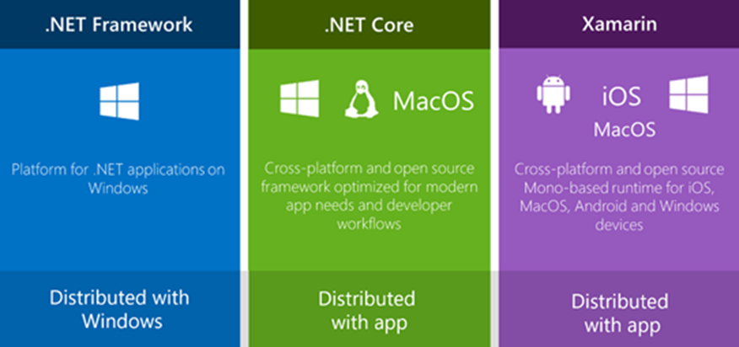
The .net family of frameworks

Slide 9
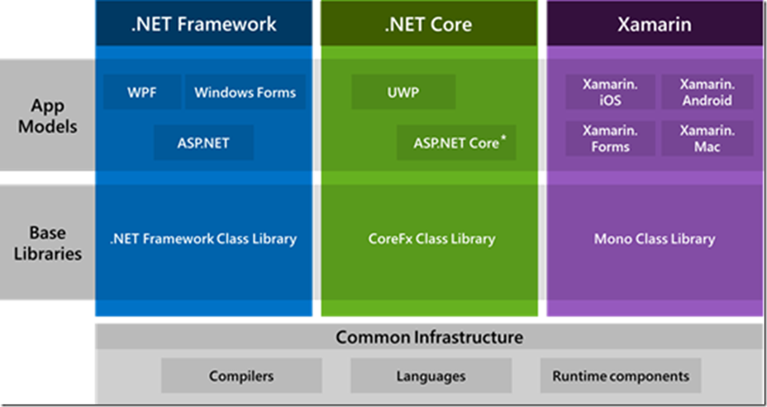
The .net ecosystem

Slide 10
Did you know?
StackOverflow
Microsoft
GoDaddy
DELL
Where all made in ASP.NET?

Slide 11
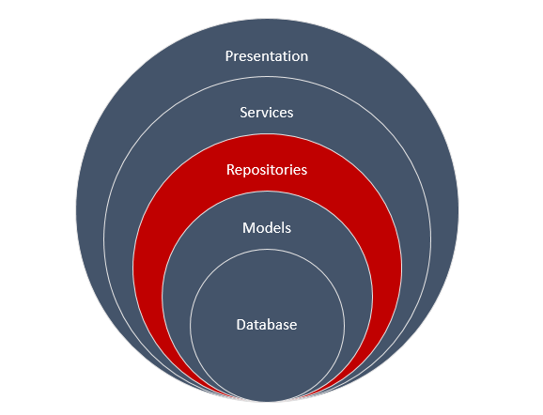
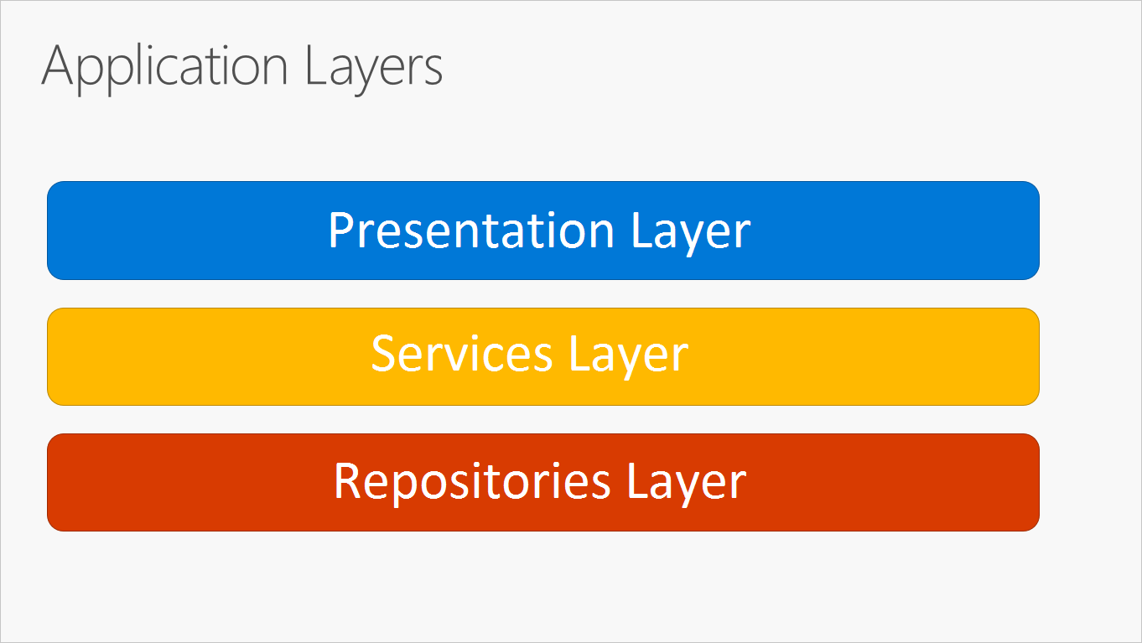
N-Layer Architecture

Slide 12
Let’s get started with the basics

Slide 13
Create a new Console Application in VS

Slide 14
Even more basics

Slide 15
Most used Data types
Data Type | C++ | Java | C#
Boolean | bool | boolean | bool
Number | int | int | int
Real number | decimal | java.math.BigDecimal | decimal
Nullable Boolean | - | java.lang.Boolean | bool?
Nullable Number | - | java.lang.Integer | int?
Nullable real number | - | java.math.BigDecimal | decimal?
Text | char[∞] | java.lang.String | string

Slide 16
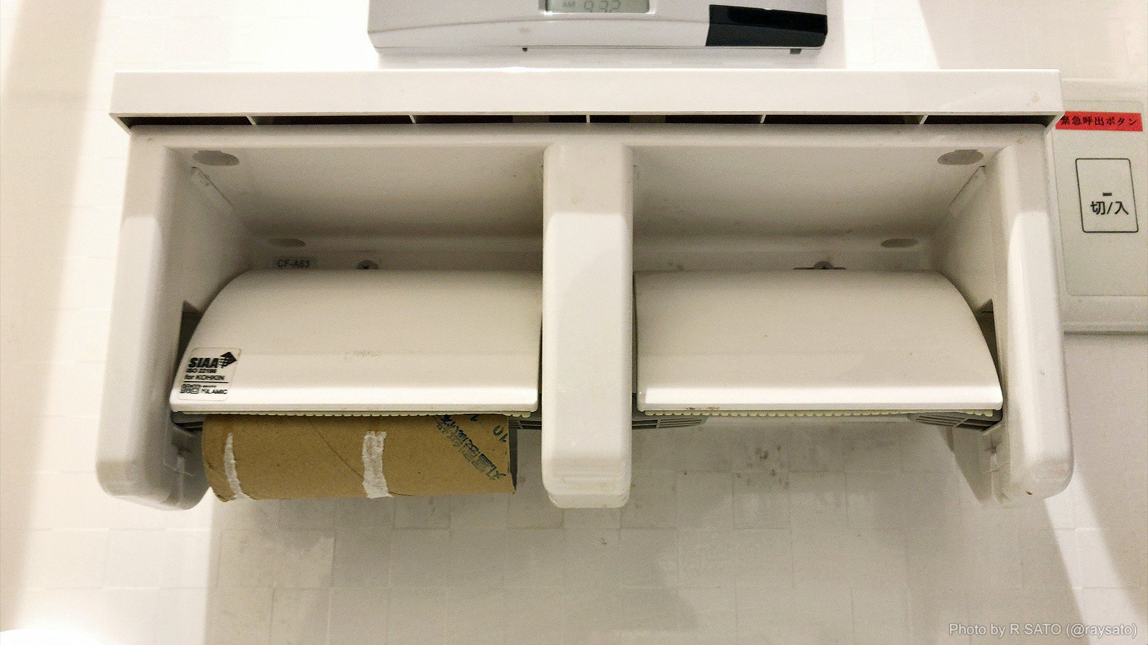
0 vs null

Slide 17
Power of var keyword

Slide 18
How Some people do it
Dictionary<string, string> dict = new Dictionary<string, string>();

Slide 19
How Other people do it
var dict = new Dictionary<string, string>();

Slide 20
Declaration may var-y
Implicitly typed
Explicitily typed
var i = 10;
var user = new User();
var magicResult = GenerateMagicMethod();
var map = new Dictionary<string, string>();
int i = 10;
User user = new User();
Magic magicResult = GenerateMagicMethod();
Dictionary<string, string> map = new Dictionary<string, string>();//this says a lot

Slide 21
Only variables declared at method scope can use var
This works
This doesn’t
public int Number = 1;
public int Increment()
{
var newNumber = Number + 1;
return newNumber;
}
public var Number = 1;
public int Increment()
{
var newNumber = Number + 1;
return newNumber;
}

Slide 22
Only variables with a clear type can use var
This works
This doesn’t
int five;
five = 5;
int six = 6;
var five; //← Compile-Time Error
five = 5;
var six = 6

Slide 23
Classes

Slide 24
Declaring Classes
public class Customer
{
//Fields, properties, methods go here...
}

Slide 25
Creating objects
var object1 = new Customer(); //object1 is a reference to a Customer object

Slide 26
Constructors

Slide 27
Default constructors
If you don't provide a constructor for your class, compiler creates one by default that instantiates the object and sets member variables to the default values.
public class Customer
{
}
var customerObject = new Customer(); //calls default constructor

Slide 28
Constructor syntax
public class Person
{
private string last;
private string first;
public Person(string lastName, string firstName)
{
last = lastName;
first = firstName;
}
}
var person1 = new Person("John", "Doe");
var person2 = new Person(); //<--Doesn't work

Slide 29
Constructor syntax
public class Person
{
private string last;
private string first;
public Person(string lastName, string firstName)
{
last = lastName;
first = firstName;
}
public Person()
{
}
}
var person1 = new Person("John", "Doe");
var person2 = new Person(); //<--Works now

Slide 30
Methods

Slide 31
Methods
A method is a code block that contains a series of statements. In C#, every executed instruction is performed in the context of a method.

Slide 32
Method signatures
Methods are declared in a class or struct by specifying:
An optional access level, such as public or private (default).
The return value, or void if the method has none.
The method name.
Any method parameters, enclosed in parentheses and separated by commas. Empty parentheses indicate that the method required no parameters.

Slide 33
Method signatures
public void Method(int a, int b=1)
Because of the optional parameter b this method can be called in two ways:
Method(2, 5);
Method(2);//b will be 1
Access level
Method name
Return type or in this case void
Method parameters

Slide 34
Inheritance

Slide 35
Inheritance
public class Angajat
{
public string Name {get;set;}
}
public class Developer: Angajat
{
public string Tehnologie {get;set;}
}
var unicornDeveloper = new Developer();
unicornDeveloper.Name = "John Doe";
unicornDeveloper.Tehnologie = “.NET Core";

Slide 36
Inheritance
public class Angajat
{
public string Name {get;set;}
public Angajat(string name)
{
Name = name;
}
}
public class Developer: Angajat
{
public string Tehnologie {get;set;}
public Developer(string name, string tehnologie): base(name)
{
Tehnologie = tehnologie;
}
}
var unicornDeveloper = new Developer("John Doe", “Brainfuck");

Slide 37
polymorphism

Slide 38
Virtual and override
public class Rectangle
{
public int Length {get;set;}
public int Width {get;set;}
public virtual int Area()
{
return Length * Width;
}
}
public class Square : Rectangle
{
public override int Area()
{
return Length * Length;
}
}
var rectangle = new Rectangle {Length = 2, Width = 3};
rectangle.Area(); // returns 6
var square = new Square {Length = 2};
square.Area(); // returns 4

Slide 39
Generics

Slide 40
Cool! En-List ME

Slide 41
Lists
var integerList = new List<int>();
integerList.Add(2);
integerList.Add(3);
integerList.Add(5);
integerList.Add(6);

Slide 42
ITERATING
for(var i = 0; i < integerList.Count; i++)
{ Console.WriteLine(integerList[i]);
}
foreach(var integer in integerList)
{
Console.WriteLine(integer);
}
integerList.ForEach(integer => Console.WriteLine(integer)); //Next chapter

Slide 43
Basic usage
myList.Add();
myList.AddRange();
myList.Remove();
myList.RemoveAt();
myList.RemoveRange();

Slide 44
LINQ

Slide 45
Linq sintaxes
Method Sintax
Query Sintax
var names = collection
.Where(item => item.Name == "Fred") .OrderBy(item => item.Age)
.Select(item => item.FullName);
var names = from item in collection
where item.Name == "Fred"
order by item.Age
select item.FullName;

Slide 46
Linq sintaxes
Method Sintax
Query Sintax
var names = collection
.Count(item => item.Name == "Fred");
var names = (from item in collection
where item.Name == "Fred"
select item).Count()

Slide 47
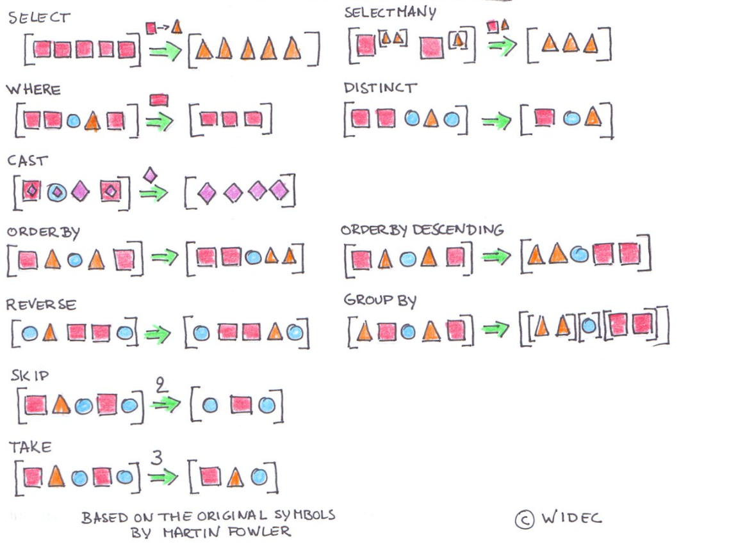

Slide 48
practice

Slide 49
N-Layer

Slide 50
N-Layer Architecture

Slide 51
Facebook

Slide 52


How Facebook uses diferent presentation layers
https://www.facebook.com/ExpertNetwork/
https://m.facebook.com/ExpertNetwork/

Slide 53
Why this never happens
public List<User> Users { get; set; }
//trying to mimic a database
public UserService(List<User> users)
{
Users = users;
}

Slide 54
Entity Framework Core

Slide 55
Database

Slide 56
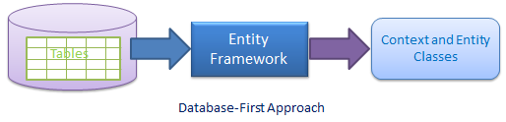
Create classes using an existing database

Slide 57
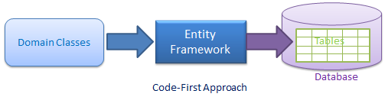
Create a Database using existing classes

Slide 58
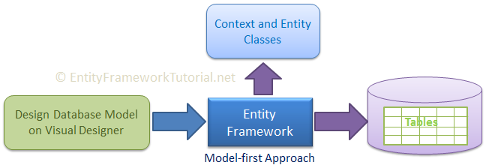
There is another one but we will not talk about it

Slide 59
command line interface
dotnet new [console|classlib|web|mvc|…] –n <OUTPUT_NAME>
dotnet build
dotnet run

Slide 60
Code first

Slide 61
Create a new Class Library
dotnet new sln –n CodeFirst
dotnet new classlib –n CodeFirst.Data –f netcoreapp2.0
dotnet sln list
dotnet sln add CodeFirst.Data/CodeFirst.Data.csproj
dotnet sln list

Slide 62
Prerequisites
cd CodeFirst.Data
dotnet add package Microsoft.EntityFrameworkCore.SqlServer
dotnet add package Microsoft.EntityFrameworkCore.Design

Slide 63
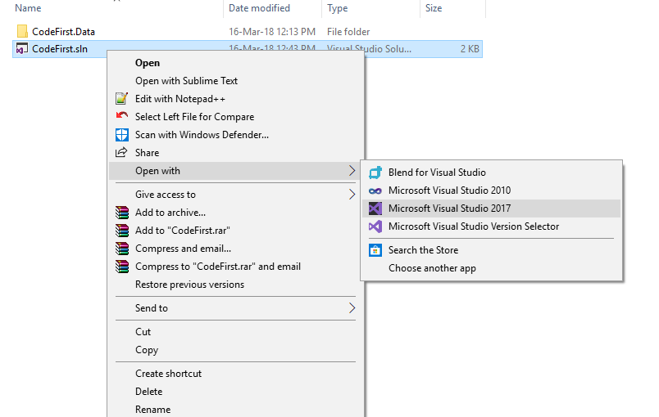
Open the Solution

Slide 64
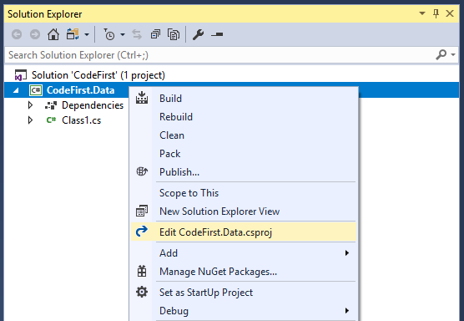
Edit the Class Library project

Slide 65
You need to add this Ef Core CLI Reference
<ItemGroup>
<DotNetCliToolReference Include="Microsoft.EntityFrameworkCore.Tools.DotNet" Version="2.0.0" />
</ItemGroup>

Slide 66
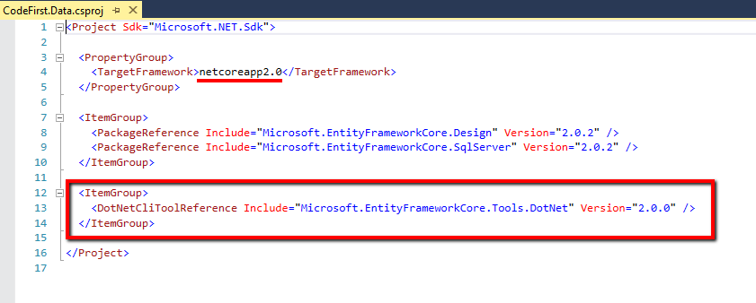
It should look somewhat similar to this

Slide 67
To install this reference you’ll need to restore the project
dotnet ef <- will not work
dotnet restore
dotnet ef <- will work

Slide 68
The added CLI commands
dotnet ef dbcontext list
dotnet ef dbcontext info
dotnet ef migrations list
dotnet ef migrations add <Migration Name>
dotnet ef migrations remove <- removes the last migration

Slide 69
Let’s make a simple DB

Slide 70
Add an Entity (class that represents a table)
public class User
{
public int Id { get; set; }
public string Name { get; set; }
}

Slide 71
Add A Context (class that represents a database)
public class TestContext : DbContext
{
public DbSet<User> Users { get; set; }
protected override void OnConfiguring(DbContextOptionsBuilder ){…}
}

