Slide 1
ASP.NET Core, PEEk into the future
By Expert Network
@FII Practic

Slide 2
Who are we
Developers (fancy way of saying I google code online fast)

Slide 3
What do we do

Slide 4
What's the plan
Get you familiar with .NET Core
We will do a project together
And we will have a gathering where you will showcase your fancy project to your colleagues
Have fun and learn stuff

Slide 5
What will you do
Learn how to make an ASP.NET Core Web Application
Ask us every time you have a question or just have something you are not familiar with (that’s why we’re here after all)
Call us by our first name, no mister or other fancy stuff

Slide 6
What is .net?
.NET is a free platform for building many different types of applications (web, mobile, desktop, gaming, IoT)
.NET applications can be written in C#, F# or Visual Basic

Slide 7
.NET Implementations
.NET Core – cross-platform .NET implementation for websites, servers and console apps on Windows, Linux and macOS
.NET Framework – supports websites, services, desktop apps, and more on Windows
Xamarin/Mono - .NET implementation for running apps on all major mobile operating systems

Slide 8
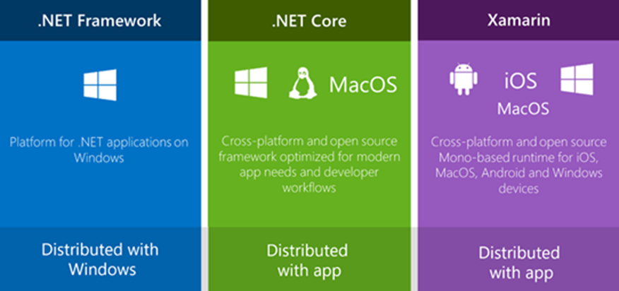
The .net family of frameworks

Slide 9
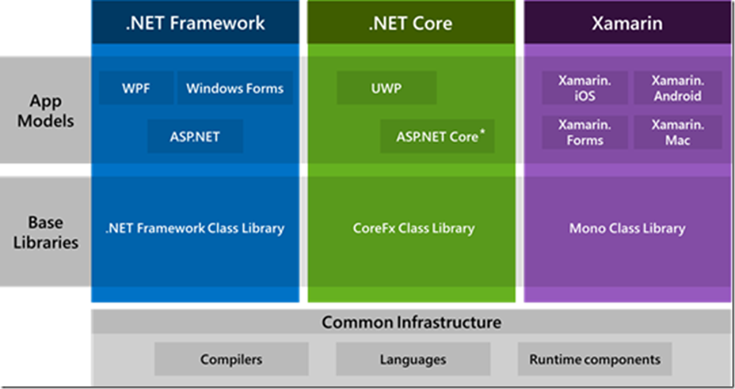
The .net ecosystem

Slide 10
Did you know?
StackOverflow
Microsoft
GoDaddy
DELL
Where all made in ASP.NET?

Slide 11
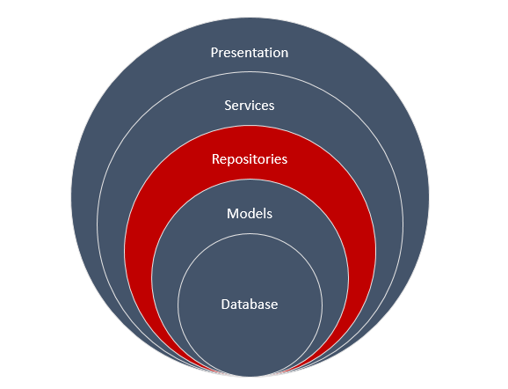
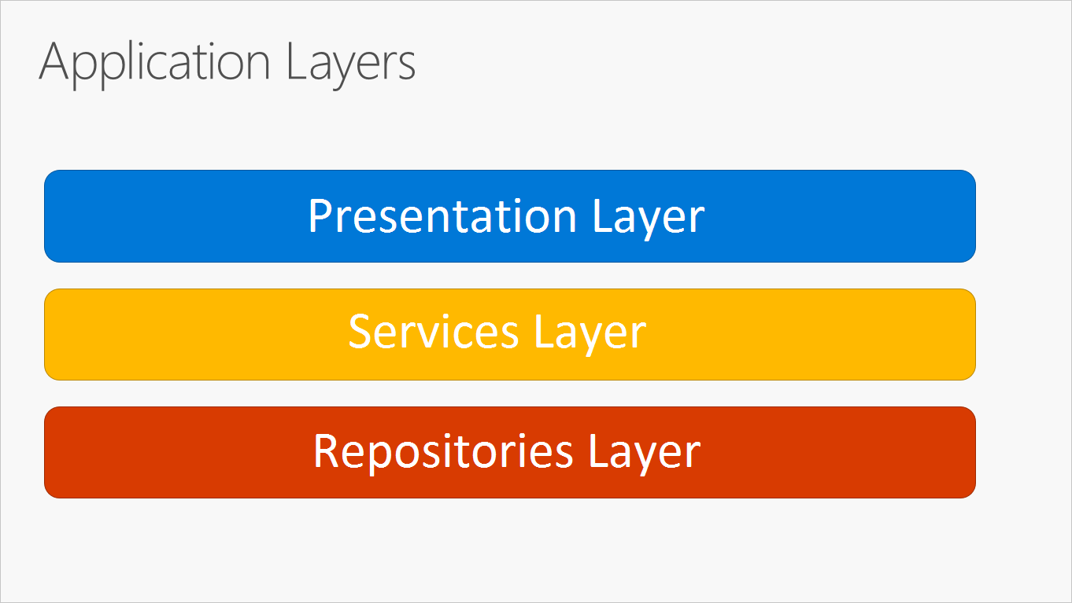
N-Layer Architecture

Slide 12
Let’s get started with the basics

Slide 13
Create a new Console Application in VS

Slide 14
command line interface
dotnet new [console|classlib|web|mvc|…] –n <OUTPUT_NAME>
dotnet build
dotnet run

Slide 15
Even more basics

Slide 16
Most used Data types
Data Type | C++ | Java | C#
Boolean | bool | boolean | bool
Number | int | int | int
Real number | decimal | java.math.BigDecimal | decimal
Nullable Boolean | - | java.lang.Boolean | bool?
Nullable Number | - | java.lang.Integer | int?
Nullable real number | - | java.math.BigDecimal | decimal?
Text | char[∞] | java.lang.String | string

Slide 17
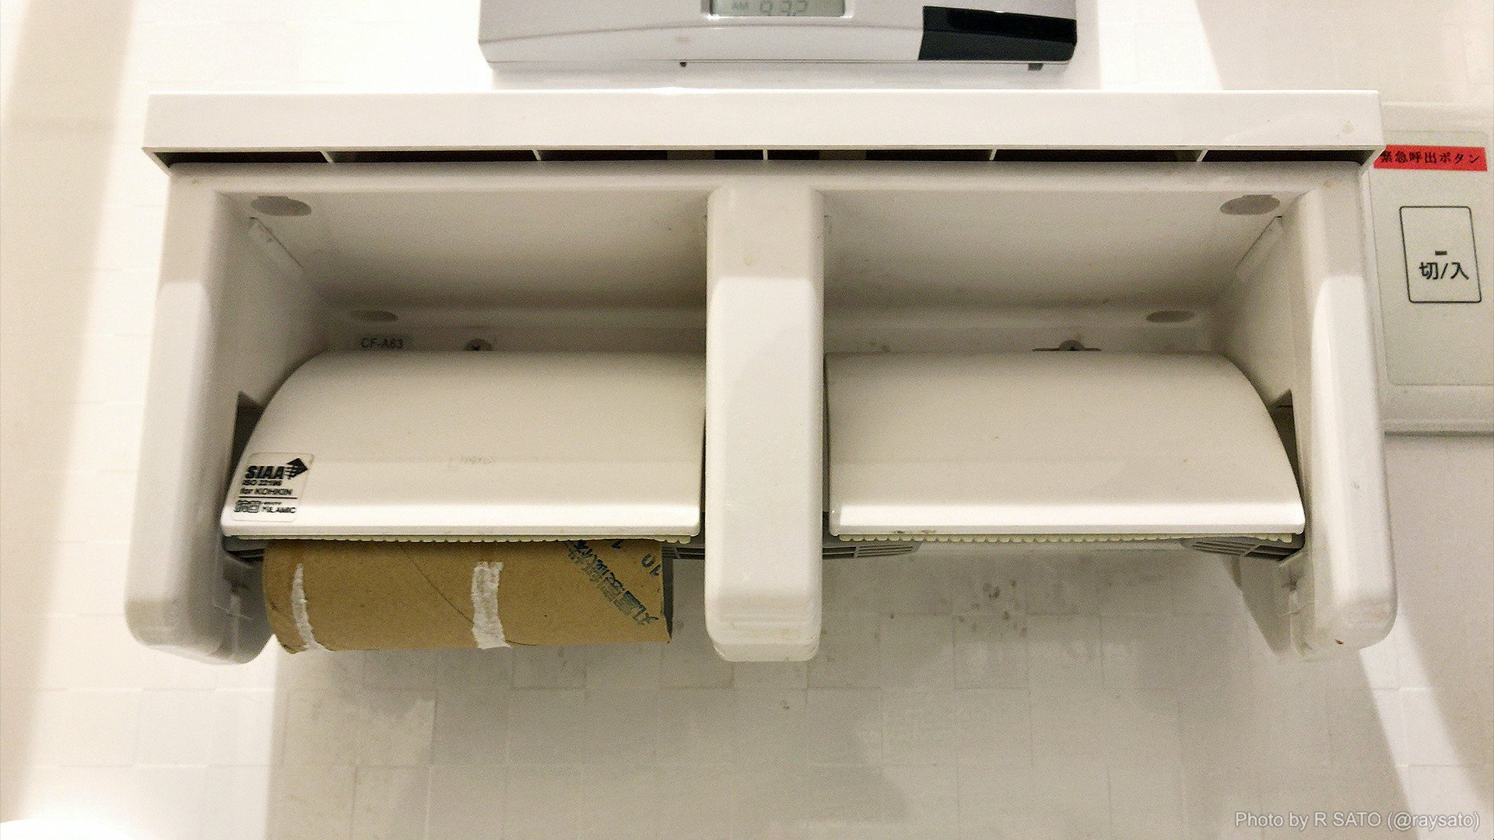
0 vs null

Slide 18
Power of var keyword

Slide 19
How Some people do it
Dictionary<string, string> dict = new Dictionary<string, string>();

Slide 20
How Other people do it
var dict = new Dictionary<string, string>();

Slide 21
Declaration may var-y
Implicitly typed
Explicitily typed
var i = 10;
var user = new User();
var magicResult = GenerateMagicMethod();
var map = new Dictionary<string, string>();
int i = 10;
User user = new User();
Magic magicResult = GenerateMagicMethod();
Dictionary<string, string> map = new Dictionary<string, string>();//this says a lot

Slide 22
Only variables declared at method scope can use var
This works
This doesn’t
public int Number = 1;
public int Increment()
{
var newNumber = Number + 1;
return newNumber;
}
public var Number = 1;
public int Increment()
{
var newNumber = Number + 1;
return newNumber;
}

Slide 23
Only variables with a clear type can use var
This works
This doesn’t
int five;
five = 5;
int six = 6;
var five; //← Compile-Time Error
five = 5;
var six = 6

Slide 24
Classes

Slide 25
Declaring Classes
public class Customer
{
//Fields, properties, methods go here...
}

Slide 26
Creating objects
var object1 = new Customer(); //object1 is a reference to a Customer object

Slide 27
Constructors

Slide 28
Default constructors
If you don't provide a constructor for your class, compiler creates one by default that instantiates the object and sets member variables to the default values.
public class Customer
{
}
var customerObject = new Customer(); //calls default constructor

Slide 29
Constructor syntax
public class Person
{
private string last;
private string first;
public Person(string lastName, string firstName)
{
last = lastName;
first = firstName;
}
}
var person1 = new Person("John", "Doe");
var person2 = new Person(); //<--Doesn't work

Slide 30
Constructor syntax
public class Person
{
private string last;
private string first;
public Person(string lastName, string firstName)
{
last = lastName;
first = firstName;
}
public Person()
{
}
}
var person1 = new Person("John", "Doe");
var person2 = new Person(); //<--Works now

Slide 31
Methods

Slide 32
Methods
A method is a code block that contains a series of statements. In C#, every executed instruction is performed in the context of a method.

Slide 33
Method signatures
Methods are declared in a class or struct by specifying:
An optional access level, such as public or private (default).
The return value, or void if the method has none.
The method name.
Any method parameters, enclosed in parentheses and separated by commas. Empty parentheses indicate that the method required no parameters.

Slide 34
Method signatures
public void Method(int a, int b=1)
Because of the optional parameter b this method can be called in two ways:
Method(2, 5);
Method(2);//b will be 1
Access level
Method name
Return type or in this case void
Method parameters

Slide 35
Inheritance

Slide 36
Inheritance
public class Angajat
{
public string Name {get;set;}
}
public class Developer: Angajat
{
public string Tehnologie {get;set;}
}
var unicornDeveloper = new Developer();
unicornDeveloper.Name = "John Doe";
unicornDeveloper.Tehnologie = “.NET Core";

Slide 37
Inheritance
public class Angajat
{
public string Name {get;set;}
public Angajat(string name)
{
Name = name;
}
}
public class Developer: Angajat
{
public string Tehnologie {get;set;}
public Developer(string name, string tehnologie): base(name)
{
Tehnologie = tehnologie;
}
}
var unicornDeveloper = new Developer("John Doe", “Brainfuck");

Slide 38
polymorphism

Slide 39
Virtual and override
public class Rectangle
{
public int Length {get;set;}
public int Width {get;set;}
public virtual int Area()
{
return Length * Width;
}
}
public class Square : Rectangle
{
public override int Area()
{
return Length * Length;
}
}
var rectangle = new Rectangle {Length = 2, Width = 3};
rectangle.Area(); // returns 6
var square = new Square {Length = 2};
square.Area(); // returns 4

Slide 40
Generics

Slide 41
Cool! En-List ME

Slide 42
Lists
var integerList = new List<int>();
integerList.Add(2);
integerList.Add(3);
integerList.Add(5);
integerList.Add(6);

Slide 43
ITERATING
for(var i = 0; i < integerList.Count; i++)
{ Console.WriteLine(integerList[i]);
}
foreach(var integer in integerList)
{
Console.WriteLine(integer);
}
integerList.ForEach(integer => Console.WriteLine(integer)); //Next chapter

Slide 44
Basic usage
myList.Add();
myList.AddRange();
myList.Remove();
myList.RemoveAt();
myList.RemoveRange();

Slide 45
LINQ

Slide 46
Linq sintaxes
Method Sintax
Query Sintax
var names = collection
.Where(item => item.Name == "Fred") .OrderBy(item => item.Age)
.Select(item => item.FullName);
var names = from item in collection
where item.Name == "Fred"
order by item.Age
select item.FullName;

Slide 47
Linq sintaxes
Method Sintax
Query Sintax
var names = collection
.Count(item => item.Name == "Fred");
var names = (from item in collection
where item.Name == "Fred"
select item).Count()

Slide 48
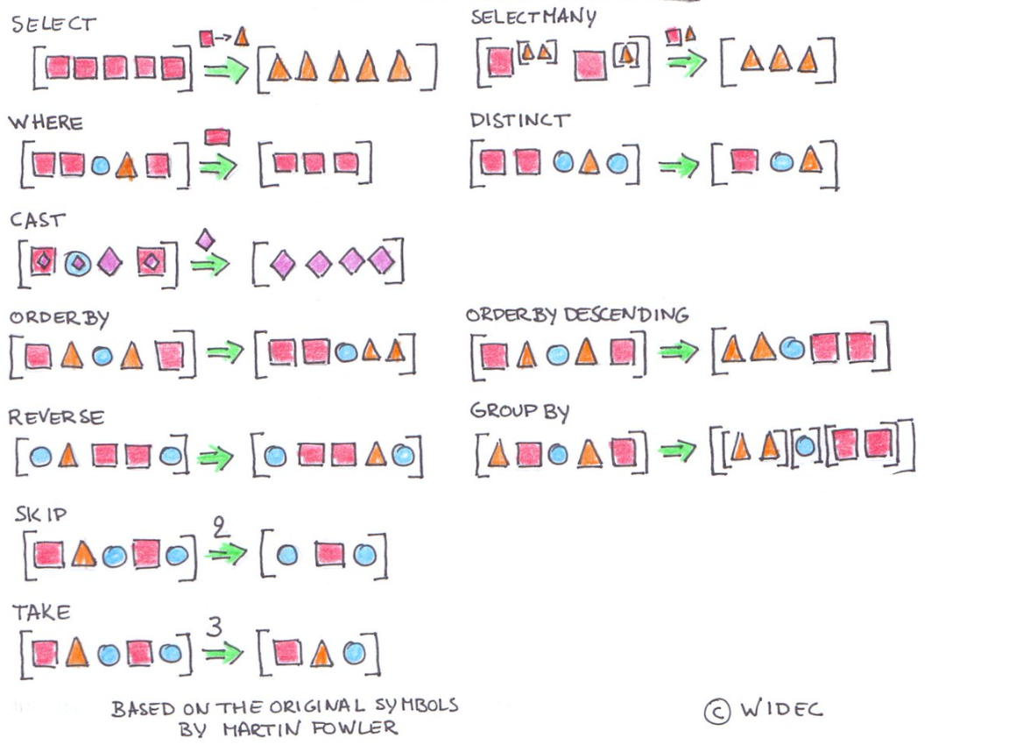

Slide 49
practice

Slide 50
N-Layer

Slide 51
N-Layer Architecture

Slide 52
Facebook

Slide 53


How Facebook uses diferent presentation layers
https://www.facebook.com/ExpertNetwork/
https://m.facebook.com/ExpertNetwork/

Slide 54
Entity Framework Core

Slide 55
Database

Slide 56
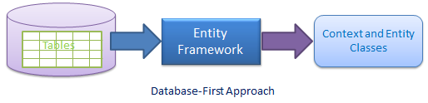
Create classes using an existing database

Slide 57
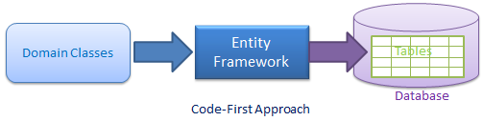
Create a Database using existing classes

Slide 58
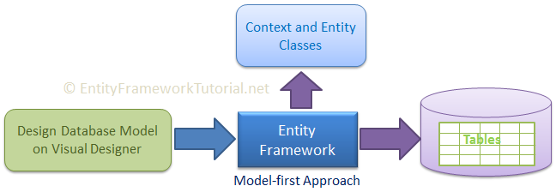
There is another one but we will not talk about it

Slide 59
Code first

Slide 60
Create a new Class Library
dotnet new sln –n CodeFirst
dotnet new classlib –n CodeFirst.Data –f netcoreapp2.2
dotnet sln list
dotnet sln add CodeFirst.Data/CodeFirst.Data.csproj
dotnet sln list

Slide 61
Prerequisites
cd CodeFirst.Data
dotnet add package Microsoft.EntityFrameworkCore.SqlServer
dotnet add package Microsoft.EntityFrameworkCore.Design
dotnet add package Microsoft.EntityFrameworkCore.Tools --version 2.2.2

Slide 62
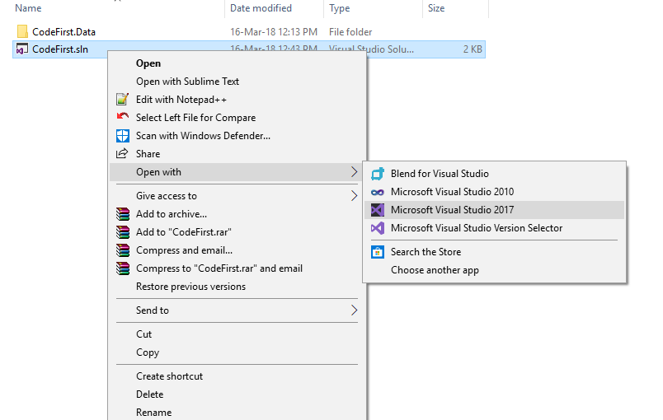
Open the Solution

Slide 63
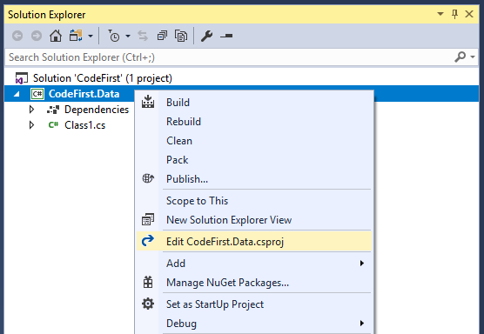
Edit the Class Library project

Slide 64
The added CLI commands
dotnet ef dbcontext list
dotnet ef dbcontext info
dotnet ef migrations list
dotnet ef migrations add <Migration Name>
dotnet ef migrations remove <- removes the last migration

Slide 65
Let’s make a simple DB

Slide 66
Add an Entity (class that represents a table)
public class User
{
public int Id { get; set; }
public string Name { get; set; }
}

Slide 67
Add A Context (class that represents a database)
public class TestContext : DbContext
{
public DbSet<User> Users { get; set; }
protected override void OnConfiguring(DbContextOptionsBuilder ){…}
}

