Slide 1
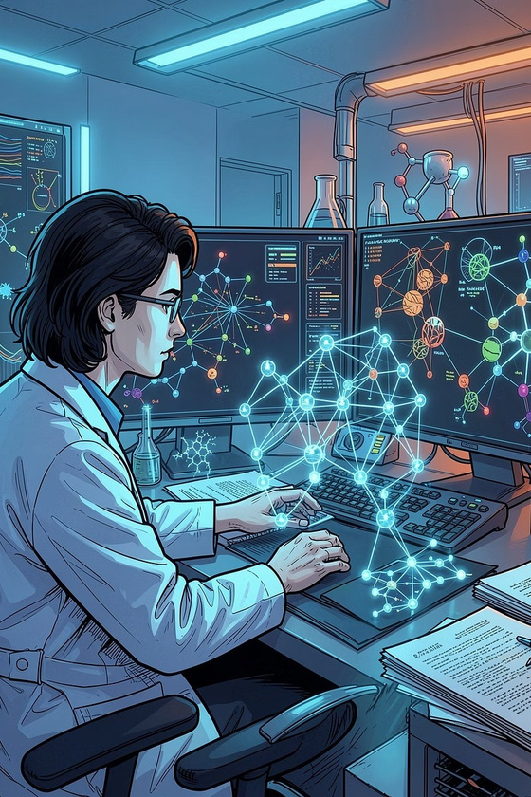
From Papers to Precision: Building Biomedical Intelligence at Scale
A Practical Framework for Extracting Biomedical Knowledge from Scientific
Literature
Alexandru Ghiuruțan · NLP Engineer and
PhD Student at Technical University of Cluj-Napoca

Slide 2
Contents
The
From Text to Structured
The Extraction
Hybrid
Enterprise
Biomedical Literature
GraphRAG
Impact
Claims
Pipeline
Problem
1
2
3
4
5
6
7
8
9
10
Why Retrieval Alone Is Not
Why Relations and Evidence
Graph-Based
Demo Flow
Key
Intelligence
Takeaways
Enough
Matter

Slide 3

The Biomedical Literature Bottleneck
35M+ Papers
Published and growing — impossible to read manually
Fragmented Evidence
Critical findings scattered
across separate publications
No Inherent Structure
Scientific claims lack machine-readable form and traceability
The challenge is not finding papers — it is extracting and connecting knowledge from them.

Slide 4
The Scale of Biomedical Publishing
PubMed, a free resource supporting the search and retrieval of biomedical and life sciences literature, offers a glimpse into the
immense volume of scientific output:
36.5M
1.57M
130K
Cumulative total citations in PubMed
Papers added to PubMed (1,567,478
Approximate average papers added monthly
citations) — most recent official NLM data
14%+
11.9%
Annual compound growth rate in anti-
Year-over-year growth in scientific
cancer drug research (2024), up from 6% cancer share in 1950 to 16%+ today
publishing in 2025, with 8.3% CAGR from 2022–2025
This massive volume of literature makes manual review and knowledge extraction an impossible task for humans.

Slide 5
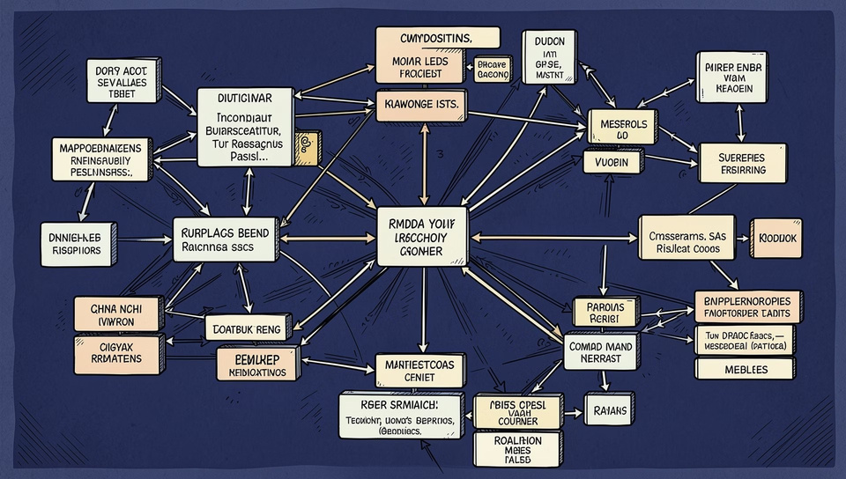
From Papers to Biomedical Intelligence
What WeStart With
Unstructured abstracts and full-text articles
Free-form language, inconsistent
terminology
What We Need to Produce
Identified entities, relations and claims
Supporting evidence with provenance
Cross-document knowledge connections
A useful biomedical AI system must convert literature into machine-readable, evidence- grounded knowledge.

Slide 6
How We Represent and Compare Scientific Text Today
Embeddings
Semantic representations for document and sentence comparison
Cross-Encoders
Precise relevance scoring for query–passage pairs
NLI / Entailment Models
Claim comparison and logical relationship detection
Semantic Search
The current baseline — powerful for matching, limited for reasoning
These tools match language well — but semantic similarity is not scientific reasoning.

Slide 7
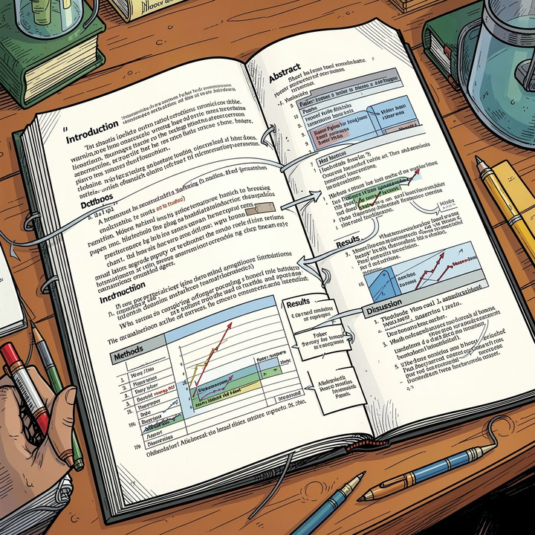
The Within-Paper Challenge
scattered across sections with no explicit link:
A single paper contains critical insights—but they are
Introduction
Methods
"EGFR mutations are associated with lung cancer progression."
"Samples processed using RNA sequencing with paired-end reads."
Results
Discussion
"Found 47 novel variants in the EGFR pathway across cohorts."
"Variants may affect drug response in targeted therapies."
The answer is fragmented across sections. Standard search cannot connect these insights into a coherent finding.

Slide 8
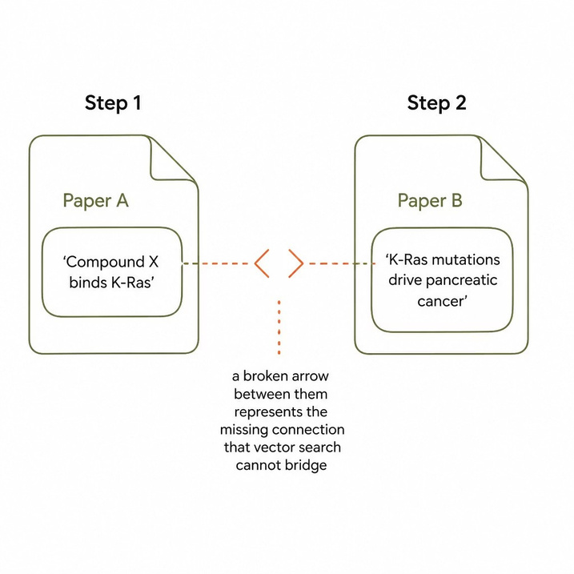
Why Standard Vector Retrieval Falls Short
The Multi-Hop Problem
Paper A: CompoundXbindsto K-Ras
Paper B: K-Ras mutations drive pancreatic cancer
A query about pancreatic cancer treatments retrieves Paper
B — but misses the therapeutic link in Paper A.
The answer is distributed across documents. Vector similarity cannot bridge that gap.

Slide 9
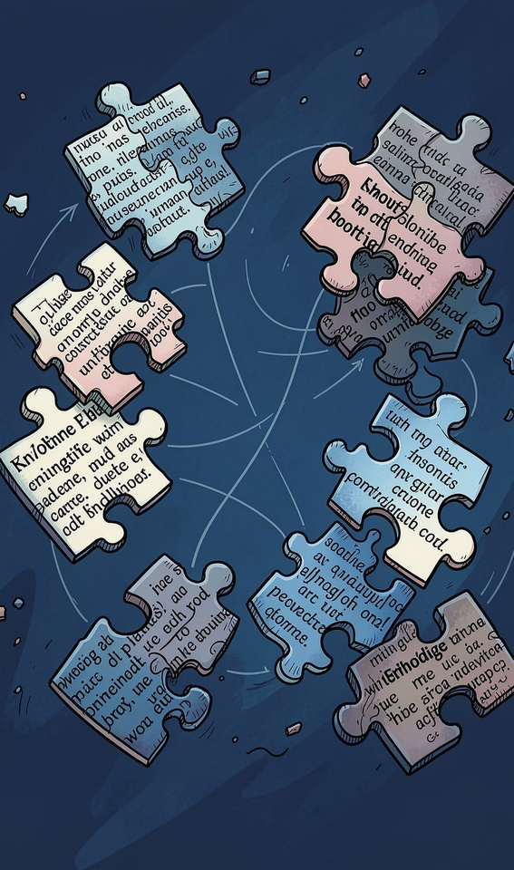
Why Extracting Knowledge Matters
Answers Are Split Across Papers
No single publication contains the complete picture
Critical Links Are Implicit
Important relationships may never be stated in one place
Retrieval ≠ Understanding
Access to documents is not the same as structured knowledge
Biomedical AI Needs Connected Facts
Not just similar passages—but linked, typed, evidence-backed
claims

Slide 10
The Knowledge Extraction Pipeline
Document
Named Entity
Text Chunking
Ingestion
Recognition
This pipeline transforms free-text scientific literature into structured, traceable, machine-readable knowledge — ready for graph storage and multi-hop reasoning.

Slide 11
Why NER Alone Does Not Solve the Problem
Extracting Entities Is the Starting Point
The Real Questions Remain Unanswered
Does Osimertinib inhibit EGFR?
Is the relation experimentally supported or merely
mentioned?
What is the evidence sentence?
EGFR
Gene
Osimertinib
Drug
The value lies in relations, evidence, and context — not entity labels alone.

Slide 12
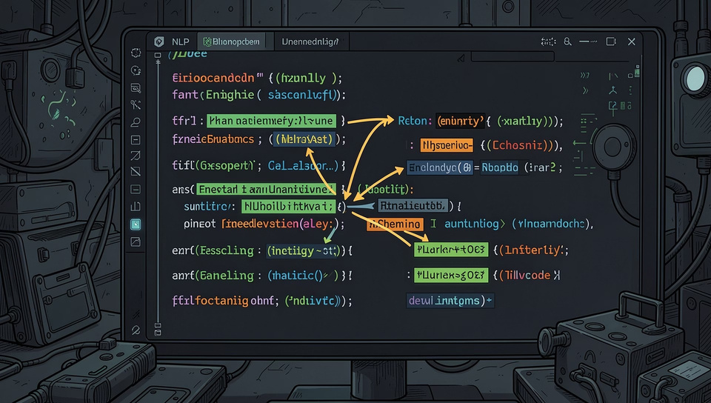
Scalable Biomedical Triplet Extraction
GLiNER-Relex
Specialized zero-shot relation extraction model
Head
→
Relation
→
Tail
Structured triplets from unstructured text
Scale Without Labels
No large manual annotation required

Slide 13
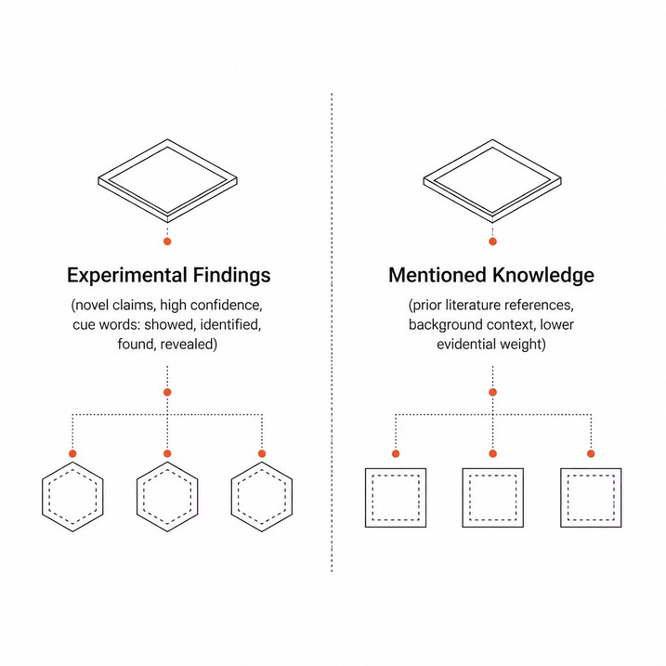
Experimental Findings vs. Mentioned Knowledge
Why It Matters
Contextual cue words classify statement strength — separating novel evidence from background mention improves downstream reasoning quality.

Slide 14
From Extracted Claims to a Knowledge Graph
Node Types
Relationship Types
Gene
Disease
INHIBITS
REGULATES
Chemical
Variant
MUTATES
INTERACTS_WITH
Chunk
Schema reflects both biomedical meaning and retrieval needs.

Slide 15
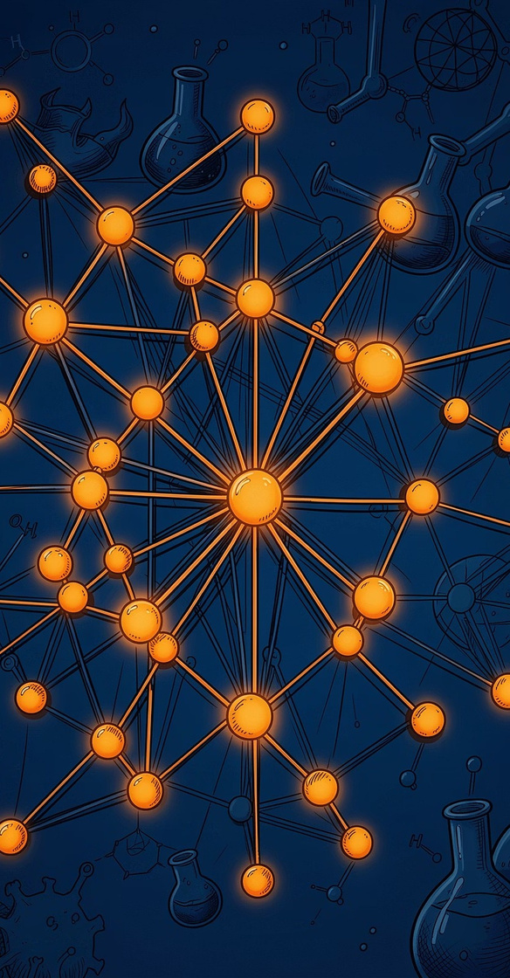
Native Graph Storage for Biomedical Intelligence
Native Traversal
Relationship-first querying at scale
ACID-Compliant
Transactional integrity for scientific data
Vector Indexes
Semantic+graph search coexist
Reasoning Layer
Not just storage—operational intelligence

Slide 16
Building a Reusable Knowledge Base
Canonicalize
entities
Store embeddings
Extract triplets
Link claims to
sources
Each step ensures the graph remains normalized, traceable, and queryable across millions of papers.
Example: EGFR in 1,000 papers → one canonical node linked to many evidence sources.

Slide 17
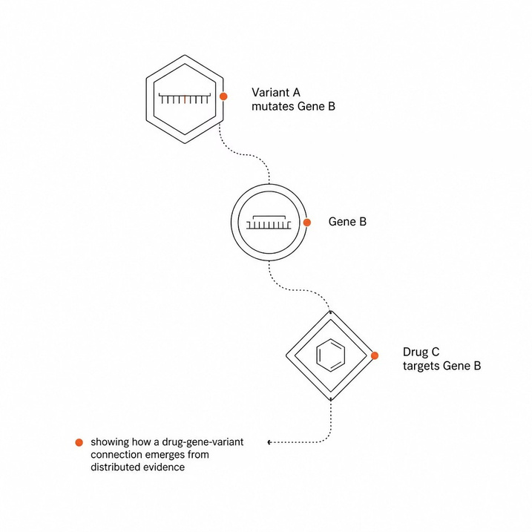
How Multi-Hop Discovery Works
Reasoning Hop
A traversal path revealing a connection distributed across
sources.
1
Variant A
2
Gene B
3
Drug C

Slide 18
Combining Semantic Retrieval and Graph Traversal
Vector Search
Retrieve
Expand
Send Triples
Chunks
Graph
+ Evidence
Hybrid GraphRAG unifies semantic search flexibility with graph structure precision.

Slide 19
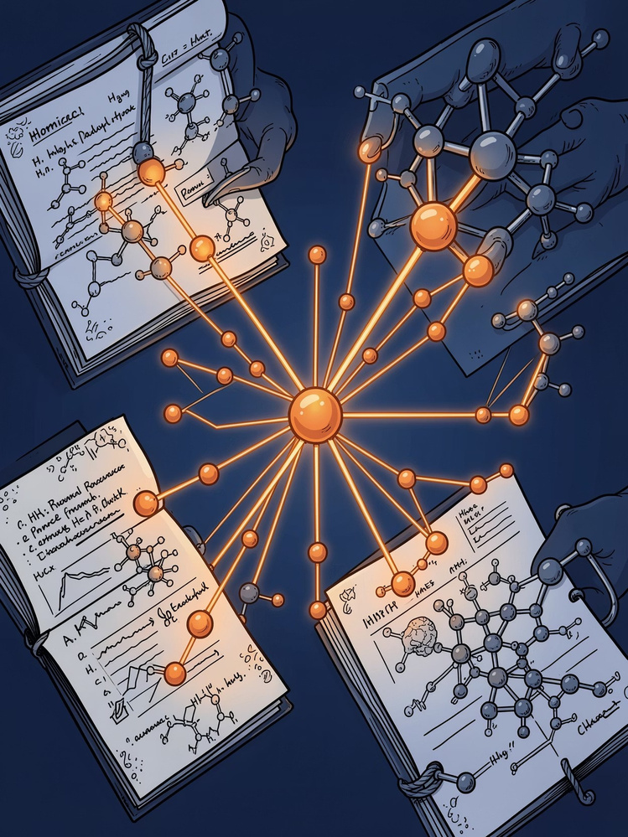
Why Hybrid Retrieval Improves LLM Outputs
Structured + Raw Context
LLM receives both facts and supporting text
Provenance Built-In
Every claim traceable to source chunks
Reduced Hallucination
Grounded prompts yield precise, explainable
responses
Example: BRAF V600E → mutates → BRAF ← inhibited by ← Vemurafenib

Slide 20
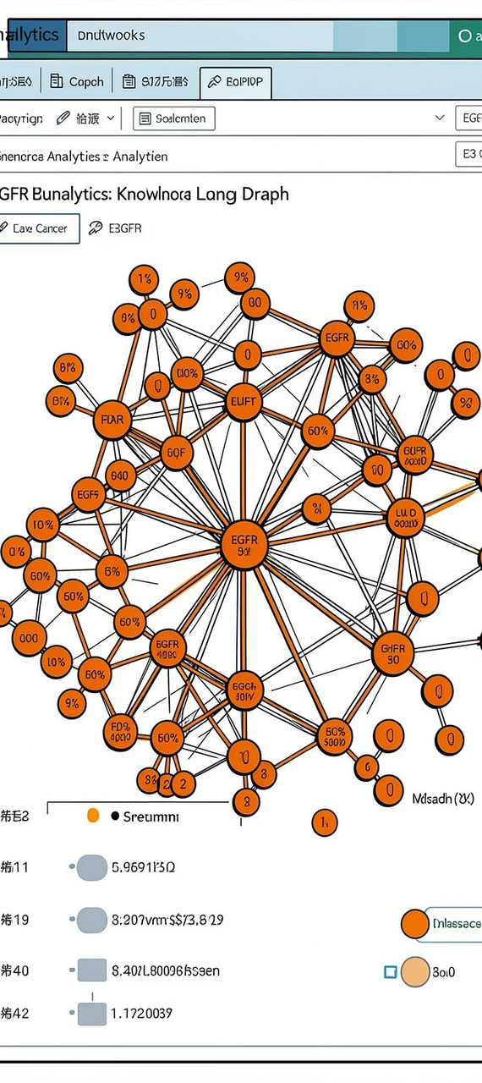
From PubMed Abstracts to Biomedical Intelligence
1
Fetch PubMed abstracts
2
Extract triplets
3
Store in Neo4j
4
Visualize & query
Traceability
Scalable Updates Retrieval Completeness Reasoning Guardrails

Slide 21
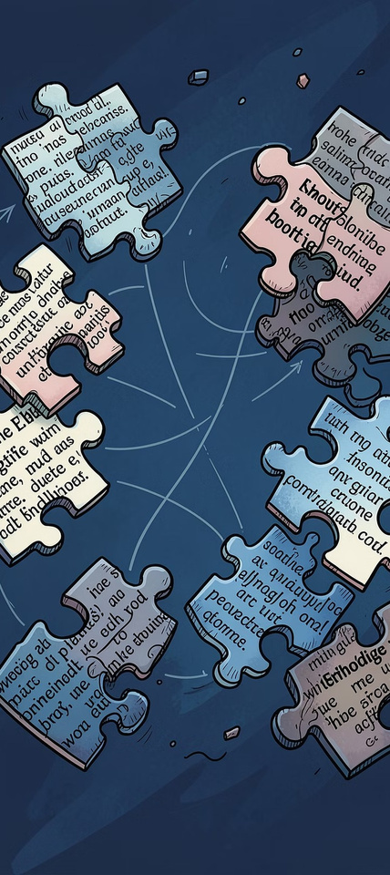
Thank you for your kindly attention!
Questions please!

