Slide 1
Car Recognition
Team
Niculae Alexandru 934
Paul Muresan 931

Slide 2
What we are going to talk about?
Introduction
Problem Definition
Cars Dataset
Friendliness
Results
Conclusions
Bibliography

Slide 3

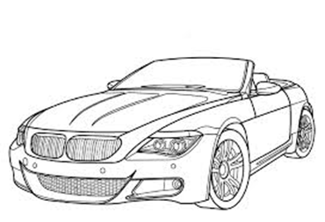
Introduction
Our objective is to compare TensorFlow and Keras when it comes to Convolutional Networks used in the classification of cars.
Both libraries are used for Machine Learning and other Artificial Intelligence related research.
The question we are trying to answer is which one is more programmer friendly and which one is more efficient or more powerful.

Slide 4



Tutorials
Here we are comparing the Convolutional Networks results provided by each tutorial on the MNIST dataset:
According to TensorFlow’s website it obtains an average of 99.2% accuracy;
The Keras guide results in an accuracy of over 99.25% on the same set

Slide 5
Problem Definition
In order to compare them on a different and much more complicated dataset rather than MNIST, we will use a dataset of cars in which the network is tasked with recognizing the car's producer and model from the image.

Slide 6
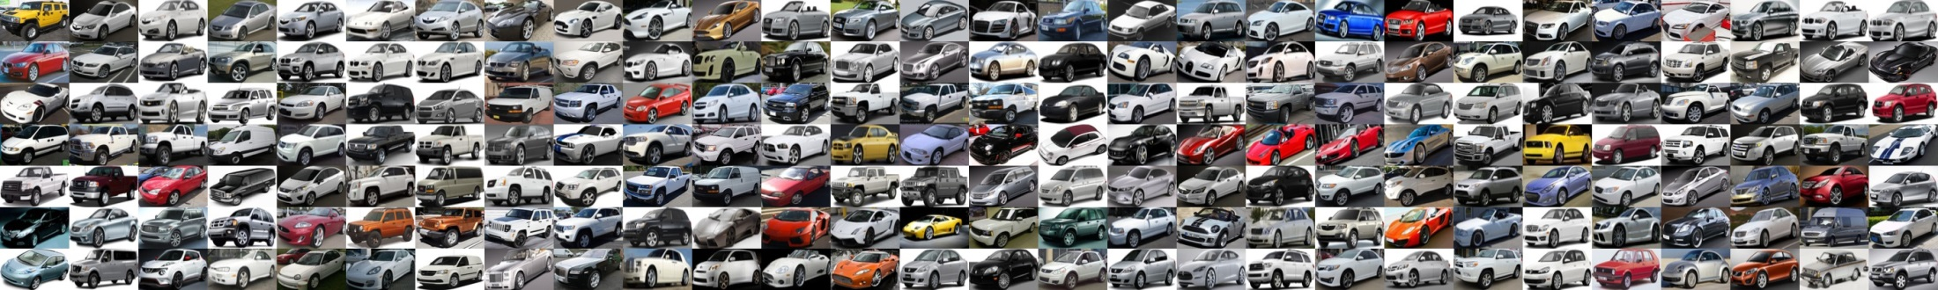
Cars Dataset
The dataset contains 16,185 images of 196 classes of cars. The data is split into 8,144 training images and 8,041 testing images, where each class has been split roughly in a 50-50 split.

Slide 7
Friendliness
Keras (plug and play)
After installation it can be used right away.
Building a convolution neural network its like pushing onto a stack.
Easy and straight forward.
More ‘pythonic’
TensorFlow (double check)
Tutorials are very in-depth
Each convolution layer is built step by step
Far more control over behavior
More of a C++

Slide 8
Results
The results obtained by the algorithms 3000 images that include both training and testing images are:
Keras: ~ ??%
TensorFlow: ~??%

Slide 9
Conclusions
When it comes to building a fast AI that should work right away Keras is the most recommended.
If more resource managing is required or different behavior is wanted in certain parts of the AI then TensorFlow allows for a very detailed craft.

Slide 10
Bibliography
TensorFlow:
https://www.tensorflow.org/
https://github.com/tensorflow/
Keras:
https://elitedatascience.com/keras-tutorial-deep-learning-in-python
https://keras.io/
Dataset:
http://ai.stanford.edu/~jkrause/cars/car_dataset.html

