Slide 1
PlugHunt
Alexandru Dinu & Ionescu Andrei
Ovidius Highschool Constanta
by ID-CREW

Slide 2
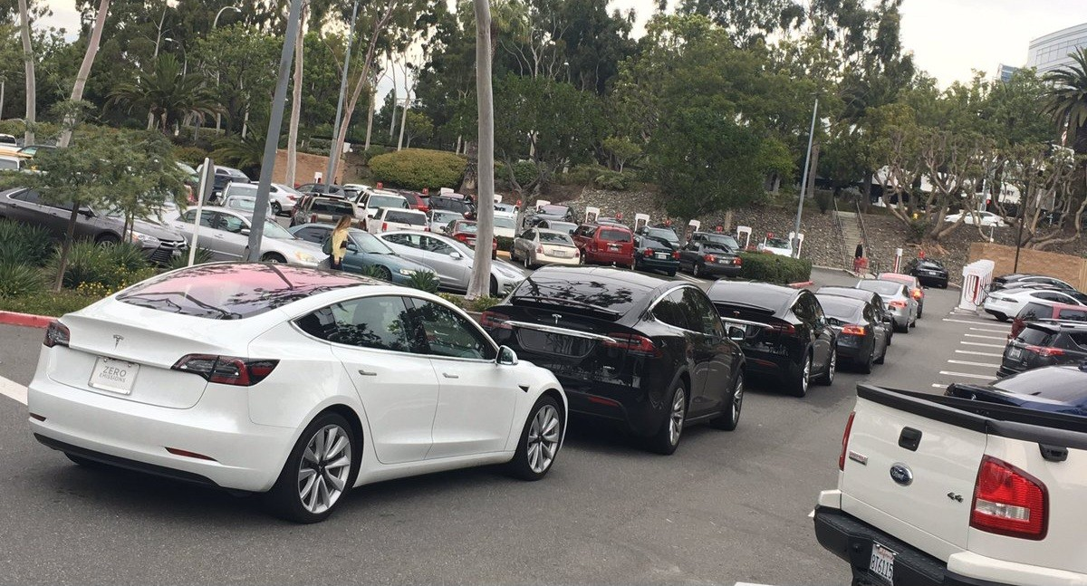
The Problem
Crowded and undersized charging station system

Slide 3

Solution
We develop PlugHunt: Adds more charging stations on the map
Adds sharing feature to the charging stations
Adds new revenue streams for our users

Slide 4

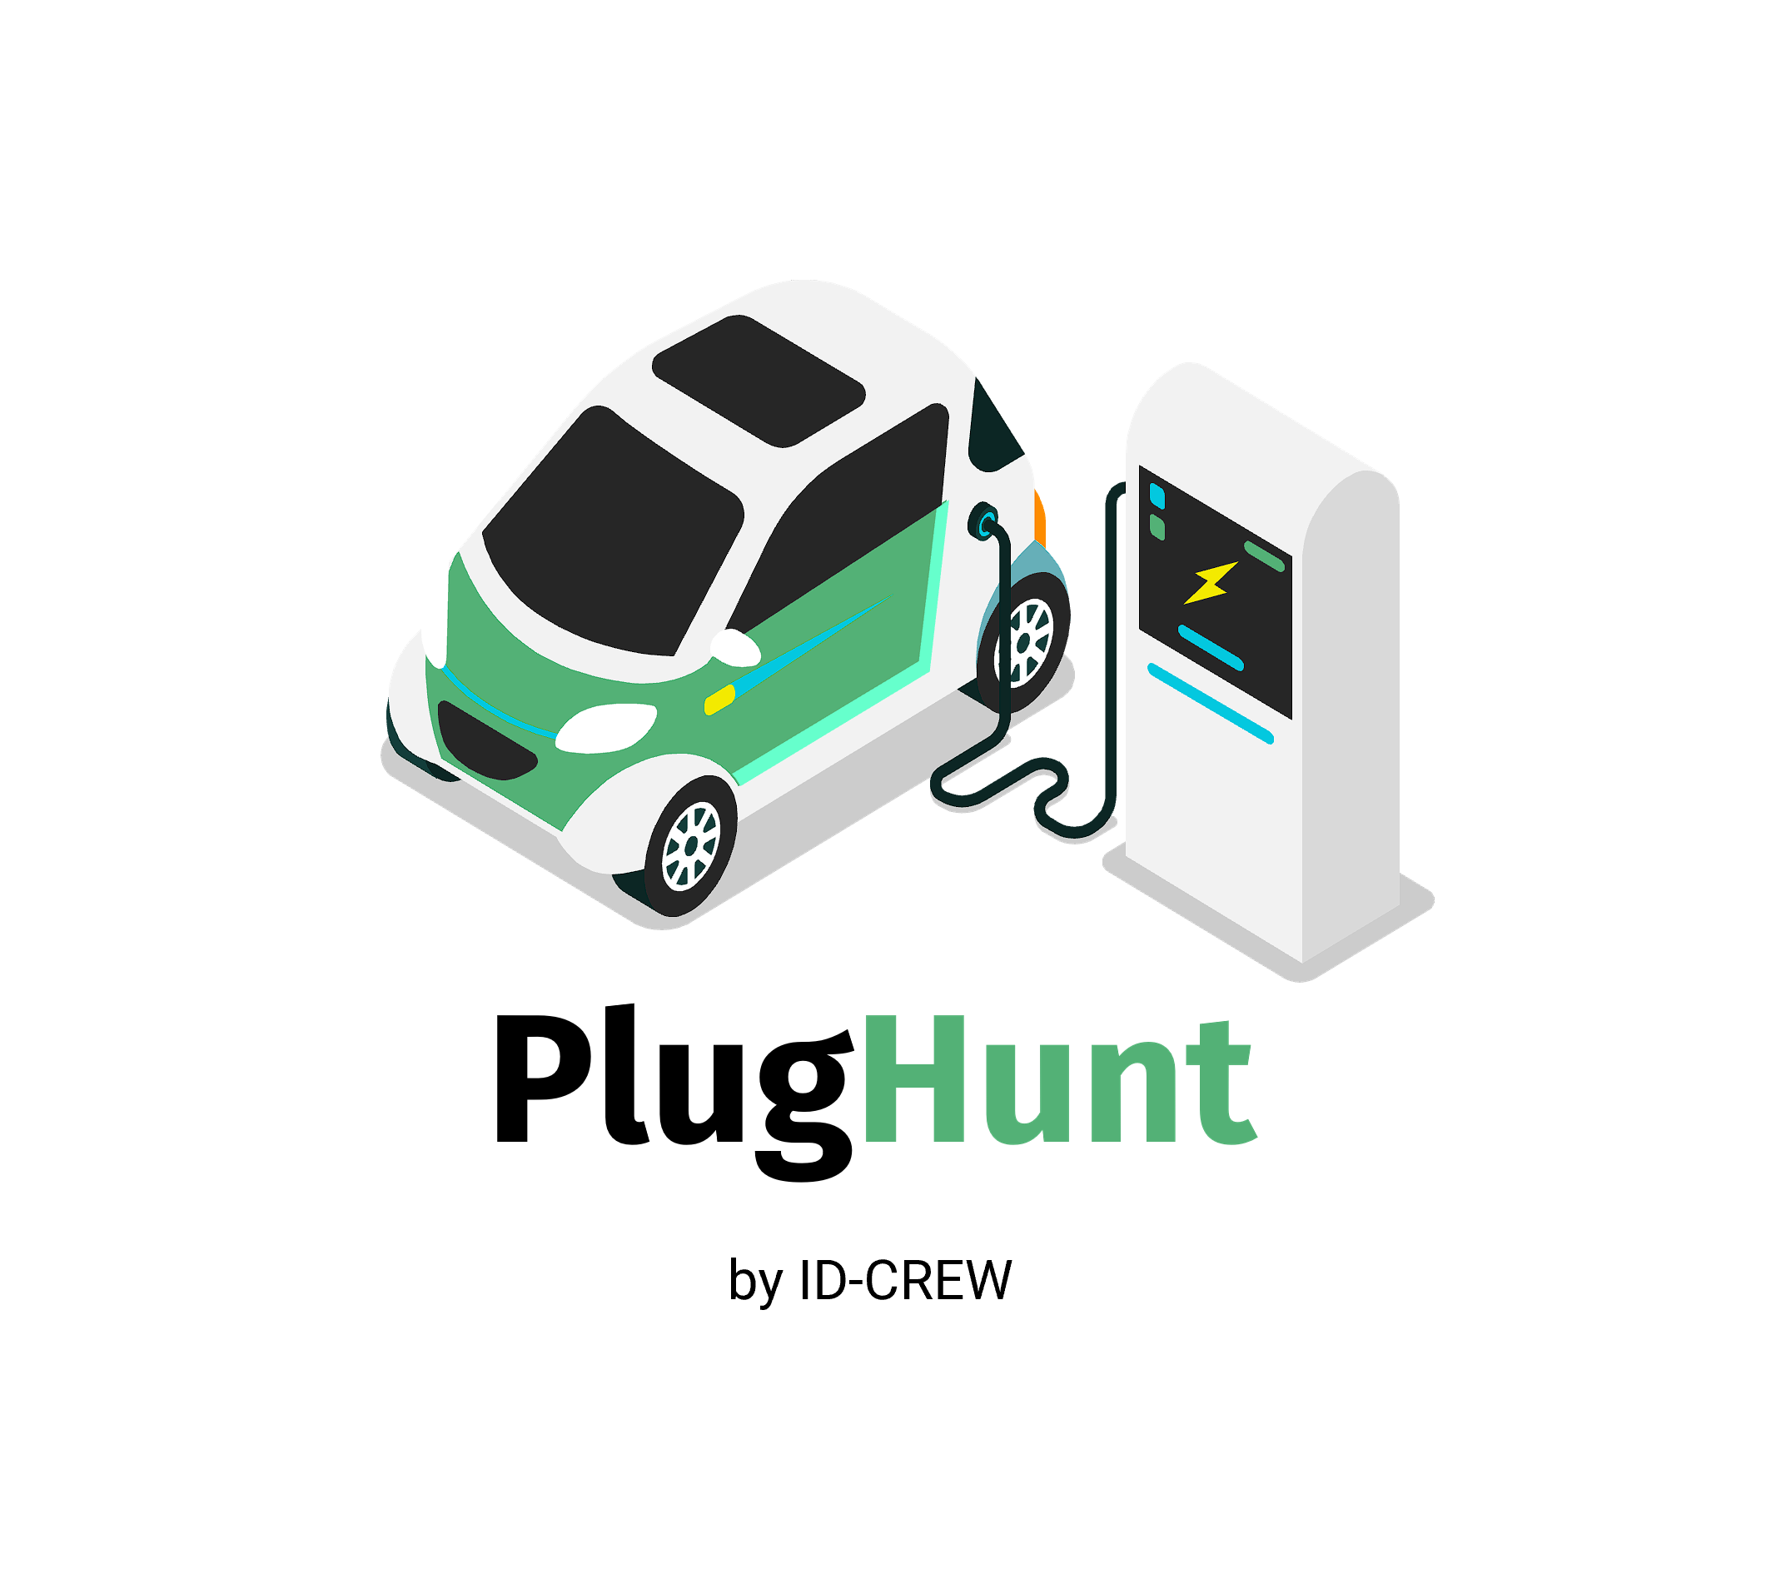




Technologies used to implement solutions

Slide 5
The market
People who urgently need a charging station
People who have invested in their own charging station
Small businesses that would rent out their charging stations

Slide 6


Marketing Strategy

Slide 7
Our competition compared to PlugHunt
Feature/Strategy | PlugHunt | Google Maps | EV Maps Plus | ChargePoint | PlugShare
Data Accuracy | Real-time availability updates, KYC-user | Some outdated data | Regular updates, mostly accurate | High accuracy with verified stations | Highly accurate, user-verified data
Real-Time Data | Strong focus on real-time data for EV charging availability | Bad real-time availability for EV specifics | Good real-time updates | Excellent real-time data and alerts | Excellent real-time data and updates
Features | High community engagement, peer-to-peer rentals, user-driven updates, payment and schedule. | Less community interaction, broad mapping features | Moderate community features, specialized EV navigation | High user engagement, scheduling, payment options | Very high community feedback, detailed station info, trip planning

Slide 8
Our competition compared to PlugHunt
Feature/Strategy | PlugHunt | Google Maps | EV Maps Plus | ChargePoint | PlugShare
Data Accuracy | Real-time availability updates, KYC-user | Some outdated data | Regular updates, mostly accurate | High accuracy with verified stations | Highly accurate, user-verified data
Real-Time Data | Strong focus on real-time data for EV charging availability | Bad real-time availability for EV specifics | Good real-time updates | Excellent real-time data and alerts | Excellent real-time data and updates
Features | High community engagement, peer-to-peer rentals, user-driven updates, payment and schedule. | Less community interaction, broad mapping features | Moderate community features, specialized EV navigation | High user engagement, scheduling, payment options | Very high community feedback, detailed station info, trip planning

Slide 9

How we make money?
01
Transactions to the Platform
02
Withdraws from the platform
03
In App Ads
04
Google AdMob

Slide 10
How much money do we really need to really lunch this?
Development costs: $125,000
Operating costs: $41,400
Marketing and promotion costs: $56,000
Administrative costs: $13,000
Technology and infrastructure costs: $37,000
Total initial investment: $272,400

Slide 11
Here is an improved costs strategy.
Development costs: We develop, innovate 0 costs.
Operating costs: $20,000
Marketing and promotion costs: $15,000
Administrative and other costs: $15,000
Technology and infrastructure costs: Initially 0.
Total: $50,000 < €50,000 => a good candidate for Startup Nation

Slide 12
LIVE DEMO

Slide 13
Q&A

