Slide 1

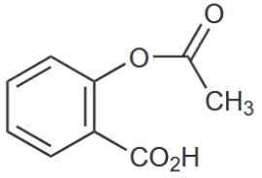
Determination of pH-Dependent Aspirin Hydrolysis Rate Constants
By Steven Nixon*
Marrs, P. S. Class Projects in Physical Organic Chemistry: The Hydrolysis of Aspirin.
Journal of Chemical Education 2004, 81 (6), 870.

Slide 2
Overview
Experiment closely follows Marrs’ paper
Aims to gather and interpret kinetic data about aspirin
Uses UV-vis spectroscopy and buffers to test at various pH’s
Different pH’s have different mechanisms
Marrs, P. S. Class Projects in Physical Organic Chemistry: The Hydrolysis of Aspirin.
Journal of Chemical Education 2004, 81 (6), 870.

Slide 3
Aspirin Information
Common medication used to reduce headaches, blood clots, arthritis symptoms, etc.
Chemical name is acetylsalicylic acid
Carboxylic acid that can undergo different mechanisms
Reactions occur here
Aspirin: MedlinePlus Drug Information. https://medlineplus.gov/druginfo/meds/a682878.html (accessed Apr 4, 2022).

Slide 4
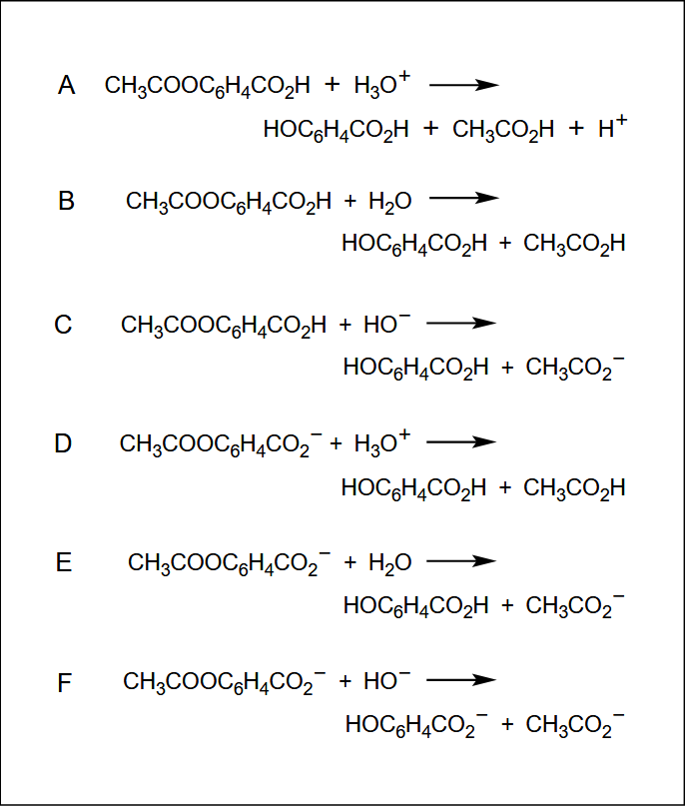
Possible Mechanisms
Depend on pH
Hydrolysis reactions
Can be acid catalyzed, base catalyzed, or spontaneous
Involves protonated or deprotonated acetylsalicylic acid
Marrs, P. S. Class Projects in Physical Organic Chemistry: The Hydrolysis of Aspirin.
Journal of Chemical Education 2004, 81 (6), 870.

Slide 5
Possible Mechanisms
Acid Catalyzed
Spontaneous
Base Catalyzed
Marrs, P. S. Class Projects in Physical Organic Chemistry: The Hydrolysis of Aspirin.
Journal of Chemical Education 2004, 81 (6), 870.

Slide 6
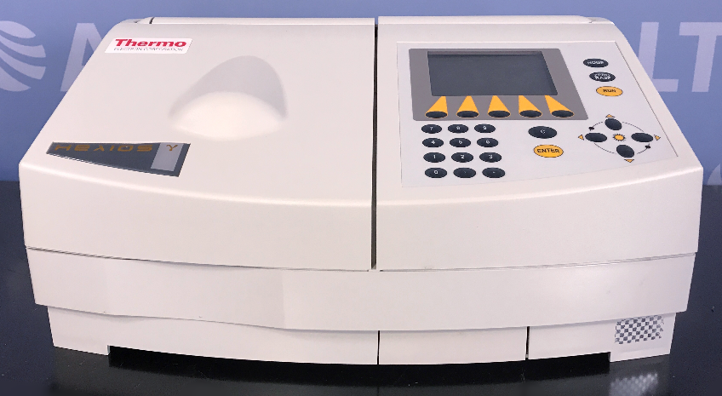
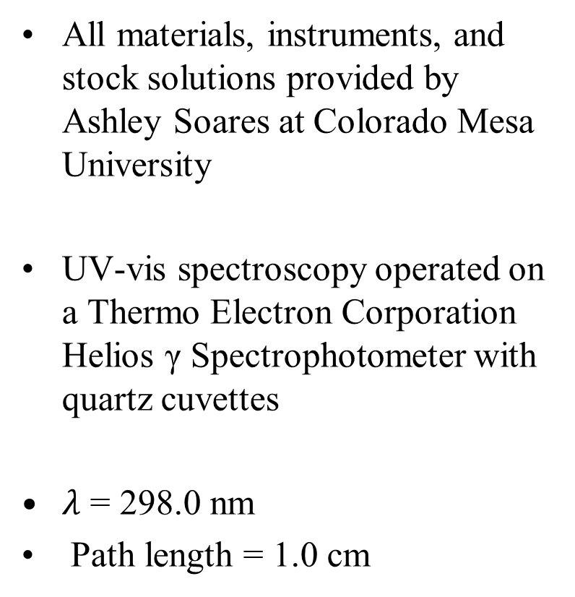
Experimental: General Considerations
All materials, instruments, and stock solutions provided by Ashley Soares at Colorado Mesa University
UV-vis spectroscopy operated on a Thermo Electron Corporation Helios γ Spectrophotometer with quartz cuvettes
$λ$ = 298.0 nm
Path length = 1.0 cm
Read, K. Cozi / Thermo 49C Ozone Monitor. https://amof.ac.uk/instruments/cozi-thermo-49c-ozone-monitor/ (accessed May 5, 2022).

Slide 7
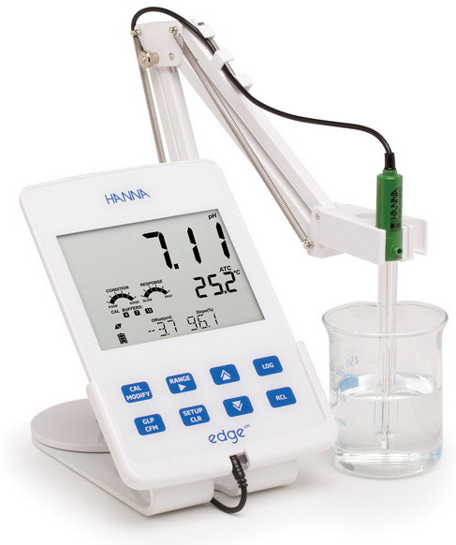
Experimental: General Considerations Cont.
pH’s taken on a Hanna edge pH meter
Buffers stored at ~60 ℃ in a LabLine Aquabath
Spectroscopy performed at room temperature and pressure
Edge ph and ORP meter - HI2002-01: Hanna Instruments.
https://www.hannainst.com/edge-dedicated-ph-orp-meter.html?hsLang=en (accessed May 5, 2022).

Slide 8
Experimental: Buffer Procedure
Twelve buffers were prepared and tested: two per person
Each buffer was made using 0.20 M stock solutions and measured with 100 mL graduated cylinders
4.48 pH buffer created by mixing 25.0 mL D.I H₂O, 25.0 mL NaOH, and 50.0 mL AcOH into a 100 mL plastic bottle
10.21 pH buffer created by mixing 15.0 mL D.I H₂O, 30.0 mL NaOH, and and 50.1 mL of H₃BO₃ into a 100 mL glass bottle

Slide 9
Experimental: All Buffers
HCl (mL)2 | KCl (mL) | AcOH (mL) | KH₂PO₄ (mL) | H₃BO₃ (mL) | NaOH (mL) | H₂O (mL) | pH | Time (mins)
75 | 25 |  |  |  |  |  | 1.0 | 12
2 | 25 |  |  |  |  | 75 | 2.3 | 15
 |  | 100 |  |  |  |  | 2.8 | 15
10 |  |  |  |  |  | 90 | 3.2 | 15
 |  | 50 |  |  | 10 | 40 | 4.0 | 12
 |  | 50 |  |  | 25 | 25 | 4.5 | 12
 |  |  | 50 |  | 40 | 10 | 7.2 | 10
 |  |  | 50 |  | 50 |  | 8.1 | 10
 |  |  |  | 50 | 25 | 25 | 9.2 | 5
 |  |  |  | 50 | 35 | 15 | 9.6 | 3
 |  |  |  | 50 | 42 | 10 | 10.1 | 2
 |  |  |  | 50 | 50 |  | 10.6 | 2

Slide 10
Experimental: Continued
Buffers were tested with pH probe at ~21 ℃ for exact pH’s
~97 mL of each buffer was combined with 1.0 mL of aspirin solution in a 100.00 mL volumetric flask
Aspirin solution was a 100.00 mL volumetric flask of 1.0086 g aspirin in 100% EtOH

Slide 11
Experimental: Continued 2
10.21 pH solution tested roughly every 12 minutes
4.48 pH solution tested roughly every 3 minutes
Every UV-vis scan was performed using the same quartz cuvette
Cuvette was washed with 100% EtOH, dried with compressed air, and rinsed with solution between every reading

Slide 12
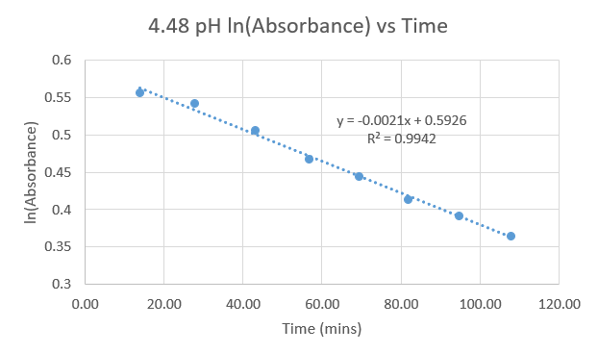
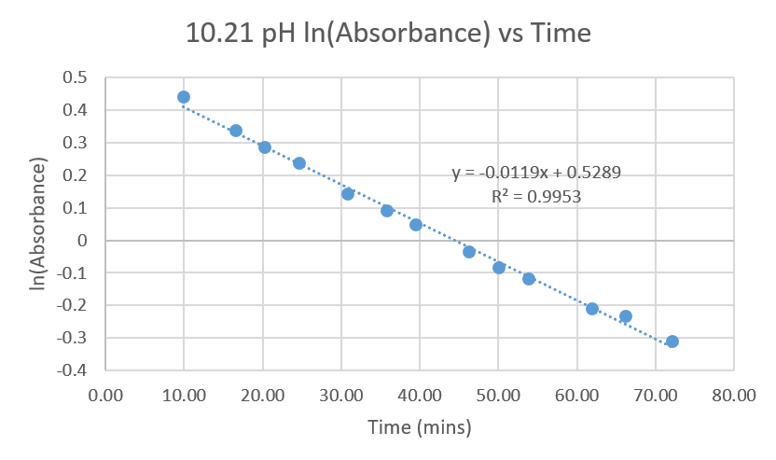
Results and Discussion
Reaction rate is first order because ln(Absorbance) vs time is linear
Reaction rate = -slope
Marrs, P. S. Class Projects in Physical Organic Chemistry: The Hydrolysis of Aspirin.
Journal of Chemical Education 2004, 81 (6), 870.

Slide 13
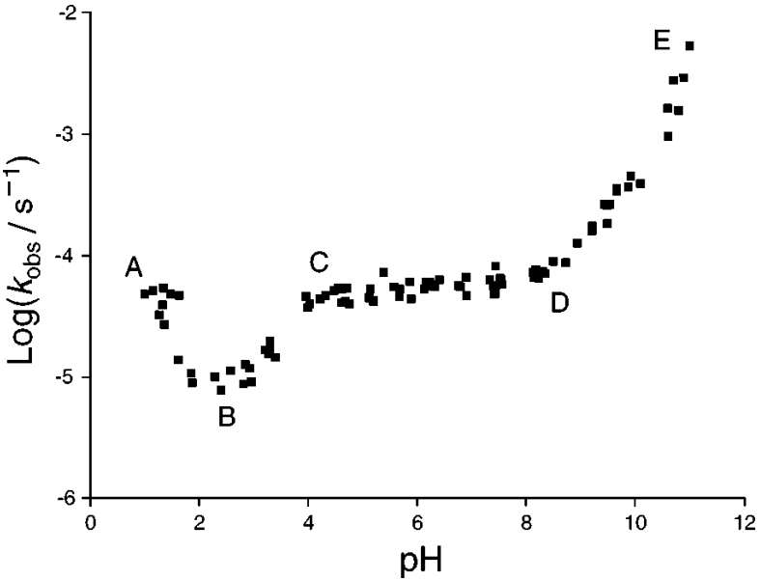
Results and Discussion: Literature Comparison
Observed trends seem to correlate with literature
Note that units and scale have been modified to match literature
Experimental
Literature
Marrs, P. S. Class Projects in Physical Organic Chemistry: The Hydrolysis of Aspirin.
Journal of Chemical Education 2004, 81 (6), 870.

Slide 14
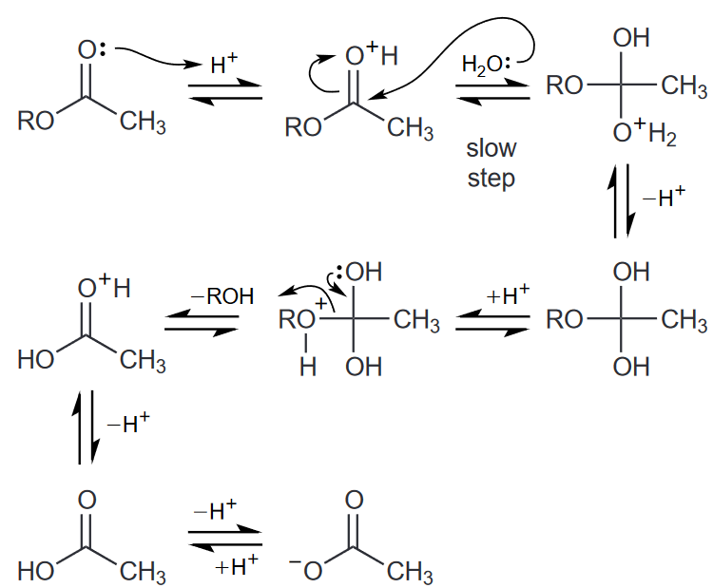
Results and Discussion: Region A
Undergoes specific acid catalysis
Caused by highly acidic conditions
Marrs, P. S. Class Projects in Physical Organic Chemistry: The Hydrolysis of Aspirin.
Journal of Chemical Education 2004, 81 (6), 870.

Slide 15
Results and Discussion: Region B
no evidence of dominance
unlikely
unlikely
Marrs, P. S. Class Projects in Physical Organic Chemistry: The Hydrolysis of Aspirin.
Journal of Chemical Education 2004, 81 (6), 870.

Slide 16
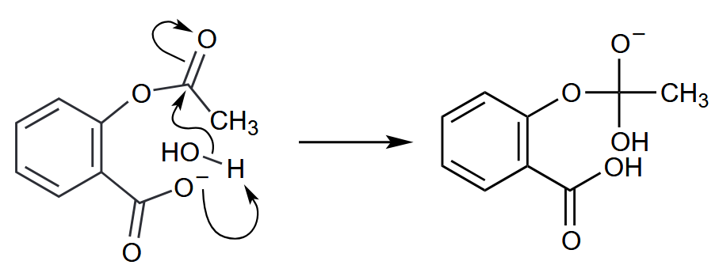
Results and Discussion: Region C
Undergoes spontaneous hydrolysis
Caused by lack of acid or base catalysts
Marrs, P. S. Class Projects in Physical Organic Chemistry: The Hydrolysis of Aspirin.
Journal of Chemical Education 2004, 81 (6), 870.

Slide 17
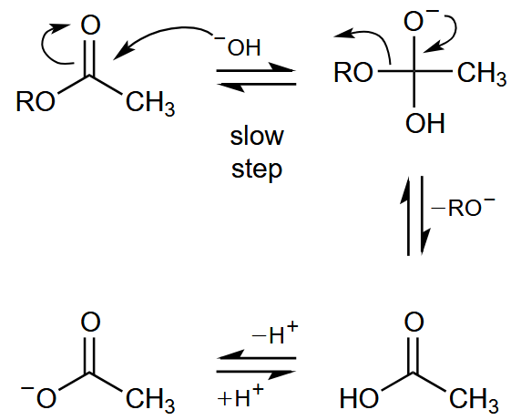
Results and Discussion: Region D
Undergoes base-catalyzed hydrolysis
Caused by highly basic conditions
Marrs, P. S. Class Projects in Physical Organic Chemistry: The Hydrolysis of Aspirin.
Journal of Chemical Education 2004, 81 (6), 870.

Slide 18
Conclusion
Experimental results correlated with Marrs’ paper
Shared Log(k) vs pH trends allowed for the identification of different mechanisms
Marrs, P. S. Class Projects in Physical Organic Chemistry: The Hydrolysis of Aspirin.
Journal of Chemical Education 2004, 81 (6), 870.

Slide 19
Questions?

