Slide 1
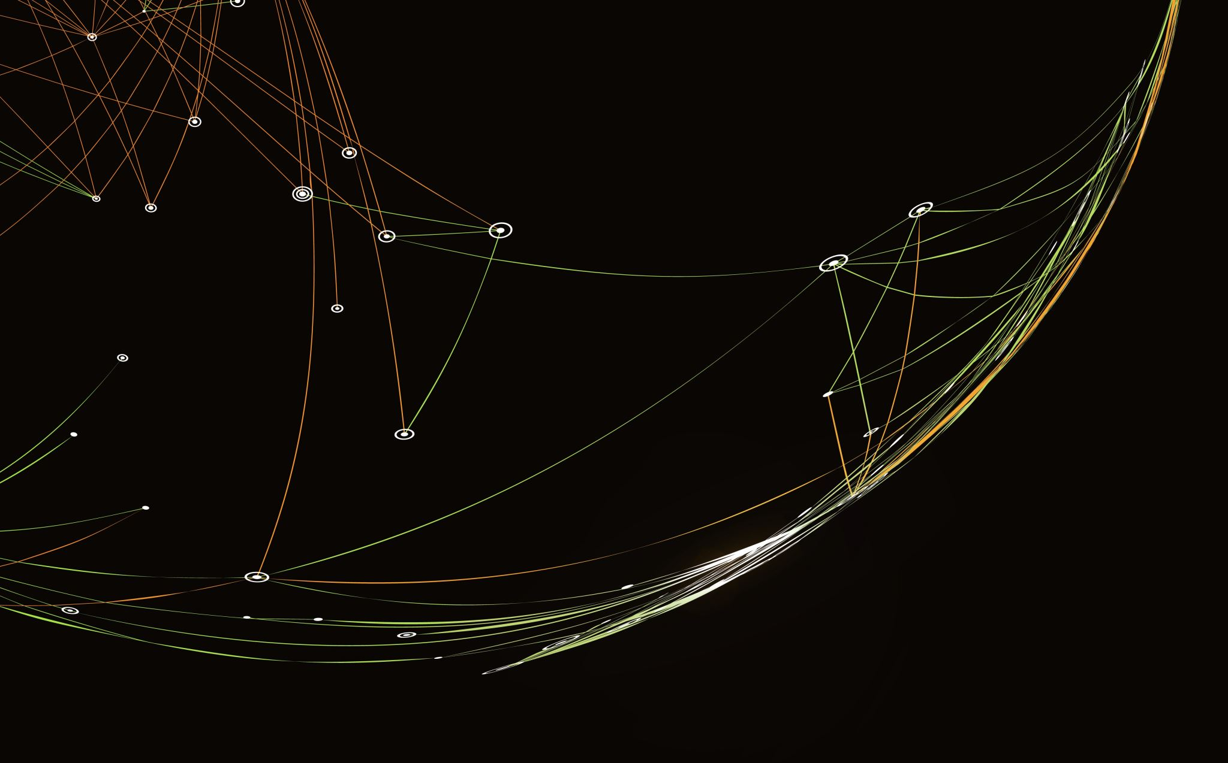
Networks Final Project
James Halladay, Alexander Antoun

Slide 2
Abstract
Use an Arduino to collect sensor data.
Program a socket to act as a server that will:
Receive data from the Arduino.
Listen for a request from a client
Respond to client with sensor data
Arduino read, temperature, humidity, and button status from user
Server appended the time
Used Arduino C, Python, flask via Python, and bash.

Slide 3
Listener.py
Binds the port to the socket program
Listens for connection on a port
Accepts connection
Takes in ~10 seconds worth of Arduino data
Inputs each read into a list,
Writes readings to a csv file
We encountered errors when the input came in too quick and out of order
Created functions that validates input to fix the socket errors that arose from this

Slide 4
Server.py
Simple server using flask
The host ip is given in manager.sh
Loads a given dataset into a pandas dataframe
Once queried, returns the dataset in an html format
Simple API of pandas and flask made this take less than 20 lines of code

Slide 5
Manager.sh
Initially was going to automate the process of sending data file and appending to data file
Initial algorithm was to run both server and listener programs concurrently, and send updated data once the size of the .csv file changed
Ditched the idea due to over-engineering. Plus, didn’t want to flood the network and client with new data
Instead we use it to sequentially launch listener.py to populate the dataset and then server.py to make it accessible to
Written in bash

Slide 6
Arduino
Used the ESP8266 Node-MCU board.
Used a red LED to provide feedback of button push
Used a DHT-11 sensor for temperature and humidity
Initializes serial monitor for debugging,
Initializes WiFi credentials
Waits until it's connected to the specified network
Sets the pins as input and output (as appropriate)
Attempts to establish a connection to the client
In this case, the client is the listener.py program
If unsuccessful, it will reattempt in 5 seconds

Slide 7
Arduino - Continued
Reads the button status, and sets the LED to either a high or low state
Then it sends the state to client
Reads the temperature and sends the read to client
Made a string with the first character as the flag for what's being read
Then it reads the humidity and sends to client
Similarly, it will send the data as a string with a different flag to indicate data
Rinse and Repeat

Slide 8
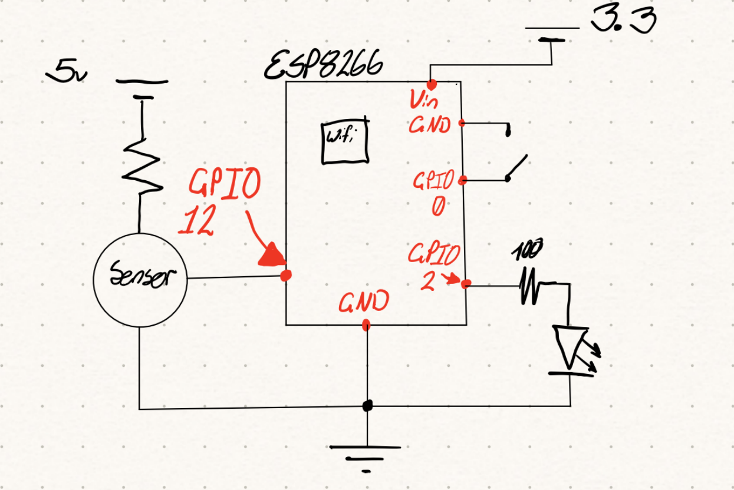
Circuitry

Slide 9
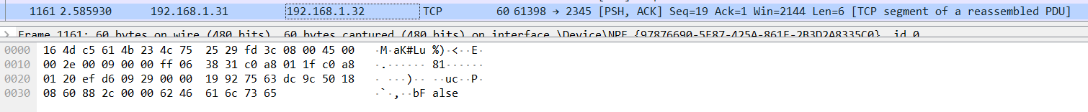
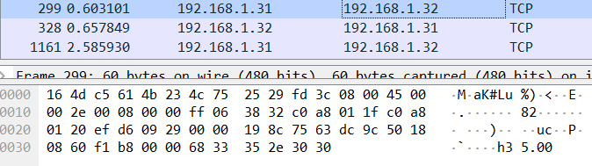
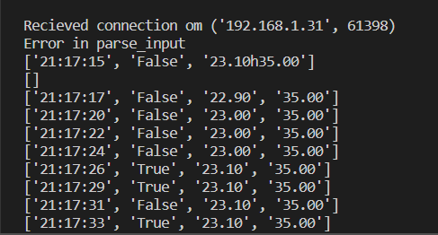
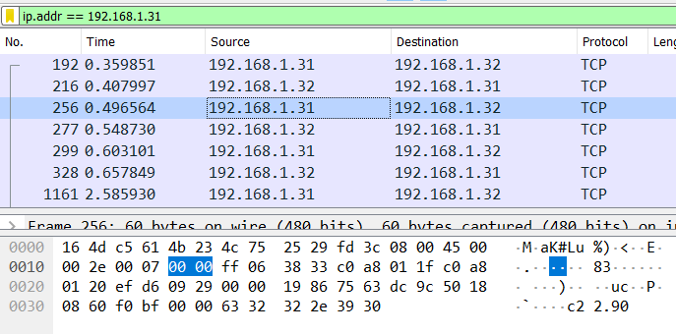





Wireshark Data

Slide 10
First Problem Encountered
First set of ESP8266's was faulty
Contained no documentation and couldn't connect without a large amount of libraries
Severely limited resources made casting to other class objects problematic
To read sensor data, we needed to attach another Arduino board to send it data directly.
As this is a networks class and not an electronics class, this would yield minimal gain
The module would simply parrot what it had received from the larger Arduino board over the network to the server.

Slide 11
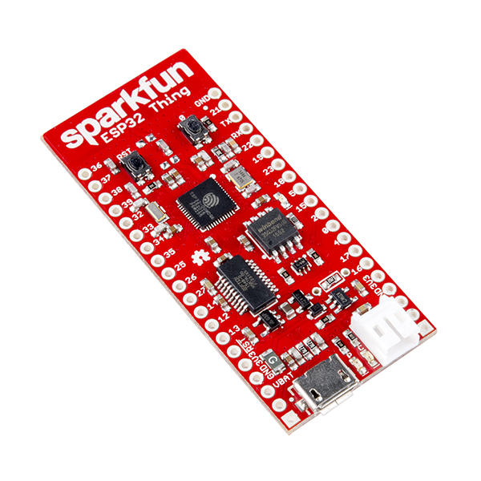
Second Problem Encountered
To fix first problem I had borrowed an ESP32 – Sparkfun "Thing" from Prof. Castleton.
We broke it attempting to hold a soldering-iron, the board, the solder, and new wires simultaneously
Had to order a new one from Amazon
The wifi hardware was pathetic and unreliable

Slide 12
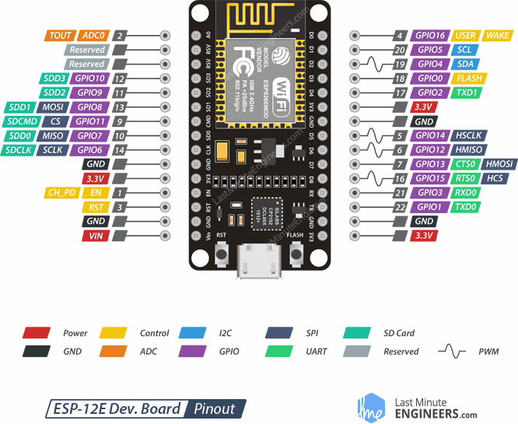
Third Problem Encountered
DHT library did not want to talk to the NEW, new ESP8266's
Had to find another DHT library that would work with this architecture.
ESP8266-Node-MCU had a ridiculous pinout
Prof. Wall and I spent a few hours trying to figure out the architecture of the Node MCU, only to find documentation on the Amazon page was incorrect.
I found out through dumb luck.

