Slide 1
Spacey
Aleksandr Artemov

Slide 2
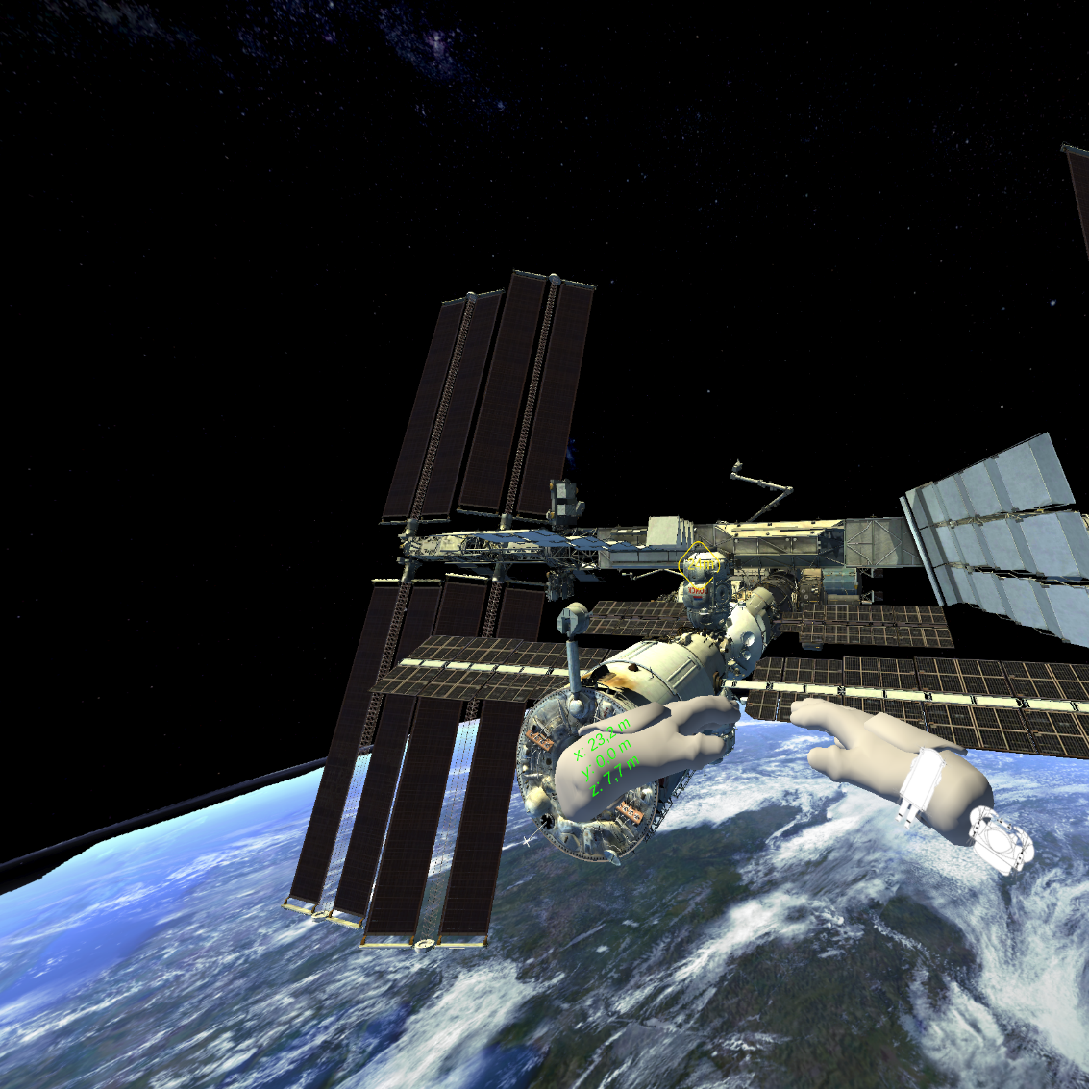
Problem
Training and Simulation for Precision Operations in Space
Risk Mitigation and Validation
Manual docking

Slide 3
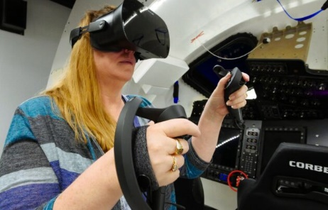
Solution
VR/AR Applications for astronauts testing and preparing for different situations
Implementation of ML/DL algorithms for docking

Slide 4
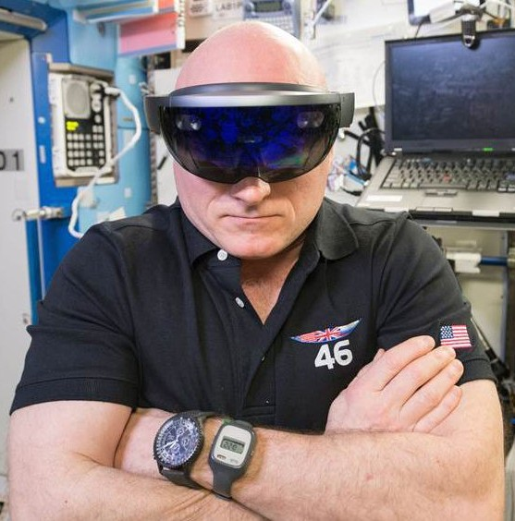
Product
Docking to ISS Simulator with testing maxmin theory inside of VR Simulator
VR Bike for astronauts (in development)
VR Mars landing (in development)

Slide 5
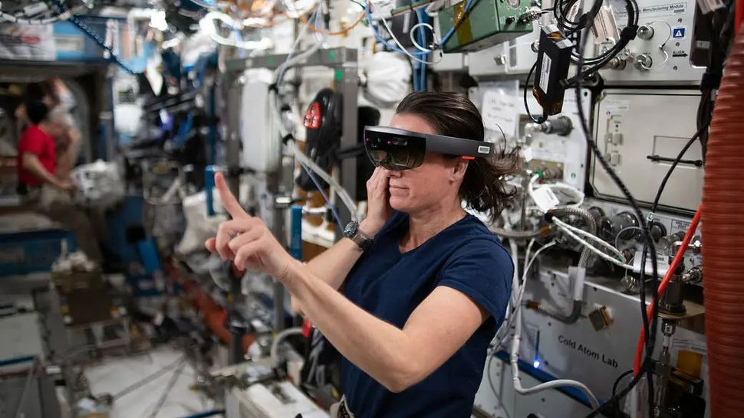
Use Case
Testing Docking accuracy of astronauts or system
VR Bike for astronauts to stay in good physical form

Slide 6
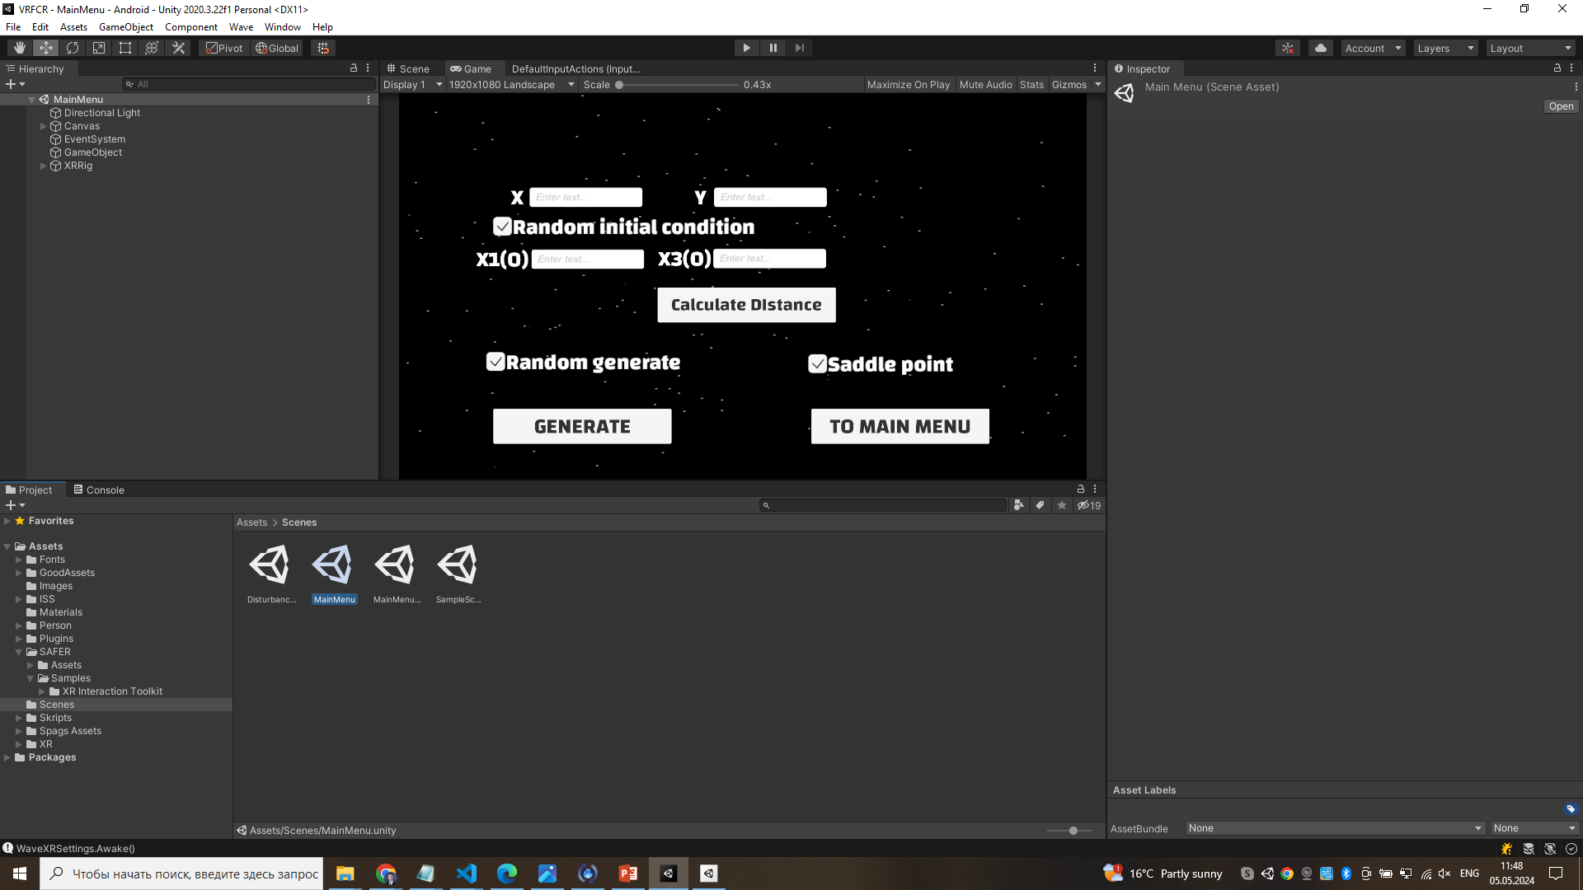
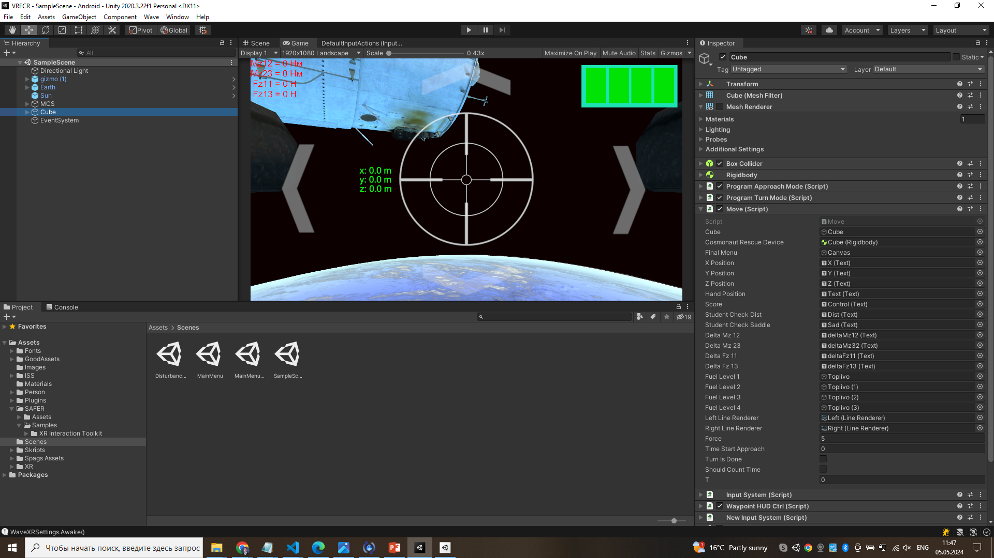
Technology
VR Helmets
C#, C++ (Unity or Unreal Engine)
Simulators
ML & DL algorithms

Slide 7
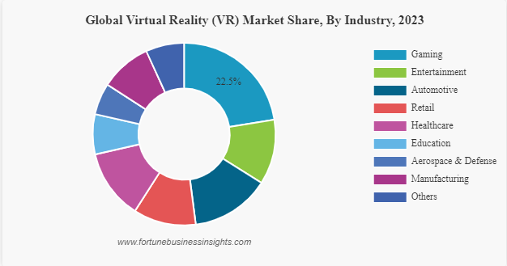
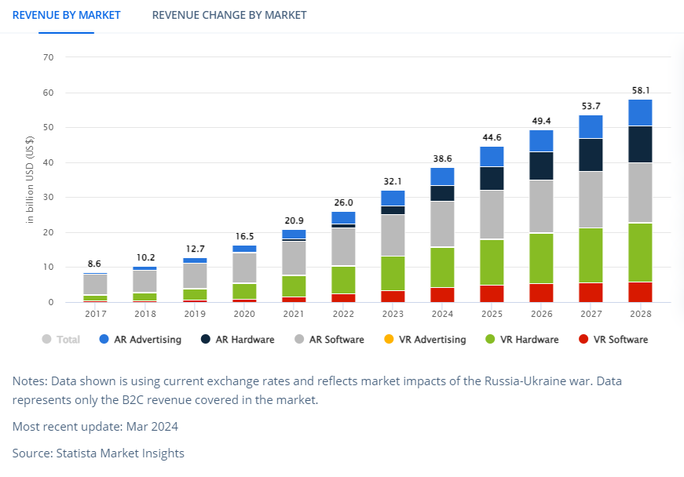
Market Size
Market in VR 32.1 bln. $
Space industry 8-10 % of VR Market
Most contributing NASA, Boeing and Research Institutes

Slide 8
Traction
July 2022 Developed VR Application with maxmin theory
February 2023 Added to VR course of MSU Started Developing VR Space Bike
1st step
Search for clients for VR Docking Simulator
3rd step
Opening VR Lab
September 2022 Tested on a group of students of MSU
now
2nd step Funding and seeds

Slide 9
Contacts
Email: alexartemov21@gmail.com
Phone: +4917684663707
LinkedIn: https://www.linkedin.com/in/aleksandr-artemov-msu/
Portfolio: https://alexart1995.github.io/assets/index.html

