Slide 1

Where to open a gym in America’s 4th fittest city
Alex dowd

Slide 2
Globo gym inc wants to open a gym in Washington, DC
Washington, DC is the 4th fittest city in America according to US News and the close-by suburb of Arlington, VA was ranked #1 by Runner’s World in 2020.
The DC Policy Center estimates that ~80% of adults in the city have a gym membership
John Smith, GloboGym CEO, wanted to know where in the city he should open his next franchise. His requirements were:
No other gyms within 300 meters.
At least 2 dining options within 100 meters.
This analysis could prove useful to any individual or company interested in opening a fitness franchise in Washington, DC.

Slide 3
The data
Foursquare API, Open Data dc, dc ward dataset

Slide 4
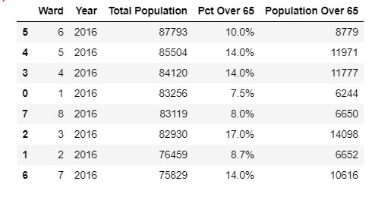
Open data dc and dc ward dataset
Washington, DC is divided by a total of 8 Wards. My first step was establishing which Ward contained the most people overall, which was Ward 6. This was accomplished with the read_csv function in Python Pandas.

Slide 5
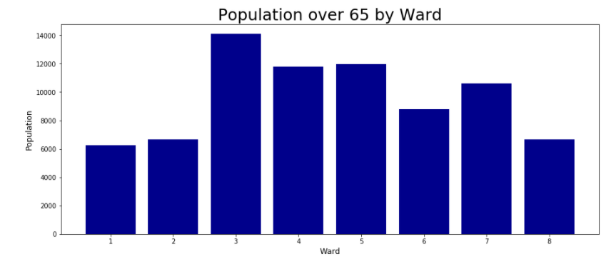
Open data dc and dc ward dataset
Next, I had to establish which Ward had the youngest population, which I defined as being under 65.
As the data show, Ward 1 has the youngest population.
Ward 1 includes a neighborhood called Petworth, which is very popular with current college students and recent college graduates.

Slide 6
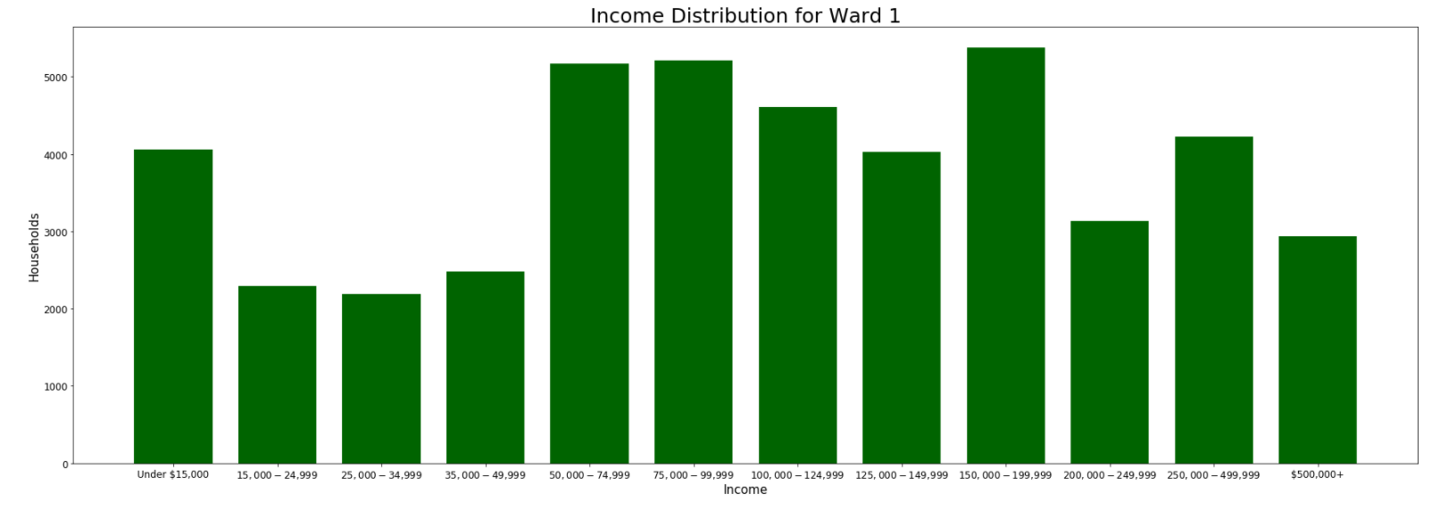
Open data dc and dc ward dataset
The next step analyzed the average income in Ward 1.
Gym memberships in Washington, DC regularly approach or exceed $100/month.
The analysis found that 21% of Ward 1 residents earn > $100K/year and ~1/3 earn >$75K/year.

Slide 7
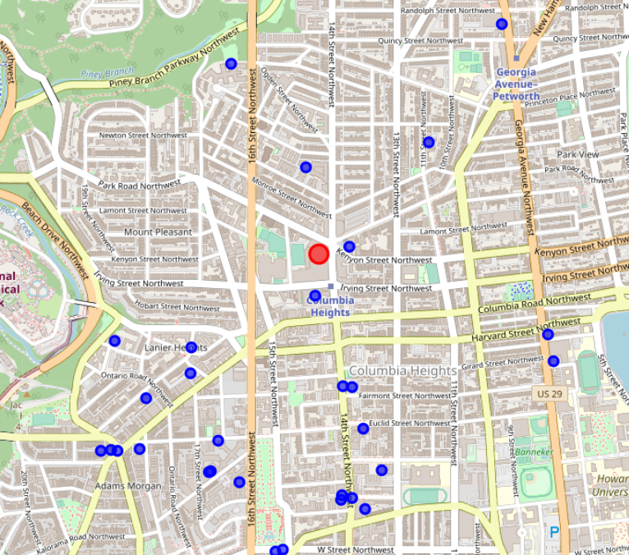
Foursquare API
Following the income analysis, I plotted where current gyms are located within Ward 1 using Folium.
I called on the Foursquare API for venues and plotted gyms within a 1,000-meter radius of the Target located on 14th ST NW.
The results showed 30 venues categorized as gyms within 1,000-meters of the Target.
This location is in a densely populated area, and walking distance from several residential neighborhoods. Thus is ideal for a business.

Slide 8
Cleaning and modeling
K-Nearest neighbor algorithm (knn)

Slide 9
Cleaning the data
The Foursquare Data did not come through in a way that can be used in an SKLearn library like NearestNeighborClassifer.
My feature set included:
Other than the latitude and longitude features, all other features had to be converted to float/integer values.
All spaces in names were replaced with “_” using str.replace().
All object (string) data types were converted to type category using the astype() function.
I then used .apply(lambda x: x.cat.codes) to assign a number value to all features in the feature set.
Name | Category | CrossStreet | Address | City | PostalCode | Longitude | Latitude

Slide 10
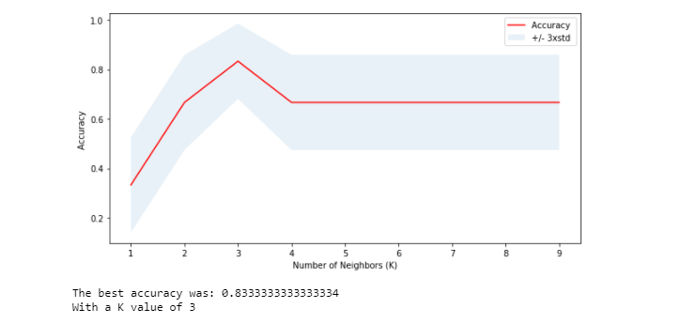
KNN results
Using train_test_split with 20% of my population being used for testing and an initial K value of 4, the test accuracy was 66%.
After running a simulation of K values 1-10, it was determined the optimum K value is 3, with an accuracy of 83%
Categorizing gyms accurately allows GloboGym Inc to determine if a new gym is a competitor or not.
Hotel and Apartment gyms do not compete with commercial gyms, for example, because they are exclusive to residents.

Slide 11
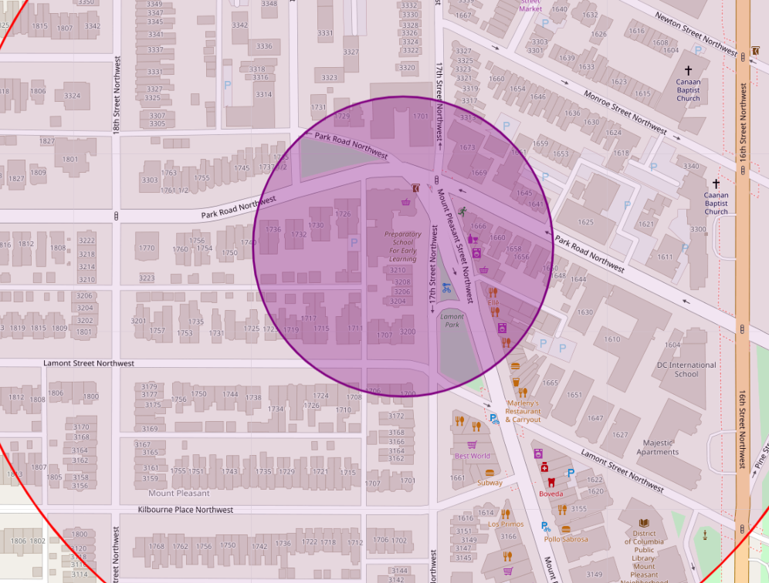
Discussion and recommendations
Based on the requirements, I recommend looking in the area of Lamont ST and Mt. Pleasant ST NW.
This area is both 300 meters from another gym and 100 meters from dining options.
The KNN model will accurately categorize gyms in the city for future use and help guide decisions around competition.
This map shows the recommended area (purple)

Slide 12
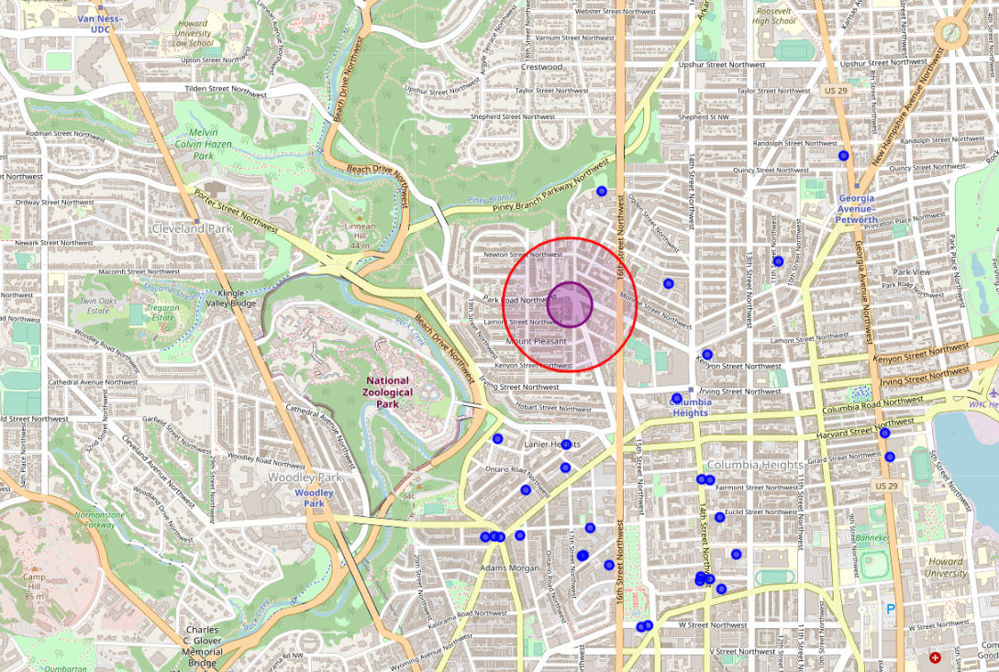
Discussion and recommendations
This is a far view of the same map, to show that there are no other gyms (blue dots) within the 300-meter red circle.

Slide 13
conclusion

Slide 14
Conclusion
John Smith, CEO of GloboGym Inc, wanted to open a gym in Washington, DC that was 300 meters from another gym and 100 meters or less from a dining option.
This report and analysis identified an area in the vicinity of Lamont ST NW and Mt. Pleasant ST NW as an ideal location that meets these requirements.
This area contains potential customers who can both afford a gym membership and probably are in the market for one.

