Slide 1

How Crime Shapes Students Fear
An analysis of the 2022 School Crime Supplement examining which student experiences most strongly predict fear of violence at school.

Slide 2


THE PROBLEM
Fear of Being Attacked Remains a Meaningful Safety Issue
5%
Students Fear Attack
School safety directly impacts attendance, learning, and student well-being. Despite widespread safety initiatives, fear persists, making deeper analysis essential.
Research Question:
“Which crime and school behavioral exposures are associated with the highest levels of fear among US students?”

Slide 3

THE DATA
Nationwide Survey Allows Comparison of Risk Factors
2022 School Crime Supplement (SCS)
The SCS is a nationally representative survey of U.S. students ages 12–18, capturing a wide range of school-related experiences.
The Cleaned/Processed Dataset Includes:
4,589 students across the United States
45 cleaned variables covering school climate, victimization, and environmental risk
Four major risk categories organized for comparative analysis (verbal/physical bullying, drug availability, crime exposure)
This dataset enables comparisons to how different school experiences relate to fear of being attacked.

Slide 4
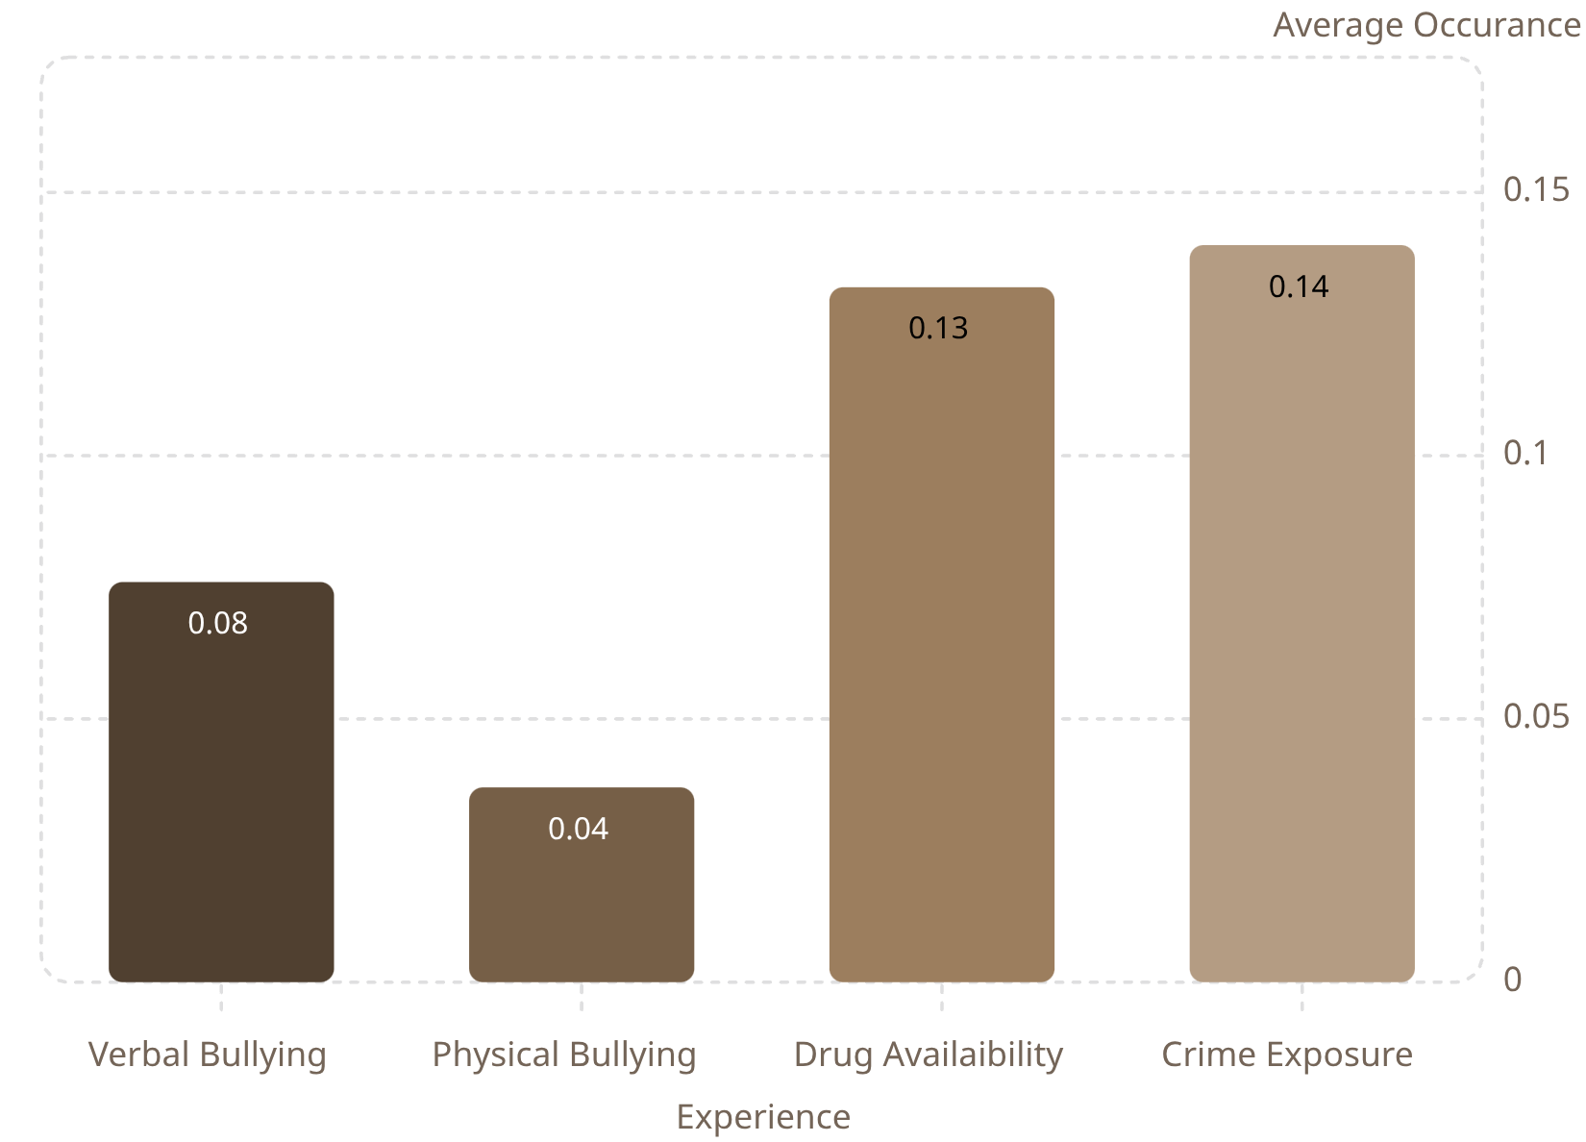

DESCRIPTIVE FINDINGS
Environmental Exposures Are More Common Than Bullying
What Students Report
The chart shows students experience a mix of environmental and interpersonal risks.
Environmental crime exposure, such as witnessing violence or seeing weapons, is more frequently reported than any form of bullying.
Frequency alone does not determine which experiences are most associated with fear. That requires examining relationships, not just rates.
Graph 1: Bar Graph Displaying Average Occurrence of Each Risk

Slide 5

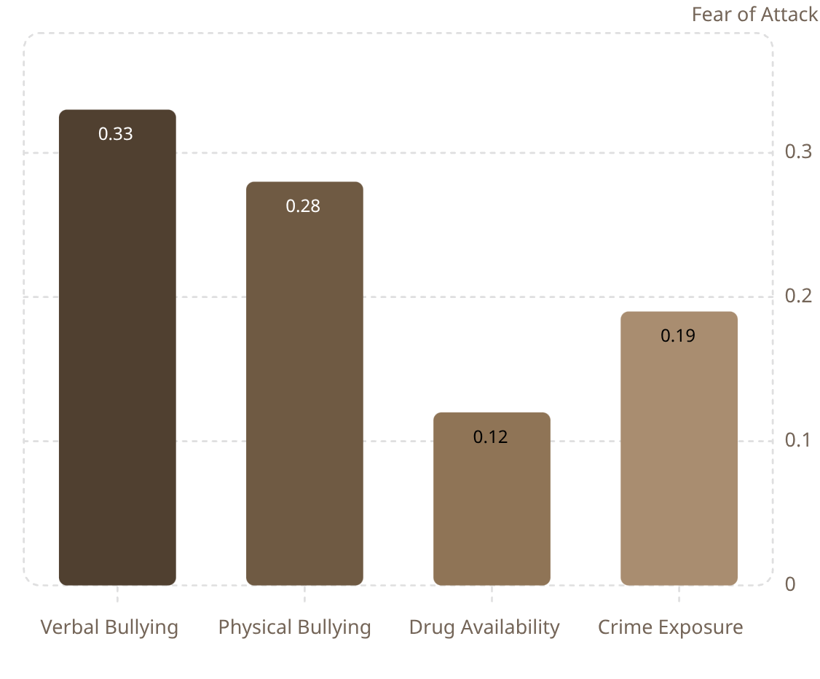


KEY RELATIONSHIP
Bullying Shows a Stronger Association With Fear Than Environmental Exposures
A clear pattern emerges: interpersonal victimization is more strongly linked to fear than environmental exposure.
1
Verbal Bullying
The strongest association with fear among all measured factors (r =0.33)
Physical Bullying
2
Also shows a meaningful association, though weaker than verbal bullying. (r = 0.28)
Crime Exposure & Drug Availability
3
More commonly reported, but show notably weaker relationships with fear of being attacked. (r = 0.12/19)
Graph 2: Bar chart Displaying Correlation of Each Risk to Fear.
Although correlation measures association, it does not quantify impact. Logistic Regression allows us to estimate the unique impact of each factor, while controlling others.

Slide 6
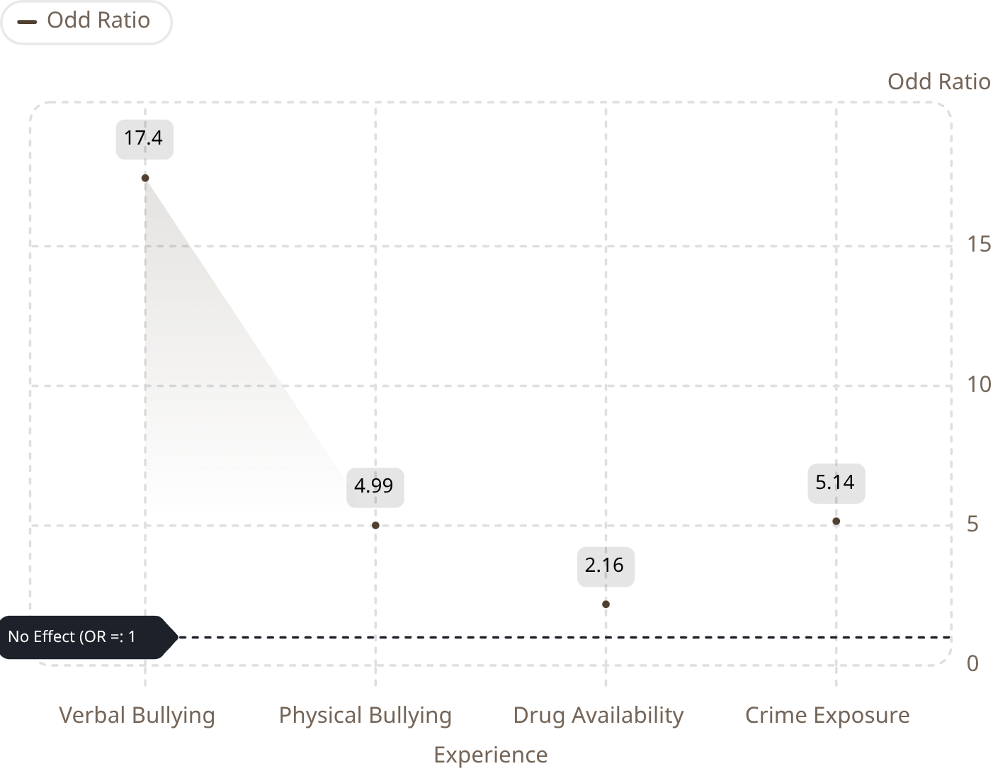

PRIMARY FINDING
Verbal Bullying Is the Strongest Predictor to Fear of Being Attacked
Even After Controlling for All Other Factors…
Verbal bullying remains the strongest predictor of fear, with students who experience it showing 17× higher odds of fearing an attack at school.
While physical bullying and crime exposure are important factors, verbal bullying's effects are more than 3 times larger.
Note: The model demonstrates strong classification (AUC = 0.82), meaning students who fear being attacked usually receive higher predicted risk scores than students who do not.
Graph 3: Scatterplot Displaying Odd Ratios of Risks Related to Fear.

Slide 7

INTERPRETATION
Fear Appears More Influenced by Peer Experiences Than Environmental Conditions
What This Suggests
School districts should prioritize preventing harmful interpersonal experiences, as these events often lead to fostering feelings of vulnerability and personal threat.
While it’s still important to prevent crimes such as drug availability and crime exposure, both are not nearly as detrimental to a student’s safety as verbal bullying.

Slide 8

CONCLUSION
Reducing Verbal Bullying May Be the Most Effective Path to Improving Perceived Safety
Conclusion: Across all analyses, verbal bullying was the strongest factor associated with fear of being attacked.
Recommendations:
Strengthen Anti-Bullying Programs
Improve Reporting Systems
Target verbal aggression explicitly.
Make it easier for students to report bullying experiences.
Support Vulnerable Students
Build Positive School Climate
Prioritize early intervention for students at risk.
Foster peer relationships to reduce interpersonal risk.
Limitation: Our study implies associations, not causation. These findings should inform (not replace) experimental research.

