Slide 1
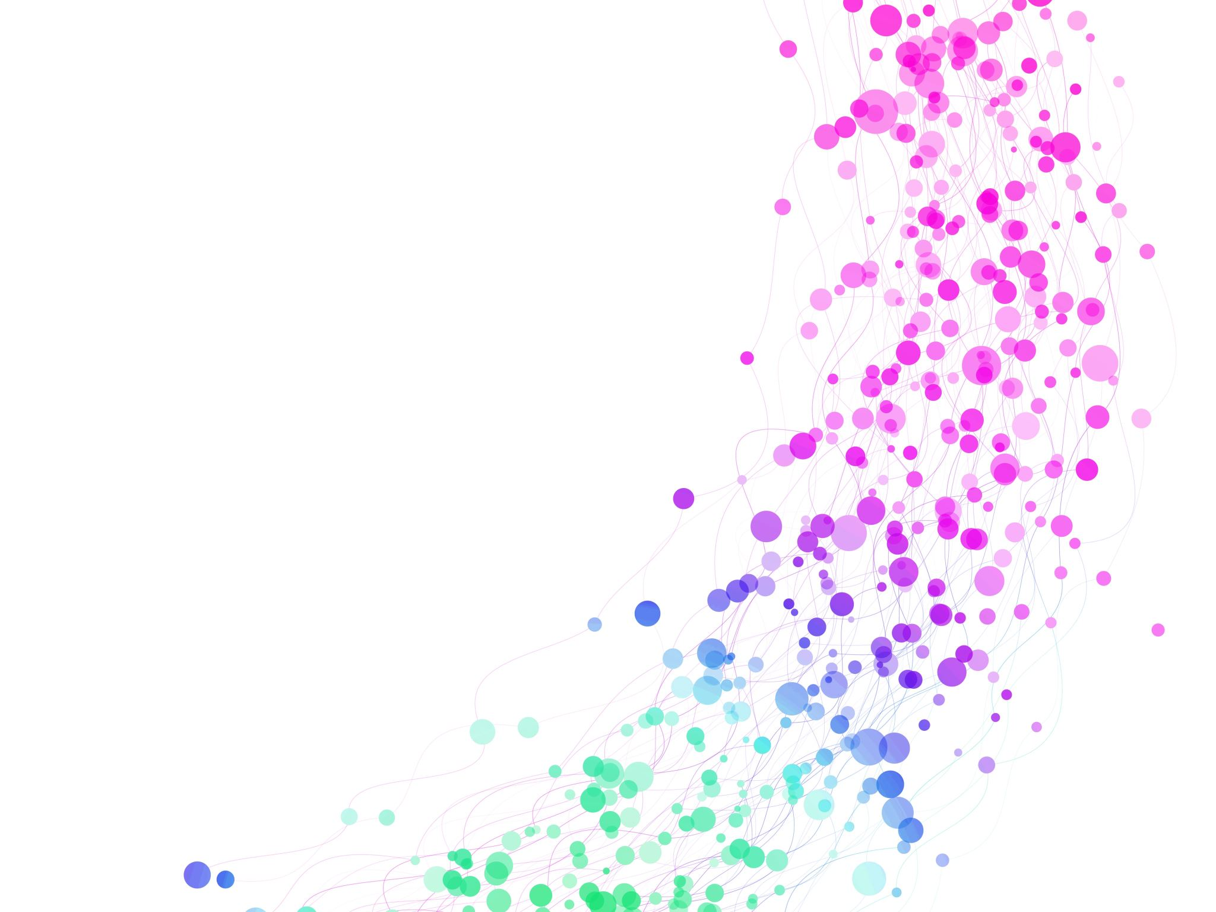
Rockbuster
Customer and Movie rental data

Slide 2
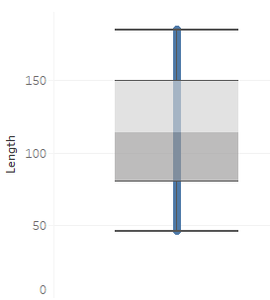
Movie length
Most movies in the Rockbuster collection are between 80 and 150 minutes long

Slide 3
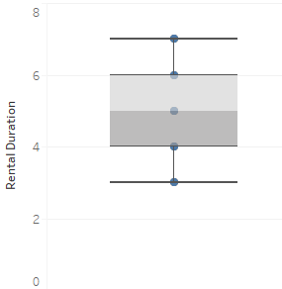
Movie rental duration
Movies can be rented from Rockbuster for 3 to 7 days

Slide 4
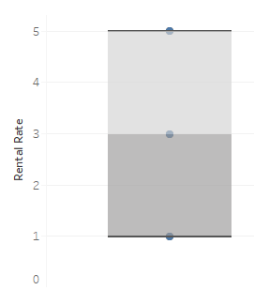
Movie rental rate
Film rental rates at Rockbuster vary from $0.99 to $4.99

Slide 5
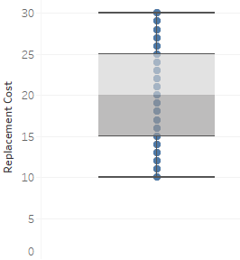
Movie replacement cost
Most movies can be replaced for between $15 and $25

Slide 6
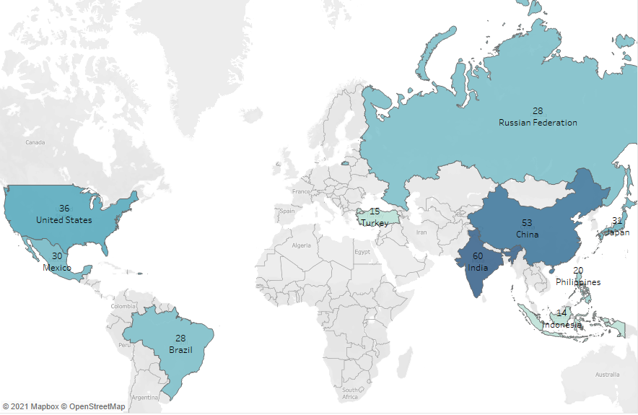
Countries with the most Rockbuster customers

Slide 7
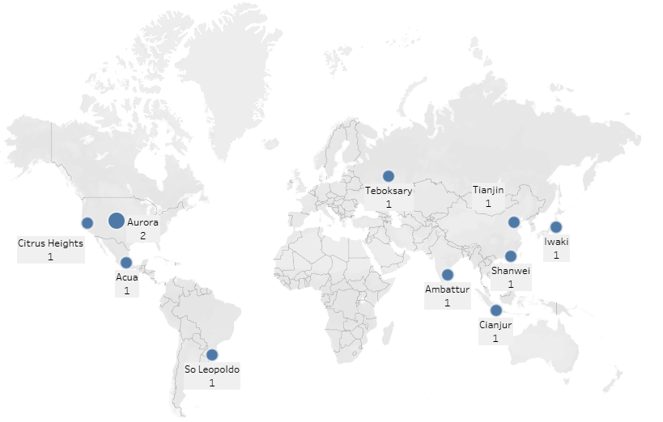
Top 10 cities with most customers

Slide 8
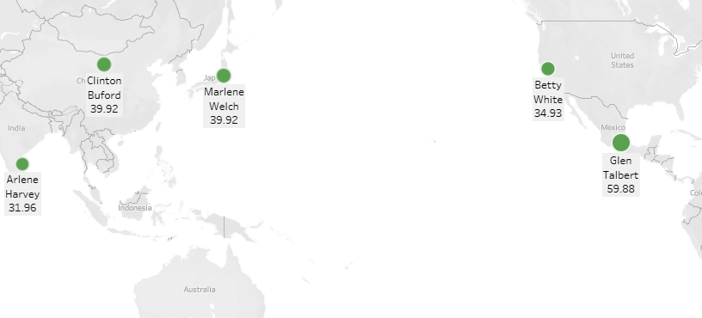
Location of highest paying customers

