Slide 1

PYTHON FUNDAMENTALS
Password manager
By: Alexei Lisitsyn
Date: 13/10/2022

Slide 2
Why “password manager”?
I believe more than once it happened to you that you forgot you password and it was not possible to remember it.
Not too long ago, the same thing happened to me…
So I decided to create something that will help avoid a similar fate again.

Slide 3
Here are some Abilities of my program
Stores data in a separate csv file.
Finds existing data.
Generates a complex password.

Slide 4

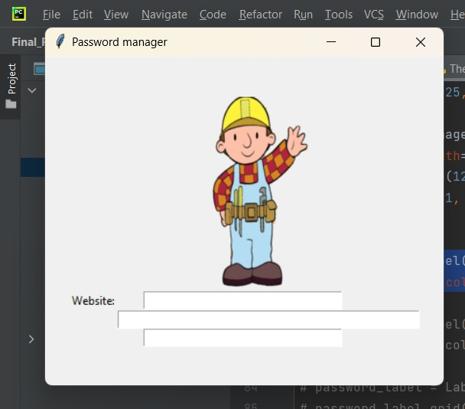

Libraries that were used to create the program
To store and create data file was used pandas data frame.
User’s interface was build via ‘Tkinter’ package.
To randomize signs used random module.

Slide 5
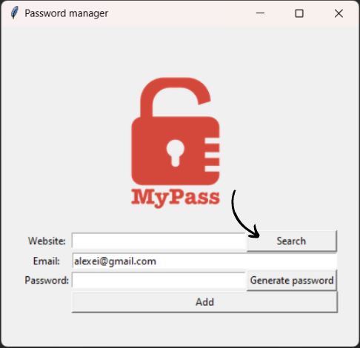
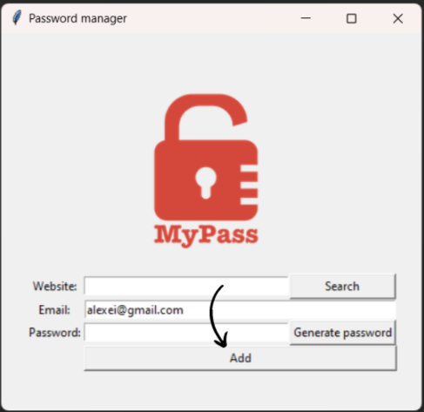
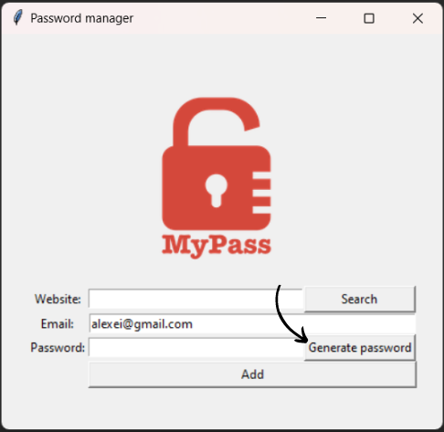
What does the program consist of?
The program have three functions:
Generate_password() – creates a complex password that contain from 12 to 18 signs including symbols, numbers and upper, lower case letters.
Used to execute “Generate password” button
Save() – gets data from fields and saved it to csv data file.
Used to execute “Add” button .
Search() – referring on “website” entry., gets e-mail, password from csv data file and showing it with popup window.
Used to execute “Search” button

Slide 6
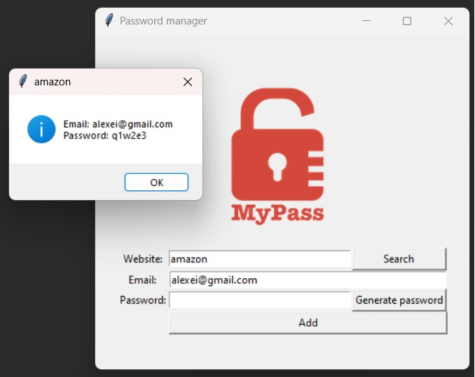
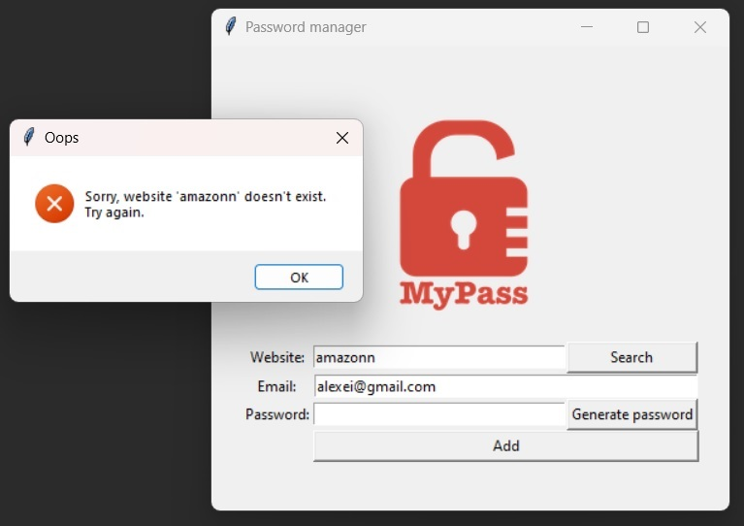
What does the program consist of?
From Tkinter package was imported specific module that called “messagebox”.
This module used to give user popup window to show message like :
requested data or some kind of error

Slide 7
Also, for the creation of the program, such tools were used as:
pyperclip module with function copy();
random module with randint(), shaffle() and choice() functions;
list comprehensions;
try, except, else blocks;
for, while loops;
boolean values;
input() function.

