Slide 1


SUITE
DREAMS
PRESENTATION
Dorm Allocation Project: Kyren Stephenson, Alexes Pagan, Jonathan Fasano, Parsa Jafaripour, John Doyle, Arman Hemmati Alamdari

Slide 2



Requirements
Student and Admin Homepages
Dorm Application
Backend
Roommate Matching Algorithm
These pages will hold similar content but different features. Students are able to apply for a dorm, find roommates, etc.
Admins are able to see the status of a room, search up students, etc.
This is the most important requirement of our application. After a student applies for a dorm, the database holds the student information and assigns them a dorm and, if applicable, a roommate.
The roommate matching algorithm pairs students who have similar interests together. This should help reduce the number of room changes per semester.
Define brainstorming and its benefits. Explain how it encourages free thinking and idea generation.
Define brainstorming and its benefits. Explain how it encourages free thinking and idea generation.
Define brainstorming and its benefits. Explain how it encourages free thinking and idea generation.

Slide 3
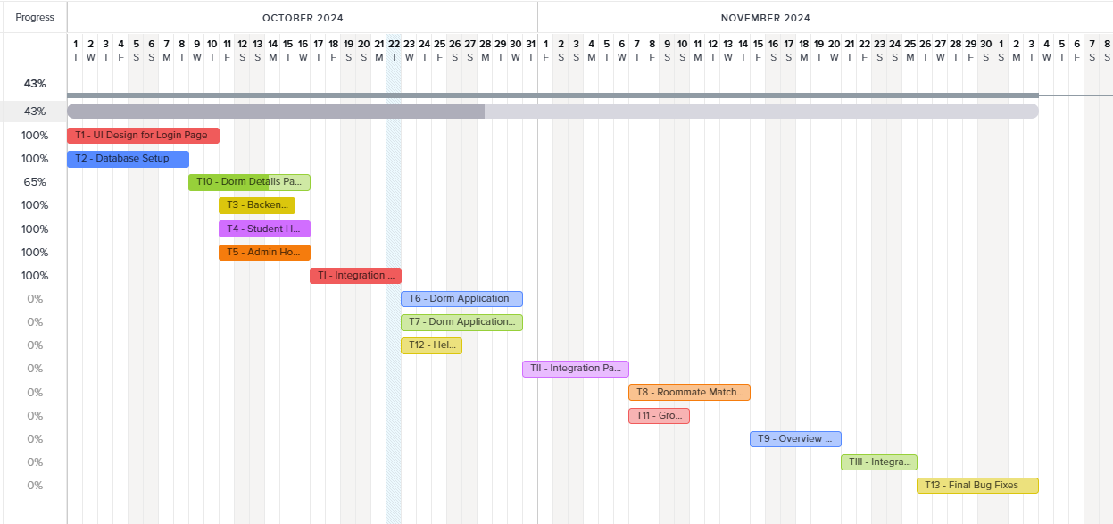

Scheduling
We created:
UI design for the login page
UI for the Student and Admin home pages
Database code for the both students and admins.
Our integration has been completed and is on time.

Slide 4

Major Risks
Integration Complexity
Delayed Prototype Development
Early challenges involved integrating Firebase Authentication with Firestore. Ensuring synchronization and management of user credentials without inconsistencies was crucial.
Initially, the project lacked a working prototype until the final stages, posing risks in testing.
01
02
Bootstrap Integration Challenges
Matching Algorithm Complexity
03
Utilizing Bootstrap for UI components but concerned about error tracing due to similar HTML tags.
04
Designing an effective matching algorithm for roommate allocation based on student preferences poses significant challenges.

Slide 5
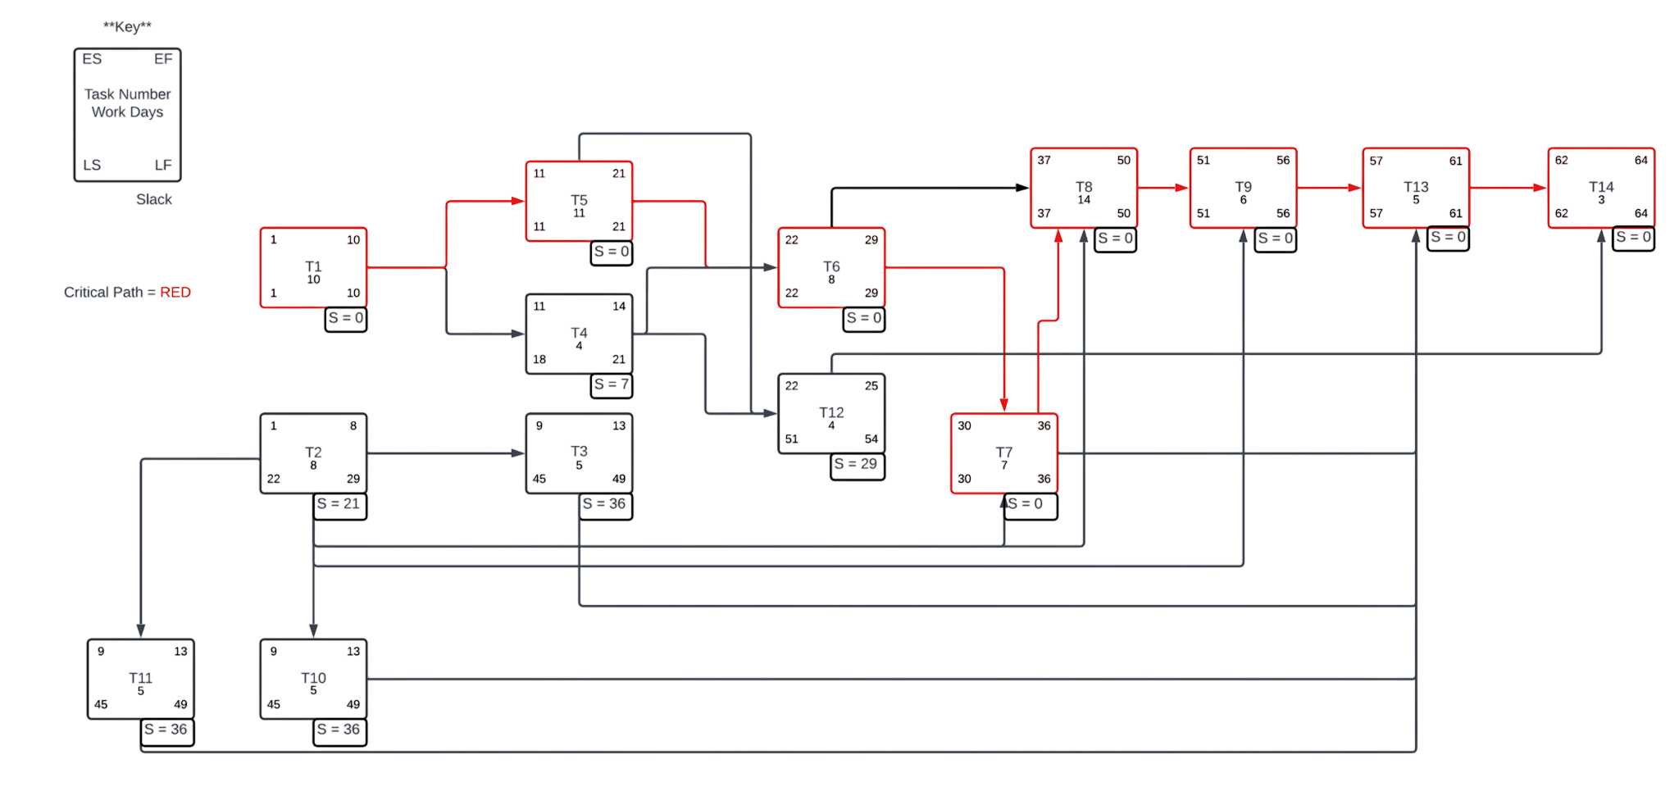
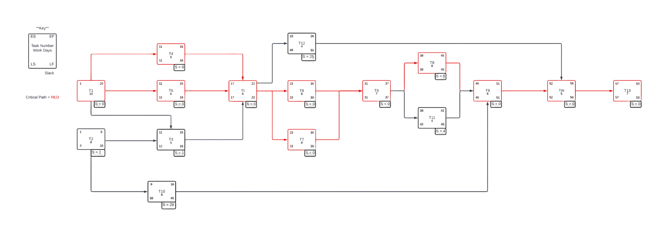
Progress Against Project Plan
Remade the project plan due to lack of integration and prototyping planned out.
Database now expected to be worked on throughout the entire project as new functionality will be added to each class during the development

Slide 6

Now to Showcase the Prototype…

