Slide 1
Integration Procedures
ROBIL, Workshop 01/11/12
Michele (IAI)

Slide 2
Content
General
  Challenges
  Highlights
  Package Structure
  Version
Git and Github
  Overview
  Practical Steps

Slide 3
Methodology Challenges
Several teams working within their own limits
Geographical spread (but at least same time zone)

Slide 4
Methodology Highlights
Version control: git
Software repository: www.github.com
Global version reference via .ver file in each component
Internal integration inside component is out of scope of general integration of ROBIL
Directory structure according format

Slide 5
Package Directory Structure
userws4@darpaws4:~/git/robil/c51_carOperation$ ls
.cproject → eclipse
.project → eclipse
.pydevproject → eclipse
bin --> generated generally
build → generated
cmake_install.cmake
CMakeLists.txt
Makefile
mainpage.dox
manifest.xml
msg
msg_gen → generated
src
srv
srv_gen → generated
.ver
userws4@darpaws4:~/git/robil/c51_carOperation$ ls -la
total 100
drwxr-xr-x 9 userws4 users 4096 Oct 29 08:14 .
drwxr-xr-x 5 userws4 users 4096 Oct 29 08:04 ..
drwxr-xr-x 2 userws4 users 4096 Oct 29 08:14 bin
drwxr-xr-x 3 userws4 users 4096 Oct 29 08:14 build
-rw-r--r-- 1 userws4 users 1644 Oct 22 15:01 cmake_install.cmake
-rwxr--r-- 1 userws4 users 1322 Oct 22 14:56 CMakeLists.txt
-rw-r--r-- 1 userws4 users 28501 Oct 24 11:33 .cproject
-rwxr--r-- 1 userws4 users 120 Oct 25 15:05 mainpage.dox
-rwxr--r-- 1 userws4 users 41 Oct 22 14:56 Makefile
-rwxr--r-- 1 userws4 users 345 Oct 29 08:00 manifest.xml
drwxr-xr-x 2 userws4 users 4096 Oct 22 14:56 msg
drwxr-xr-x 4 userws4 users 4096 Oct 29 08:14 msg_gen
-rw-r--r-- 1 userws4 users 4996 Oct 24 11:33 .project
-rwxr--r-- 1 userws4 users 1538 Oct 24 11:33 .pydevproject
drwxr-xr-x 3 userws4 users 4096 Oct 22 14:56 src
drwxr-xr-x 2 userws4 users 4096 Oct 22 14:56 srv
drwxr-xr-x 4 userws4 users 4096 Oct 29 08:14 srv_gen
-rw-r--r-- 1 userws4 users 4 Oct 29 08:04 .ver

Slide 6
Version
Two files:
  .ver – component version: 0.1, 0.2, 0.3, 0.4, 0.5
  Notes.txt:
    Known Bugs
    Known Limitations
    How to check

Slide 7
Version
Two files:
  .ver – component version: 0.1, 0.2, 0.3, 0.4, 0.5
  Notes.txt:
    Known Bugs
    Known Limitations
    How to check

Slide 8
Git and Github
GITHUB
Official Tree
RO
Created by
Integrator
Integrator Tree
Write
update
fork
Created by
Team C51
fork
C51
pull
git push
Local 1
Local-C51
Integrator
Local

Slide 9
Git and Github
GITHUB
Official Tree
RO
Integrator
Tree
Write
update
fork
fork
fork
C21
C51
pull
git push
git push
Local 1
Local 2
LocalC21
LocalC51

Slide 10
Practical Steps
In git hub:
  Each participant should open an account.
  Each team should fork the project in the github from integrator tree.
GITHUB
Official Tree
RO
Integrator Tree
Write
C51

Slide 11
Practical Steps (2)
At local site:
  Each team should create a git repository:
    Via eclipse or
    git clone https://github.com/team/robil.git or
    mkdir robil; cd robil
      git init: As result of above, the directory should include a directory .git
      Connect the repository to the github:
        git remote add origin https://github.com/team/robil.git
    This repository will be the one where the local team will integrate.
    Add remote for pull:
      Git remote add official //github.com/iops/robil.git

Slide 12
Practical Steps (3)
At local site:
  Pull (fetch and merge) the code from “official”
  Create Branch: git branch feature_plony
  Work.... & Test & happy?
git push origin feature_plony
Send pull request to integrator
Official Tree
RO
GITHUB
Pull Request
Pull official
C51
git push
Local 1
Local-C51
Master
Local-C51
Feature plony

Slide 13
Practical steps (4)
When integrator gets pull request:
  He/she pulls new code to the integrator tree in github
  He/she pull (fetch and merge) with local tree.
  He/she checks according:
    Unit test sent by team
    Sanity (test that what was working is still working)
  If happy, then integrate (push) to official tree.

Slide 14
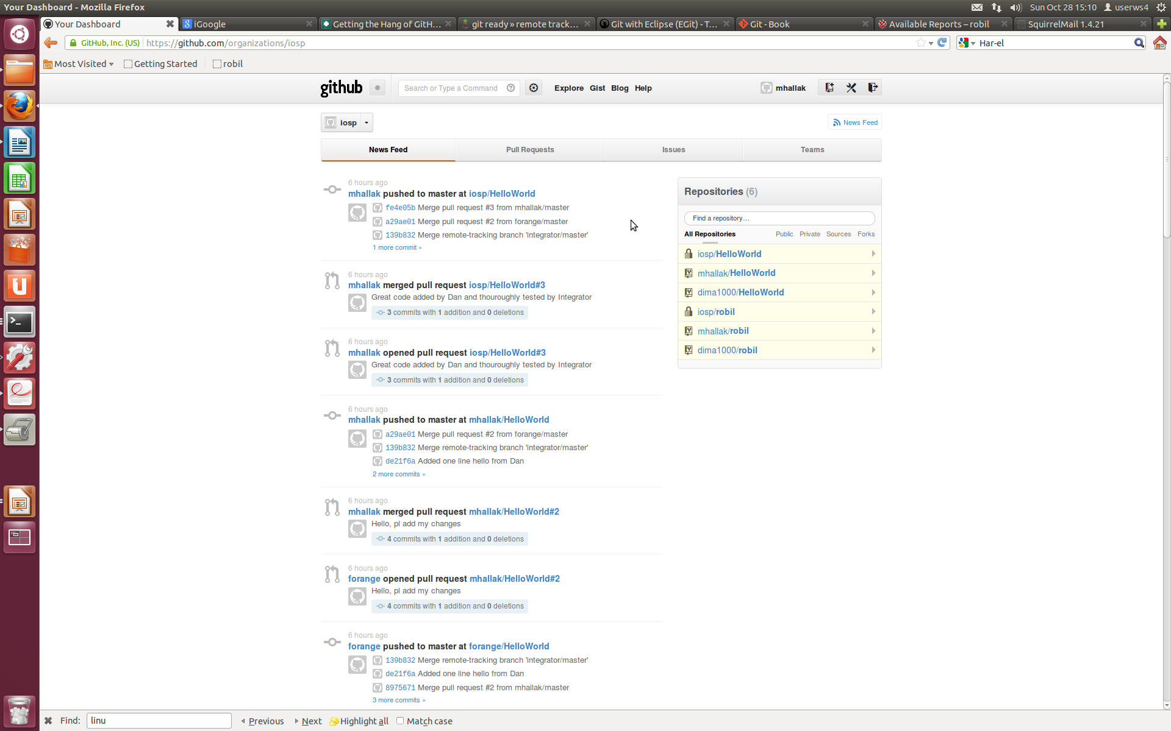
Github Wall

Slide 15
Integrator Responsibility

Slide 16
Team Responsibility

