Slide 1
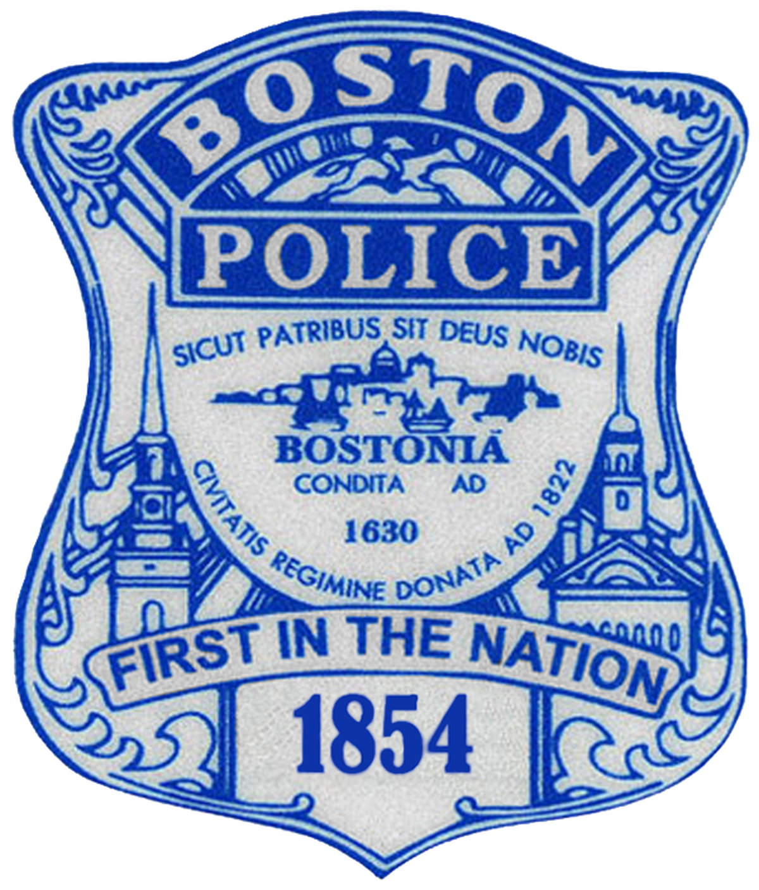
Advisory mission for the Boston municipal authorities

Slide 2
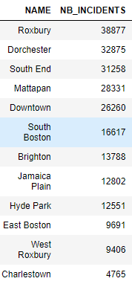
Number of incidents per district
Top 3 districts with the highest number of incidents:
1. Roxbury
2. Dorchester
3. South End

Slide 3
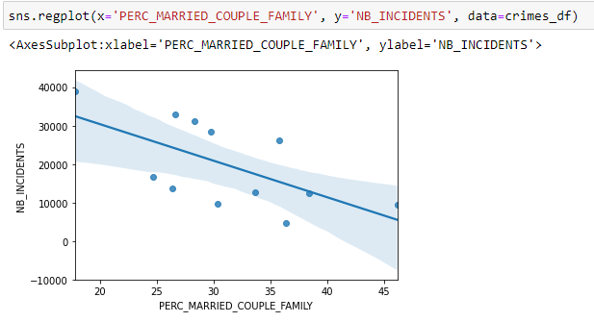
Influence of some factors on the number of incidents
It seems that the districts with the highest level of married couples are the safest

Slide 4
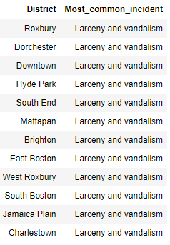
Most common incidents per district
The most common incident type is Larceny and vandalism
for all the districts!!!

