Slide 1

Study Project
Web application for scheduling meetings
Author: Baldin Alexey
NC Study Courses

Slide 2
Setting targets Formulation of the problem
Implement a web-application for scheduling meetings in a company with several offices.
NC Study Courses

Slide 3
Setting targets Technology-Stack
Java + Spring with additional libraries and technologies(Lombok, Liquibase, etc…)
Some UI-technologies(Angular, Bootstrap)
PostgreSQL, GitHub, Maven
NC Study Courses

Slide 4
Setting targets System requirements
The application must work according to the rules from the subject area.
Implement a REST application with necessary requests to interact with DB.
Implement UI.
Add authorization/authentication.
More info in documentation in repo.
NC Study Courses
Notes:
Реализовать приложение на REST архитектуре.

Slide 5
The subject area
The subject area – system with next entities:
Office
Room
Meeting
Employee
NC Study Courses

Slide 6
Architecture
Backend
REST controllers
Services
Repositories
Database
Frontend
Angular
Clients
NC Study Courses

Slide 7
Security
Client
Server
Username
Password
JWT Token
User role
NC Study Courses

Slide 8
User functional
Create meetings
Watch meeting information, accepting or declining
Watch profile information, change password
NC Study Courses

Slide 9
Admin functional
All user functions
Editing all object information in the model(office, employee, etc...)
Register new objects(offices, employees, etc...)
NC Study Courses

Slide 10
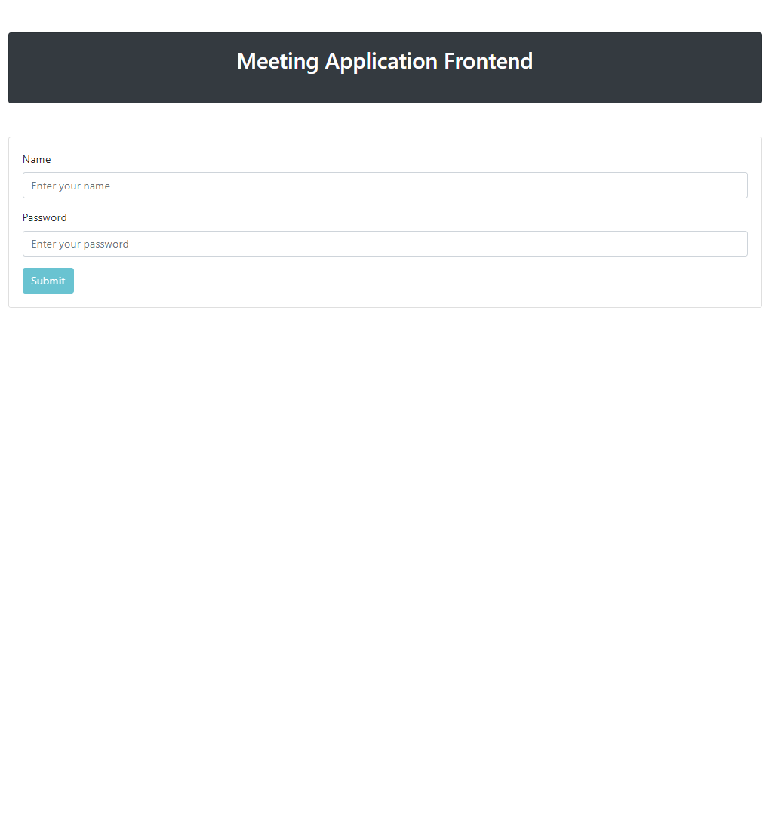
Demonstration
NC Study Courses

Slide 11
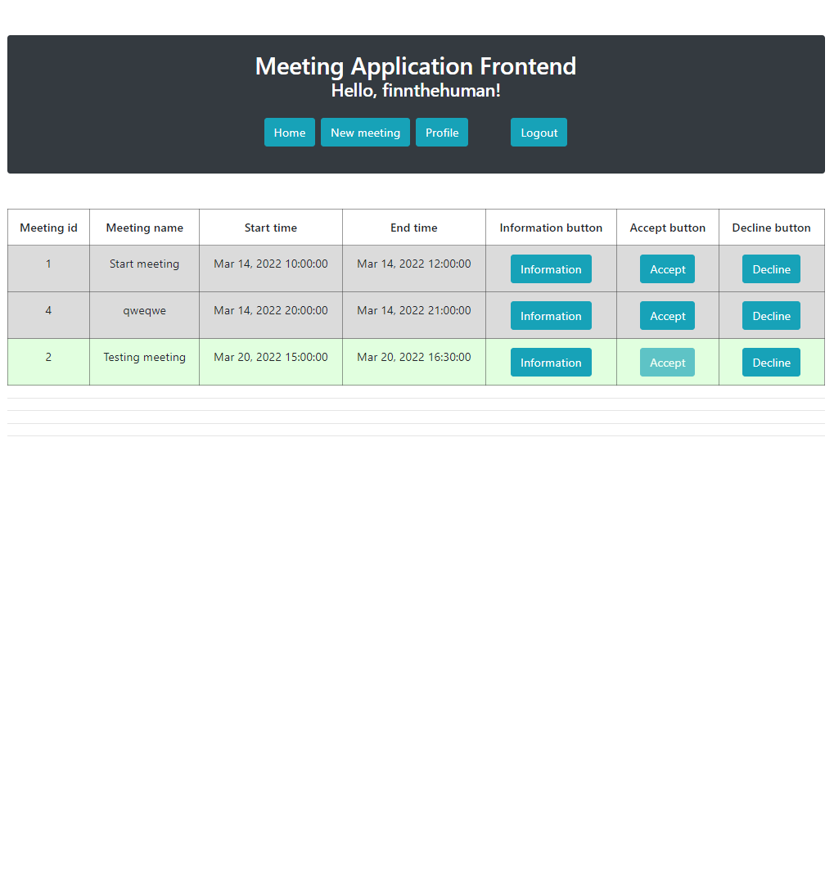
Demonstration
NC Study Courses

Slide 12
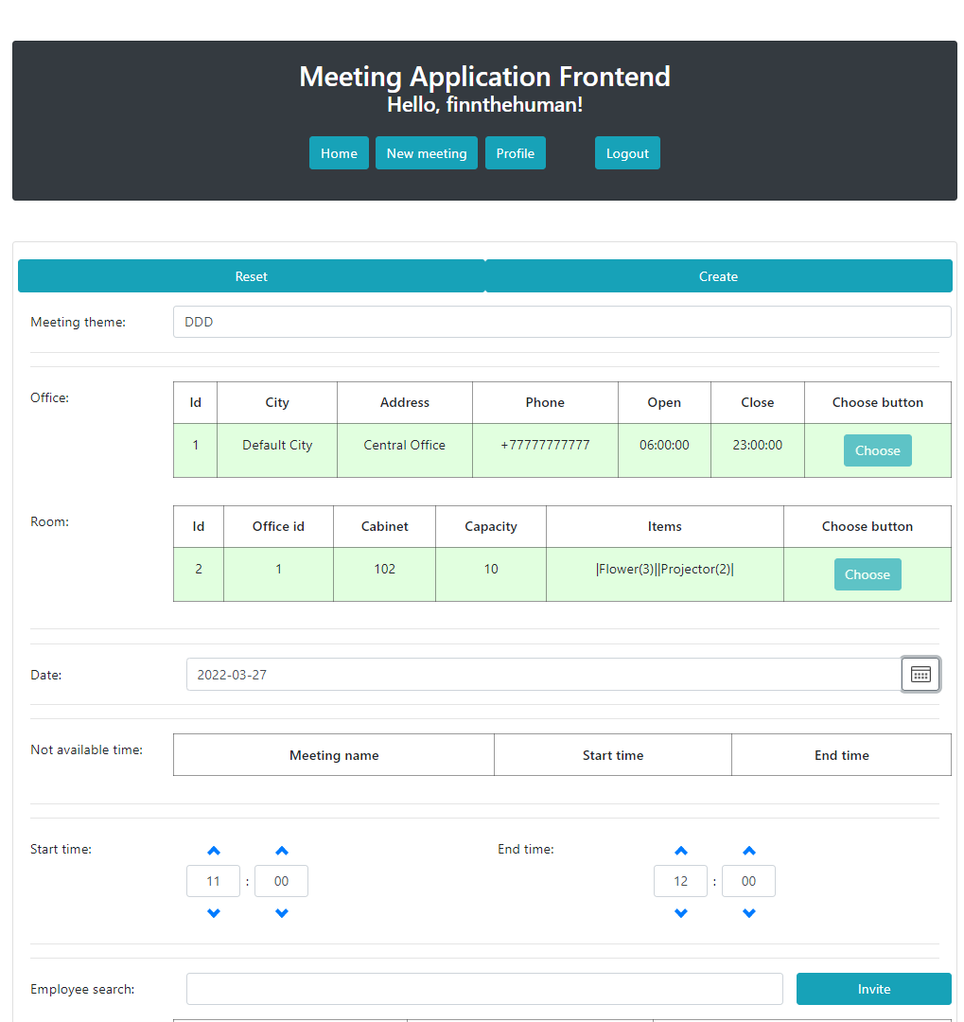
Demonstration
NC Study Courses

Slide 13
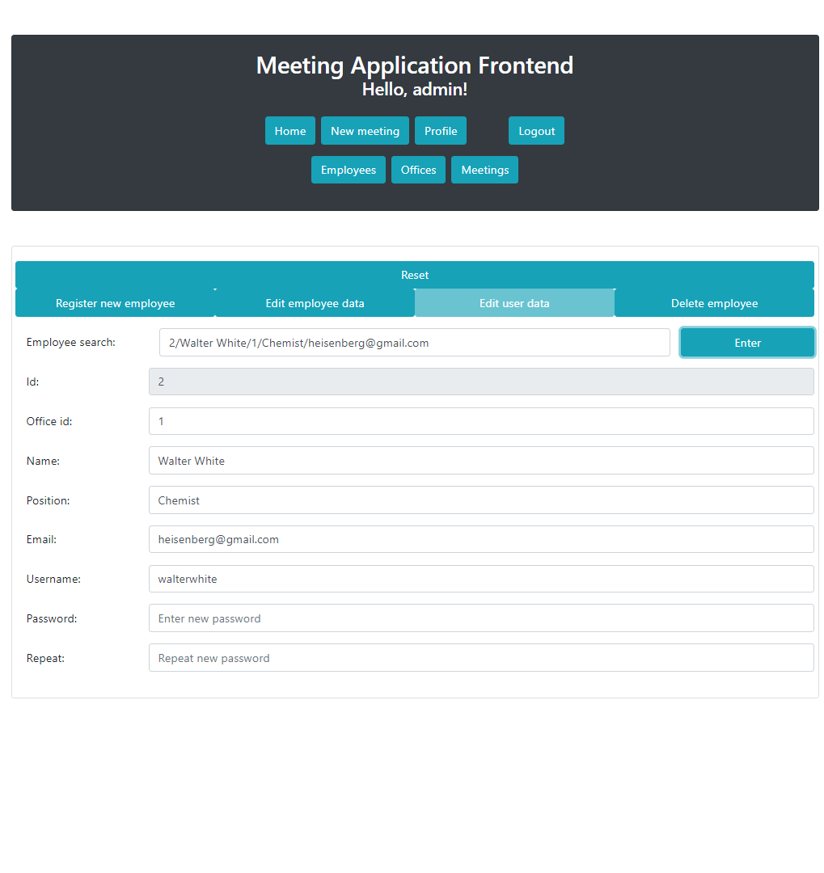
Demonstration
NC Study Courses

Slide 14
Conclusions
In the course of working of the project was created a web application for scheduling meetings, which performs all the planned functions.
Repository: https://github.com/AlexeyBaldin/meeting-application
NC Study Courses

Slide 15
Thanks for attention!
NC Study Courses

