Slide 1
American Sign Language (ASL) Recognition System
Final Project Presentation
Alexey Kresin – Hood College – June 27, 2025

Slide 2
What is ASL
ASL is a complete visual language used by the Deaf and hard-of-hearing community.
It uses hand gestures, facial expressions, and body movements to communicate ideas.
Just like spoken languages, ASL has its own grammar and rules—it's not simply a set of hand signs for English words.
ASL is widely used in the United States and Canada, with millions of fluent users.

Slide 3
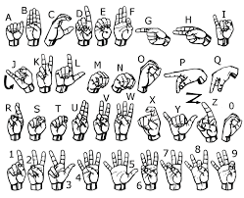
ASL ALPHABET

Slide 4
Project Motivation
There’s a growing need for technology that can recognize sign language in real time and translate it into text or speech.
With advances in AI and computer vision, it’s now possible to create systems that can see and understand gestures, helping break down communication barriers.

Slide 5
How Neural Networks Helped Build the ASL Recognizer
A neural network is a computer system inspired by how the human brain works—it learns from examples.
We showed it thousands of pictures of hand signs, each labeled with the correct letter (A–Z).
Over time, it learned to recognize patterns—like finger shapes, positions, and angles.

Slide 6
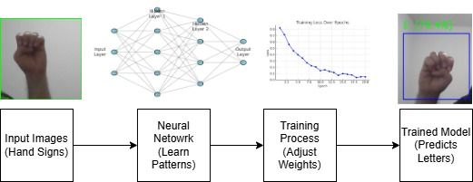
From Hand Gestures to Predicted Letters: How the AI Learns

Slide 7
Data Set Preparation
I initially prepared 150 photographs of American Sign Language (ASL) letters ranging from A to L. However, after training my model, I observed low confidence levels in the predictions. As a result, I decided to switch to a publicly available dataset from Kaggle. The Kaggle dataset contains 29 ASL classes, with approximately 3,000 images per class, offering significantly more data and diversity for effective model training

Slide 8
Performance Optimization
Early Stopping - It watches the model during training and stops automatically when it's no longer improving, which prevents overfitting (when the model memorizes training data but fails on new data).
Residual blocks are special layers in the neural network that let the model "skip over" parts of itself and compare what it’s learning now to what it already knew.

Slide 9
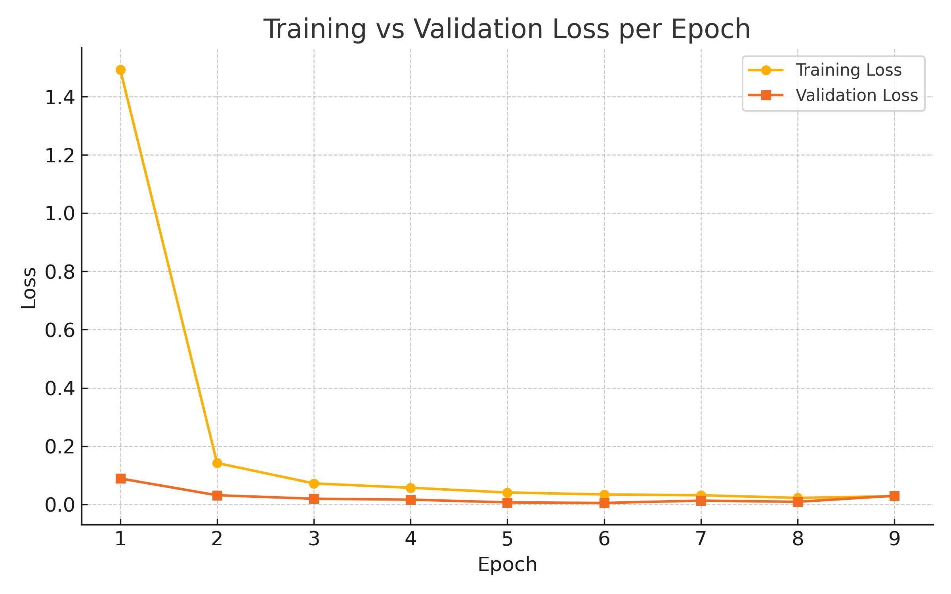
Loss Decreases as the Model Learns

Slide 10

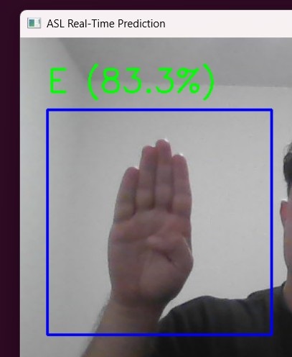
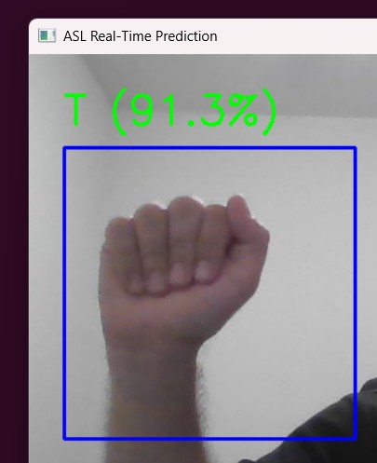
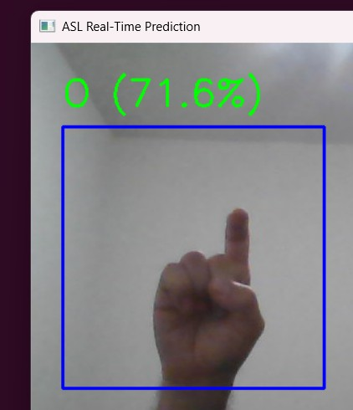
Identified Issues
• Letters A, B, and X not consistently recognized
• Possible causes: lighting, hand orientation, or similarity

Slide 11
Conclusion and Future Work
• Summary of findings
• Limitations
• Potential improvements (e.g., more data, right/left hand model)
• Real-world applications

