Slide 1










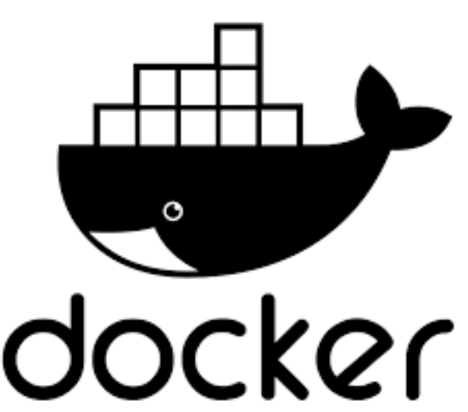

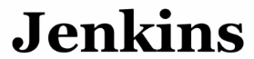


DevOps
Final Project

Slide 2


CI/CD Human Automation

Slide 3







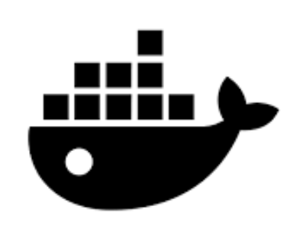



Flow of Data
automated analyzation
Push Code
Notify Jenkins
USER
Github Webhook
CI/CD
Build & Push Images
Github Repositor
Deploy
Continues Deployment
Update K8s Files

Slide 4


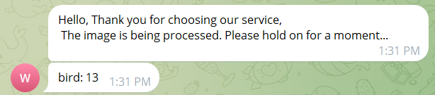
Updating Client Messages in a Continuous Deployment Pipeline
-let’s say we want to change the message that the client is receiving when he/she uses our Telegram service:
We go to the microservices files in GitHub.
We change the message and commit the changes.
Then GitHub webhook triggers Jenkins, based on the Jenkin's URL that has been given:
https://jenkins-final-project.atech-bot.click/

Slide 5
Analysis and deployment process
Jenkin’s pipeline that is triggered runs in stages.
It analysis the microservice code using SonarQube.
SonarQube tool helps identify potential code issues, security issues, and help the developer remediate any potential problems before code is pushed into production.
If everything is successful we build and push Docker image into our own Docker hub Registry.

Slide 6
Update and Deploy Files:
- The Kubernetes deployment files in the GitHub repository are updated to use the new Docker images.
Argo CD provides automated deployment, rollbacks, and status monitoring of applications running in Kubernetes, ensuring continuous deliver of updated files from GitHub.
The updated application is deployed to the Kubernetes cluster. Kubernetes orchestrates the deployment, scaling, and management of containerized applications, providing high availability and scalability.

Slide 7
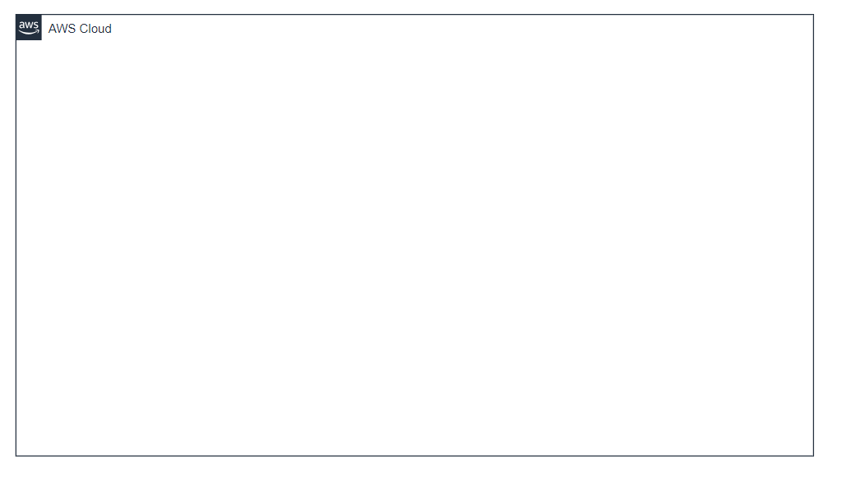
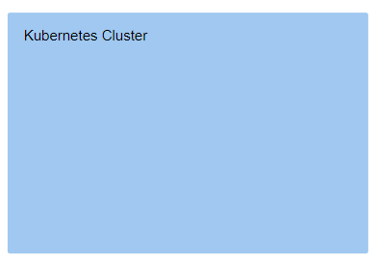


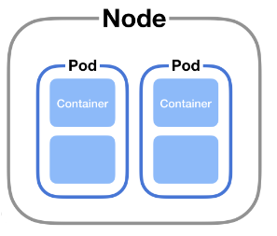



Poly-Bot Micro Service Functionality
3.Upload Image
2.Request is sent to bot Service
4. S3 Bucket
Telegram
1.Sending request
3. Send a message : - Image Details -Telegram ChatID
Bot Service in Kubernetes
4. Simple Queue Service
USER

Slide 8



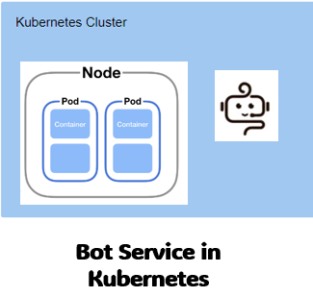
Yolo5 Micro Service Functionality
4.Proccessing Image: Identify Objects in The Image
3.Writes the prediction Results in DB
1.Pulls The message
Simple Queue Service
DynamoDB
Yolo5 Service🚀
6.Fetching Results Based on PreictionID
5.Send an request to Polybot service with PredectionID
2.Downloads the image
S3 Bucket

Slide 9
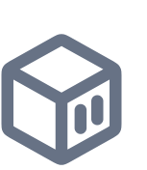
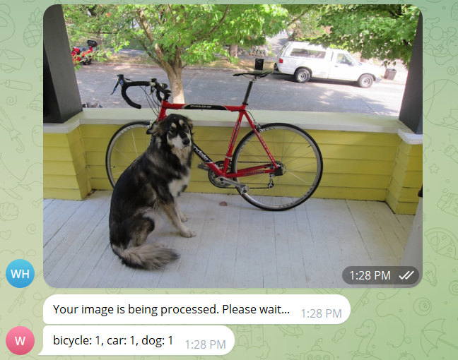
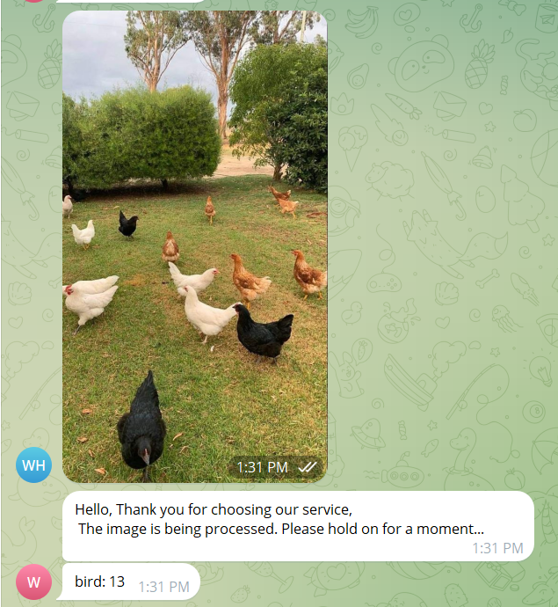
Final Results:
walaahij/yolo5-service:291_20240724_124732
- walaahij/polybot:291_20240724_124732
- walaahij/yolo5-service:292_20240724_124822
- walaahij/polybot:292_20240724_124822

Slide 10
Benefits of the tools we used:
Automation: Reduces manual intervention, increasing consistency and reliability.
Continuous Integration: Ensures that code changes are frequently merged and tested, leading to early detection of issues.
Continuous Deployment: Automates the deployment process, allowing for rapid delivery of new features and bug fixes.
Quality and Security: Integrates static code analysis to maintain high standards of code quality and security.
Consistency: Uses containerization to ensure that the application runs consistently across different environments.
Scalability and Management: Leverages orchestration tools to manage application deployment, scaling, and availability efficiently.
Monitoring: Provides visibility into the deployment process and operational status of the application, facilitating proactive management.

Slide 11
Students
Walaa Hijazi
Samer Jamamaa
Noor Basoul
Muhamed Joulani

