Slide 1
Game of Life Rules and Games
Linh Tran
ECE 573

Slide 2
What is Life?
Life is just one example of a cellular automaton, which is any system in which rules are applied to cells and their neighbors in a regular grid.
Ever since its publication, it has attracted much interest because of the surprising ways the patterns can evolve. It is interesting for physicists, biologists, economists, mathematicians, philosophers, generative scientists and others to observe the way that complex patterns can emerge from the implementation of very simple rules.

Slide 3









Basic Rules (Conway)
A dead cell with exactly three live neighbors becomes a live cell (birth).
A live cell with two or three live neighbors stays alive (survival).
In all other cases, a cell dies or remains dead (overcrowding or loneliness).

Slide 4
Variations on Life
The standard Game of Life is symbolized as "23/3".
The first number, or list of numbers, is what is required for a cell to continue.
The second set is the requirement for birth. Hence "16/6" means "a cell is born if there are 6 neighbours, and lives on if there are either 1 or 6 neighbours".

Slide 5
Some Variations
23/3 (chaotic) "Conway's Life"
23/36 (chaotic) "HighLife" (has replicator)
5/346 (stable) "Long life"
125/36 (chaotic) Life-like 2x2 block rule
238/357 (chaotic) broken life
235678/3678 (stable) ink blot, quick drying
235678/378 (exploding) coagulations in chaos
234 (exploding) phoenix, lacey patterns
12345/3 (exploding) maze-like designs

Slide 6








Kinds of Objects
Still Life Objects
Some of the most common objects in Life remain the same from step to step. No live cells die and no new cells are born
Oscillators
Oscillators are objects that change from step to step, but eventually repeat themselves
Blinker
Toad
Gliders
You will see that after four steps, it looks just like it did when it started. The only difference is that it is shifted along a diagonal.

Slide 7
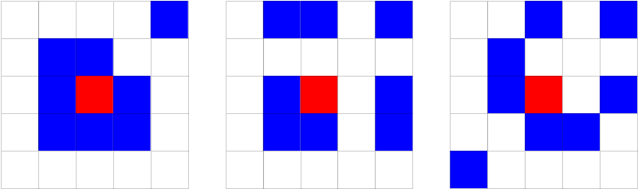
Redefinition of Neighbor
Neighbor need not to be near the cell
We make new neighbor patterns
Neighbor definition changed -> new games

Slide 8

GOL on Triangular grid
Neighborhood redefined on a triangular grid.
Triangular has 12 neighborhoods compare to 8 of regular (square) grid (Moore rule).

Slide 9
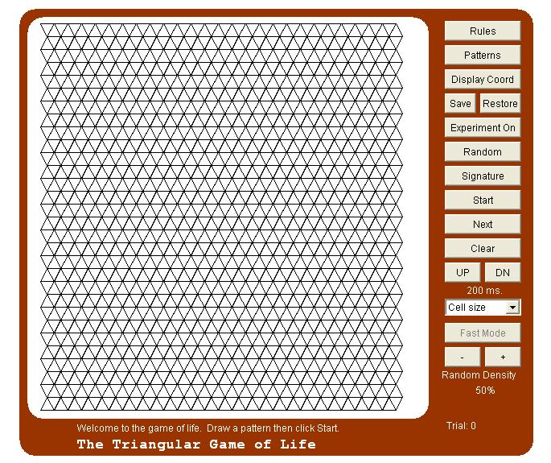
GOL Triangular program
The program created by Carte Bays

Slide 10
GOL Triangular program (cont)
We can modify the rules by click to Rules button, it also include Conway’s rule
Also there are some favorite patterns that we can see or experiments by choosing from the “Patterns” library.
We can fill it with random density, choose the cell size and some more options to be chosen from the program.

Slide 11

GOL on Hexagon grid
Neighborhood redefined on a hexagonal grid.
Triangular has 6 neighborhoods compare to 8 of regular (square) grid or 12 of triangular grid (Moore rule).

Slide 12
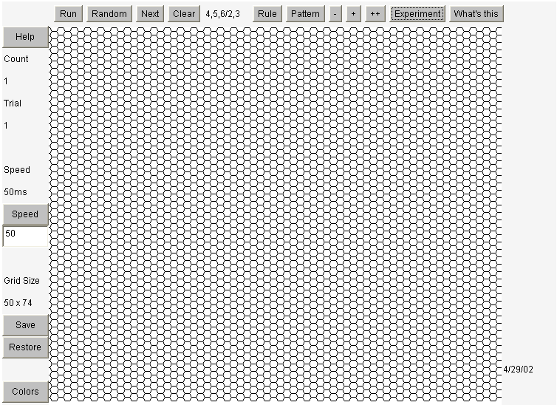
GOL hexagon program
Same as triangular program we can modify the rules, choose patterns, or create self-experiment for the game

Slide 13
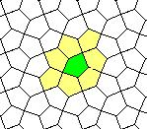
GOL on Pentagon grid
Neighborhood redefined on a hexagonal grid.
Triangular has 7 neighborhoods compare to 8 of regular (square) grid or 12 of triangular grid or 7 of hexagon grid (Moore rule).

Slide 14
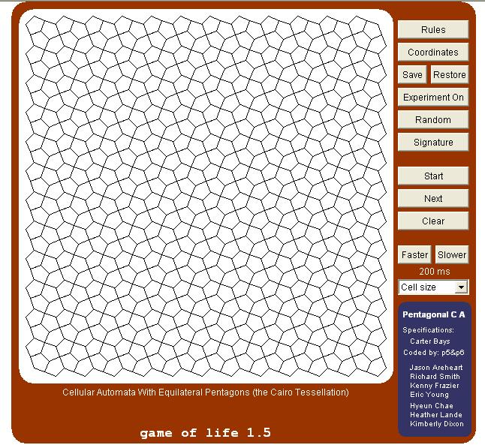
GOL pentagon program
Same as triangular program we can modify the rules, choose patterns, or create self-experiment for the game

Slide 15
3D Game Of Life
3D Life was investigated by Carter Bays. In a M-dimentional Life a point has 3M - 1 neighbors, i.e. 8 for 2D (M = 2) and 26 for 3D (M = 3). Therefore in 3D we can get richer rules and structures.
Rules: R = (r1, r2, r3, r4)
a new ball will appear if the number of neighbors (sum) is equal or more than r1 and equal or less than r2.
a ball will die if the sum is more than r3 or less than r4.

Slide 16
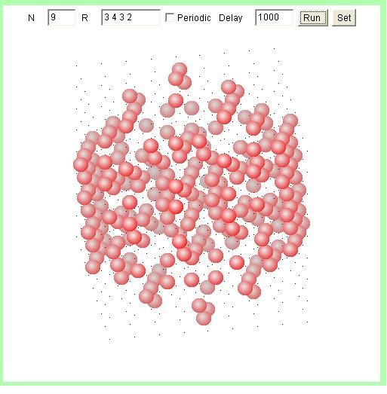
3D Game of Life program
Press & Drag mouse to rotate a life form.
Press Enter to set new parameters values from the text fields.
You can choose any reasonable N - size of the grid

Slide 17
Games with multiple variations
Mirek's Java Cellebration v.1.50
a Java applet that allows playing 300+ Cellular Automata rules and 1400+ patterns. It can play rules from 13 CA rules families: Generations, Life, Vote, Weighted Life, Rule tables, Cyclic CA, 1D totalistic, 1D binary, Neumann binary, General binary, Margolus neighborhood, Larger than Life, and some of the User rules.
http://psoup.math.wisc.edu/mcell/ca_rules.html

Slide 18
Programmer’s view
They represented Life patterns as two-dimensional arrays in computer memory. Typically two arrays are used, one to hold the current generation and one in which to calculate its successor. Often 0 and 1 represent dead and live cells, respectively. A double loop considers each element of the current array in turn, counting the live neighbors of each cell to decide whether the corresponding element of the successor array should be 0 or 1. At the end of this process, the contents of the successor array are moved to the current array, the successor array is cleared, and the current array is displayed.

Slide 19
Simple code
//for each cell in current generation
for ( i = 0; i < MAX_LINE; i++ ) {
for ( j = 0; j < MAX_COL; j++ ) {
//count the alive neighbor cell
count = neighbor_alive (i - 1, j - 1) + neighbor_alive (i - 1, j) +
neighbor_alive (i - 1, j + 1) + neighbor_alive (i, j - 1) +
neighbor_alive (i, j + 1) + neighbor_alive (i + 1, j - 1) +
neighbor_alive (i + 1, j) + neighbor_alive (i + 1, j + 1);
//if count = 2 or count = 3 and cell is alive, it continues to live
if ( (count == 2 || count == 3) && currgen [i][j] == ‘*' ) {
nextgen [i][j] = ‘*';
//if count = 3 and cell is dead, it springs to life
} else if ( count == 3 && currgen [i][j] == ' ' ) {
nextgen [i][j] = ‘*';
//else cell is dead or remains dead
} else {
nextgen [i][j] = ' ';
}
}
}

