Slide 1
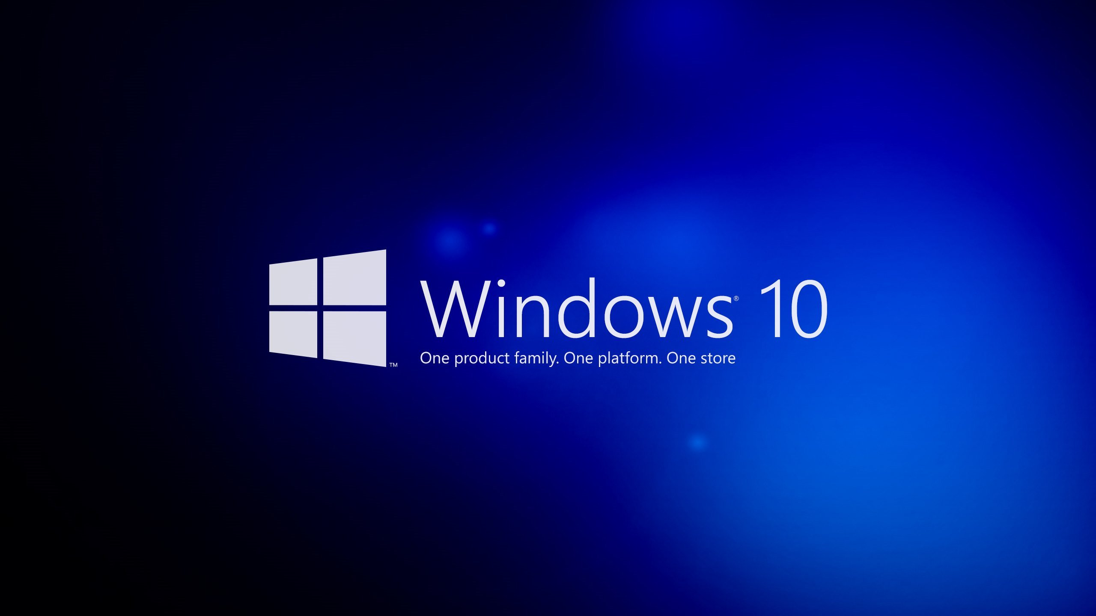

Slide 2
To begin, I would like to ask a couple of questions
Who use Windows 10?
What is your attitute about it?

Slide 3
Windows 10
Cross-platform operating system developed by Microsoft as part of the family of Windows NT, with closed source.
Windows 10 will be the last version of Microsoft Windows. For today last version was released 12.11.2015.
Supported Platforms:x86, x86-64 и ARM.
Have Hybrid kernel .

Slide 4
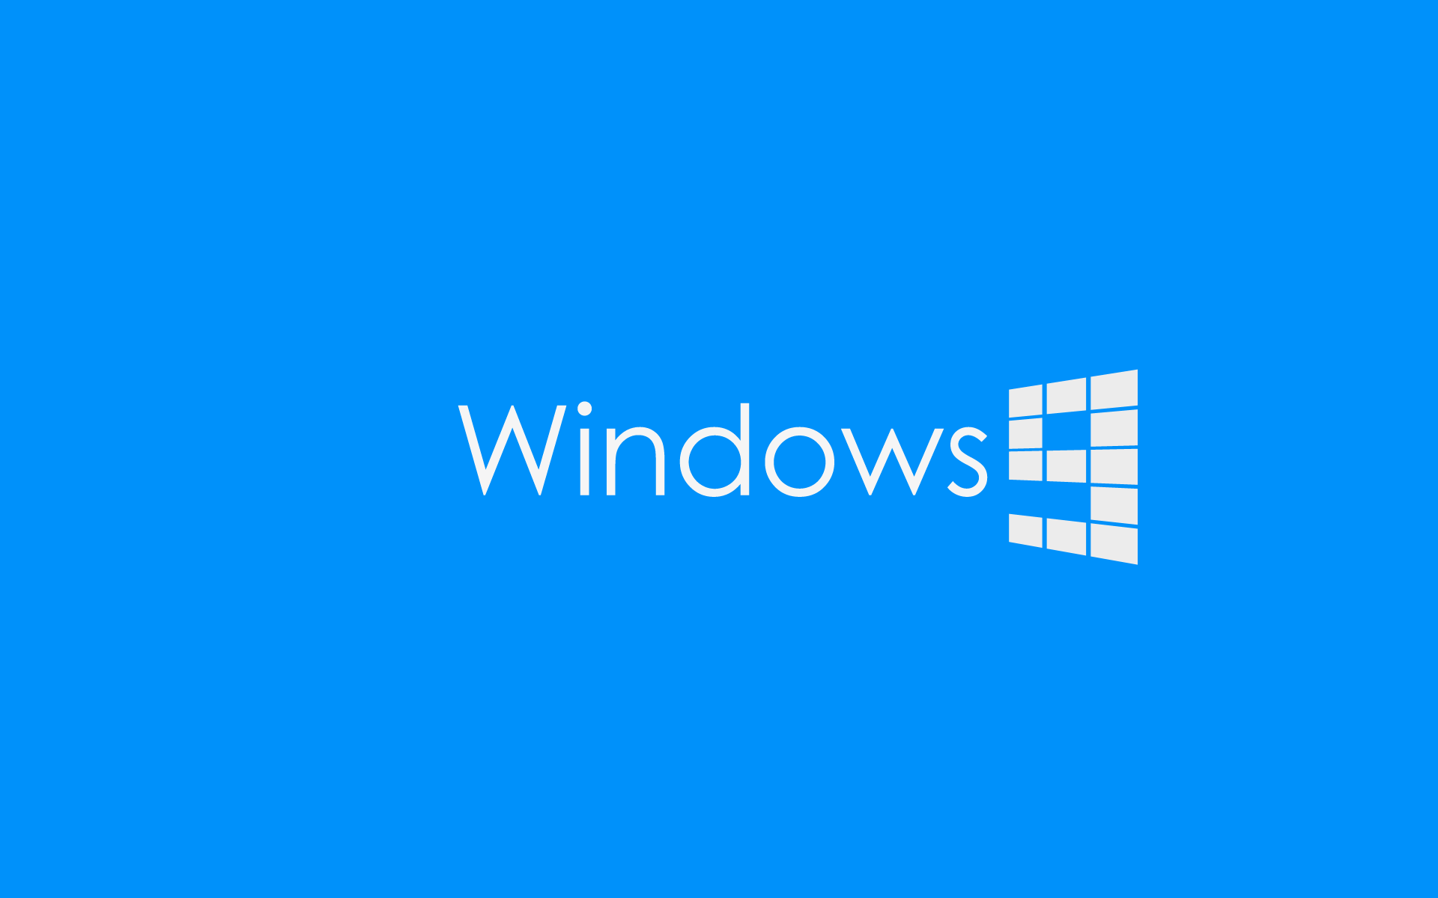

Slide 5
Why we didn’t see Windows 9??
After Windows 8 system has received the number 10 without going through 9. As explained by the head of marketing at Microsoft Windows Tony Prophet, 9 pass in the name of the Windows operating system is not related to compatibility. Many programs would define it as a system of family Windows 9x, which were issued between 1995 and 2000.

Slide 6
Spread
Windows 10 - the first operating system Microsoft, which officially applies not only to the provider's server, but also with the computers of its users, on the basis of the protocol BitTorrent.
And this option is enabled by default, but you can turn it off

Slide 7
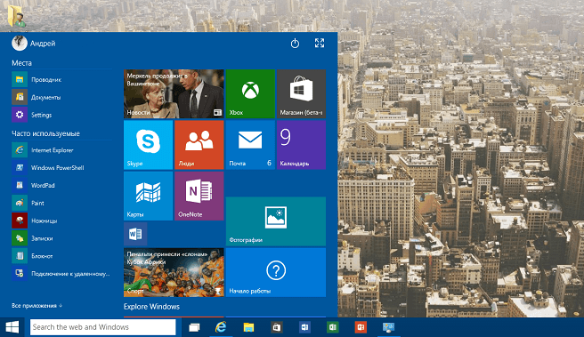
An updated "Start" menu allows the user one-click to view a list of frequently used applications and files, as well as configure the application program, contacts and websites. It is possible to fix tiles in "Start" menu, and if the tiles are not needed, they can be removed. However, if users prefer the screen "Start" in Windows 8.1, they will be able to switch to it.
Since assembly 10056 can resize the "Start" menu by using the mouse or the open menu on the screen.

Slide 8
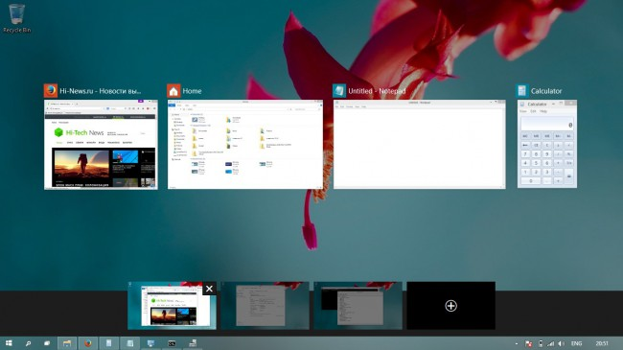
The button allows the user to view the task to create multiple desktops and switch among them to improve the efficiency of work with multiple programs simultaneously. Also screen viewing problems can be opened with the key combination Win + Tab ↹.

Slide 9
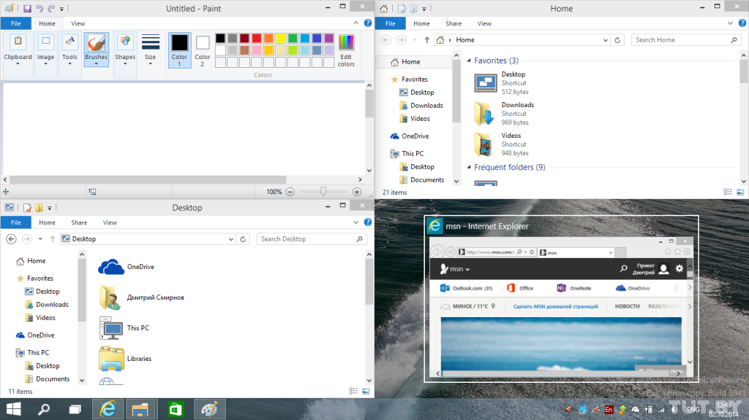
Improved Snap, you can open just 4 applications simultaneously and suggests what other applications are running and how they can be placed.

Slide 10
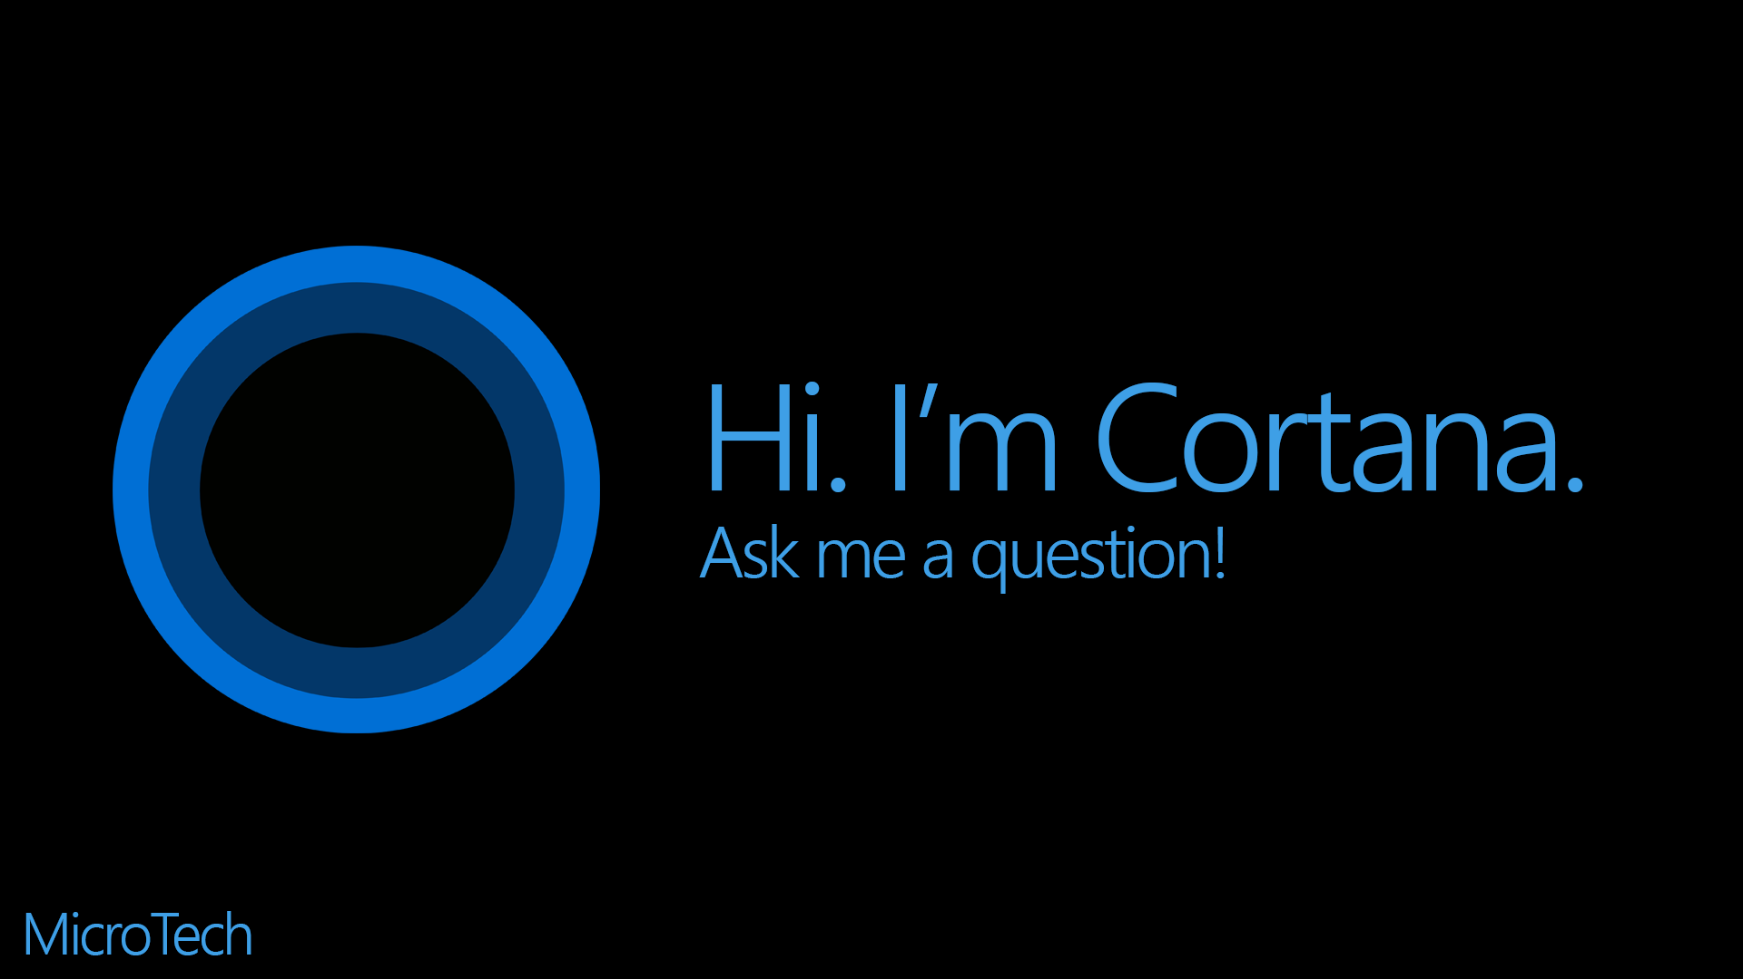
Cortana
New search panel with integrated voice assistant Cortana. Voice activation allows you to call the search team «Hey, Cortana». It can search for and open files or applications, send messages and so on. So far available only for the United States, Britain, China, France, Italy, Germany and Spain, however, with the official release is scheduled for optimization and other countries, but only with the advent of Windows Redstone in 2016.

Slide 11
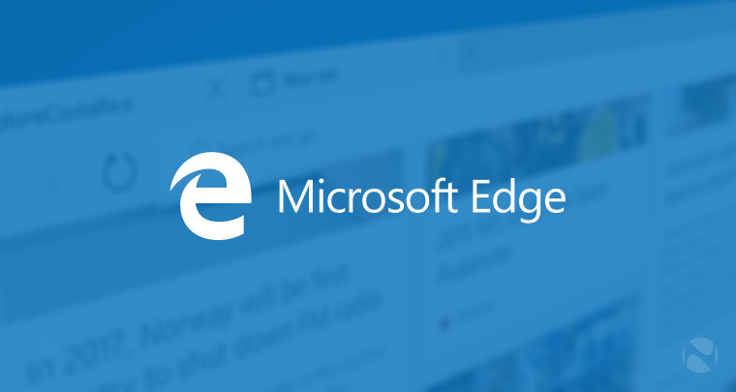
New browser Microsoft Edge

Slide 12
New browser engine – EdgeHTML.
New interpreter JavaScript – Chakra.
The ability to make notes and drawings on a Web page and share them.
Voice Assistant Cortana.
Extension support different browsers (from 2016).

Slide 13
Something “New”
Modified GUI with thin lines and the new animation opening and closing.
There are mode "Airplane“.
New Windows Market app.
Continuum mode allows you to interact both with the touch interface and the traditional hybrid devices.
Support Center in Windows 10 renamed "Security and maintenance“.
Storage Sense feature allows you to save the application from the Windows Store is not only on the hard drive, but also to the memory card.
Updated welcome screen and lock screen.
In the Taskbar added to the search bar, the button tasks view (as desktops) and the Center for notifications.
The new "Notification Center" buttons quick settings.
Service Windows Hello logon using biometrics makes it possible not to enter a password on the sites and the applications that support it.
The new application "Settings" in the near future will replace the "Control Panel", which is still there in Windows 10, but with limited functionality.

Slide 14
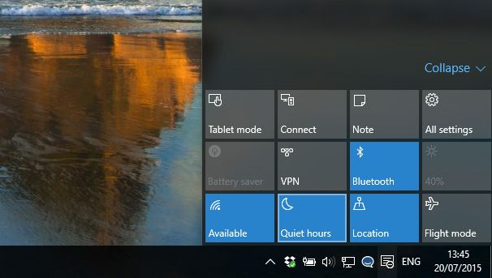
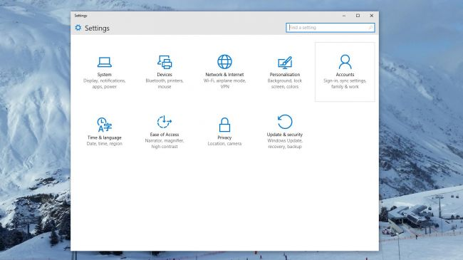

Slide 15
More
Into the system is integrated service OneGet, allowing to install software in Linux using the package manager.
Appendix feedback allows Windows Feedback Microsoft says about his experience of using prerelease version of Windows 10, as well as error and wishes.
In the "Explorer" to add more functional search and display the latest file with the most visited folders.

Slide 16
Now that Windows 10 is finished, perhaps it's clear to see that it's a very usable and flexible operating system, which tried to take the best of all existing operating systems.(Siri, Aqua GUI Mac OS X, Market and Settings from Unix, tracking ).

Slide 17
My Opinion
I amn’t user of this system, and in near future I willn’t going to be, in the reason of many bad reviews , which claim that the system is crude and unproductive.

Slide 18
