Slide 1
Table 1. Agronomical traits of three Chenopodium quinoa cultivars growing under different agroecological conditions
(*) Seed losses were detected due to defects related to the timing of maturity, the uniformity of maturity and the drydown of plant at seed maturity
(**) Plants did not yield seeds.

Slide 2
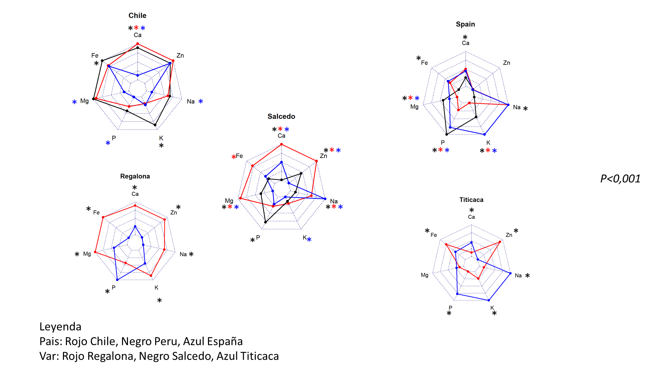
a
b
Figure 1. Mineral composition of three cultivars of C. quinoa seeds growing at three different locations. Quantitative multi-elemental analysis was performed using inductively coupled plasma (ICP) spectrometry and the total content of phosphorous (P), potassium (K), calcium (Ca), magnesium (Mg), iron (Fe), sodium (Na) and zinc (Zn) were determined. Three cultivars (Regalona, Salcedo-INIA and Titicaca) grown at three different locations (Perú, Chile and Spain) were used to evaluate changes in the mineral composition associated with different agroecological conditions. (a) Mineral composition of one variety comparing among countries (Red: Chile; Black: Perú; Blue: Spain). (b) Mineral composition of seeds from Spain or Chile comparing among varieties (Red: Regalona; Black: Salcedo-INIA; Blue: Titicaca).Values are Mean ± SE (n=4). Asterisks indicate statistical differences at a P < 0.05 (Tukey t-test or Student t-Test when comparing pairs). When more than 2 samples are compared, colored asterisks indicate the sample that is statistically significant.

Slide 3
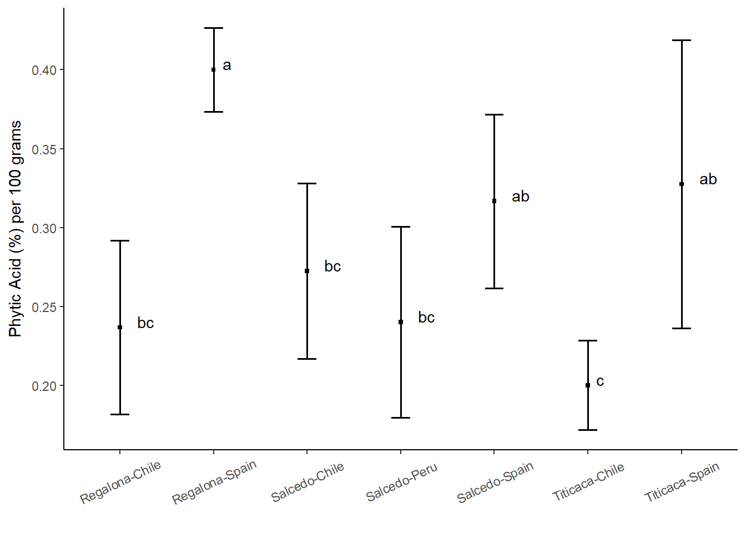
Figure 2. Phytic acid content among three varieties of C. quinoa seeds growing at different locations. Phytic acid content of quinoa seeds was determined using the myo-inositol hexakisphosphate method. Phytic acid is presented as the % of phytate per 100 grams of seeds. Values are Mean ± SE (n=4). Different letters indicate statistical differences at a P < 0.05 (Duncan t-test).

Slide 4
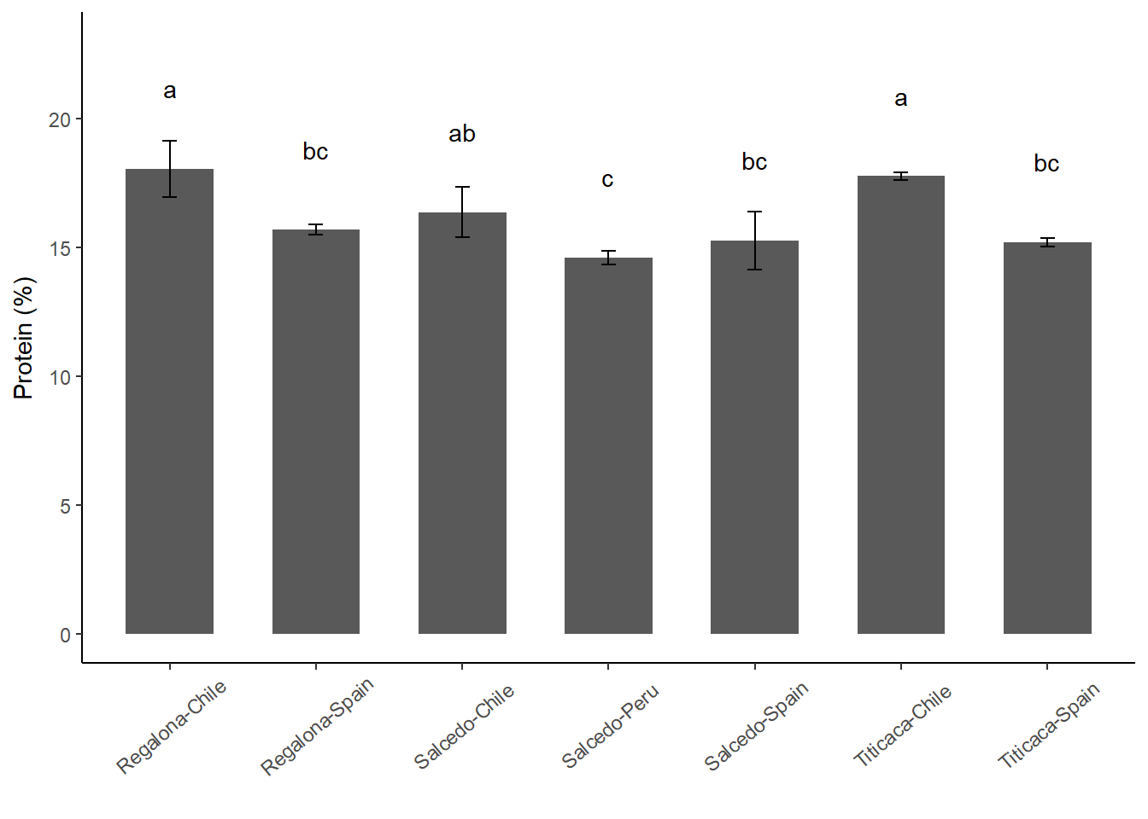
Figure 3. Total Protein content of C. quinoa seeds. Total protein content was determined by using the Kjeldahl method in seeds of Regalona, Salcedo-INIA and Titicaca cultivars grown in Chile, Peru or Spain. Values are Mean ± SE (n=3). Different letters indicate statistical differences at a P < 0.05 (Duncan t-test).

Slide 5
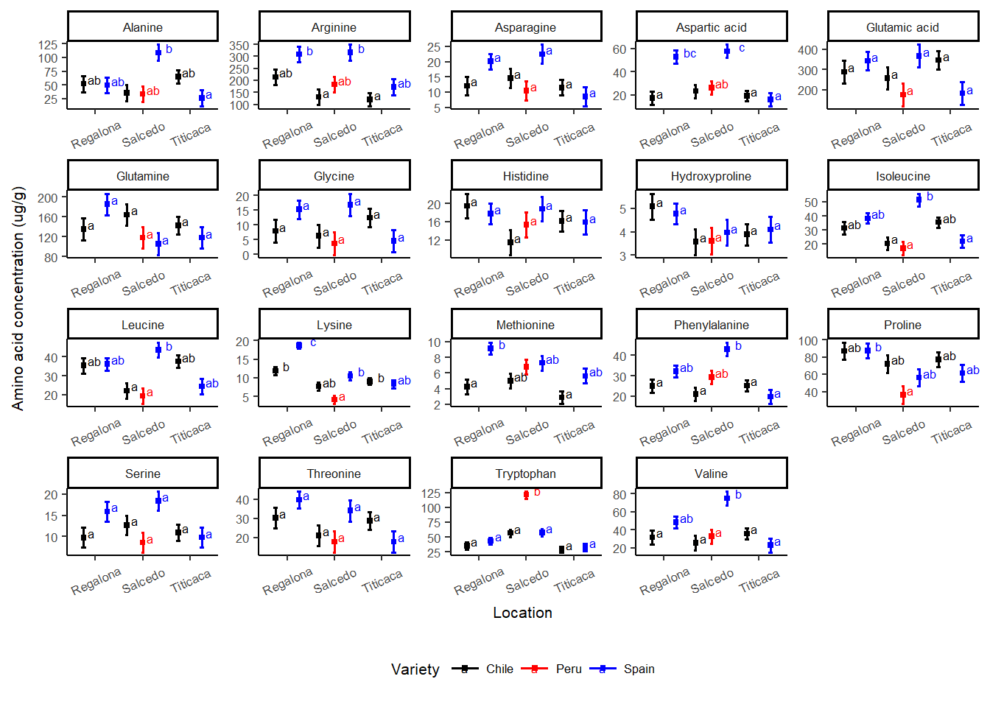
ab
ab
ab
Figure 4. Free amino acid composition of C. quinoa seeds from different cultivars and locations. Amino acid contents of a pool of 10 g of C. quinoa seeds were determined by using LC/MS. Seeds of different cultivars including Regalona, Salcedo-INIA and Titicaca were obtained from different locations (Chile, Peru or Spain). Values are Mean ± SE (n=4). Different letters indicate statistical differences at a P < 0.05 (Tukey t-test).

Slide 6
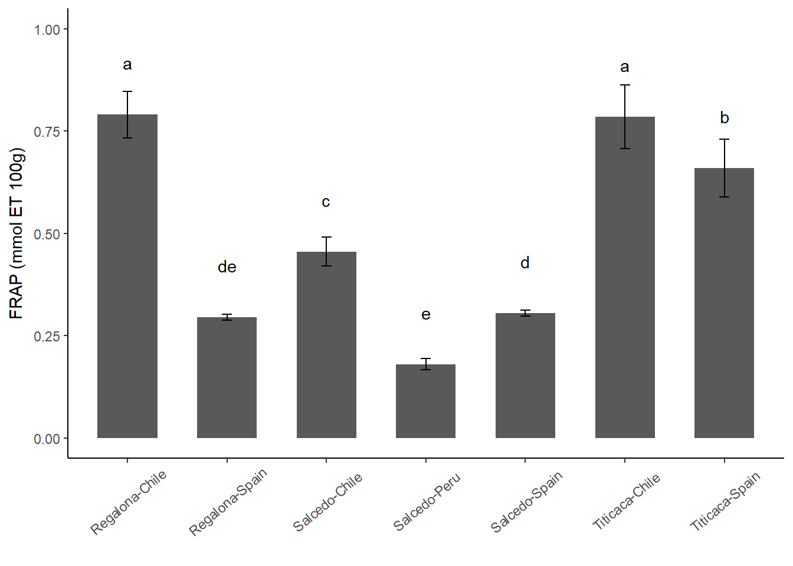
Figure 5. Variation of antioxidant properties of C. quinoa seeds of different cultivars and locations . Antioxidant properties were determined by using FRAP in seeds of Regalona, Salcedo-INIA and Titicaca cultivars grown in Chile, Peru or Spain. Values are Mean ± SE (n=3). Different letters indicate statistical differences at a P < 0.05 (Duncan t-test).

Slide 7
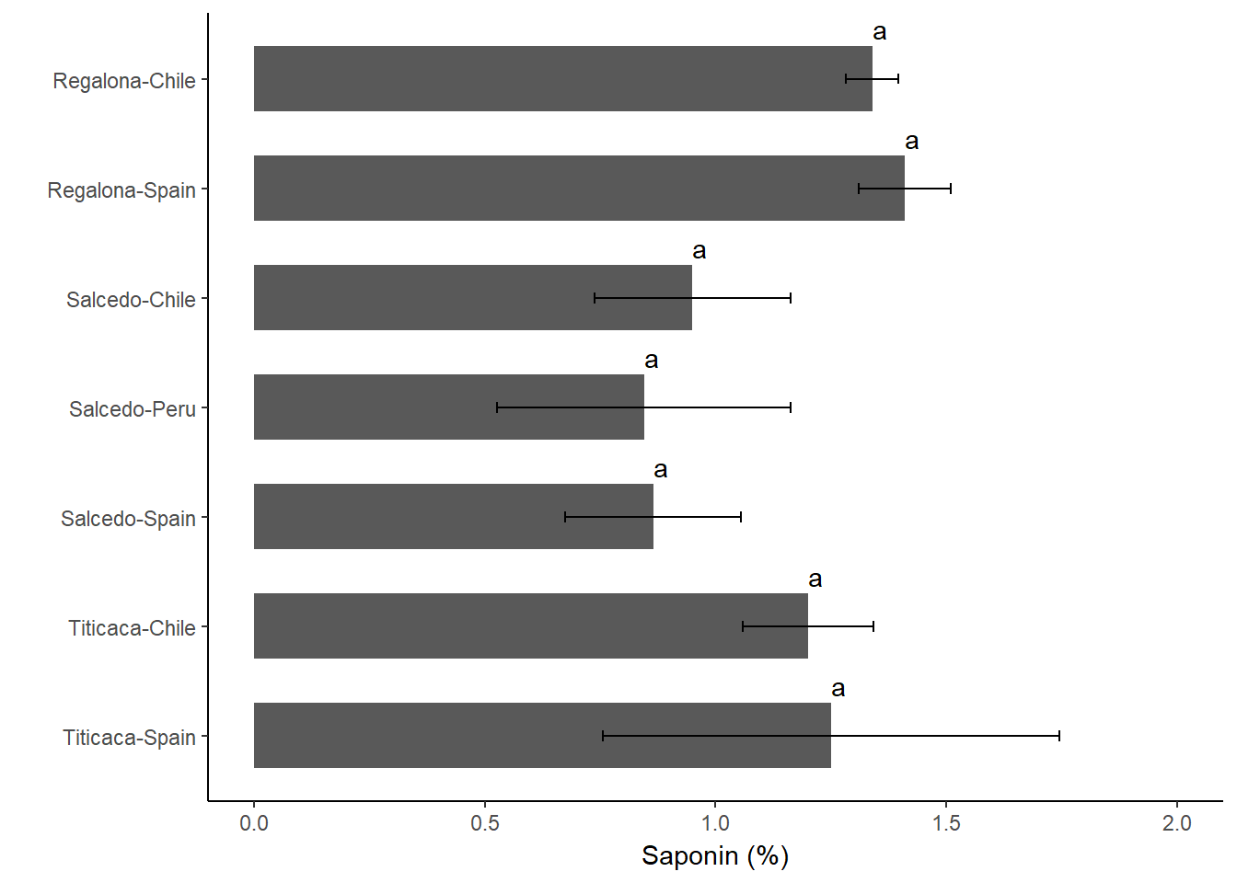
Figure 6. Saponin content of C. quinoa seeds from three cultivars grown at three different locations. Saponin content was determined in Regalona, Salcedo-INIA and Titicaca seeds obtained at three different locations (Chile, Peru or Spain) using XXXX method. Values are Mean ± SE (n=3). Different letters indicate statistical differences at a P < 0.05 (Duncan test).

Slide 8
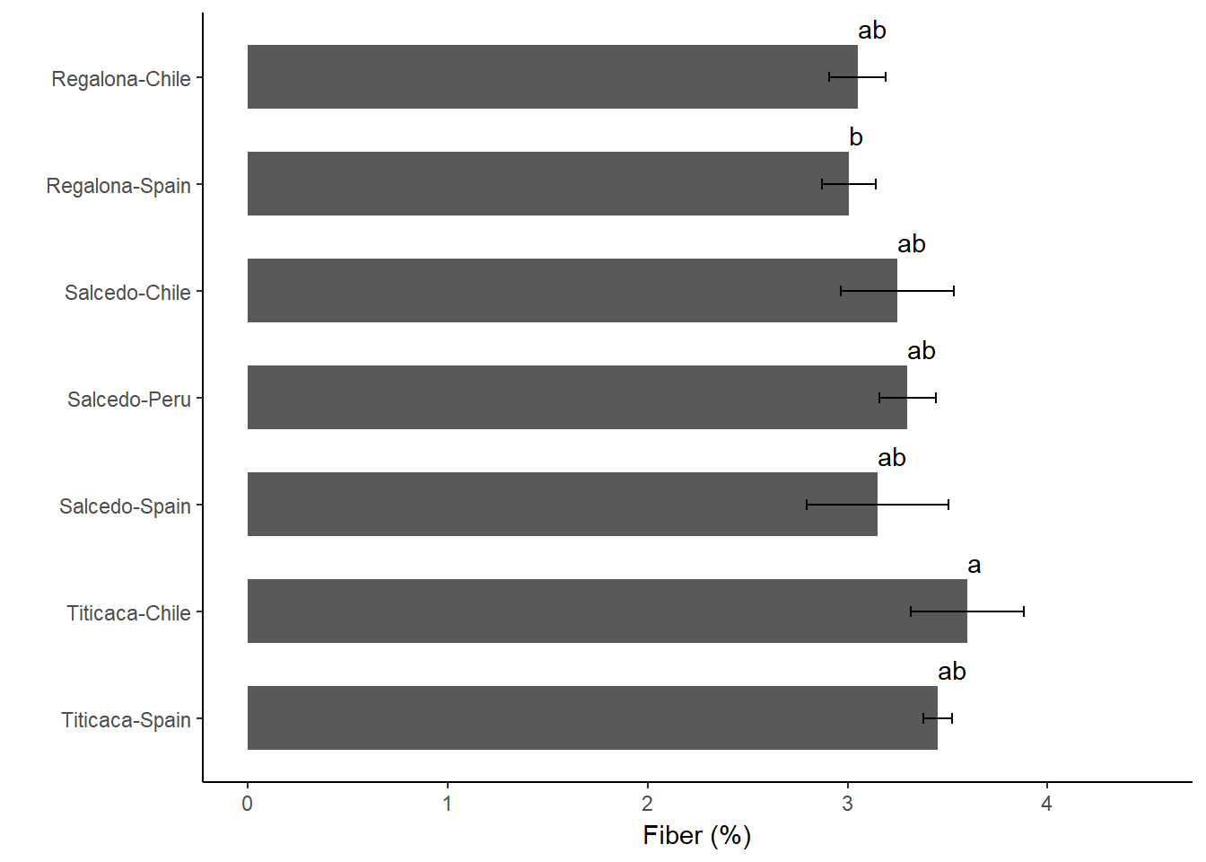
Figure 7. Fiber content of C. quinoa seeds changes . Fiber content of quinoa seeds was determined in Regalona, Salcedo-INIA and Titicaca seeds grown in Chile, Peru or Spain using the XXX method. Values are Mean ± SE (n=3). Different letters indicate statistical differences at a P < 0.05 (Duncan test).

Slide 9
a
b

Slide 10
ab
ab
ab
b

