Slide 1
HW2P1 Bootcamp
Convolutional Neural Networks with Numpy
Khushali, Yichen, Ketan, Choowon
Acknowledgment: Denis, Harshith, Pavitra, Shreyan for the slide content.

Slide 2
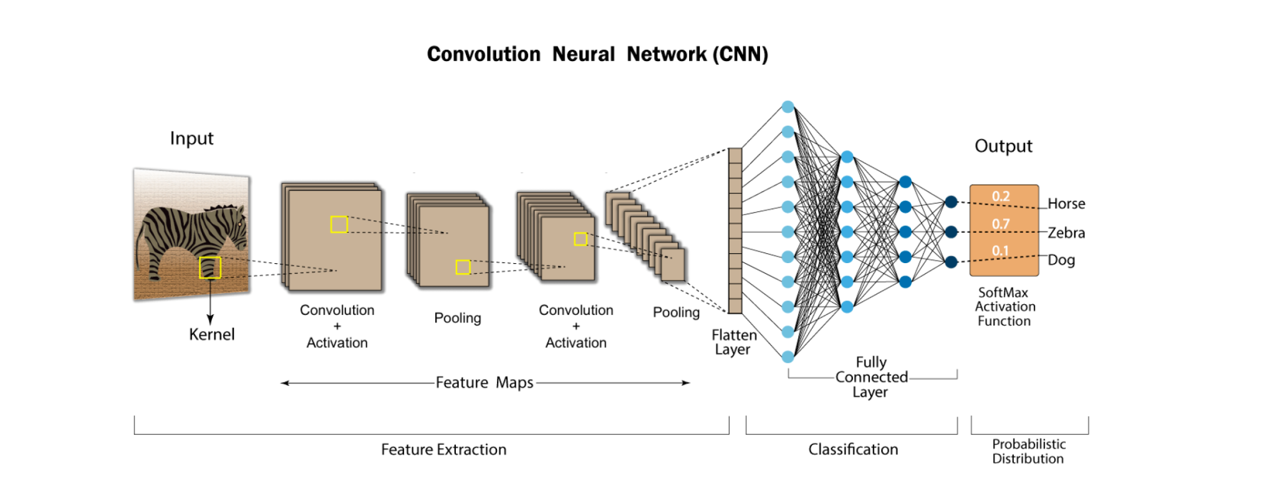
Notes:
(Especially in down sampling) Down sampling an input of length 6 and an input of length 5 with a factor of 2 will both give you an output of length 3 (You may need to store in other questions also)

Slide 3
Resampling
For loop is not required in python
Look up np.kron
Array slicing: [start:end:step]
Things to remember
Trying to compute the required shape while up sampling (some simple formula you can think of?)
Computing and storing the shape in forward.
This is because the gradient should be the same shape as the input.
Notes:
(Especially in down sampling) Down sampling an input of length 6 and an input of length 5 with a factor of 2 will both give you an output of length 3 (You may need to store in other questions also)

Slide 4
Convolutions
You can perform convolutions in 2 ways:
The Loopy way (Bad)
Tensordot (Good)
The more for loops you use for your questions, the more time it takes to run.
With tensordot, you don’t have to do all those broadcasting and everything given in the write-up

Slide 5
Tensordot
Ref: https://numpy.org/doc/stable/reference/generated/numpy.tensordot.html
Appendix of the write up has amazing documentation of it
Don’t use for loops for convolution even though everything is given in the lecture slides
Tensordot is faster and helps you (also TAs) to debug easily
You only need 1 for loop for conv1d and 2 for loops for conv2d. If you are using more, then your implementation of tensordot is wrong even if you get the answer right

Slide 6
Tensordot
Before starting ConvXd.py, open a notebook and try to understand tensordot with random examples
Consider the shapes:
Input: X(A, B, C); Weight: W(P, Q, R)
You can do tensordot when you have matched shapes
If B = Q and C = R,
Tensordot(X, W, matched axes) -> Output(A, P)
You can think that the output shape will be the shape of the unmatched axes in that order
Make sure inputs (input and weight) to tensordor have some matching axes. Why do you need matching axes in convolution? (Hint: A filter only looks at a segment of input)
Tip: Print shapes in your code to understand

Slide 7
Tensordot
(A, X, C, Y)
(X, P, Q, Y)
(A, C, P, Q)
Can you find the output pattern?
(X, Y) from input 1 matches to (X, Y) from input 2
Can you think in terms of axes?
Should match all the axes that you think needs to be matched. Not restricted to 2 axes

Slide 8
Conv1d to Conv2d
Try to understand each step while coding conv1d
Every step between Conv1d and Conv2d (forward and backward) are identical
While transitioning from Conv1d to Conv2d, you just need to account for the extra dimension and do an extra something

Slide 9
Pooling
Lectures have a basic pseudocode which can be developed
You might need many loops for this task
Np.max and np.unravel_index might be useful if you want to reduce the number of loops
But multiple loops are acceptable for this particular task
Backprop in both might is harder than forward, but if you know the concept behind it, it will not be that hard.
Look at the write up for images.

Slide 10
Easy way to understand gradient propagation
Input (A)
Kernels (2)
Output (Z)
We get 2 maps in backward for dLdZ. After some process for finding dLdA, you again get 2 maps. But A has 1 map and dLdA will also have the same shape. How to understand gradient propagation?

Slide 11
Easy way to understand gradient propagation
Input (A)
Kernels (2)
Output (Z)
Draw the influence diagram.

Slide 12
Easy way to understand gradient propagation
dA
Input (A)
Kernels (2)
Output (Z)
Any small change dA will cause a change in both maps of Z.

Slide 13
Scanning MLP
Difference between input to Conv1d and Linear
How Linear sees the input
How Conv1d sees the input

Slide 14
Scanning MLP
MLP
You did this in HW1P2
Linear(9, 2)
Flatten

Slide 15
Scanning MLP
transformed Linear(9, 2) to Conv1d(in_channels = 3,
out_channels = 2, kernel_size= 3,
stride= 1)
Out_channel =2
MLP
in_channel=3
Kernel size=3

Slide 16
Scanning MLP
transformed Linear(9, 2) to Conv1d(in_channels = 3,
out_channels = 2, kernel_size= 3,
stride= 1)
MLP
Input:

Slide 17
Scanning MLP
transformed Linear(9, 2) to Conv1d(in_channels = 3,
out_channels = 2, kernel_size= 3,
stride= 1)
MLP

Slide 18
Scanning MLP
MLP
You did this in HW1P2
Flatten

Slide 19
Scanning MLP
MLP
Flatten

Slide 20
Scanning MLP
MLP
Flatten

Slide 21
Scanning MLP
Output:
Input:

Slide 22
Scanning MLP
Output:
Input:
Which gives in_channels = 3, out_channels = 2, kernel_size = 3, stride = 1
We transformed Linear(9, 2) to Conv1d(3, 2, kernel_size= 3, stride= 1)

Slide 23
CNN Model
Just calling all the layers which you implemented previously
Only thing to think about: Initialization size of the final Linear Layer?
Errors which you may get:
If you have a closeness error (true_divide error), change to np.tanh()

Slide 24
THANK YOU

