Slide 1
ARGUS - THE OMNISCIENT CI
Cosmin Poieană
Co-Founder @ RoPython
Employee @ Cloudbase
Student @ UAIC
cmin@ropython.org

Slide 2
Contents
1. Clouds
2. Cloudbase-Init
3. Testing Cloudbase-Init
4. Argus
5. Components
6. Relationship between components
7. Advanced concepts
8. Argus configuration file
9. Create a comprehensive test

Slide 3

Clouds
Cloud computing
InternetAsAService
OpenStack
OpenNebula
CloudStack

Slide 4

Clouds
VM creation & initialize
Metadata providers
Cloud initialization services
Cloud-Init
Cloudbase-Init

Slide 5
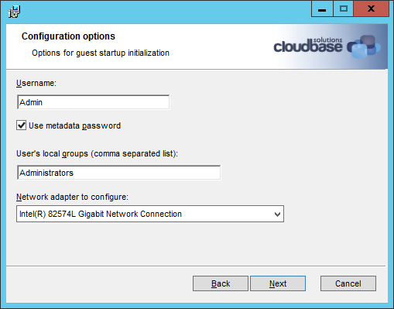
Cloudbase-Init
Portable customization
For NT systems
OSS & written in Python
Supports popular clouds
Independent of the hypervisor
Merge with Cloud-Init

Slide 6
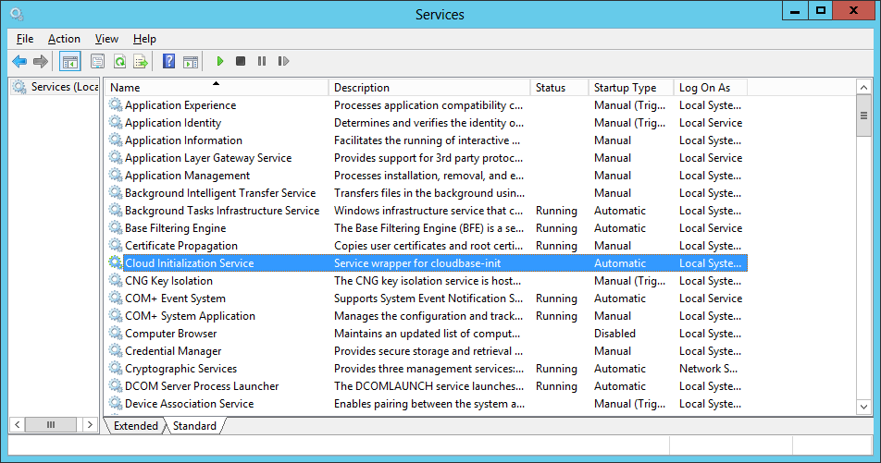
Cloudbase-Init
Runs as a service at startup
Services (different metadata providers)
Plugins:
Host name
Networking
Local scripts
SSH public keys
Userdata
Configuration file

Slide 7
Cloudbase-Init
[DEFAULT]
# What user to create and in which group(s) to be put.
username=Admin
groups=Administrators
inject_user_password=true # Use password from the metadata (not random).
# Where to store logs.
logdir=C:\Program Files (x86)\Cloudbase Solutions\Cloudbase-Init\log\
# Where are located the user supplied scripts for execution.
local_scripts_path=C:\Program Files (x86)\Cloudbase Solutions\Cloudbase-Init\LocalScripts\
# Services that will be tested for loading until one of them succeeds.
metadata_services=cloudbaseinit.metadata.services.configdrive.ConfigDriveService,
cloudbaseinit.metadata.services.httpservice.HttpService
# What plugins to execute.
plugins=cloudbaseinit.plugins.common.mtu.MTUPlugin,
cloudbaseinit.plugins.common.sethostname.SetHostNamePlugin

