Slide 1
ARGUS - THE OMNISCIENT CI
Cosmin Poieană
Co-Founder @ RoPython
Cloud Engineer @ Cloudbase
Student @ UAIC
cmin@ropython.org
Notes:
Hi, my name is Cosmin Poieana and in this talk I’ll show you the true power of Argus, an open source continuous integration framework, mainly used to test Cloudbase-Init and not only.
Together with some friends (and coworkers) we created RoPython, the Romanian community which stands for anything that involves Python and open-source software, by organizing workshops, trainings and conferences. In my full time, I’m working at a cool startup named Cloudbase Solutions and also following to obtain the Bachelor degree at Cuza university.
In case of future questions, regarding my involvement in these things, you can contact me using the E-mail address shown below my name, C-M-I-N at ropython dot O-R-G.

Slide 2
Contents
1. Clouds
2. Cloudbase-Init
3. Testing Cloudbase-Init
4. Argus
5. Components
6. Argus configuration file
7. Advanced concepts
8. Using Argus
9. Create a comprehensive test
Notes:
As a fast reference, today I will talk about clouds in general, closed to our current approach, about cloud initialization services and in particular, Cloudbase-Init and how we test it. For the testing part, we use Argus, which is made by some cool components working together, all specified and bundled in the most important part of the project, the configuration file. I will also talk about some in-depth and pretty advanced concepts and capabilities handled by Argus, how to customize your tests starting from the command line interface and finally, I’ll show you how to actually create a test for your patch or for some aspect already implemented in your tested project and a demo demonstrating how this works in real life.

Slide 3

Clouds
Cloud computing
InfrastructureAsAService
OpenStack
OpenNebula
CloudStack
Notes:
Before starting talking about anything related to initialization services, I will briefly go through the essence of cloud computing. So, what is a cloud at all (by IT meaning)? In simple words, is a place over multiple hosts in a network, where many types of data are stored, processed and served to the user, rather than using a local computer. Usually, clouds stacks services like Platform As A Service, Infrastructure As A Service and Software As A Service, but we will focus on IaaS and handling virtual machine instances created through it. Such popular deploys, mainly used in the world, starts with noisy names like OpenStack, the biggest open-source project mostly written in Python, OpenNebula, which is something similar but lighter than OpenStack and resource friendly and another cloud even more simpler to handle, called CloudStack.

Slide 4

Clouds
VM creation & initialize
Metadata providers
Cloud initialization services
Cloud-Init
Cloudbase-Init
Notes:
These infrastructures are mainly used to create and handle with ease many instances which are basically virtual machines emulated by a hypervisor.
There are some important things which we should know about the Clouds, like…

Slide 5
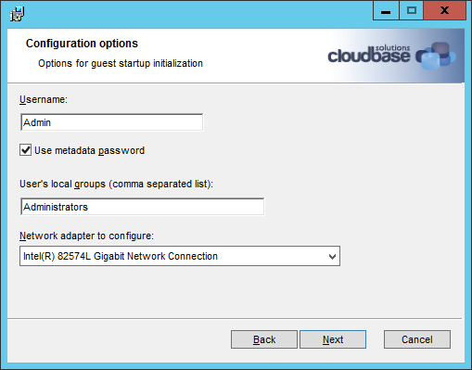
Cloudbase-Init
Portable customization
For NT systems
OSS & written in Python
Supports popular clouds
Independent of the hypervisor
Merge with Cloud-Init

Slide 6
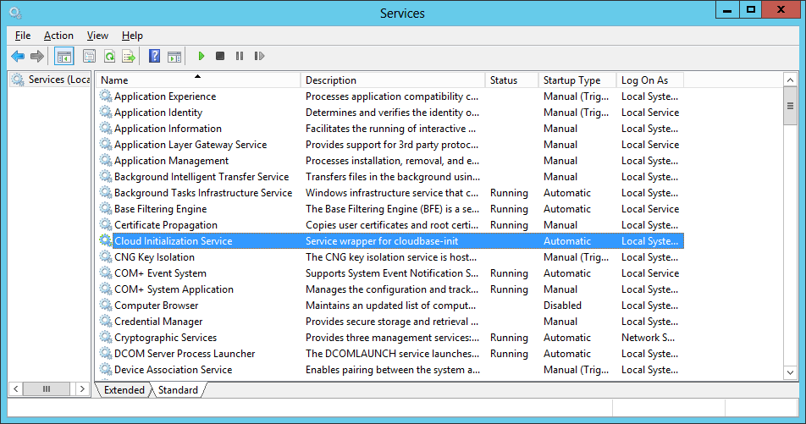
Cloudbase-Init
Runs as a service at startup
Services (different metadata providers)
Plugins:
Host name
Networking
Local scripts
SSH public keys
Userdata
Configuration file

Slide 7
Cloudbase-Init
[DEFAULT]
# What user to create and in which group(s) to be put.
username=Admin
groups=Administrators
inject_user_password=true # Use password from the metadata (not random).
# Where to store logs.
logdir=C:\Program Files (x86)\Cloudbase Solutions\Cloudbase-Init\log\
# Where are located the user supplied scripts for execution.
local_scripts_path=C:\Program Files (x86)\Cloudbase Solutions\Cloudbase-Init\LocalScripts\
# Services that will be tested for loading until one of them succeeds.
metadata_services=cloudbaseinit.metadata.services.configdrive.ConfigDriveService,
cloudbaseinit.metadata.services.httpservice.HttpService
# What plugins to execute.
plugins=cloudbaseinit.plugins.common.mtu.MTUPlugin,
cloudbaseinit.plugins.common.sethostname.SetHostNamePlugin

Slide 8
Testing Cloudbase-Init
Unit testing (local & Jenkins)
Windows VM
Installer & Service
OpenStack instance
OpenNebula, CloudStack etc. instance
Automation?

Slide 9
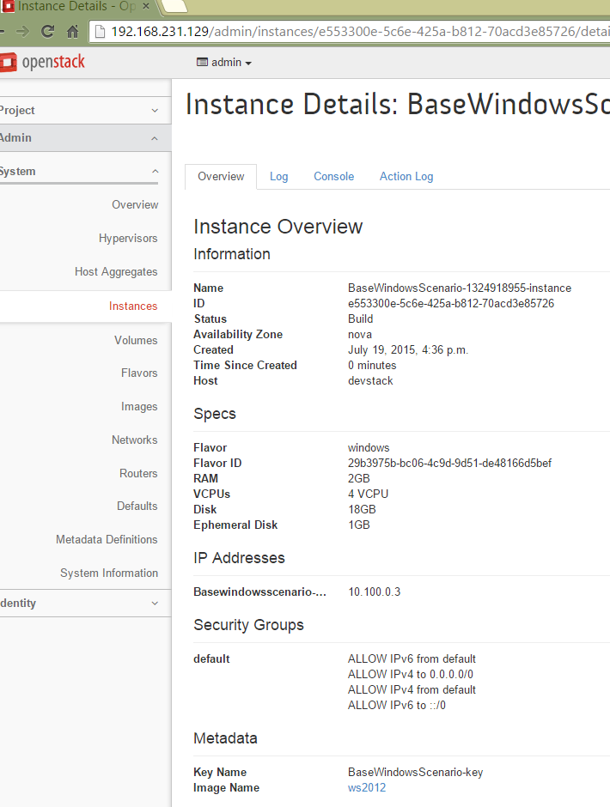
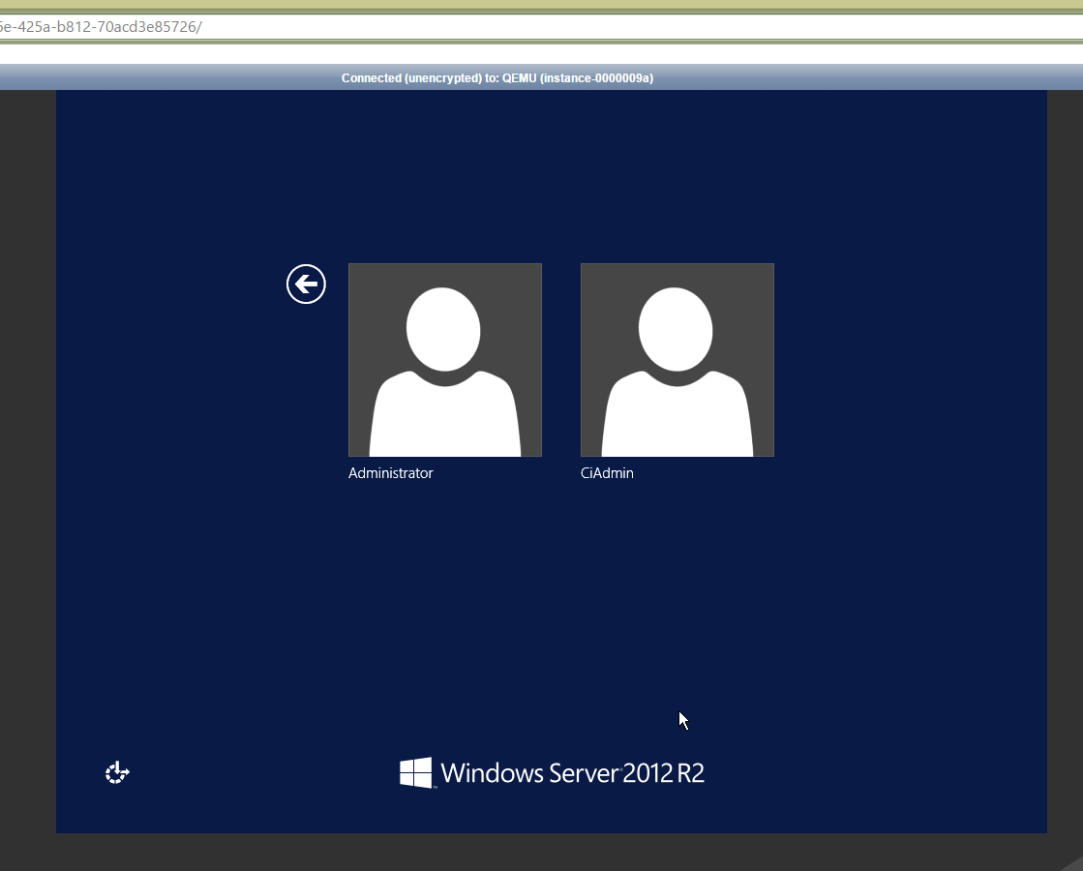
Testing Cloudbase-Init

Slide 10
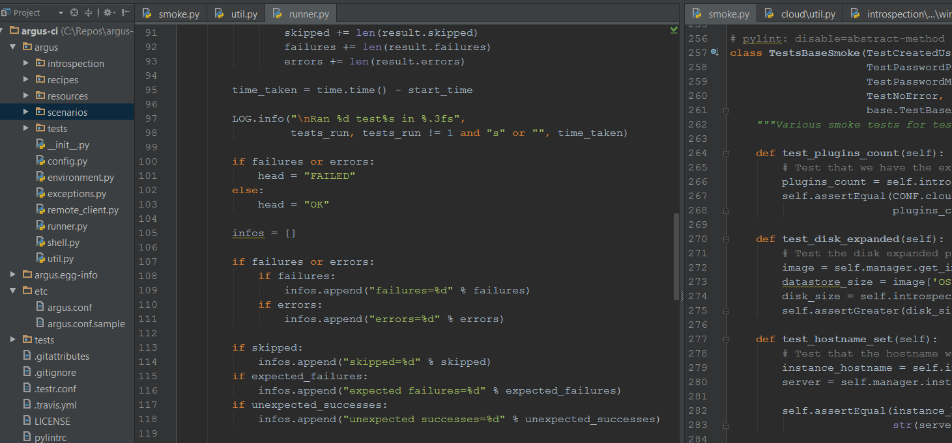
Argus
Integration tests
More than a CI framework
- General use
Written in Python

Slide 11
Argus
Uses tempest
Scenario based
Unittest-like reports
Conf level tests
2015-06-28 02:35:31,720 - argus - INFO - Cleaning up...
=========================================
FAIL: test_any_exception_occurred (argus.tests.cloud.smoke.TestNoError)
----------------------------------------------------------------------
Traceback (most recent call last):
File "/home/devstack/argus-ci/argus/tests/cloud/smoke.py", line 257, in test_any_exception_occurred
self.assertEqual('', instance_traceback)
FAIL: test_any_exception_occurred (argus.tests.cloud.windows.test_smoke.TestSmoke)
----------------------------------------------------------------------
Ran 19 tests in 704.051s
FAILED (failures=2, skipped=1)

Slide 12
Argus components
Scenarios
Recipes
Tests
Introspection
The Runner
Configuration file (actual tests & settings)

Slide 13
Scenarios
@six.add_metaclass(abc.ABCMeta) class BaseArgusScenario(object):
...
def instance_output(self, limit=OUTPUT_SIZE): """Get the console output, sent from the instance.""" while True: resp, content = self._instance_output(limit) if resp.status not in OUTPUT_STATUS_OK: LOG.error("Couldn't get console output <%d>.", resp.status) return if len(content.splitlines()) >= (limit - OUTPUT_EPSILON): limit *= 2 else: break return content def instance_server(self): """Get the instance server object.""" return self._servers_client.get_server(self._server['id']) def public_key(self): return self._keypair['public_key'] def private_key(self): return self._keypair['private_key'] def get_image_by_ref(self): return self._images_client.show_image(self._image.image_ref) def get_metadata(self): return self._metadata

Slide 14
Recipes
@six.add_metaclass(abc.ABCMeta) class BaseCloudbaseinitRecipe(base.BaseRecipe): def __init__(self, *args, **kwargs): super(BaseCloudbaseinitRecipe, self).__init__(*args, **kwargs) self.build = None self.arch = None @abc.abstractmethod def wait_for_boot_completion(self): """Wait for the instance to finish up booting.""" @abc.abstractmethod def get_installation_script(self): """Get the installation script for cloudbaseinit.""" @abc.abstractmethod def install_cbinit(self): """Install the cloudbaseinit code.""" @abc.abstractmethod def wait_cbinit_finalization(self): """Wait for the finalization of cloudbaseinit.""" @abc.abstractmethod def install_git(self): """Install git in the instance.""“
…

Slide 15
Introspection
@six.add_metaclass(abc.ABCMeta) class BaseInstanceIntrospection(object): """Generic utility class for introspecting an instance.""" def __init__(self, remote_client, instance, image): self.remote_client = remote_client self.instance = instance self.image = image @abc.abstractmethod def get_plugins_count(self): """Return the plugins count from the instance.""" @abc.abstractmethod def get_disk_size(self): """Return the disk size from the instance.""" @abc.abstractmethod def username_exists(self, username): """Check if the given username exists in the instance.""" @abc.abstractmethod def get_instance_hostname(self): """Get the hostname of the instance.""" @abc.abstractmethod def get_instance_ntp_peers(self): """Get the NTP peers from the instance.""" @abc.abstractmethod def get_instance_keys_path(self): """Return the authorized_keys file path from the instance."""

Slide 16
Tests
class TestsBaseSmoke(TestCreatedUser, TestPasswordPostedSmoke, TestPasswordMetadataSmoke, TestNoError, base.TestBaseArgus): """Various smoke tests for testing cloudbaseinit.""" def test_plugins_count(self): # Test that we have the expected numbers of plugins. plugins_count = self.introspection.get_plugins_count() self.assertEqual(CONF.cloudbaseinit.expected_plugins_count, plugins_count) def test_disk_expanded(self): # Test the disk expanded properly. image = self.manager.get_image_by_ref() datastore_size = image['OS-EXT-IMG-SIZE:size'] disk_size = self.introspection.get_disk_size() self.assertGreater(disk_size, datastore_size) def test_hostname_set(self): # Test that the hostname was properly set. instance_hostname = self.introspection.get_instance_hostname() server = self.manager.instance_server() self.assertEqual(instance_hostname, str(server['name'][:15]).lower())

Slide 17
Components’ relationship
Scenario defines a “test suite”
Recipe configures the scenario
Test does the checks
Introspection retrieves instance data

Slide 18
Argus config file
Basic settings (argus, cloudbaseinit)
Image (credentials, ID, flavor)
Base scenario (common defaults)
Group inheritance

Slide 19
Argus config file
[image_windows_2012_r2]
default_ci_username = CiAdmin
default_ci_password = Passw0rd
image_ref = 9d56607b-88f2-405e-838b-6aefc037fb46
[base_smoke_windows]
type = smoke
scenario = argus.scenarios.cloud:BaseWindowsScenario
recipe = argus.recipes.cloud.windows:CloudbaseinitRecipe
introspection = argus.introspection.cloud.windows:InstanceIntrospection
images = windows_2012_r2

Slide 20
Advanced concepts
Metadata
Userdata
Environments (start/stop, settings)
Preparers
Volatile IaaS config options

Slide 21
Mock metadata
Web server (custom port)
Drive attach
Explicit configuration
Custom data
Result: behave as a different cloud

Slide 22
Using Argus
devstack@devstack:~/argus-ci$ argus cloud --help
usage: argus cloud [-h] [--failfast] --conf CONF [-p]
[--test-os-types [TEST_OS_TYPES [TEST_OS_TYPES ...]]]
[--test-scenario-type TEST_SCENARIO_TYPE] [-o DIRECTORY]
[-b {beta,stable}] [-a {x64,x86}] [--patch-install URL]
[--git-command GIT_COMMAND]

Slide 23
Using Argus
devstack@devstack:~/argus-ci$ argus cloud --help
…
optional arguments:
-h, --help show this help message and exit
--failfast Fail the tests on the first failure.
--conf CONF Give a path to the argus conf. It should be an .ini
file format with a section called [argus].
-p, --pause Pause argus before doing any test.

Slide 24
Using Argus
devstack@devstack:~/argus-ci$ argus cloud --help
…
--test-os-types [TEST_OS_TYPES [TEST_OS_TYPES ...]]
Test only those scenarios with these OS types. By
default, all scenarios are executed. For instance, to
run only the Windows and FreeBSD scenarios, use
`--test-os-types Windows,FreeBSD`
--test-scenario-type TEST_SCENARIO_TYPE
Test only the scenarios with this type. The type can
be `smoke` or `deep`. By default, all scenarios types
are executed.

Slide 25
Using Argus
devstack@devstack:~/argus-ci$ argus cloud --help
…
-o DIRECTORY, --instance-output DIRECTORY
Save the instance console output content in this path.
If this is given, it can be reused for other files as
well.
-b {beta,stable}, --builds {beta,stable}
Choose what installer builds to test.
-a {x64,x86}, --arches {x64,x86}
Choose what installer architectures to test.

Slide 26
Using Argus
devstack@devstack:~/argus-ci$ argus cloud --help
…
--patch-install URL Pass a link that points *directly* to a zip file
containing the installed version. The content will
just replace the files.
--git-command GIT_COMMAND
Pass a git command which should be interpreted by a
recipe.
Example: argus cloud --conf argus.conf -p -o cblogs -a x64 --git-command “git fetch … && git checkout …”

Slide 27
Develop a test
Cloudbase-Init patch (not merged)
Custom new one or use already created (class):
Scenario
Recipe
Test(s)
Introspection
New “scenario_” group in config file
Run argus & inspect logs

Slide 28
Q & a
Cloudbase-Init:
http://cloudbase.it/
https://github.com/stackforge/cloudbase-init
Argus:
https://github.com/PCManticore/argus-ci
ropython.org

