Slide 1
ARGUS - THE OMNISCIENT CI
Cosmin Poieană
Co-Founder @ RoPython
Cloud Engineer @ Cloudbase
Student @ UAIC
cmin@ropython.org

Slide 2
Contents
1. Clouds
2. Cloudbase-Init
3. Testing Cloudbase-Init
4. Argus
5. Components
6. Argus configuration file
7. Advanced concepts
8. Using Argus
9. Create a comprehensive test

Slide 3

Clouds
Cloud computing
InternetAsAService
OpenStack
OpenNebula
CloudStack

Slide 4

Clouds
VM creation & initialize
Metadata providers
Cloud initialization services
Cloud-Init
Cloudbase-Init

Slide 5
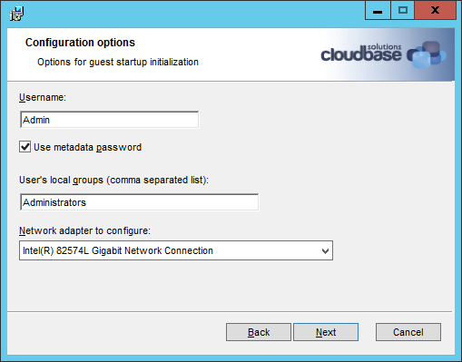
Cloudbase-Init
Portable customization
For NT systems
OSS & written in Python
Supports popular clouds
Independent of the hypervisor
Merge with Cloud-Init

Slide 6
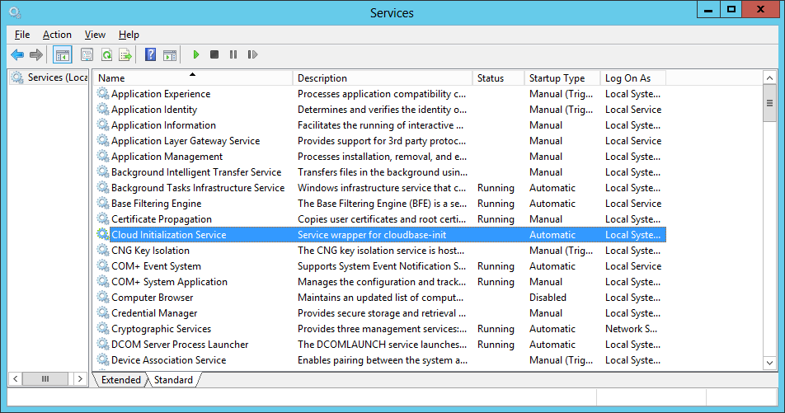
Cloudbase-Init
Runs as a service at startup
Services (different metadata providers)
Plugins:
Host name
Networking
Local scripts
SSH public keys
Userdata
Configuration file

Slide 7
Cloudbase-Init
[DEFAULT]
# What user to create and in which group(s) to be put.
username=Admin
groups=Administrators
inject_user_password=true # Use password from the metadata (not random).
# Where to store logs.
logdir=C:\Program Files (x86)\Cloudbase Solutions\Cloudbase-Init\log\
# Where are located the user supplied scripts for execution.
local_scripts_path=C:\Program Files (x86)\Cloudbase Solutions\Cloudbase-Init\LocalScripts\
# Services that will be tested for loading until one of them succeeds.
metadata_services=cloudbaseinit.metadata.services.configdrive.ConfigDriveService,
cloudbaseinit.metadata.services.httpservice.HttpService
# What plugins to execute.
plugins=cloudbaseinit.plugins.common.mtu.MTUPlugin,
cloudbaseinit.plugins.common.sethostname.SetHostNamePlugin

Slide 8
Testing Cloudbase-Init
Unit testing (local & Jenkins)
Windows VM
Installer & Service
OpenStack instance
OpenNebula, CloudStack etc. instance
Automation?

Slide 9
Argus
Integration tests
More than a CI framework
- General use
Written in Python

Slide 10
Argus
Uses tempest
Scenario based
Unittest-like reports
Conf level tests

Slide 11
Argus components
Scenarios
Recipes
Tests
Introspection
The Runner
Configuration file (actual tests & settings)

Slide 12
Components’ relationship
Scenario defines a “test suite”
Recipe configures the scenario
Test does the checks
Introspection retrieves instance data

Slide 13
Argus config file
Basic settings (argus, cloudbase-init)
Image (credentials, ID, flavor)
Base scenario (common defaults)
Group inheritance

Slide 14
Advanced concepts
Environments (start/stop, settings)
Preparers
Volatile IaaS config options
Metadata
Userdata

Slide 15
Mock metadata
Web server (custom port)
Drive attach
Explicit configuration
Custom data
Result: behave as a different cloud

Slide 16
Using Argus
devstack@devstack:~/argus-ci$ argus cloud --help
usage: argus cloud [-h] [--failfast] --conf CONF [-p]
[--test-os-types [TEST_OS_TYPES [TEST_OS_TYPES ...]]]
[--test-scenario-type TEST_SCENARIO_TYPE] [-o DIRECTORY]
[-b {beta,stable}] [-a {x64,x86}] [--patch-install URL]
[--git-command GIT_COMMAND]

Slide 17
Using Argus
devstack@devstack:~/argus-ci$ argus cloud --help
…
optional arguments:
-h, --help show this help message and exit
--failfast Fail the tests on the first failure.
--conf CONF Give a path to the argus conf. It should be an .ini
file format with a section called [argus].
-p, --pause Pause argus before doing any test.

Slide 18
Using Argus
devstack@devstack:~/argus-ci$ argus cloud --help
…
--test-os-types [TEST_OS_TYPES [TEST_OS_TYPES ...]]
Test only those scenarios with these OS types. By
default, all scenarios are executed. For instance, to
run only the Windows and FreeBSD scenarios, use
`--test-os-types Windows,FreeBSD`
--test-scenario-type TEST_SCENARIO_TYPE
Test only the scenarios with this type. The type can
be `smoke` or `deep`. By default, all scenarios types
are executed.

Slide 19
Using Argus
devstack@devstack:~/argus-ci$ argus cloud --help
…
-o DIRECTORY, --instance-output DIRECTORY
Save the instance console output content in this path.
If this is given, it can be reused for other files as
well.
-b {beta,stable}, --builds {beta,stable}
Choose what installer builds to test.
-a {x64,x86}, --arches {x64,x86}
Choose what installer architectures to test.

Slide 20
Using Argus
devstack@devstack:~/argus-ci$ argus cloud --help
…
--patch-install URL Pass a link that points *directly* to a zip file
containing the installed version. The content will
just replace the files.
--git-command GIT_COMMAND
Pass a git command which should be interpreted by a
recipe.
Example: argus cloud --conf argus.conf -p -o cblogs -a x64 --git-command “git fetch … && git checkout …”

Slide 21
Develop a test
Cloudbase-init patch (not merged)
Custom new one or use already created (class):
Scenario
Recipe
Test(s)
Introspection
New “scenario_” group in config file
Run argus & inspect logs

