Slide 1
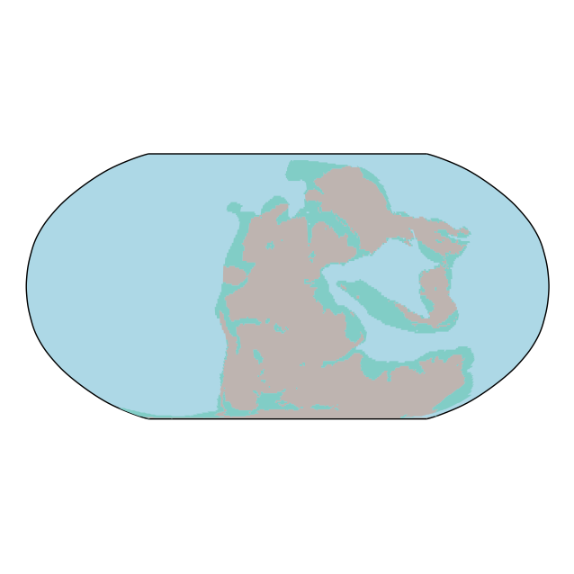
255
Pacific
Paleo Tethys
W Pacific
Tethys

Slide 2
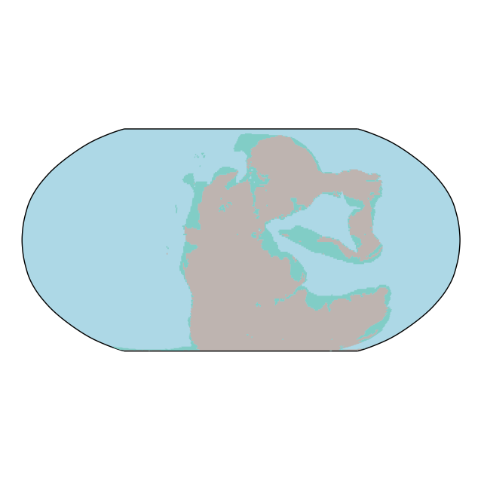
245
Pacific
Paleo Tethys
W Pacific
Tethys

Slide 3
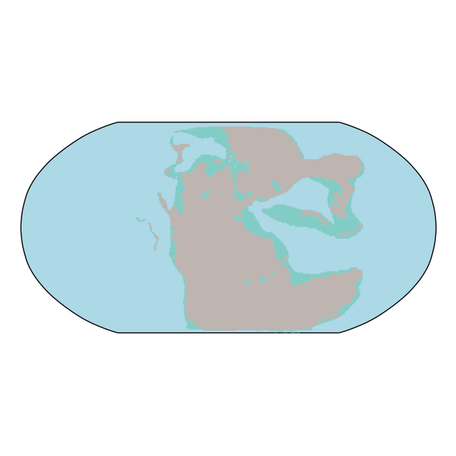
235
Paleo Tethys
Pacific
W Pacific
Tethys

Slide 4
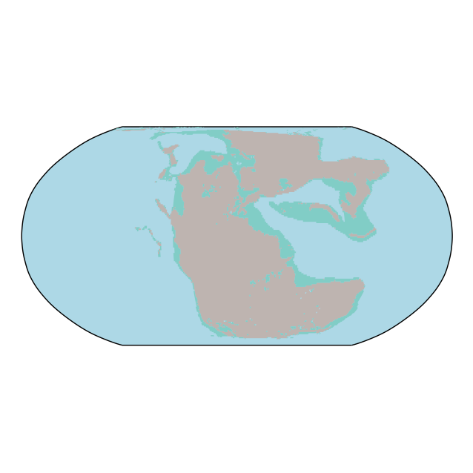
225
Paleo Tethys
Pacific
W Pacific
Tethys

Slide 5
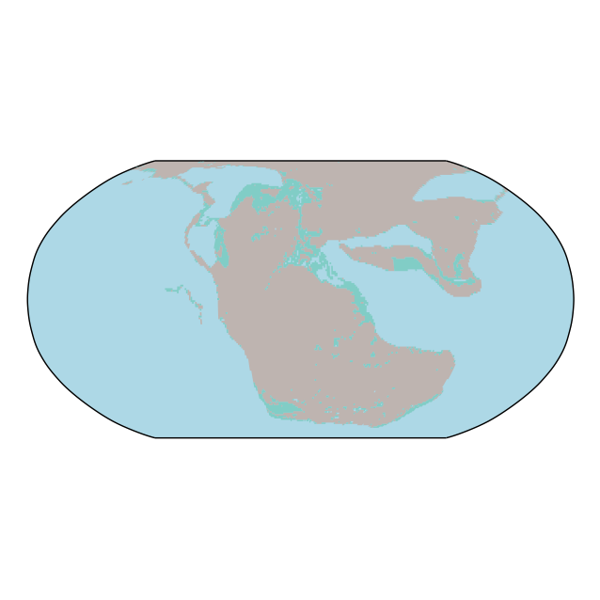
215
Paleo Tethys
Pacific
W Pacific
Tethys

Slide 6
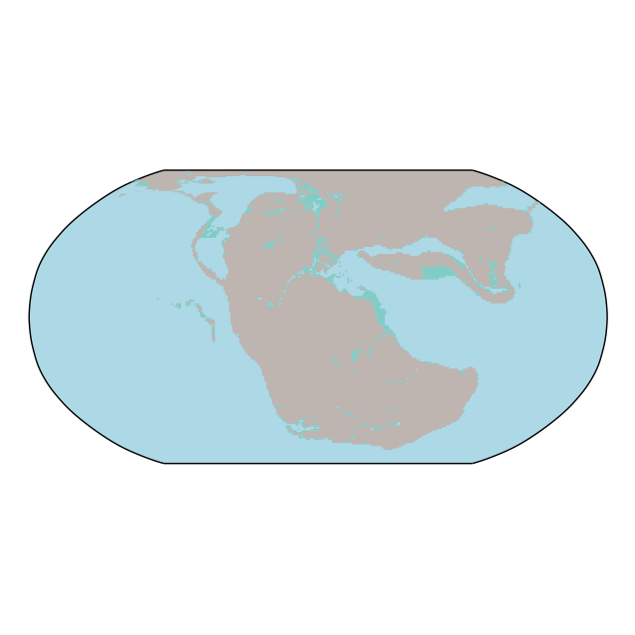
205
Paleo Tethys
Pacific
W Pacific
Tethys

Slide 7
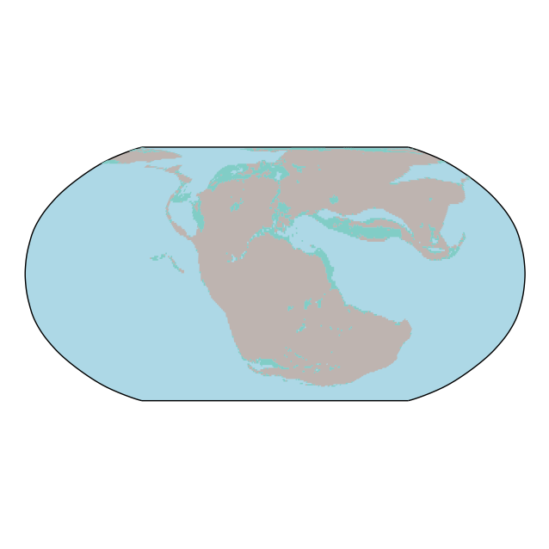
195
Paleo Tethys
Pacific
W Pacific
Tethys

Slide 8
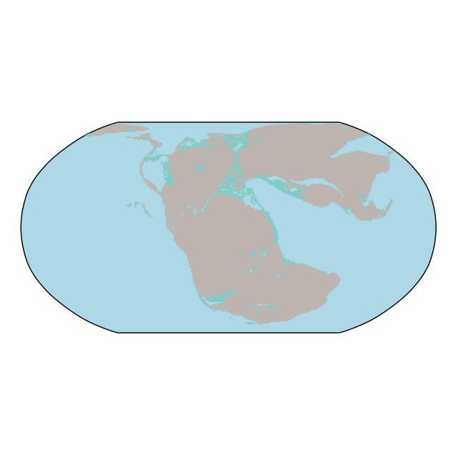
185
Paleo Tethys
W Pacific
Pacific
Tethys

Slide 9
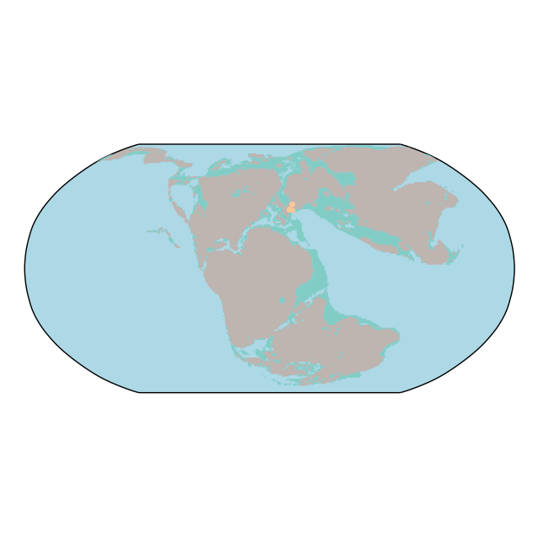
175
Atlantic
W Pacific
Pacific
Tethys

Slide 10
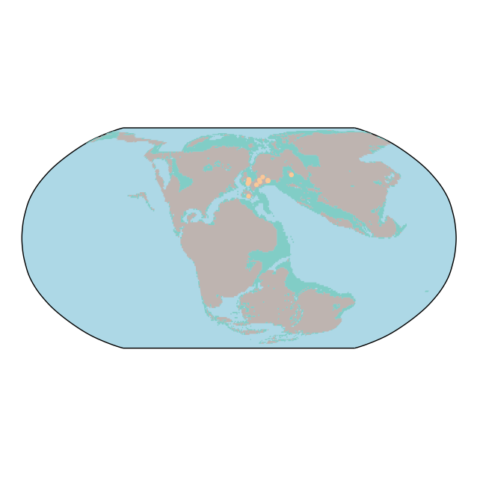
165
Atlantic
W Pacific
Pacific
Tethys

Slide 11
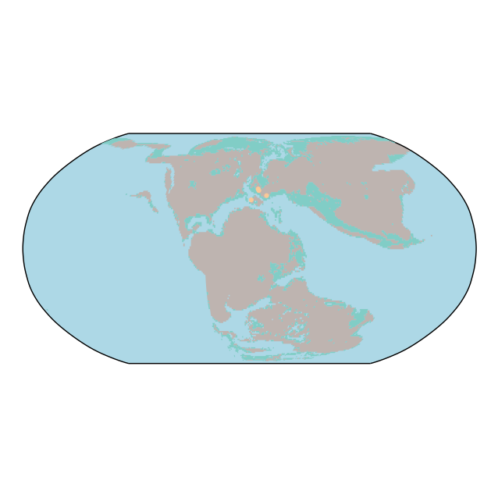
155
Atlantic
W Pacific
Pacific
Tethys
West indian

Slide 12
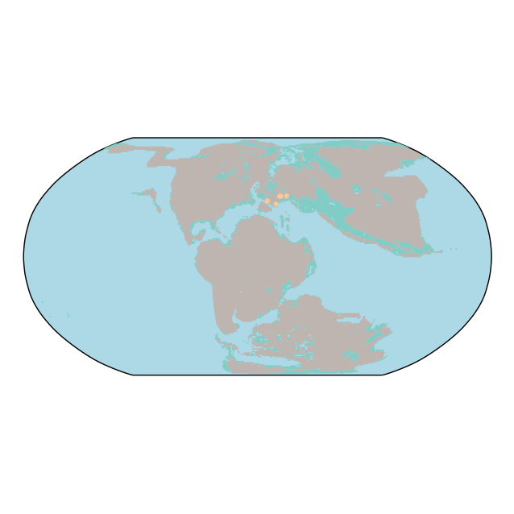
145
Atlantic
W Pacific
Pacific
Tethys
West indian

Slide 13
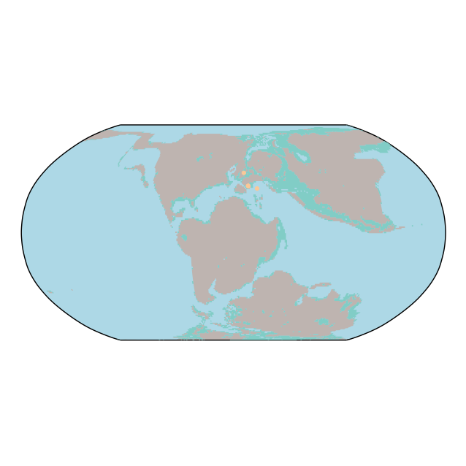
135
Atlantic
W Pacific
Pacific
Tethys
West indian

Slide 14
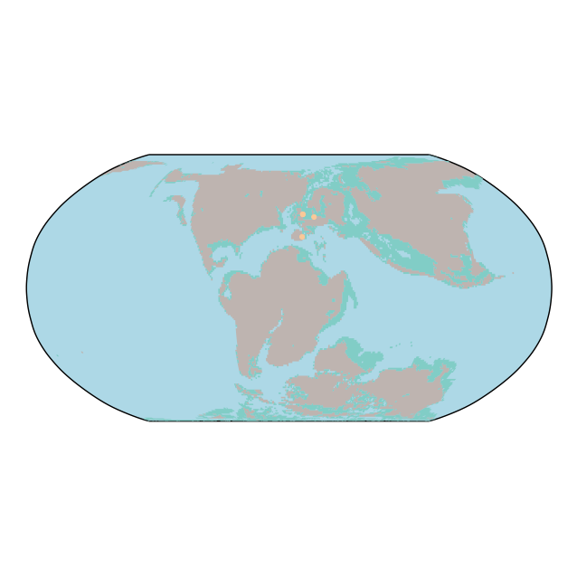
125
Atlantic
W Pacific
Pacific
Tethys
West indian
Temperate Australia

Slide 15
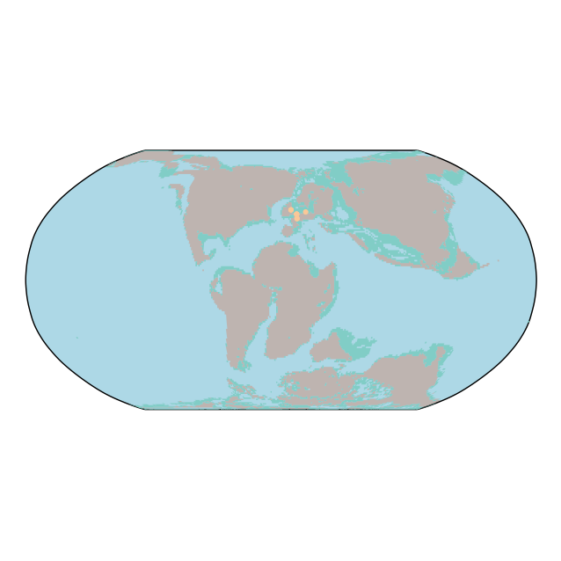
115
Atlantic
W Pacific
Pacific
Tethys
West indian
Temperate Australia

Slide 16
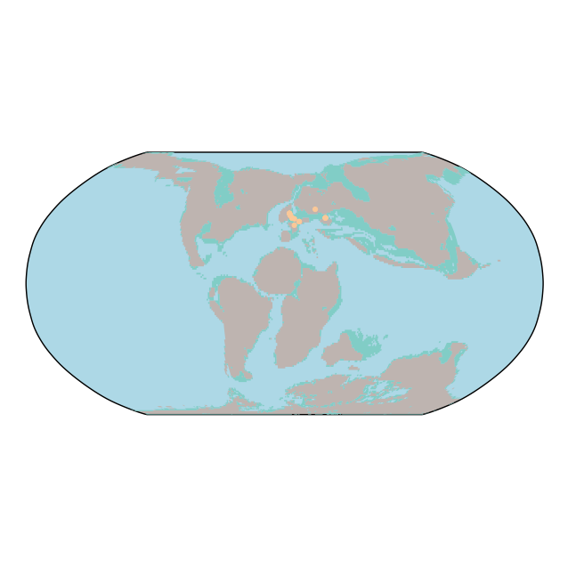
105
Atlantic
W Pacific
Pacific
Tethys
West indian
Temperate Australia

Slide 17
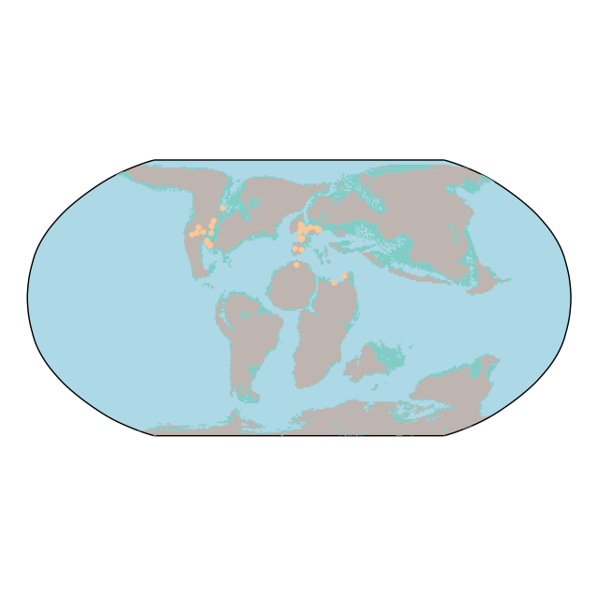
95
Atlantic
W Pacific
Pacific
Tethys
West indian
Temperate Australia

Slide 18
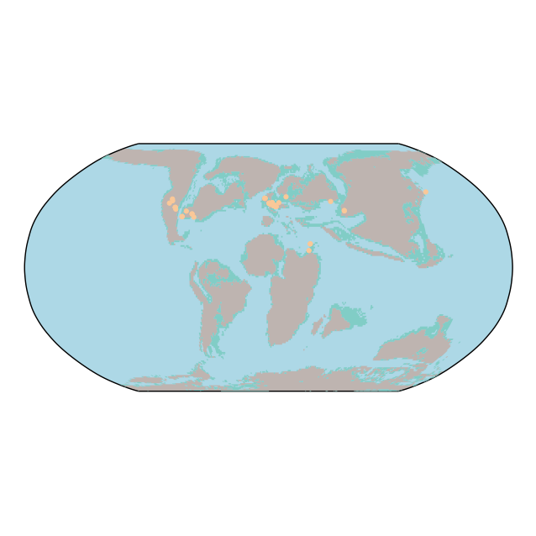
85
Atlantic
W Pacific
Pacific
Tethys
West indian
Temperate Australia

Slide 19
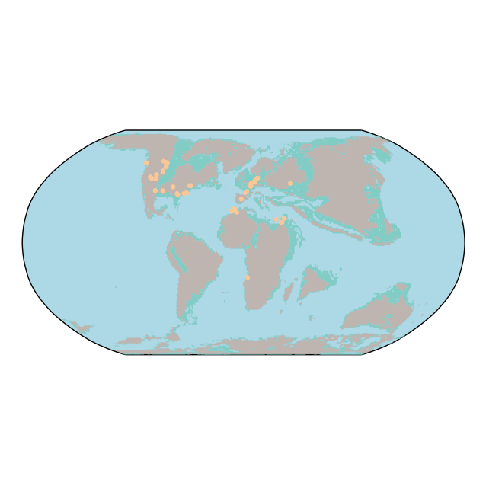
75
Atlantic
W Pacific
Pacific
Tethys
West indian
Temperate Australia

Slide 20
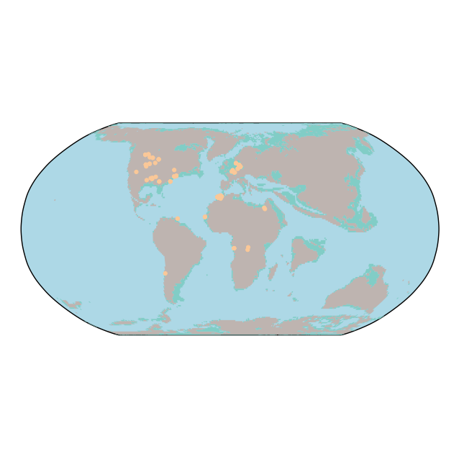
65
W Atlantic
W Pacific
Pacific
E Atlantic
Tethys
West indian
Temperate Australia

Slide 21
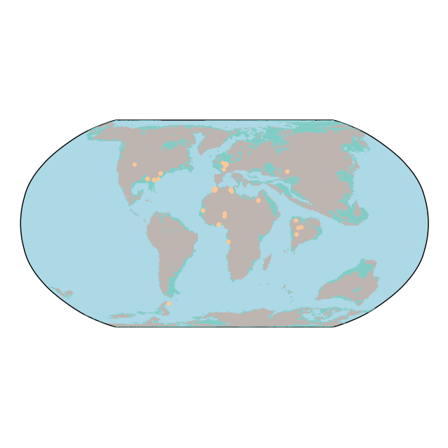
55
W Atlantic
W Pacific
Tethys
Pacific
E Atlantic
West indian
Temperate Australia

Slide 22
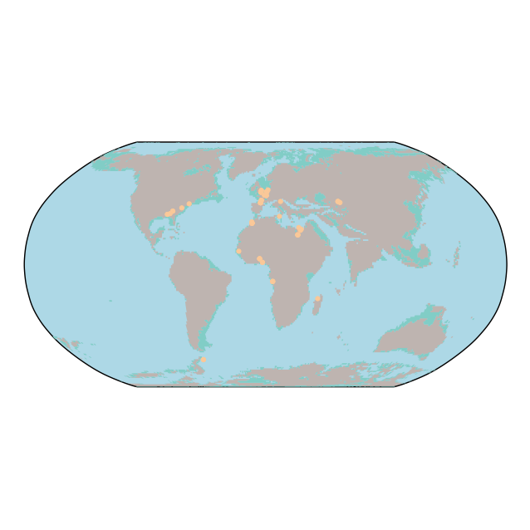
45
W Atlantic
W Pacific
Tethys
Pacific
E Atlantic
West indian
Temperate Australia

Slide 23
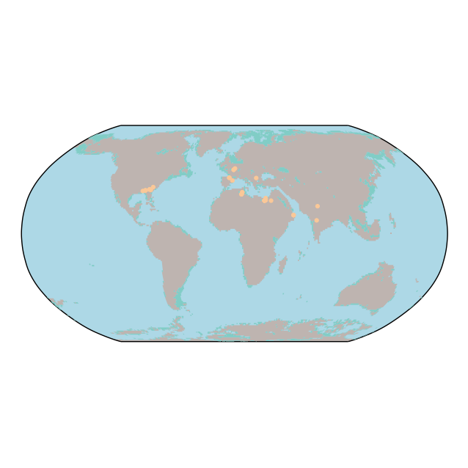
35
W Atlantic
Tethys
W Pacific
Pacific
West indian
E Atlantic
Temperate Australia

Slide 24
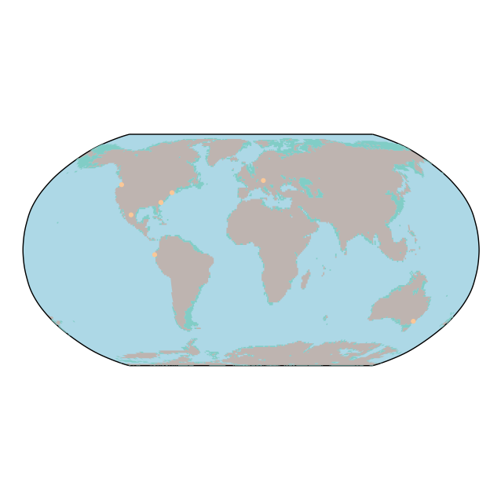
25
W Atlantic
W Pacific
Pacific
West indian
E Atlantic
Temperate Australia

Slide 25
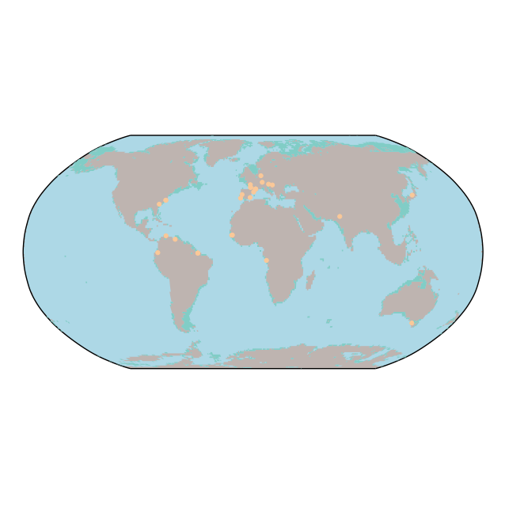
15
W Atlantic
W Pacific
Pacific
West indian
E Atlantic
Temperate Australia

Slide 26
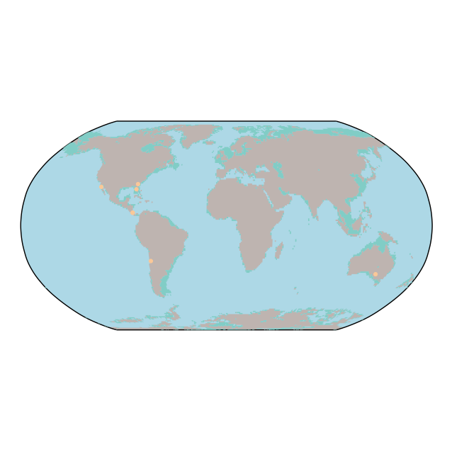
05
W Atlantic
W Pacific
Pacific
West indian
E Atlantic
Temperate Australia

