Slide 1
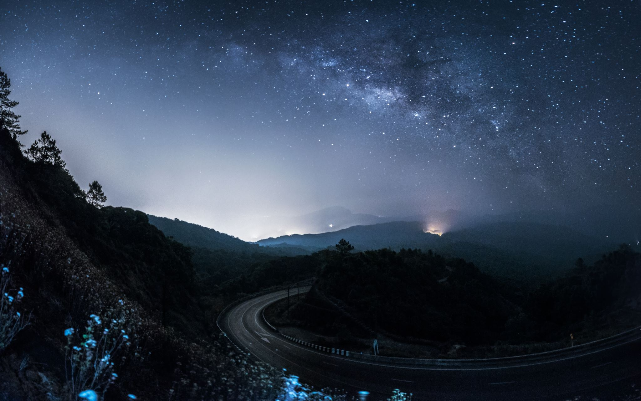
Pyber
Trends and Conclusions
Alexis Summey

Slide 2
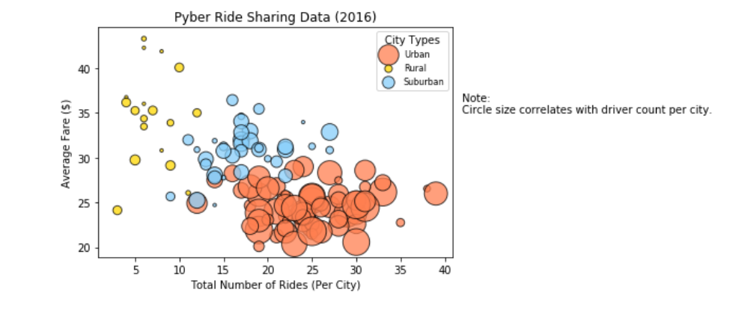
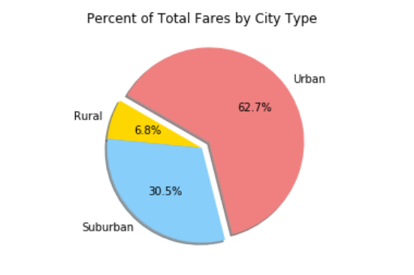
Urban cities tend to have more rides than other city types.

Slide 3
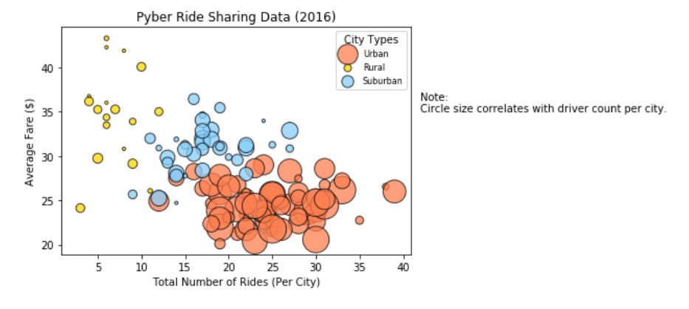
The average fare per ride increases in rural areas.

Slide 4
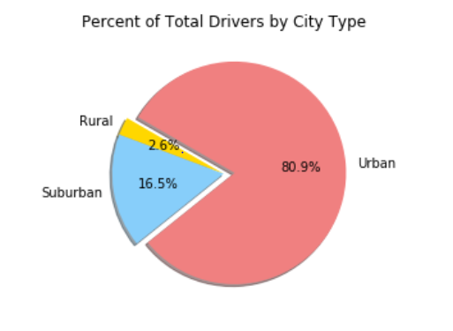
The percent of total drivers increases in urban cities.

