Slide 1

KREITEKFY
Backend:
Pablo Sanz, Pablo Fornals
Frontend:
Alexis García, Susana Palacios

Slide 2
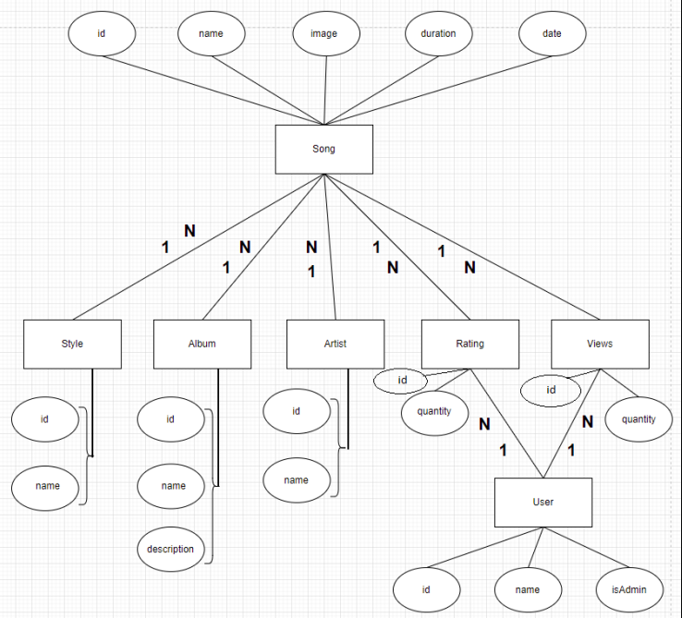
Diagrama Entidad-Relación

Slide 3
Consulta de Style
Endpoint:
List<Style> getAllStyles();
Json:
[{
"id" : "1",
"name": " Estilo1 "
},
{
"id" : "2",
"name": " Estilo2 "
}]
Endpoint: Page<Style> findAll(Pageable pageable, String filter)
Endpoint:
Optional<Style> getStyleById(Long styleId);
Json:
{
"id" : "1",
"name": " Estilo1 "
}
Endpoint: (post)
Style saveStyle(Style style);
Json:
{
"name" : "Estilo1"
}
Endpoint:
void deleteStyle(Long styleId);
Endpoint: (patch)
Style saveStyle(Style style)
Json:
{
"name" : "Estilo nuevo"
}

