Slide 1

Recurring Pattern 1
Recurring Pattern 2

Slide 2
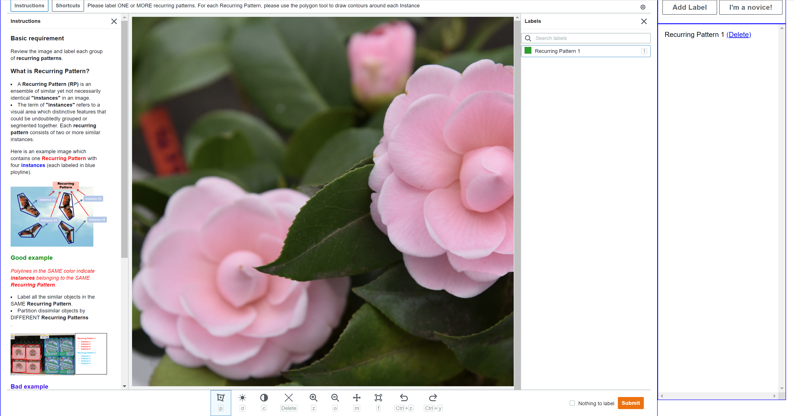
1. Display/Hide instructions
7. Add a new Recurring Pattern
5. Right Panel
2. Image Display Here
8. Delete a Recurring Pattern
6. Each Recurring Pattern display here
3. Bottom Panel
4. Polygon Tool
9. Submit Here

