Slide 1
Hamiltonia
----Ziyan Ma, Haowen Lin, Ming Chen

Slide 2
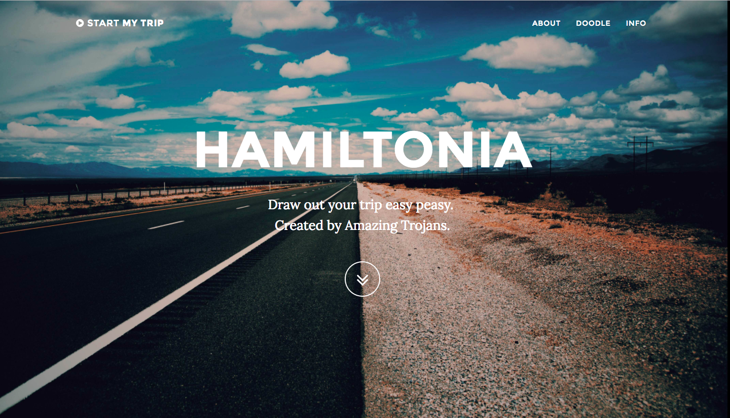
Hello hamiltonia world

Slide 3
Objective
TRIP ARE HARD TO PLAN!!!

Slide 4
Ui design

Slide 5
Frontend challenge

Slide 6
api
Google map API: assist on designing the frontend user interface.
Amadeus Travel innovation Sandbox:
Help generating

Slide 7
Data management
Algorithm
Generating popularities of cities.
Making suggestions of hotels among the selected city.

