Slide 1
Hamiltonia
----Ziyan Ma, Haowen Lin, Ming Chen

Slide 2
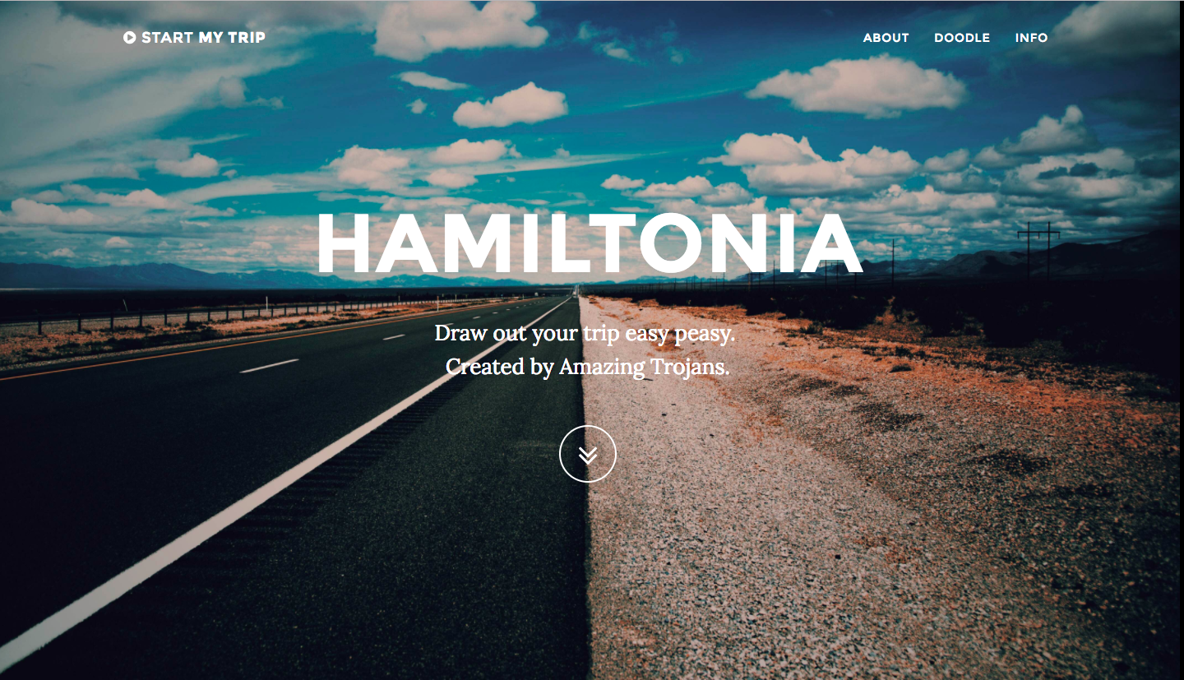
Hello hamiltonia world

Slide 3
Objective
TRIP ARE HARD TO PLAN
Integrating merely a travelling direction into a practical plan. EASILY!

Slide 4
Ui design
A user-friendly and aesthetic UI
Take input as few as possible!

Slide 5
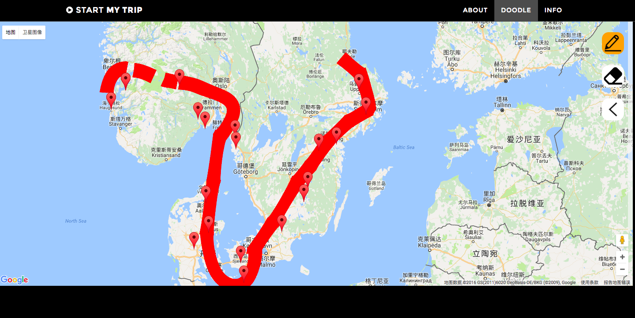
How you draw your trip out

Slide 6
Frontend challenge
Cooperate with HTML5 Canvas and Google Map API
Get real world by window coordinates without physically touching the map. (Limited by Canvas element)
Make it aesthetic and user friendly!

Slide 7
api
Google map API:
Designing the user interface
Getting world coordinate from mouse input
Amadeus Travel innovation Sandbox:
Translate coordinate into traffic/housing/travel data.
Generating optimal housing option for the trip.
Other Helping Libraries:
JQuery
Bootstrap

Slide 8
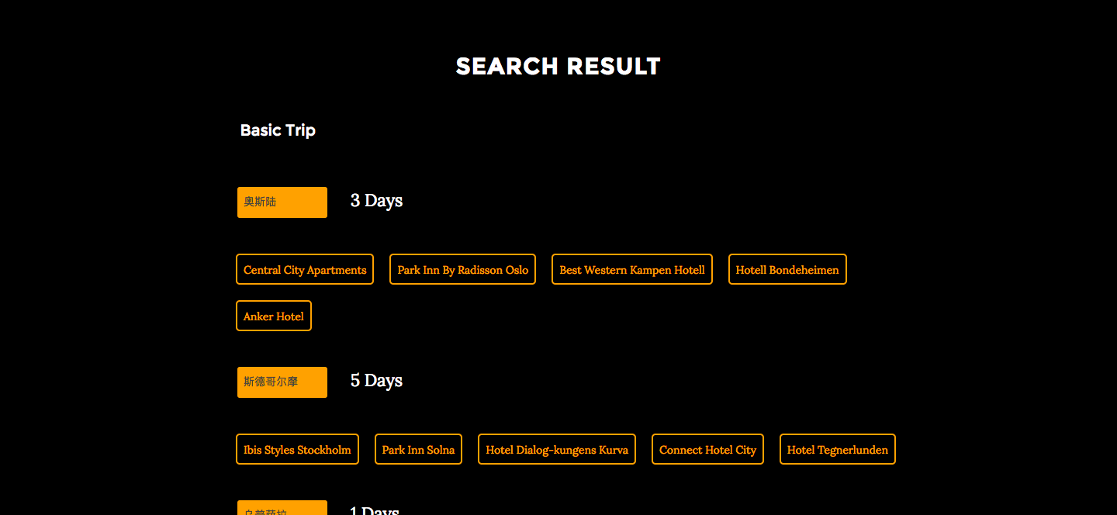
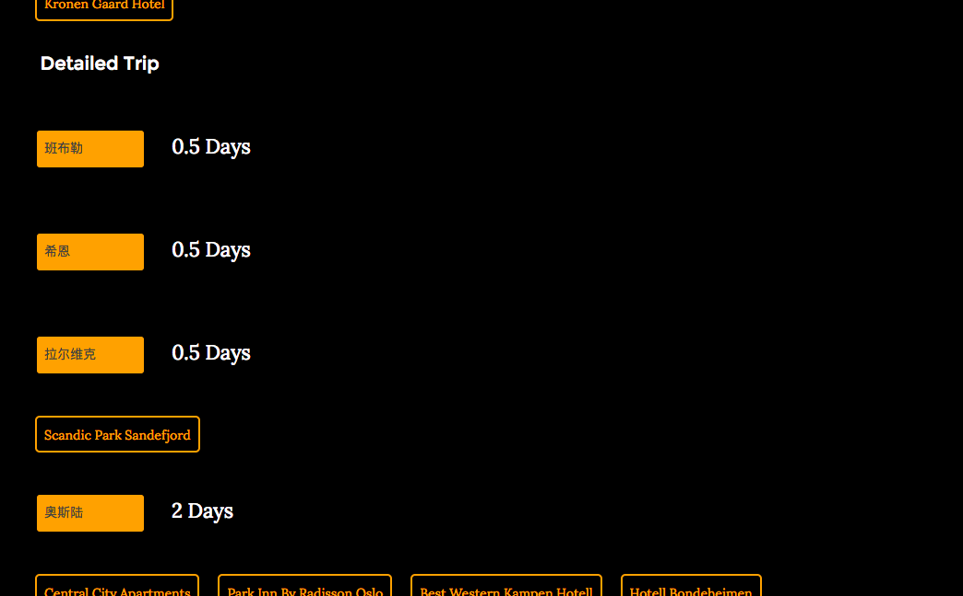
Multiple plans by different algorithms

Slide 9
Data management
Algorithm
Generating popularities of cities by the limited data resources.
Translate popularity into a several ordered travel plan.
Making suggestions of hotels among the selected city.

Slide 10
Improvements
More data collections and analysis to enhance the system.
The accuracy on touching(right now limited by API and yet to improved frame rates)
User customization and community building: common interest among customers and more.
Cross-platform implementation: Immigrant to Mobile!

