Slide 1
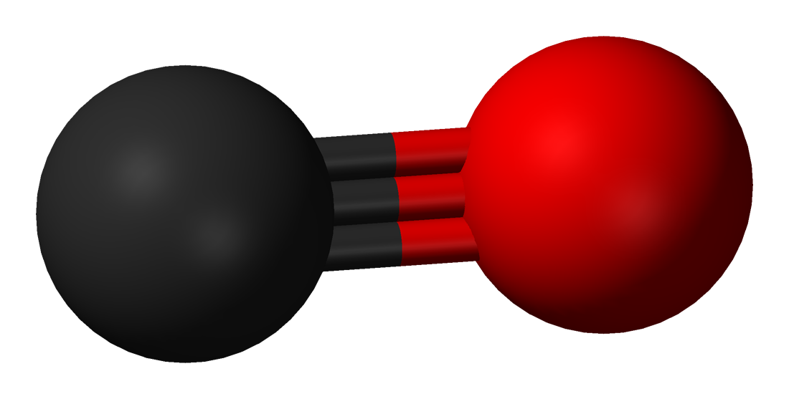
Mapping Carbon Monoxide levels in the U.S
CSE 6242 — Data Visualization and Analytics
Vincent Marois, Alexandre Jouandin, Baptiste Amato, Alexis Durocher
Gabriel Hurtado, Nicolas Six, Eymard Prevost

Slide 2
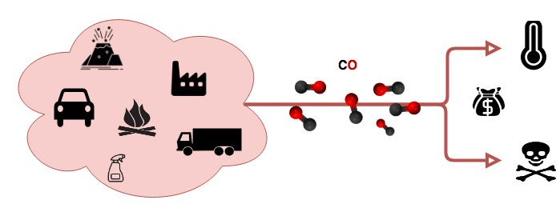
Why ? CO is a colorless, odorless, and tasteless gas. One of the most common causes of poisoning in the U.S * with high warming potential.

Slide 3
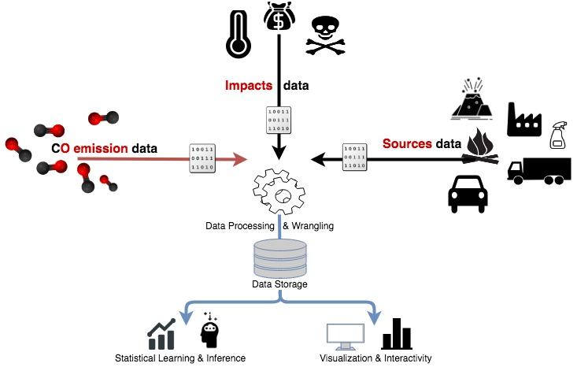
How ?

Slide 4
What ?
Visualization as a public awareness tool
Interactivity to emphasize sources and impacts correlations
Filtering in time and space
Statistical Learning for CO emission prediction a/o clustering

