Slide 1
Identify the best place to open a business in Nuevo León, Mexico
Introduction
Nuevo Leon is a state in the north of Mexico where an arid and extreme climate prevails, it has the financial and business center of the country, so it is always an attractive place for investments, but which municipality will be the best to open a factory? Or which county will be the most suitable to have access to basic services or venues?
Data
I will use the information available at https://es.wikipedia.org/wiki/Anex:Municipios_de_Nuevo_Le%C3%B3n
and then it will be reviewed on Foursquare

Slide 2
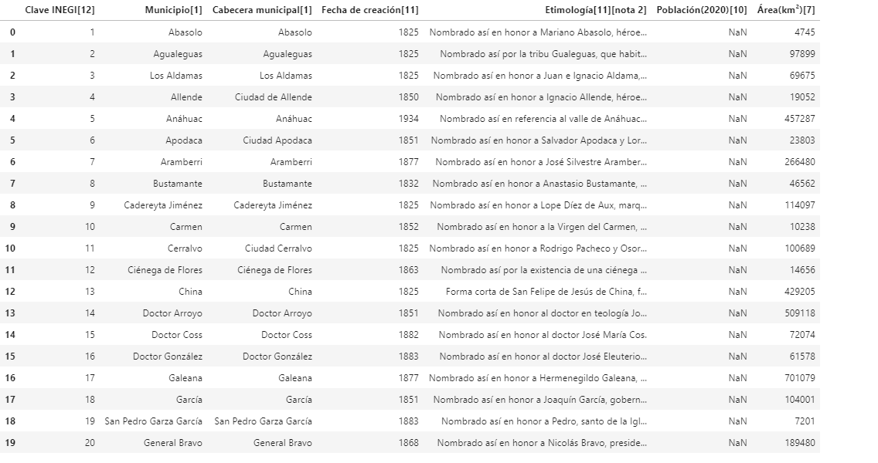
Methodology First we read the information on Wikipedia

Slide 3
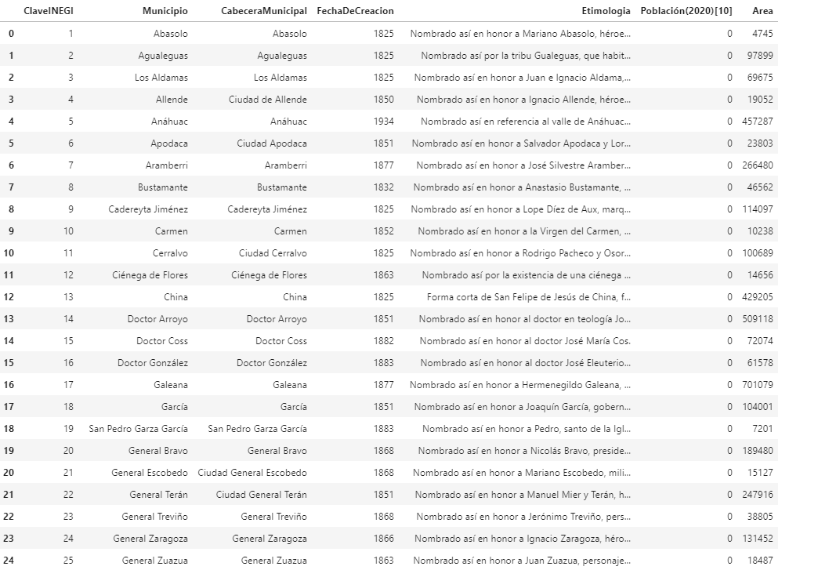
Then we transform the columns to consult them better

Slide 4
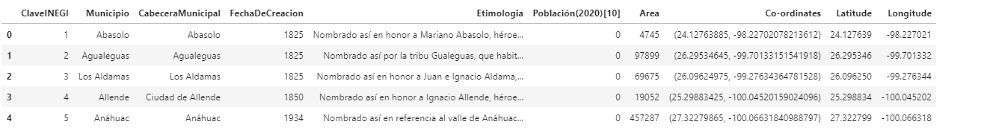
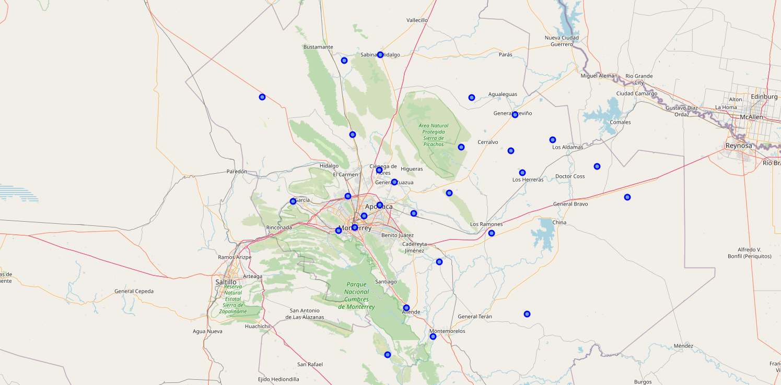
We get the coordinates, latitude and longitude
We generate the map based on the coordinates

Slide 5
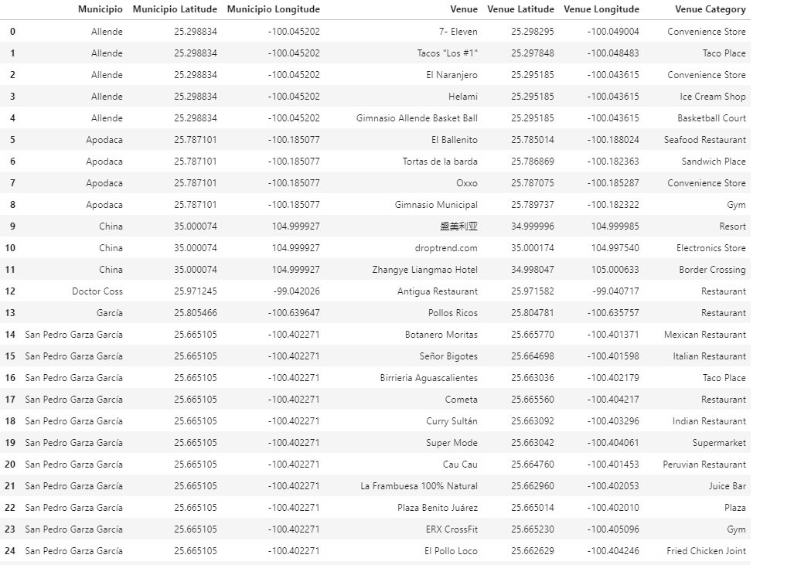
We verify the venues for each municipality

Slide 6
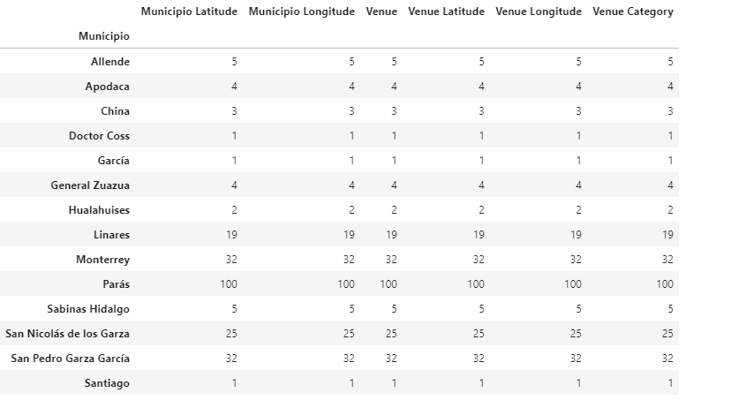
Check how many venues were returned for each county

Slide 7
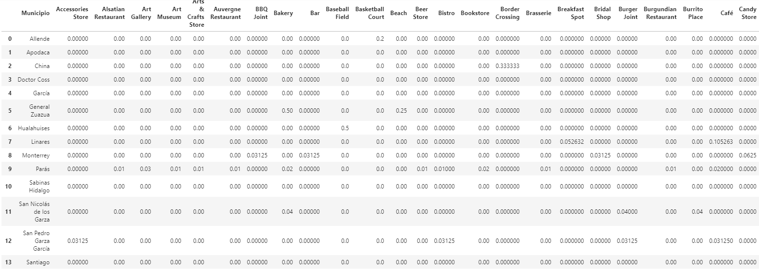
Next, lets group rows by neighborhood and by taking the mean of the frequency of occurrence of each category

Slide 8
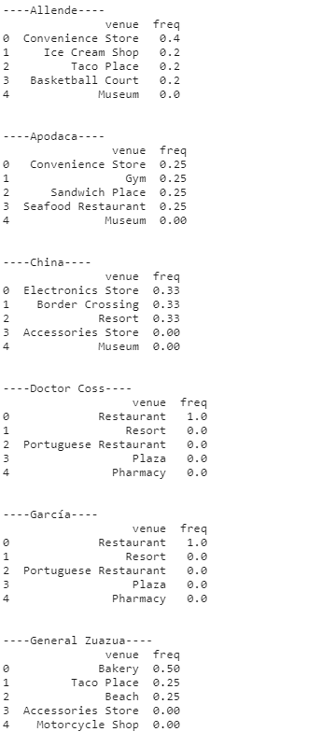
We validate the top 5 venues for each municipality

Slide 9
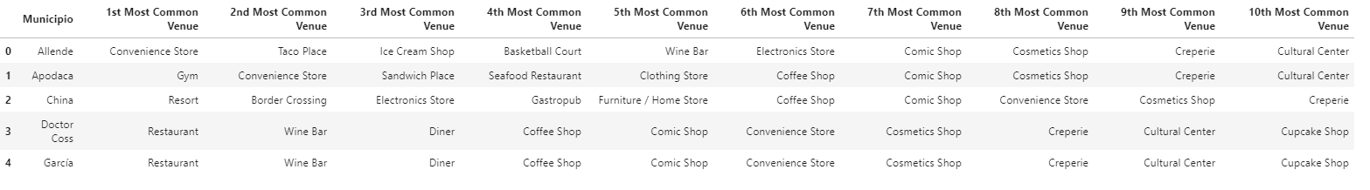
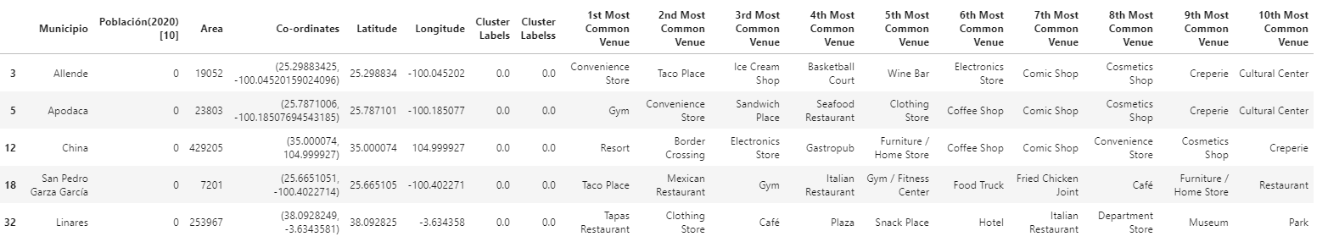
We generate a dataframe with the first 10 most common places
Then we observe the results for the first 5 clusters
Cluster 1

Slide 10
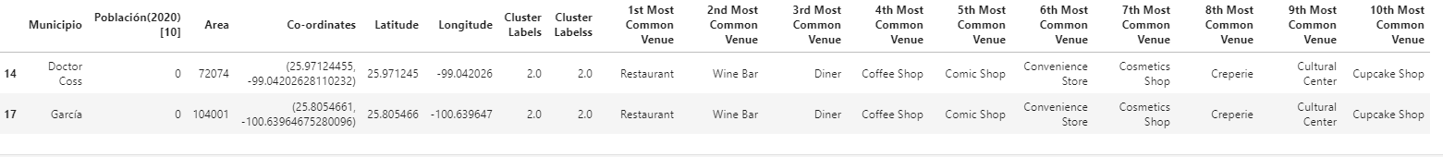
Cluster 2
Cluster 3
Cluster 4
Cluster 5

Slide 11
Results
The biggest clusters are the best for making investments, something that happens in real life because the municipalities of Apodaca and San Pedro Garza Garcia are the most required for this type of growth.
Apodaca for factories and San Pedro Garza Garcia for companies and entrepreneurship
Discussion
There are places that seem suitable to grow but somehow, they have not succeeded, either due to lack of state resources, the lack of population, the lack of roads or the distance from the center of the state.
Conclusion
It is interesting that by reviewing free information on the internet and with the appropriate sentences, real and truthful results can be obtained to make a good business decision

